Slide 1
Cough zahraa abdulGhani MSc in clinical pharmacy

Slide 2
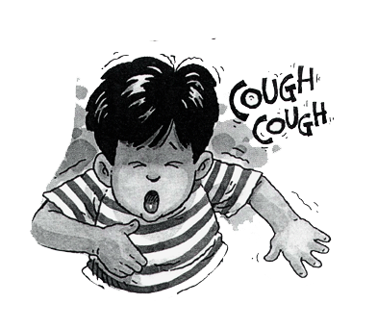

Slide 3
Coughing is a protective reflex action caused when the airway is being irritated or obstructed. Its purpose is to clear the airway so that breathing can continue normally.

Slide 4
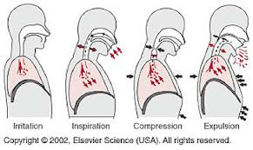

Slide 5
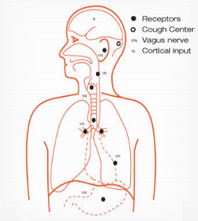

Slide 6
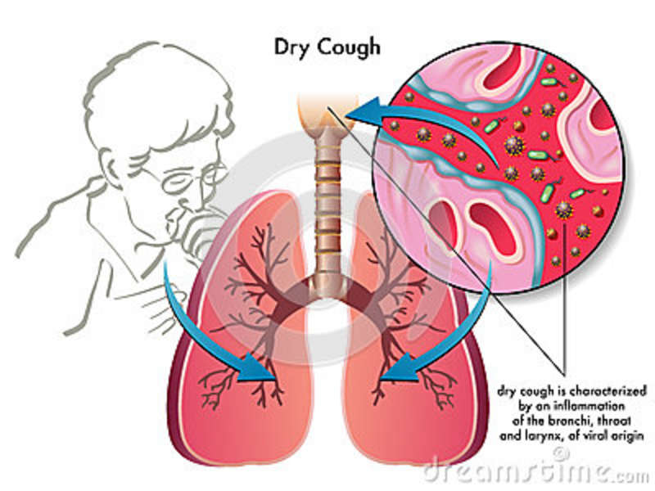

Slide 7
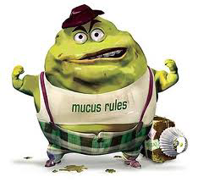

Slide 8
Types of cough
Unproductive (dry): no sputum is produced caused by viral infection and is self-limiting.
Productive (chesty or loose): sputum is normally produced but over secretion to coughing may be caused by irritation of the airways due to infection, allergy, etc., or when the cilia are not working properly (e.g. in smokers).
Non-coloured (clear or whitish) sputum is uninfected and known as mucoid.
Coloured sputum may indicate a bacterial chest infection such as bronchitis or pneumonia and require referral. In these situations the sputum is described as green, yellow or rust-coloured thick mucus and the patient is more unwell usually with a raised temperature, shivers and sweats. Sometimes blood may be present in the sputum (haemoptysis), with a colour ranging from pink to deep red. Haemoptysis is an indication for referral.

Slide 9
Significance of questions and answers
Age: the patient is – child or adult – will influence the choice of treatment.
Duration: most coughs are self-limiting and will be better within a few days with or without treatment. In general, a cough of longer than 2 weeks’ duration should be referred.
Associated symptoms: cold, sore throat and catarrh may be associated with a cough.
Postnasal drip: is a common cause of coughing and may be due to sinusitis.
Smoking habit: smoking will exacerbate a cough and can cause coughing since it is irritating to the lungs. On stopping, the cough may initially become worse as the cleaning action of the cilia is re-established during the first few days.
Angiotensin-converting enzyme (ACE) inhibitors:Chronic coughing may occur in patients, particularly women, enalapril, captopril, lisinopril and ramipril. Patients may develop the cough within days of starting treatment or after a period of a few weeks or even months.

Slide 10
Referral conditions
-Cough lasting 2 weeks or more and not improving, sputum (yellow, green, rusty or blood-stained),chest pain, shortness of breath, wheezing, recurrent nocturnal cough, suspected adverse drug reaction and failed medication requiring referral to a physician.
-Tuberculosis (TB),Chronic bronchitis
-Asthma: a recurrent night-time cough can indicate asthma, especially in children
-Croup : it usually occurs in infants. The cough has a harsh barking quality. It develops 1 day or so after the onset of cold-like symptoms, often associated with difficulty in breathing and noise in throat on breathing in).
-Whooping cough (pertussis):it starts with catarrhal symptoms. The bouts of coughing prevent normal breathing and the whoop represents the desperate attempt to get a breath.
-Cardiovascular: coughing can be a symptom of heart failure. If there is a history of heart disease, especially with a persisting cough, then referral is advisable.
Gastro-oesophageal: can cause coughing. Sometimes such reflux is asymptomatic apart from coughing.

Slide 11
Non-pharmacological Treatment

Slide 12
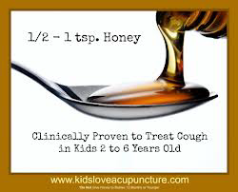

Slide 13
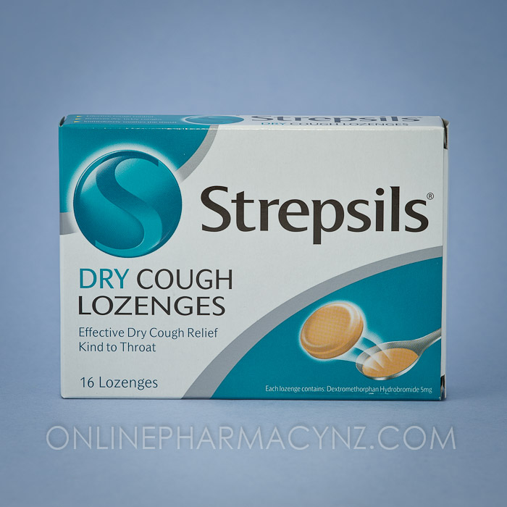
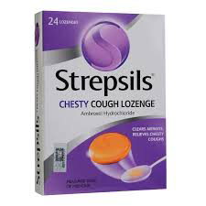

Slide 14
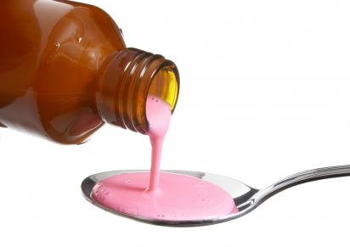
Cough Suppressant

Slide 15
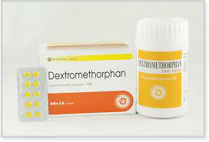
Dextromethorphan…

Slide 16
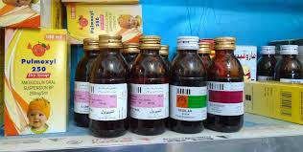

Slide 17
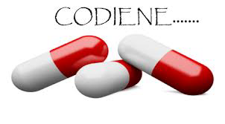

Slide 18
