Slide 1
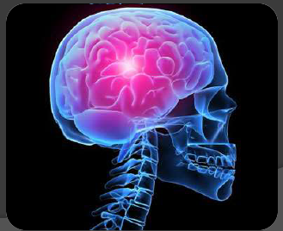
Pediatric Febrile
Convulsion
Prepared by:
Assis. Lec. Lubab Tariq Nafea

Slide 2
Contents
· What is a seizure?
· Seizure types
· Etiology of seizures
· Febrile convulsions
· Epilepsies of childhood
· Epilepsy syndromes
· Status epilepticus

Slide 3
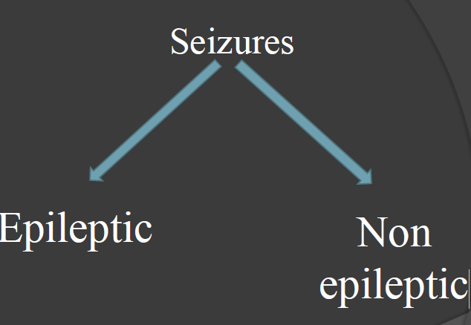
What is a Seizure ?
Paroxysmal, involuntary & sudden
disturbance of neurological function caused by an abnormal or excessive neuronal discharge.
With or without LOC.
If manifests as motor act – “convulsions”

Slide 4
Aetiology of seizures
Causes for Epileptic seizures:
Idiopathic (70-80%) – cause unknown but presumed genetic
Secondary
Cerebral malformations
Cerebral vascular occlusion
Cerebral damage (ex; congenital infections, hypoxic-Cerebral tumour
Neurodegenerative disorders
Neurocutaneous syndromes
Neurofibromatosis

Slide 5
Causes for Non-epileptic seizures
Febrile seizures
Metabolic
Hypoglycaemia
Hypocalcaemia
Hypomagnesaemia
Hypo/hyper natraemia
Head trauma
Meningitis/Encephalitis
Poisons/Toxins

Slide 6

Febrile Convulsion

Slide 7
Definition
A seizure accompanied by a fever in the absence of intracranial infection due to bacterial meningitis or viral encephalitis.

Slide 8
Incidence
Affects 3% of children
Positive family Hx in 10%-20%
Autosomal dominant inheritance (thus family hx important)
Recurrent febrile seizures in 30%-40%
1%-2% of subsequent epilepsy after a simple febrile seizure
4%-12% in complex febrile seizure
Boys > Girls

Slide 9
Diagnostic criteria
Age
6 months – 60 months (5yrs)
Peak 14 – 24 months
Temperature
Usually >= 38C with rapidly rising temp., within 24hrs of onset of fever
Duration
Should not last >10min
Generalized, not focal
Characteristics
No residual weakness of limb or disability except a brief period of drowsiness.
No evidence of CNS infections. (meningitis, encephalitis, abscess….)
, otitis media…)
No Hx of previous afebrile seizure
No acute systemic infection ,but extra cranial infection may be there ( URTI).
No acute systemic metabolic abnormality

Slide 10
Classification
SIMPLE | complex
Most common | Uncommon
Lasts less than 15min | Lasts more than 15min
One fit only in the same illness | Recurring during same illness within 24hrs
Generalized tonic-clonic | Focal

Slide 11
Risk factors for recurrent febrile
seizures
Younger than 18 months (younger the child, higher the risk...)
Shorter duration of fever before the seizure
Height of fever (lower the peak, higher the risk…)
Positive family Hx
Complex febrile seizure at onset

Slide 12
Pathogenesis:
Not well known
Due to temporary impairment of the balance between convulsion and anticonvulsant system of brain.
Studies done in children suggest that the cytokine network is activated and may have a role in the pathogenesis of febrile seizures.
Threshold level of anticonvulsant system in these genetically predisposed children is Lower .
Endogenous pyrogens such as IL-1 increase neuronal excitability & cause seizures.
Hyperthermia induced alkalosis.

Slide 13
Investigations
Usually not needed in simple febrile convulsion. Complex form may need.
Blood glucose, serum electrolytes.
LP and CSF analysis
Neuro-imaging (CT, MRI)
EEG
Lumbar puncture is strongly recommended in:-
Hx of irritability, reduced feeding or lethargy
Clinical signs of meningitis/encephalitis
Systemically ill
Prolonged post-ictal altered consciousness
After a complex convulsion
After pre-treatment with antibiotics

Slide 14
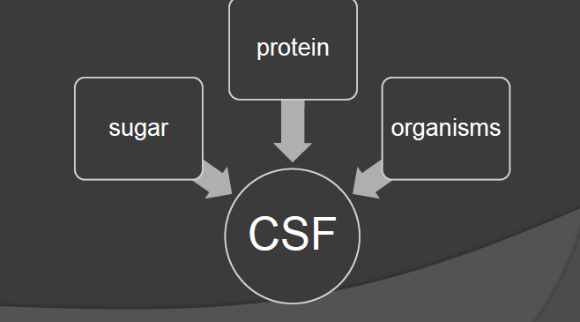
In these situations, LP must be undertaken to check for,

Slide 15
Neuroimaging is considered If:
Micro/ macrocephaly
Neuro-cutaneous syndrome
Pre-existing neurological defect
Recurrent complex febrile seizures

Slide 16
Management
Fever(Treating fever promote comfort).
Find the cause (usually viral illness)
Must exclude meningitis
Infection screen
blood culture
urine culture
LP for CSF culture
Not important in preventing seizures.
Physical methods
Fanning
Tepid sponging (now not recommended)
Light clothing
Drugs
PCM
ibuprofen

Slide 17
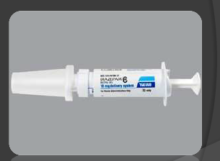
Management at home
Move danger away
Left lateral position
Do not try to stop fitting
Do not put anything in mouth
Loosen clothing
Wipe secretions from mouth
No fluids or drugs orally
Note the time
Do not panic
If seizure lasting >5-10 min:
Seek medical advice
· Diazepam
 0.5mg/kg rectal
· Midazolam
 0.5mg/kg buccal

Slide 18
Prognosis:
Generally excellent
Risk of further febrile seizures – 30%
Risk of epilepsy after single febrile seizure – 3%
No increased risk of death
Information for parents:
FC are common
Recurrences likely
Brain damage
Later epilepsy
No evidence of deaths
What to do when fitting
If lasting >10 min & not stopping
Rectal diazepam
-OR-
Take to the hospital
Information & advice sheets

Slide 19

  Thank you

