Slide 1
Pediatric ward Fifth Class
Prepared by:
Asiss. Lect. Lubab Tariq

Slide 2
Outlines: .Causative agents .Pathophysiology .Types of diarrhoea .Classification of diarrhoea .Management.

Slide 3
DEFINITION
It is a diarrheal disease (three or more times per day or at least 200 g of stool per day) of rapid onset that lasts less than two weeks and may be accompanied by nausea, vomiting, fever, or abdominal pain.
Also known as an inflammatory disease of the gastric, and enteric sites of the gastrointestinal tract. It is characterised by a sudden onset of diarrhoea with or without vomiting.
Diarrhoea in infants and small children may quickly dehydrate or get hypovolemic shock if fluids and electrolytes are not administered immediately.
Causes include; virus, bacteria, protozoal, and non infectious causes.

Slide 5
Causative Agents
Most cases of acute infectious gastroenteritis are viral, with norovirus being the most common cause of acute gastroenteritis
Rota virus
Enteric Adenovirus
Astro virus

Slide 6
viral aetiology
Characteristics of the history that suggest a viral aetiology of acute gastroenteritis include: an intermediate incubation period (24 to 60 hours), a short infection duration (12 to 60 hours), and a high frequency of vomiting.

Slide 7
Duration of the diarrhoea
The duration of the diarrhoea may differ among viral and bacterial acute gastroenteritis. Norovirus infection usually lasts a median of two days, rotavirus infection three to eight days, and Campylobacter and Salmonella last two to seven days .
Viral gastroenteritis does not typically cause bloody diarrhoea.

Slide 8
Pathophysiology of gastroenteritis.
GE is defined as vomiting or diarrhoea due to infections of the small or large intestines.
Changes are majorly non-inflammatory, in the small intestines, but inflammatory in large intestines.
Abdominal cramps, increased thirst, due to excessive water dehydration and scanty urine occurs.
Most dangerous symptoms include, high fever above 38.9 degrees celcius, blood or mucus in the diarrhoea, blood in the vomit, and severe abdominal pains or swellings.
Most of the infective microorganisms mentioned like; viruses, bacteria, and protozoans, damage the mucosal lining or the brush border in the small intestines.
Loss of protein-rich fluids and decreased ability to absorb the lost fluids occurs.
Invasion of the intestinal wall may cause bleeding especially in case of shigella, E.hystolytica and salmonella enterica.
Loss of a lot of water salts causes dehydration.

Slide 9
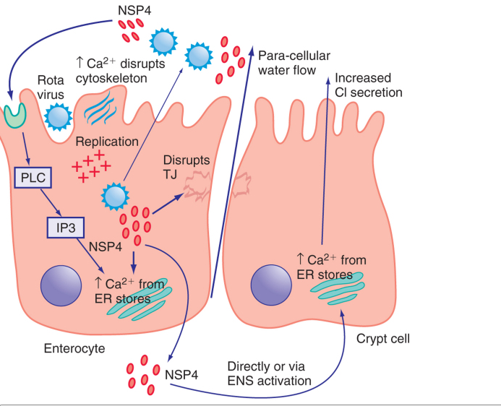
Figure 337-2 Pathogenesis of rotavirus infection and diarrhoea

Slide 10
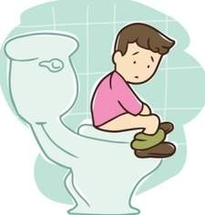
Clinical Presentation: Symptoms
Nausea / Vomiting
Cramping abdominal pain
Due to excessive fluid
Increased peristalsis
Absence of blood and faecal Leukocytes
Key to differential with bacterial infections

Slide 11
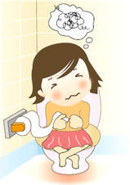
Physical Signs
Dehydration
Decreased urination
Mental status changes
Dry mucous membranes
Lethargy

Slide 12
Physical examination
Common findings on physical examination of patients with acute viral gastroenteritis include mild diffuse abdominal tenderness on palpation; the abdomen is soft.
Fever (38.3 to 38.9°C [101 to 102°F]) occurs in approximately one-half of patients.

Slide 13
Alarm symptoms and signs
Severe volume depletion/dehydration
Abnormal electrolytes or renal function
Bloody stool/rectal bleeding
Weight loss
Severe abdominal pain
Prolonged symptoms (more than one week)
Hospitalization or antibiotic use in the past three to six months
Comorbidities (eg, diabetes mellitus, immunocompromised)

Slide 14
History
Day care
Antibiotic Exposure
Foods
Hospitalize with:
Severe dehydration
Abdominal tenderness
Fever
Bloody diarrhoea

Slide 15
Indications for diagnostic evaluation
Profuse watery diarrhoea with signs of hypovolemia
Passage of many small volume stools containing blood and mucus
Bloody diarrhoea
Temperature ≥38.5ºC (101.3ºF)
Passage of ≥6 unformed stools per 24 hours or a duration of illness >48 hours
Severe abdominal pain
Hospitalized patients or recent use of antibiotics
Diarrhea in the immunocompromised

Slide 16
Diagnostic Testing(Diagnostic investigations of GE.)
Bloody diarrhoea?
Faecal leukocytes?
If non-inflammatory, no culture
Lab Tests?
Stool samples are collected for microscopy. A stool sample in viral GE does not contain any recognisable exudate, and its free from inflammatory cells, blood and fibrin.
Presence of leukocytes indicates presence of bacterial agent.
Cysts and trophozoites indicate parasitic GE.
Blood tests for ; FBC, renal function and electrolytes can also be done to rule any systemic effects.
Blood culture if giving antibiotics therapy.

Slide 17
Fecal leukocytes and occult blood
Several studies have evaluated the accuracy of faecal leukocytes alone or in combination with occult blood testing. The ability of these tests to predict the presence of an inflammatory diarrhoea has varied greatly, with reports of sensitivity and specificity ranging from 20 to 90 percent .

Slide 18
Faecal lactoferrin
The limitations of faecal leukocyte testing described above, provided the rationale for the development of a faecal lactoferrin latex agglutination assay (LFLA). Lactoferrin is a marker for faecal leukocytes, but its measurement is more precise and less vulnerable to variation in specimen processing.
Initial reports described sensitivity and specificity ranging from 90 to 100 percent in distinguishing inflammatory diarrhoea (eg, bacterial colitis or inflammatory bowel disease) from non-inflammatory causes (eg, viral colitis, irritable bowel syndrome).

Slide 19
When we should do stool studies?
Stool studies are not routinely necessary in patients with viral gastroenteritis and are typically negative for faecal leukocytes and occult blood.

Slide 20
stool cultures
Immunocompromised patients, including those infected with the human immunodeficiency virus (HIV).
Patients with comorbidities that increase the risk for complications.
Patients with more severe, inflammatory diarrhea (including bloody diarrhea).
Patients with underlying inflammatory bowel disease in whom the distinction between a flare and superimposed infection is critical.
Some employees, such as food handlers, might be requested to provide negative stool cultures, in addition to resolution of symptoms, in order to return to work.

Slide 21
When to obtain stool for ova and parasites
Persistent diarrhea (associated with Giardia, Cryptosporidium, and Entamoeba histolytica)
Persistent diarrhea following travel to Russia, Nepal, or mountainous regions (associated with Giardia, Cryptosporidium, and Cyclospora)
Persistent diarrhea with exposure to infants in daycare centers (associated with Giardia and Cryptosporidium)
Diarrhea in a man who has sex with men (MSM) or a patient with AIDS (associated with Giardia and Entamoeba histolytica in the former, and a variety of parasites in the latter).
A community waterborne outbreak (associated with Giardia and Cryptosporidium)
Bloody diarrhea with few or no fecal leukocytes (associated with intestinal amebiasis)
Symptoms that begin within six hours suggest ingestion of a preformed toxin of Staphylococcus aureus or Bacillus cereus.Symptoms that begin at 8 to 16 hours suggest infection with Clostridium perfringens

Slide 22
In the absence of signs of volume depletion, it is not necessary to measure serum electrolytes, which are usually normal. If substantial volume depletion is present, clinicians should measure serum electrolytes to screen for hypokalaemia or renal dysfunction
Symptoms that begin at more than 16 hours can result from viral or bacterial infection (eg, contamination of food with entero-toxigenic or entero-hemorrhagic E. coli).
Syndromes that may begin with diarrhoea but progress to fever and more systemic complaints such as head ache, muscle aches, stiff neck may suggest infection with Listeria monocytogenes, particularly in pregnant woman.

Slide 23
Continue……
The complete blood count does not reliably distinguish between viral and bacterial gastroenteritis.
The white blood cell count may or may not be elevated.
In patients with acute viral gastroenteritis with volume depletion, the complete blood count may show signs of hemoconcentration.

Slide 24
Management
Self limiting course
Replace fluids and electrolytes
Oral Rehydration (ORT)
Mild to moderate dehydration
Commercially available ORT
The composition of the oral rehydration solution (per liter of water) recommended by the World Health Organization consists of:
3.5 g sodium chloride
2.9 g trisodium citrate or 2.5 g sodium bicarbonate
1.5 g potassium chloride
20 g glucose or 40 g sucrose

Slide 25
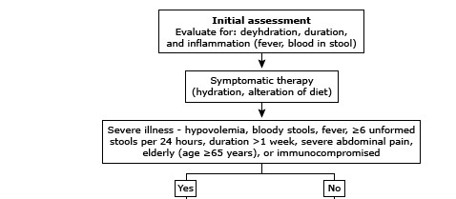

Slide 26
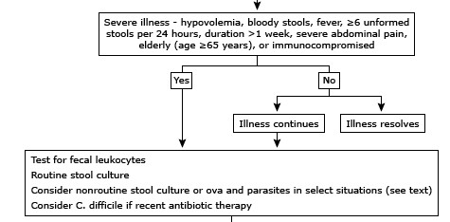

Slide 27
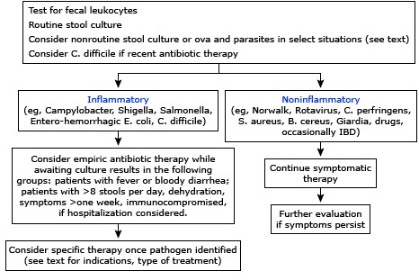

Slide 28
Antibiotics
We recommend empiric therapy with an oral fluoroquinolone (ciprofloxacin 500 mg twice daily, norfloxacin 400 mg twice daily (not available in the US), or levofloxacin 500 mg once daily) for three to five days in the absence of suspected EHEC or fluoroquinolone-resistant campylobacter infection .
Azithromycin (500 mg PO once daily for three days) or erythromycin (500 mg PO twice daily for five days) are alternative agents , particularly if fluoroquinolone resistance is suspected

Slide 30
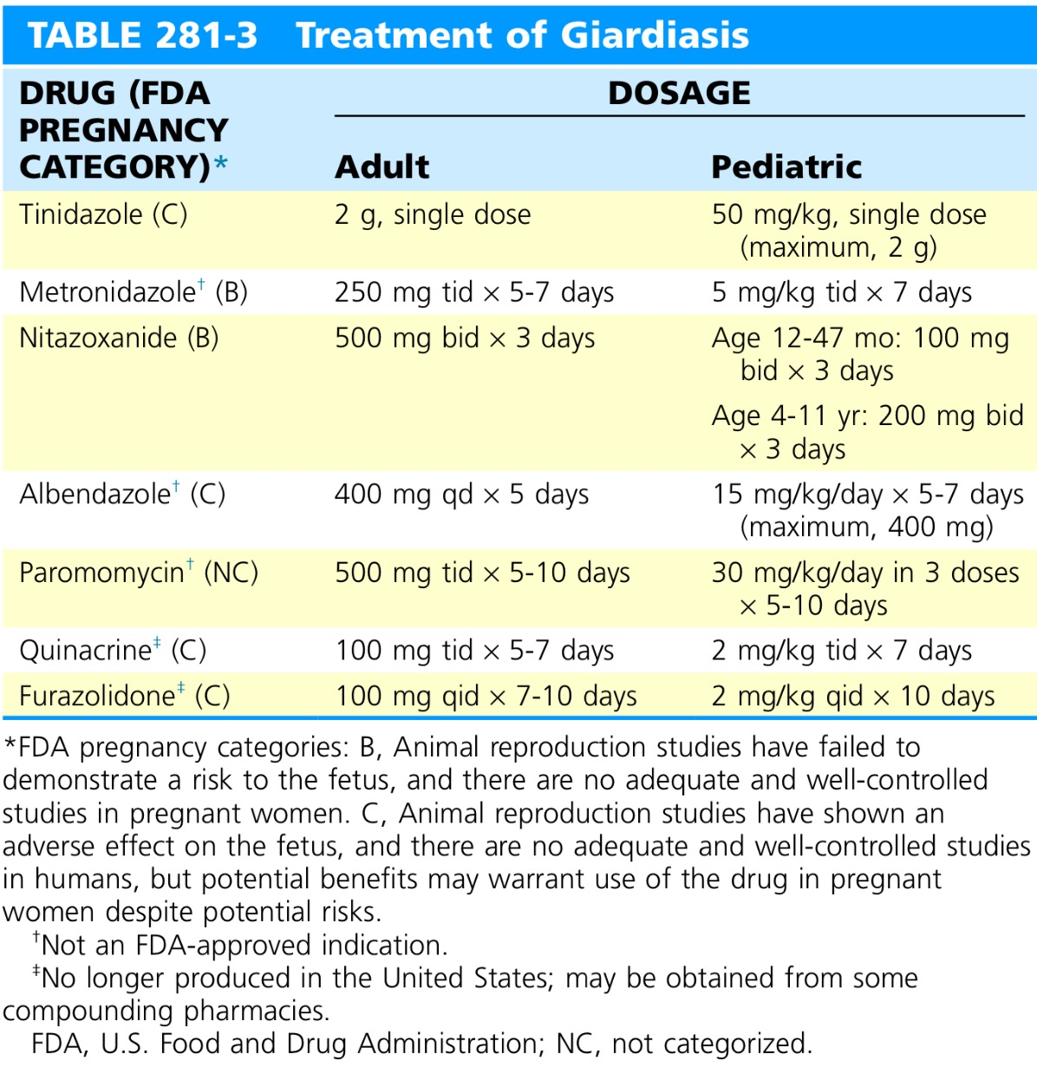

Slide 31
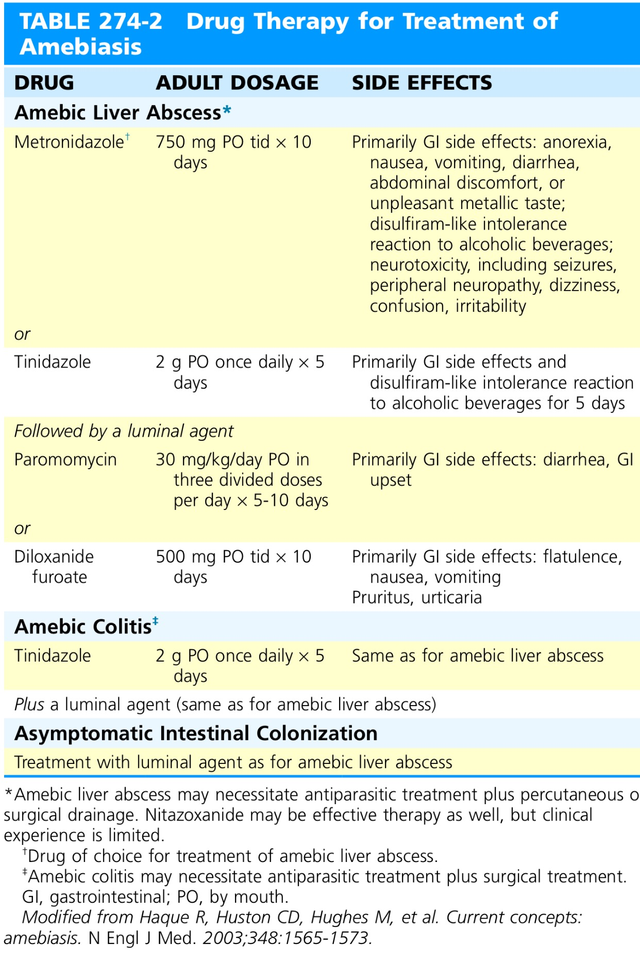

Slide 32
THANK YOU.
QUESTIONS.

