Slide 1
ANTI HYPERTENSIVE DRUGS

Slide 2
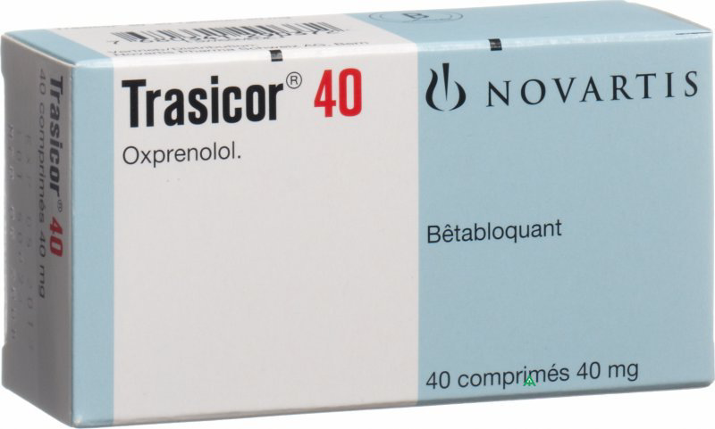
Beta-adrenoceptor blocking drugs
Beta-adrenoceptor blocking drugs (beta-blockers) block the beta-adrenoceptors in the heart, peripheral vasculature, bronchi, pancreas, and liver.
Intrinsic sympathomimetic activity (ISA, partial agonist activity) represents the capacity of beta-blockers to stimulate as well as to block adrenergic receptors.they tend to cause less bradycardia than the other beta-blockers and may also cause less coldness of the extremities.
Oxprenolol , pindolol , acebutolol, and celiprolol
ISA
Partial agonist

Slide 3
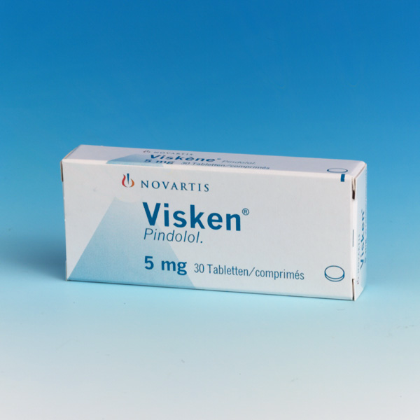
ISA
Partial agonist

Slide 4
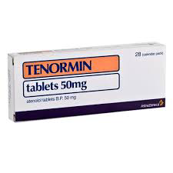
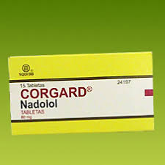
water soluble

Slide 5
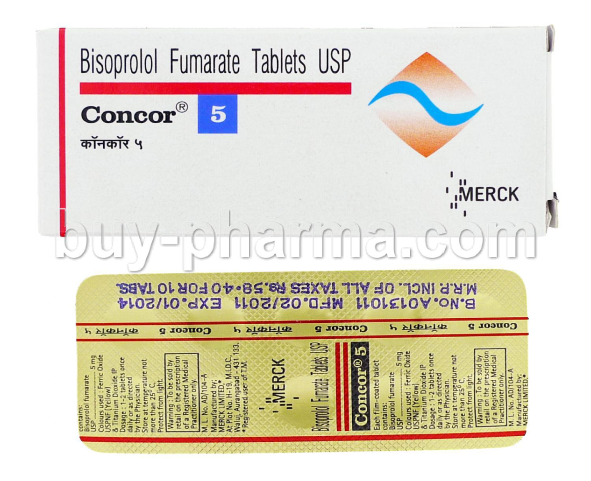
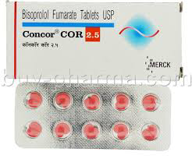
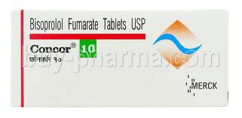
Water Soluble
Selective

Slide 6
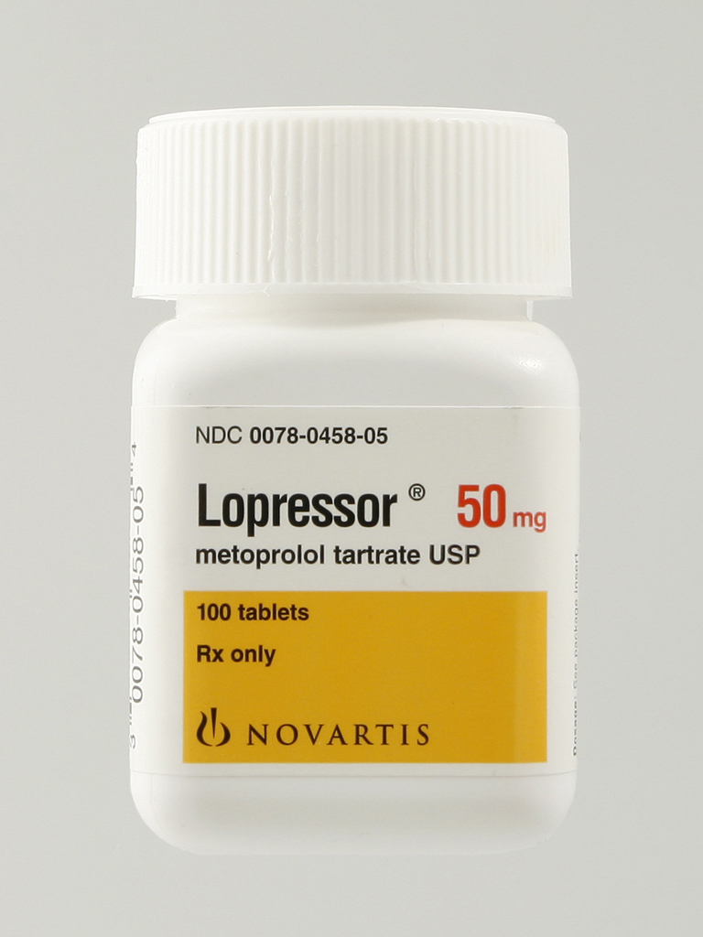
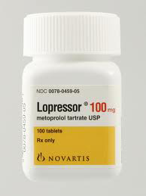
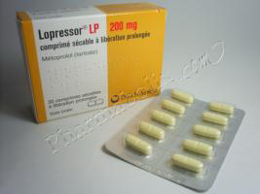

Slide 7
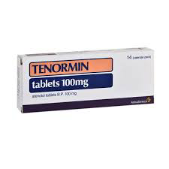
Water Soluble
Selective

Slide 8
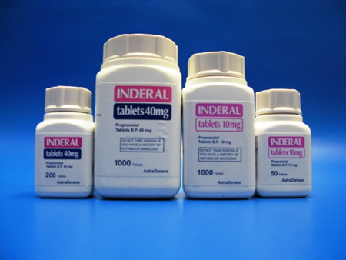
Lipid soluble β-blocker

Slide 9
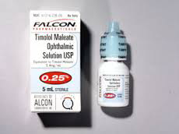
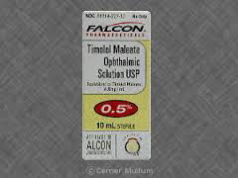
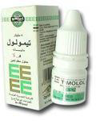
Glucoma

Slide 11
Calcium-channel blockers
Calcium-channel blockers (less correctly called ‘calcium-antagonists’) interfere with the inward displacement of calcium ions through the slow channels of active cell membranes. They influence the myocardial cells, the cells within the specialised conducting system of the heart, and the cells of vascular smooth muscle. Thus,
myocardial contractility may be reduced, the formation and propagation of electrical impulses within the heart may be depressed, and coronary or systemic vascular tone
may be diminished.

Slide 12
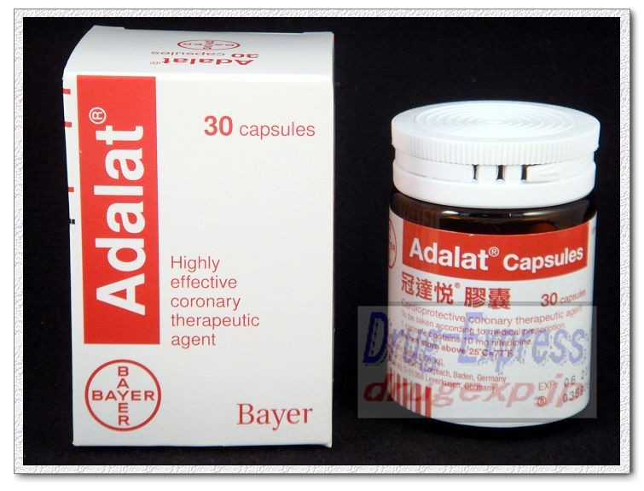
Nifedipine
relaxes vascular smooth muscle and dilates coronary and peripheral arteries. It has more influence on vessels and less on the myocardium than does verapamil hydrochloride, and unlike verapamil hydrochloride has no
anti-arrhythmic activity. It rarely precipitates heart failure

Slide 13
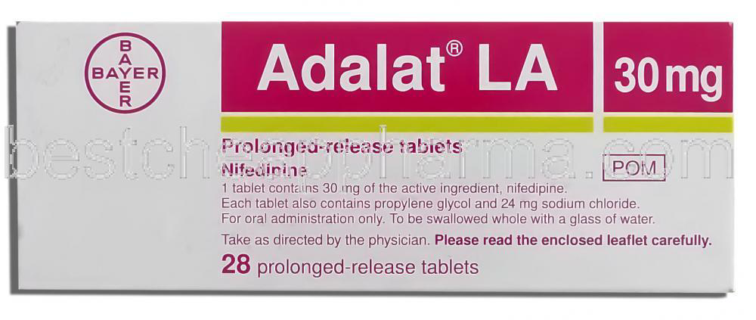
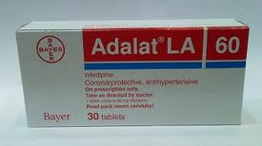

Slide 14
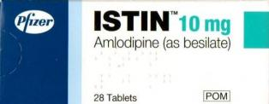
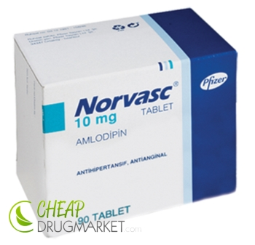

Slide 15
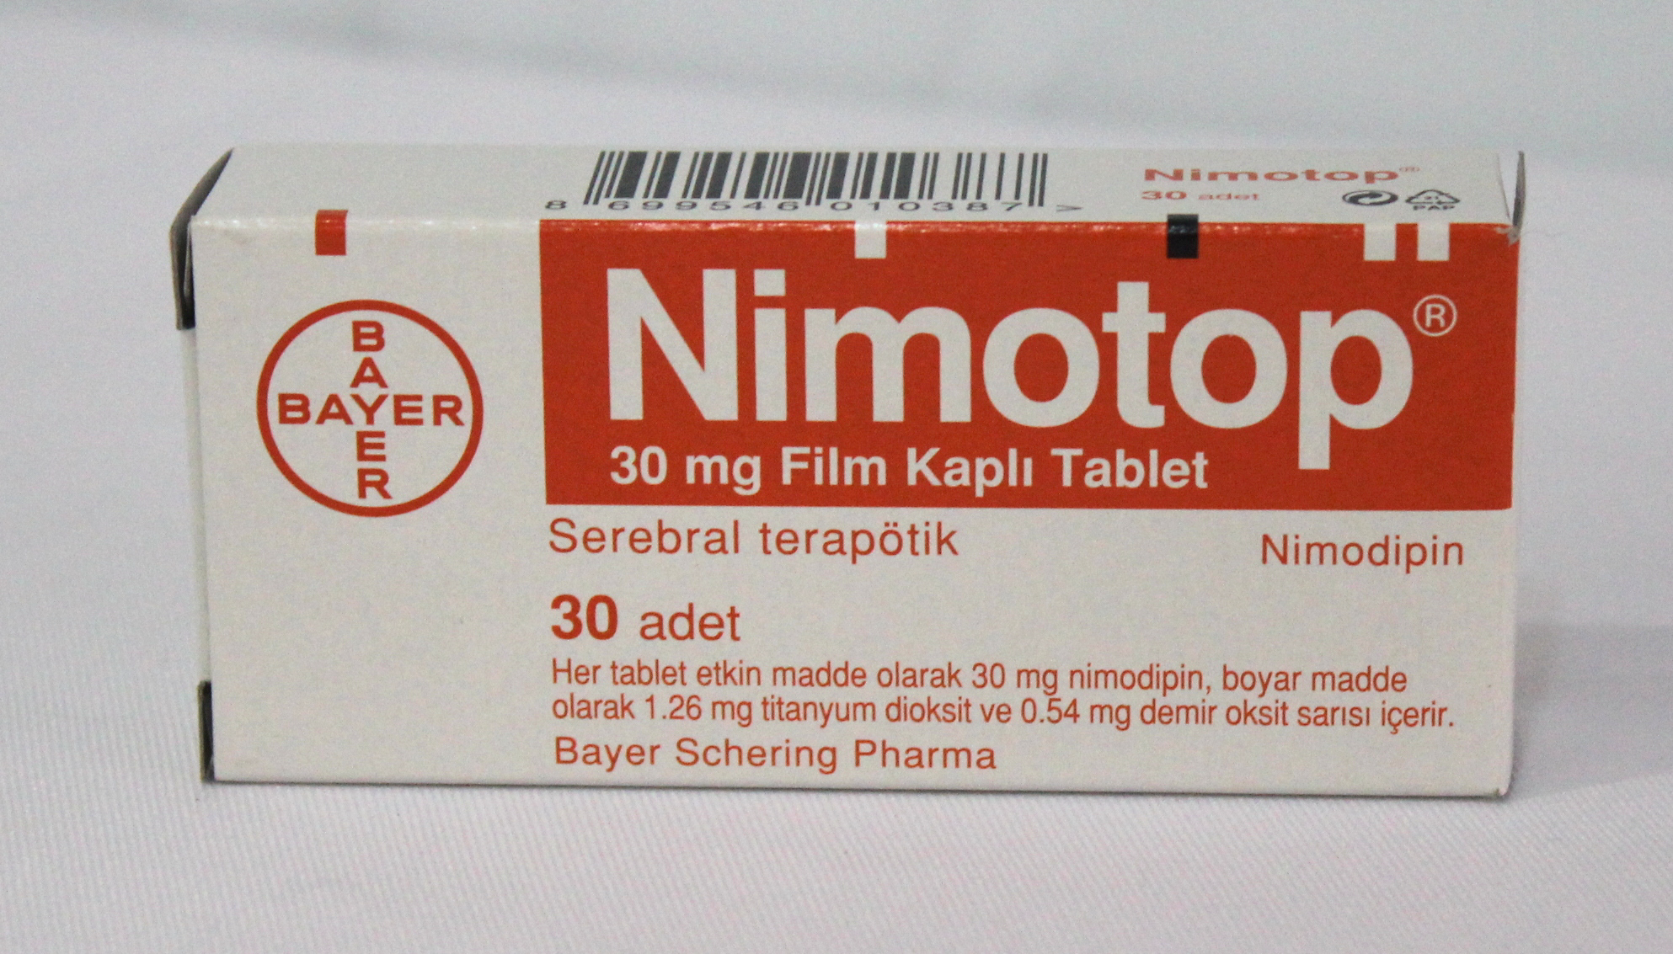
Nimodipine
is related to nifedipine but the smooth muscle relaxant effect preferentially acts on cerebral arteries. Its use is confined to prevention and treatment of vascular spasm following aneurysmal subarachnoid haemorrhage.

Slide 16
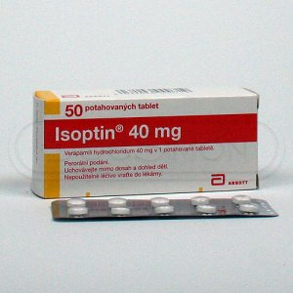
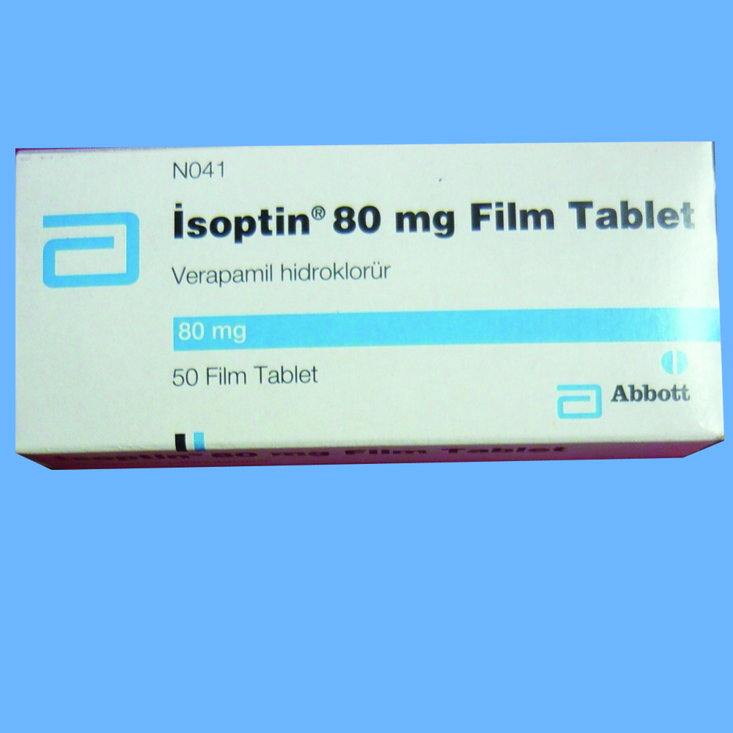
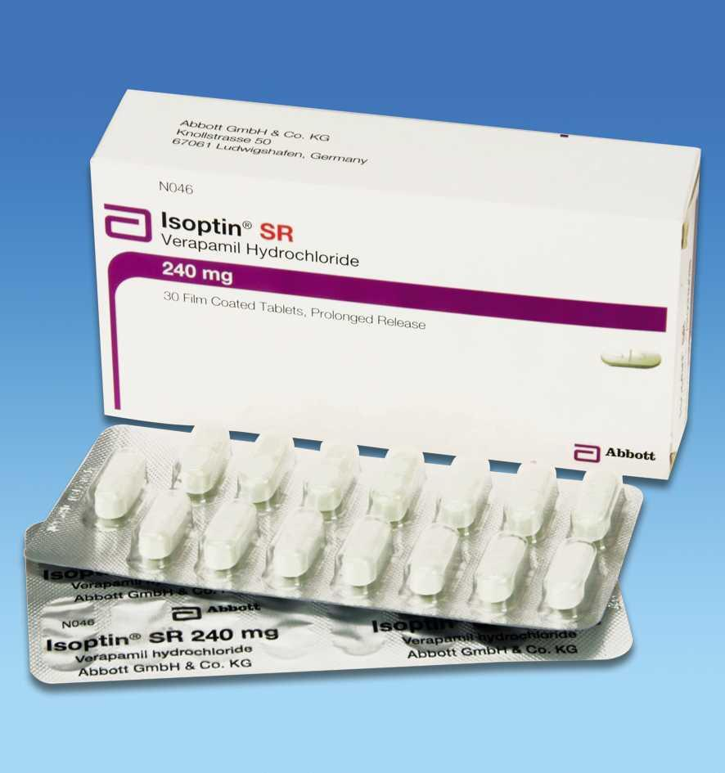
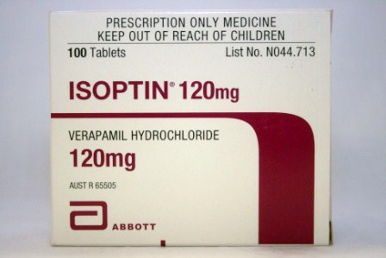

Slide 17
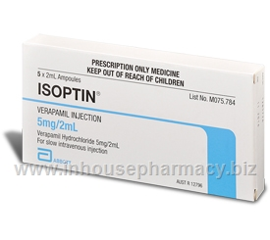
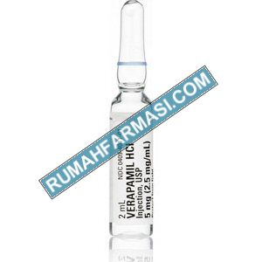
Verapamil is used for the treatment of angina, hypertension, and arrhythmias. It is a highly
negatively inotropic calcium channel-blocker and it reduces cardiac output, slows the heart rate, and may impair atrioventricular conduction. It may precipitate heart failure,
exacerbate conduction disorders, and cause hypotension at high doses and should not be used with beta-blockers.
Constipation is the most common side-effect.

Slide 18
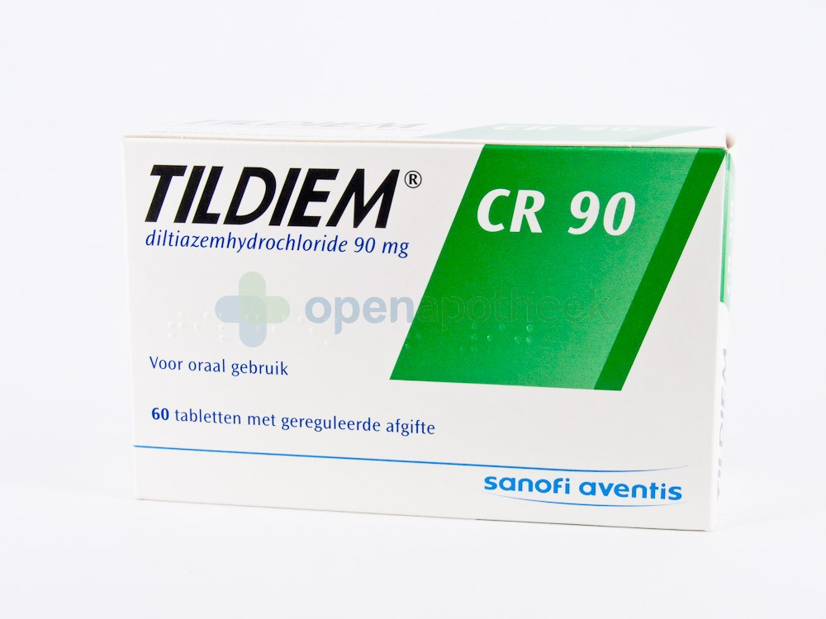
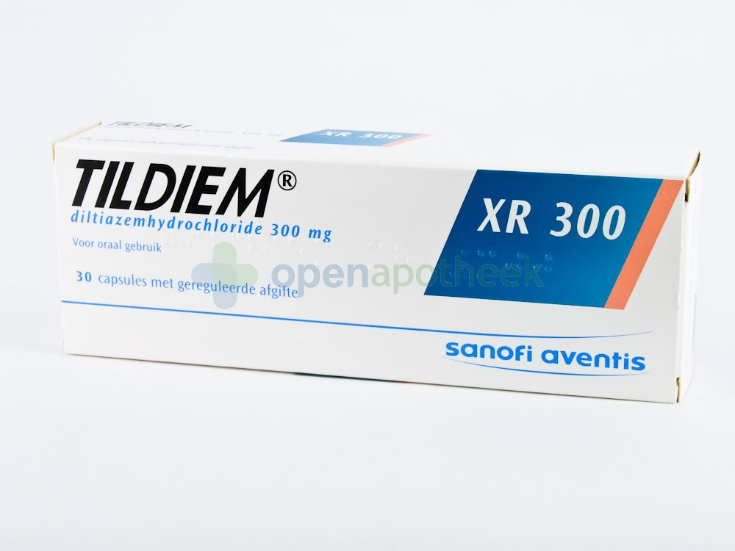
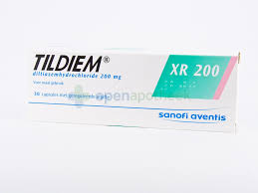

Slide 19
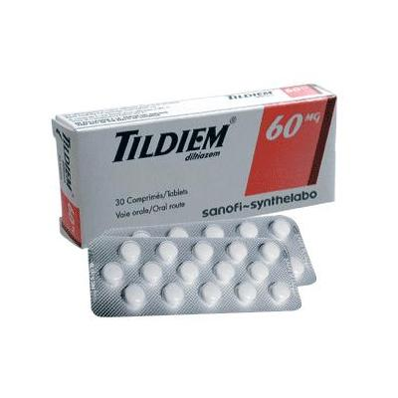
Verapamil hydrochloride and diltiazem hydrochloride should usually be avoided in heart failure because they may further depress cardiac function and
cause clinically significant deterioration.

Slide 20
Centrally Acting Agents

Slide 21
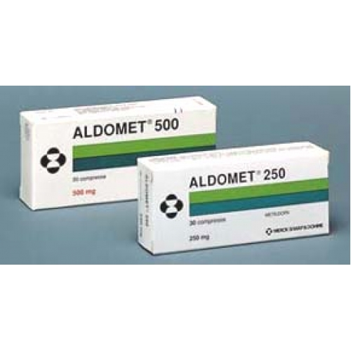

Slide 22
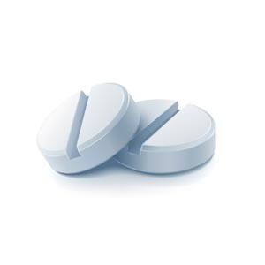
Vasodilators

Slide 23
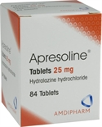
Mechanism of action
Direct relaxation to the vascular smooth muscl
Clinical uses:
Vasodilators have a potent hypotensive effect, especially when used in combination with a beta-blocker and a thiazide.
Hydralazine is given by mouth as an adjunct to other antihypertensives for the treatment of resistant hypertension but is rarely used.
Sodium nitroprusside is given by intravenous infusion to control severe hypertensive crises on the rare occasions when parenteral treatment is necessary.

Slide 24
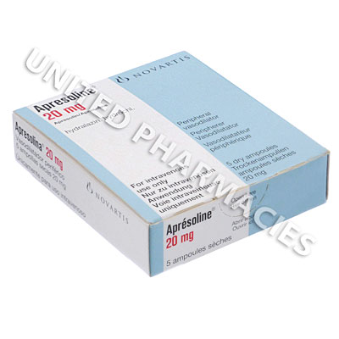
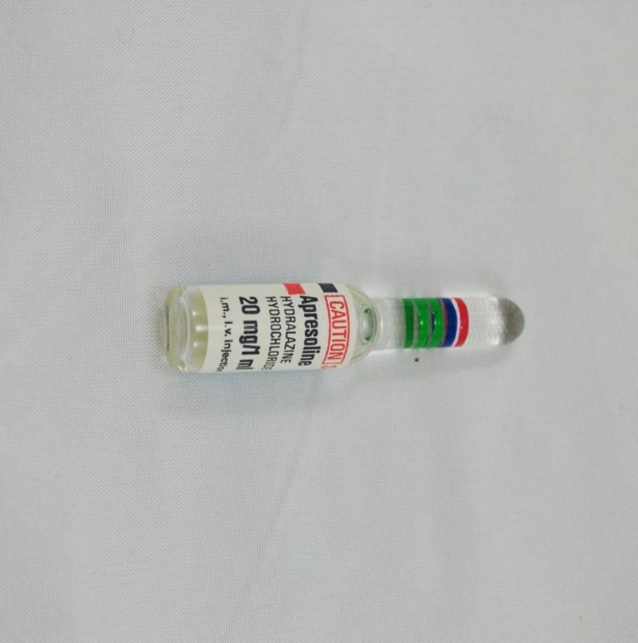

Slide 25
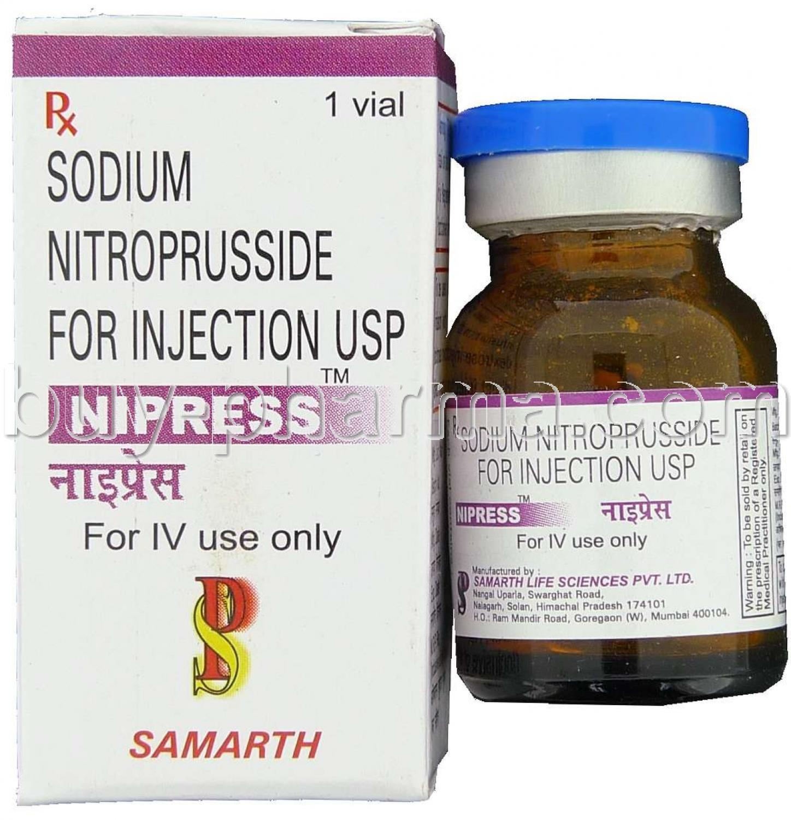

Slide 27
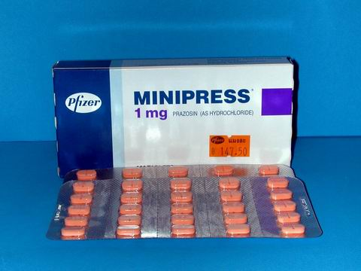
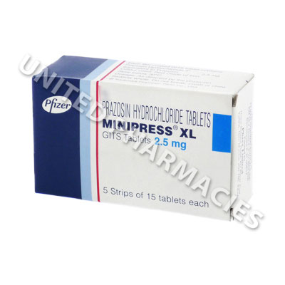

Slide 28
