Slide 1
Clinical pharmacy laboratory Part 2 DM
Done by:
Lubab Tarik Nafea/MSc in clinical pharmacy

Slide 2
Oral anti –diabetic agents part 2

Slide 3
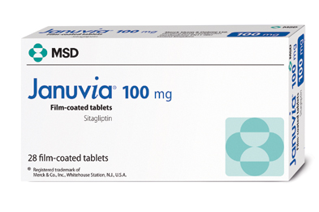

Slide 4
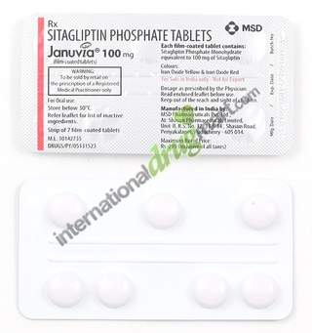

Slide 5
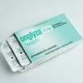

Slide 6
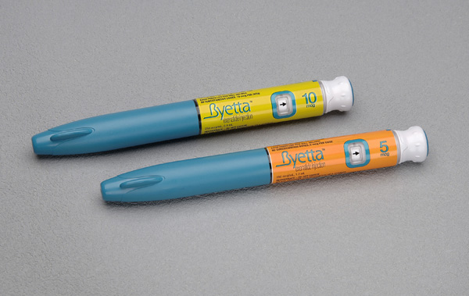

Slide 7
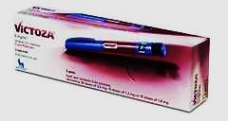

Slide 8
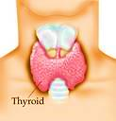
Anti-thyroid Drugs

Slide 9
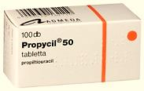
Thiouracils

Slide 10
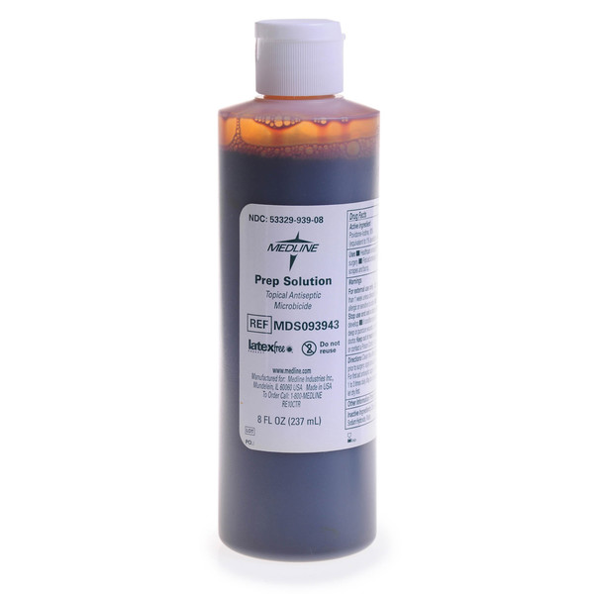
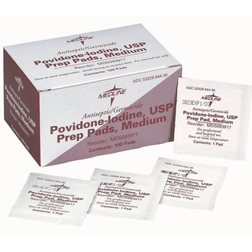
Vitamins and Trace Elements/Iodine aqueous oral solution

Slide 11
Thank you

