Slide 1
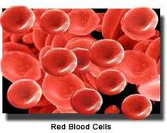

Clinical pharmacy laboratory/4 ^{th} Class
Anemias and blood disorders
Prepared by:
Assistant lecturer /Zahraa Abdul- Ghani
Assistant lecturer/Lubab Tarek Nafea

Slide 2

Lecture Outlines
ORAL IRON:- Ferrous fumarate, ferrous gluconate, ferrous sulphate.
PARENTERAL IRON:-iron dextran , iron sucrose , ferric carboxymaltose.
Vitamins and trace elements: Folic acid ,
Vitamin B Preparations :Cyanocobalamin.
Erythropoietin (eiopoitins): erythropoietin alfa

Slide 3
Anaemias
Initiation of treatment
Before initiating treatment for anaemia it is essential to determine which type is present. Iron salts may be harmful and result in iron overload if given to patients with anaemias other than iron deficiency type.
Treatment and prophylaxis
Treatment with an iron preparation is justified only in the presence of a demonstrable iron-deficiency state. Before starting treatment, it is important to exclude any serious underlying cause of the anaemia (e.g. gastric erosion, gastrointestinal cancer).

Slide 4
Oral iron
Iron salts should be given by mouth unless there are good reasons for using another route.
Ferrous salts show only marginal differences between one another in efficiency of absorption of iron.
Haemoglobin regeneration rate is little affected by the type of salt used provided sufficient iron is given. Choice of preparation is thus usually decided by the incidence of side-effects and cost.

Slide 5
Iron (oral)
SIDE-EFFECTS:- Constipation . diarrhoea . epigastric pain (dose related) . faecal impaction . gastro-intestinal irritation . nausea (dose related).
MONITORING REQUIREMENTS
▶ Therapeutic response The haemoglobin concentration should rise by about 100–200 mg/ 100mL (1–2 g/litre) per day or 2 g/100mL (20 g/litre) over 3–4 weeks. When the haemoglobin is in the normal range, treatment should be continued for a further 3 months to replenish the iron stores.
PRESCRIBING AND DISPENSING INFORMATION
▶ In children Express the dose in terms of elemental iron and iron salt and select the most appropriate preparation. The most common reason for lack of response in children is poor compliance; poor absorption is rare in children.
PATIENT AND CARER ADVICE
Although iron preparations are best absorbed on an empty stomach they can be taken after food to reduce gastro-intestinal side-effects. May discolour stools.

Slide 6
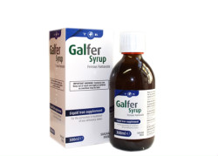
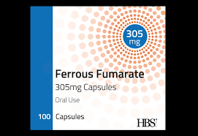
Ferrous fumarate

Slide 7
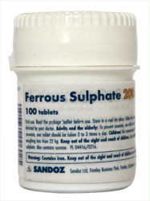
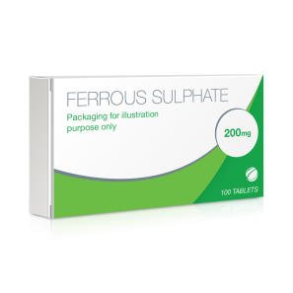
Ferrous sulfate

Slide 8
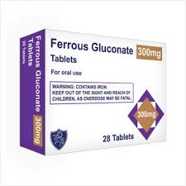
Ferrous gluconate

Slide 9
Parenteral iron :-Iron dextran, iron sucrose, ferric carboxymaltose.
Parenteral iron is generally reserved for use when oral therapy is unsuccessful because
1-the patient cannot tolerate oral iron, or 2-becausemalabsorption or 3- in the management of chemotherapy-induced anaemia, or 4- in patients with chronic renal failure who are receiving haemodialysis (and some who are receiving peritoneal dialysis).
SIDE-EFFECTS :-Hypersensitivity reactions
IMPORTANT SAFETY INFORMATION:-
Serious hypersensitivity reactions, including life threatening and fatal anaphylactic reactions, have been reported in patients receiving intravenous iron. These reactions can occur even when a previous administration has been tolerated (including a negative test dose). Test doses are no longer recommended and caution is needed with every dose of intravenous iron. Intravenous iron products should only be administered when appropriately trained staff and resuscitation facilities are immediately available; patients should be closely monitored for signs of hypersensitivity during and for at least 30 minutes after every administration. In the event of a hypersensitivity reaction, treatment should be stopped immediately and appropriate management initiated.

Slide 10
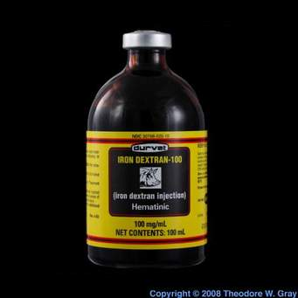
Iron dextran

Slide 11

Iron sucrose

Slide 12
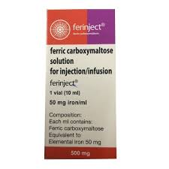
Ferric carboxymaltose

Slide 13
Anaemias , megaloblastic
Overview
Most megaloblastic anaemias result from a lack of either vitamin B12 or folate.
Causes of megaloblastic anaemia :
1.in the UK is pernicious anaemia in which lack of gastric intrinsic factor resulting from an autoimmune gastritis causes malabsorption of vitamin B12.
2.Apart from dietary deficiency, are attributable to malabsorption.
Folic acid:
Folic acid below has few indications for long-term therapy since most causes of folate deficiency are self-limiting or will yield to a short course of treatment. It should not be used in undiagnosed megaloblastic anaemia unless vitamin B12 is administered concurrently otherwise neuropathy may be precipitated.

Slide 14
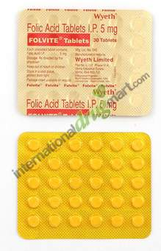
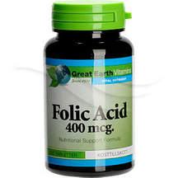
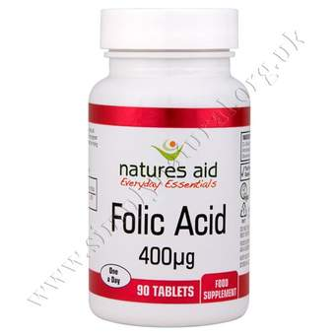
Folic acid

Slide 15
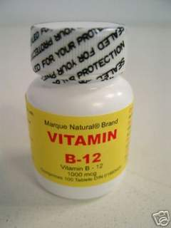
vitamin B preparations - Hydroxocobalamin , cyanocobalamin

Slide 16
Erythropoietins
Epoetins (recombinant human erythropoietins)
Darbepoetin (hyperglycosylated derivative) Methoxy polyethylene glycol-epoetin beta
Are used to:-
treat the anaemia associated with erythropoietin deficiency in chronic renal failure, to increase the yield of autologous blood in normal individuals and to shorten the period of symptomatic anaemia in patients receiving cytotoxic chemotherapy.
Epoetin beta is also used for the prevention of anaemia in preterm neonates of low birth-weight; only unpreserved formulations should be used in neonates because other preparations may contain benzyl alcohol.
Darbepoetin alfa is a hyperglycosylated derivative of epoetin; it has a longer half life and can be administered less frequently than epoetin.
Methoxy polyethylene glycol-epoetin beta is a continuous erythropoietin receptor activator that is licensed for the treatment of symptomatic anaemia associated with chronic kidney disease. It has a longer duration of action than epoetin.

Slide 17
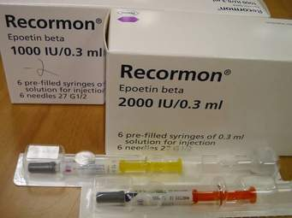
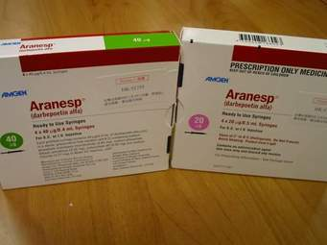

Slide 18
Thank you

