Slide 1
Cases for surgical ward
Assist.Lect.Lubab Tarek Nafea

Slide 2
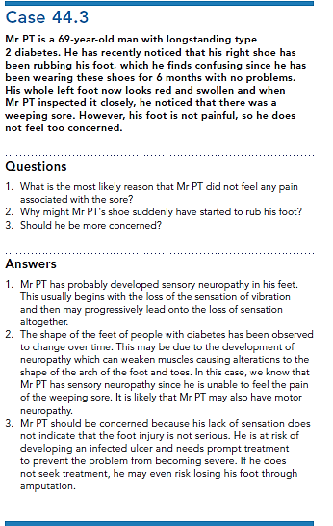
Diabetic foot case:

Slide 3
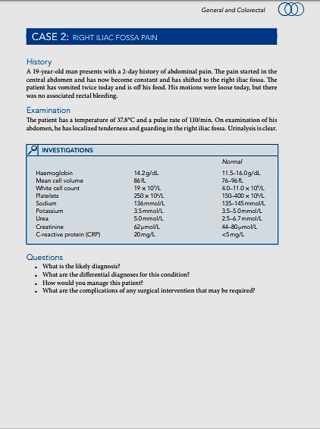
Appendix:

Slide 4
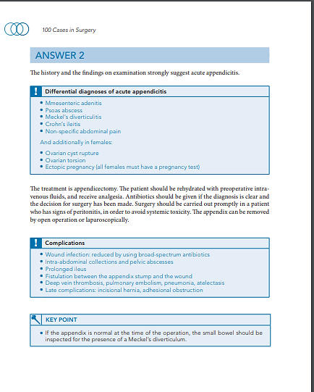

Slide 5
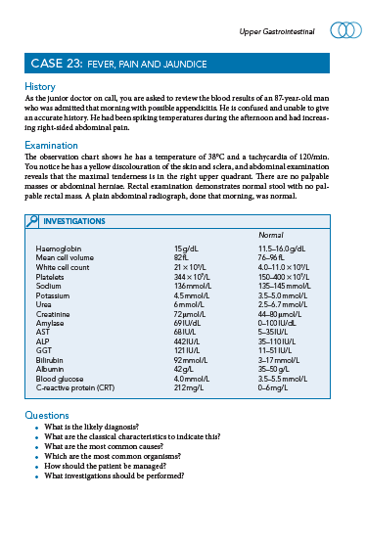
Cholelithiasis

Slide 6
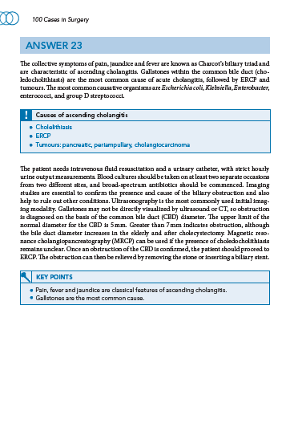

Slide 7
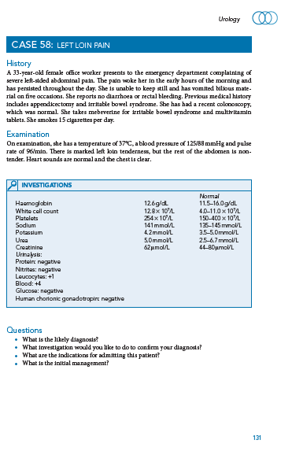
Nephrolithiasis

Slide 8
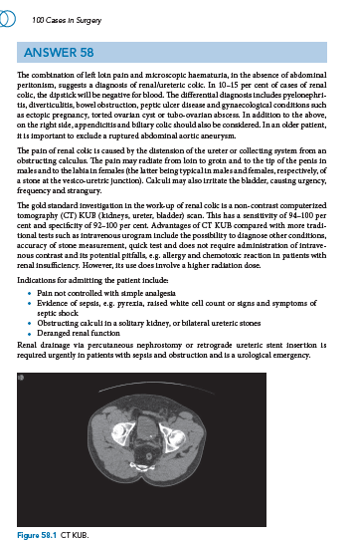

Slide 9
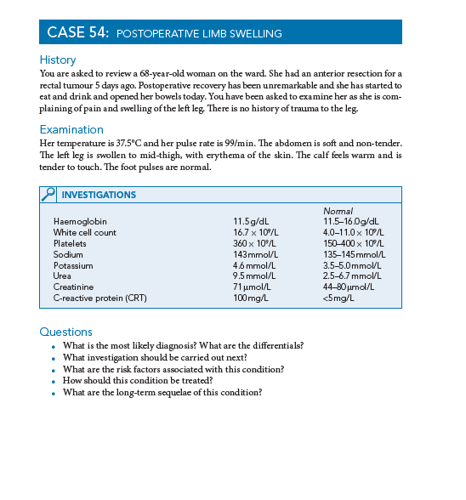
DVT

Slide 10
