Slide 1
Antiviral chemotherapy
Asst. Prof. Dr. Dalya Basil

Slide 2
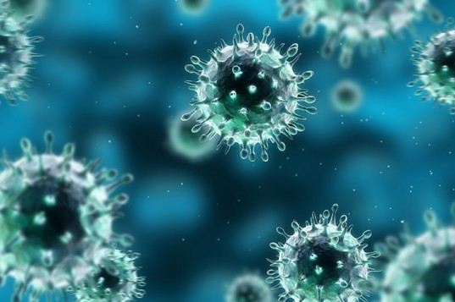
Antiviral Chemotherapy
(Prevention and Treatment of Viral Infection)
Viruses are a leading cause of disease and death worldwide. Although public health measures and vaccines are the most effective ways to control many viral infections, preventive measures have not succeeded for numerous viral diseases. For some of these diseases, antiviral drugs have been developed.

Slide 3
Antiviral Chemotherapy
(Prevention and Treatment of Viral Infection)
A number of these drugs have been highly successful, saving lives and relieving suffering. This has been most dramatic with drugs active against human immunodeficiency virus (HIV).
Because viruses are obligate intracellular parasites, antiviral agents must be capable of selectively inhibiting viral functions without damaging the host, making the development of such drugs very difficult.

Slide 4
Antiviral Chemotherapy
(Prevention and Treatment of Viral Infection)
Another limitation is that many rounds of virus replication occur during the incubation period and the virus has spread before symptoms appear, making a drug relatively ineffective.
There is a need for antiviral drugs active against viruses for which vaccines are not available or not highly effective, perhaps because of a multiplicity of serotypes (eg, rhinoviruses) or because of a constantly changing virus (eg, influenza, HIV).

Slide 5
Antiviral Chemotherapy (Prevention and Treatment of Viral Infection)
Antivirals can be used to treat established infections when vaccines would not be effective. Antivirals are needed to reduce morbidity and economic loss due to viral infections and to treat increasing numbers of immunosuppressed patients who are at increased risk of infection.

Slide 6
Types of Antiviral Agents
1- Nucleoside Analogs
2- Nucleotide Analogs
3- Nonnucleoside Reverse Transcriptase Inhibitors
4- Protease Inhibitors
5- Fusion Inhibitor

Slide 7
Nucleoside Analogs
The majority of available antiviral agents are nucleoside analogs. They inhibit nucleic acid replication by inhibition of polymerases for nucleic acid replication. In addition, some analogs can be incorporated into the nucleic acid and block further synthesis or alter its function.

Slide 8
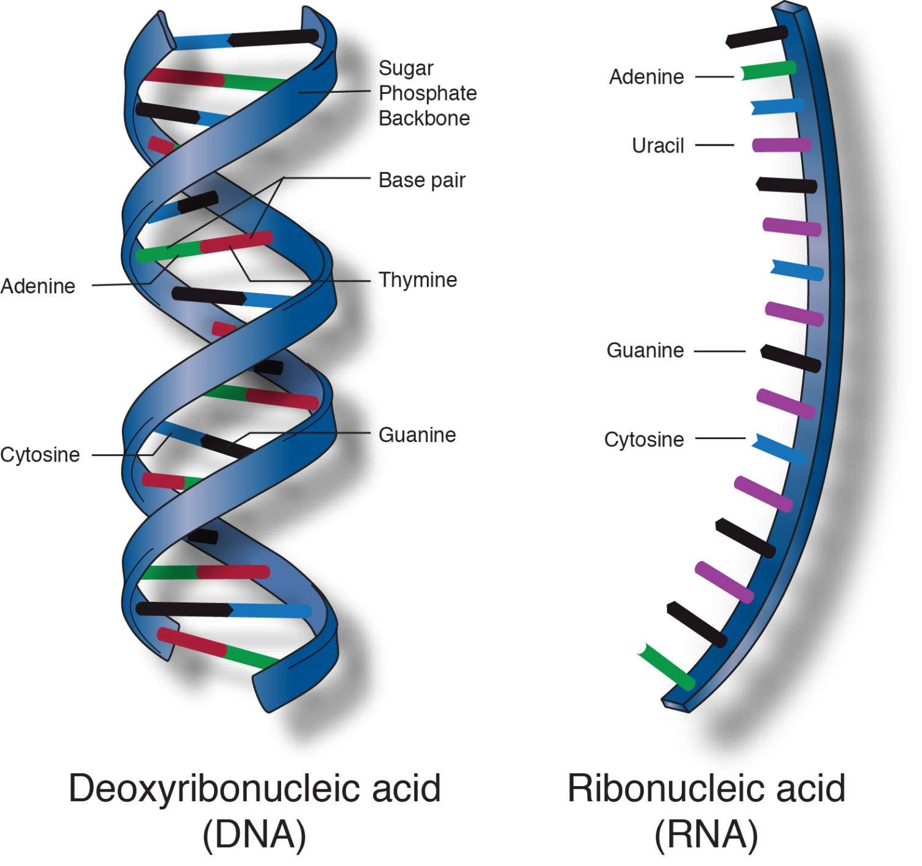

Slide 9
Nucleoside Analogs
Analogs can inhibit cellular enzymes as well as virus-encoded enzymes. The most effective analogs are those able to specifically inhibit virus-encoded enzymes, with minimal inhibition of analogous host cell enzymes.
Virus variants resistant to the drug usually arise over time, sometimes quite rapidly. The use of combinations of antiviral drugs can delay the emergence of resistant variants (eg, "triple drug" therapy used to treat HIV infections).

Slide 10
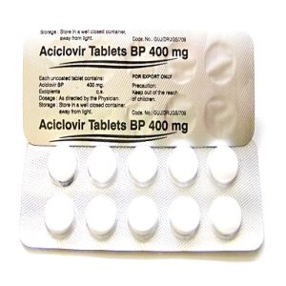
Nucleoside Analogs
Examples of nucleoside analogs include acyclovir (acycloguanosine), lamivudine (3TC), ribavirin, vidarabine (adenine arabinoside), and zidovudine (azidothymidine; AZT).

Slide 11
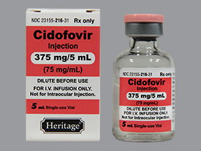
Nucleotide Analogs
Nucleotide analogs differ from nucleoside analogs in having an attached phosphate group. Their ability to persist in cells for long periods of time increases their potency. Cidofovir is an example.

Slide 12
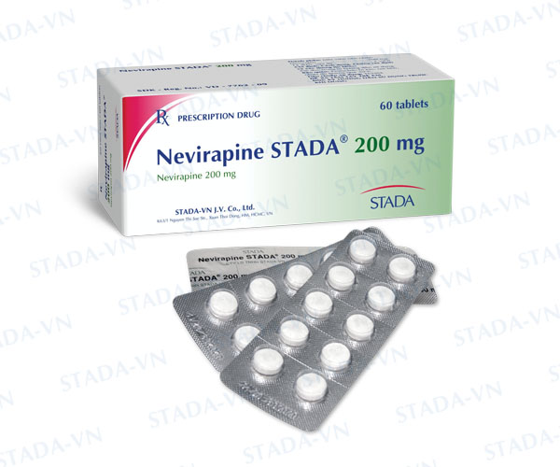
Non nucleoside Reverse Transcriptase Inhibitors
Nevirapine was the first member of the class of nonnucleoside reverse transcriptase inhibitors. It does not require phosphorylation for activity and does not compete with nucleoside triphosphates. It acts by binding directly to reverse transcriptase and disrupting the enzyme's catalytic site.

Slide 13
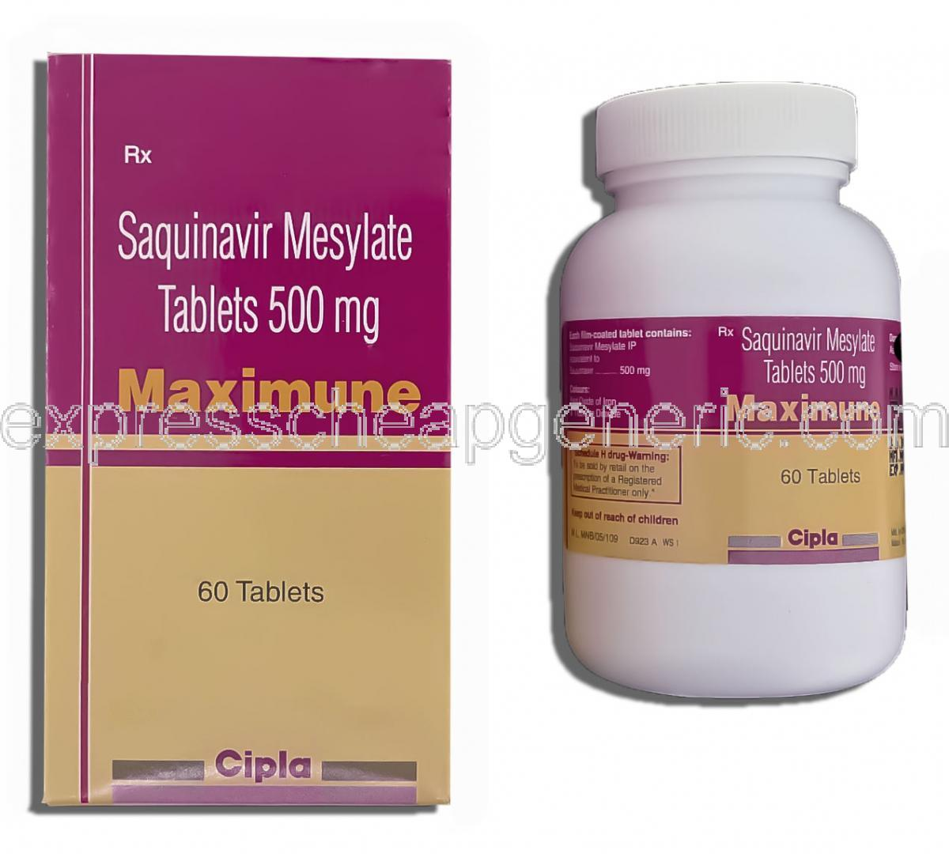
Protease Inhibitors
Saquinavir was the first protease inhibitor to be approved for treatment of HIV infection. It is a peptidomimetic agent designed by computer modeling as a molecule that fits into the active site of the HIV protease enzyme.

Slide 14
Protease Inhibitors
Such drugs inhibit the viral protease that is required at the late stage of the replicative cycle to cleave the viral gag and gag-pol polypeptide precursors to form the mature virion core and activate the reverse transcriptase that will be used in the next round of infection. Inhibition of the protease yields noninfectious virus particles.

Slide 15
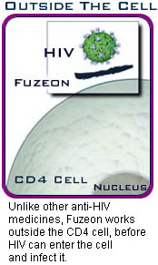
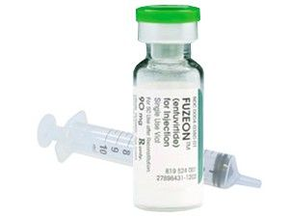
Fusion Inhibitor
Fuzeon is a large peptide that blocks the virus and cellular membrane fusion step involved in entry of HIV-1 into cells.

Slide 16
Other Types of Antiviral Agents
Other Types of Antiviral Agents have been shown to possess some antiviral activity under certain conditions.
1. Amantadine & rimantadine: These synthetic amines specifically inhibit influenza A viruses by blocking viral uncoating. They must be administered prophylactically to have a significant protective effect.

Slide 17
Other Types of Antiviral Agents
2. Foscarnet (phosphonoformic acid): Foscarnet, an organic analog of inorganic pyrophosphate, selectively inhibits viral DNA polymerases and reverse transcriptases at the pyrophosphate-binding site.
3. Methisazone: Methisazone is of historical interest as an inhibitor of poxviruses. It was the first antiviral agent to be described and contributed to the campaign to eradicate smallpox. It blocked a late stage in viral replication, resulting in the formation of immature, noninfectious virus particles.

Slide 18
Mechanisms of Specific Antiviral Drugs
In principle, any stage of viral infection can be targeted for inhibition. There are potential advantages to targeting very early or late stages such as attachment, entry, and release, because inhibitors of these steps do not have to enter cells to exert activity.

Slide 19
Mechanisms of Specific Antiviral Drugs
Stages such as genome replication, assembly, and maturation often require specific viral enzymes, which, are attractive drug targets.
Indeed, most antiviral drugs currently available inhibit genome replication. Nevertheless, there is an antiviral drug for nearly every stage of viral infection.

Slide 20
Inhibition of Viral Attachment and Entry
Inhibition of attachment and entry prevents all subsequent steps in virus infection and permits the virion to be cleared by immune and other mechanisms. Two general approaches have been used for drugs that inhibit attachment and entry. The first of these approaches has been to discover drugs that bind to the virion and block these events. Enfuvirtide (T-20) was the first drug approved for clinical use that acts this way.

Slide 21
Inhibition of Viral Attachment and Entry
This agent was discovered by a rational, directed approach that examined the ability of peptides to inhibit HIV infection in cell culture. The peptide that was most potent (T-20) is similar to a segment of gp41, the HIV protein that mediates membrane fusion.
A relatively new approach to inhibitors of attachment and entry has been to target cell surface receptors that mediate these events. Examples of this approach are anti-HIV drugs that inhibit binding to the CCR5 coreceptor, which is used by the most commonly transmitted HIV-1 strains (R5 tropic).

Slide 22
Inhibition of Viral Uncoating
The adamantane derivatives, amantadine and rimantadine, are active exclusively against influenza A virus. In most influenza A strains, these drugs inhibit virus uncoating.
Influenza A virus attaches to surface glycoproteins, and bound to its receptor, then inter by endosome.
As part of its normal function, the endosome becomes acidified. During influenza virus entry, this reduction in pH causes a conformational change in the virion hemagglutinin protein and fusion of the virion envelope and the endosomal membrane. By itself, this action would release viral ribonucleoprotein into the cytoplasm.

Slide 23
Inhibition of Viral Uncoating
In the presence of amantadine or rimantadine, however, the matrix protein, M₁, does not dissociate from the ribonucleoprotein, which remains in the cytoplasm instead of entering the nucleus.
Low pH can promote the dissociation of M₁, and allow nuclear entry of the ribonucleoprotein. Thus, it is thought that M₂ in the virion envelope functions to let H⁺ ions from the acidified endosome enter the virion, and dissociate M₁ from the ribonucleoprotein.
Amantadine and rimantadine would block the entry of H⁺ ions, thereby preventing this uncoating event.

Slide 24
Inhibition of Viral Genome Replication
Most antiviral drugs inhibit viral genome replication, and nearly all of these inhibit a DNA polymerase include certain human herpesviruses, the retrovirus HIV, and the hepadnavirus HBV. Most of these drugs are nucleoside analogues.
Some of these nucleoside analogues actually mimic nucleoside monophosphates, so they are actually nucleotide analogs. A few drugs are non-nucleoside inhibitors of DNA polymerase or RT that act by binding at a site other than the dNTP binding site.

Slide 25
Inhibition of Viral Genome Replication
All nucleoside analogues must be activated by phosphorylation, usually to the triphosphate form, to exert their effect. Phosphorylated nucleoside analogues inhibit polymerases by competing with the natural dNTP substrate; they are usually also incorporated into the growing DNA chain, where they often terminate elongation.
The more efficiently cellular enzymes phosphorylate the nucleoside analogue and the more potent the phosphorylated forms are against cellular enzymes, the more toxic the nucleoside analogue will be.

Slide 26
Inhibition of Viral Genome Replication
Selectivity, therefore, depends on how much more efficiently viral enzymes phosphorylate the drug than do cellular enzymes, as well as how much more potently and effectively viral genome replication is inhibited than are cellular functions.
The two main categories of nucleoside analogs are antiherpesvirus agents (e.g. Acyclovir &Ganciclovir)and anti-HIV agents. Three of these agents (adefovir, lamivudine, and entecavir) are approved for use against HBV. Another nucleoside analog, ribavirin, is used clinically against HCV and respiratory syncytial virus.

Slide 27
Inhibition of Viral Assembly and Maturation
Protease Inhibitors
Virus assembly and subsequent events to form an infectious virion are attractive targets for drug discovery because they are unique to virus biology. For many viruses, including HIV, assembly of proteins and nucleic acid into particles is not sufficient to produce an infectious virion.
For such viruses, an additional step, maturation, is required. In most cases, these viruses encode proteases that are essential for maturation. The approved antiviral drugs that target HIV protease (saquinavir, ritonavir, amprenavir, indinavir, nelfinavir, lopinavir, atazanavir, and tipranavir.

Slide 28
Inhibition of Viral Release
Anti-influenza Virus Neuraminidase Inhibitors
Inhibitors of influenza neuraminidases block viral release of influenza A and B.

Slide 29
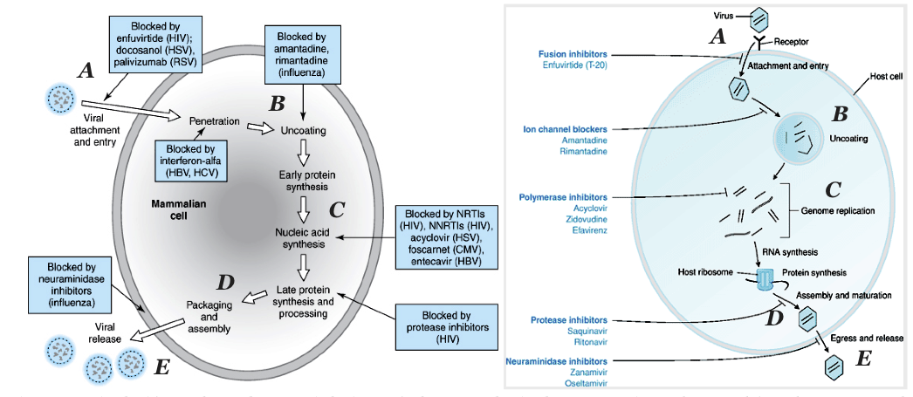

Slide 30
Interferons
IFNs are host-coded proteins that are members of the large cytokine family and which inhibit viral replication. They are produced very quickly (within hours) in response to viral infection or other inducers and are one of the body's first responders in the defense against viral infection. IFN was the first cytokine to be recognized.

Slide 31
Properties of IFNs
There are multiple species of IFNs that fall into three general groups, designated IFN-α, IFN-β, and IFN-ɤ. Both IFN-α and IFN-β are considered type I or viral IFNs, whereas IFN-ɤ is type II or immune IFN. The IFN-α family is large, being coded by at least 20 genes in the human genome; the IFN-β and IFN-ɤ families are coded by one gene each.

Slide 32
Properties of IFNs
IFN does not protect the virus-infected cell that produces it, and IFN itself is not the antiviral agent. Rather, IFN moves to other cells where it induces an antiviral state by prompting the synthesis of other proteins that actually inhibit viral replication. IFN molecules bind to specific cell surface receptors on target cells. IFN-α and IFN-β have the same receptor, whereas IFN-ɤ recognizes a different receptor.

Slide 33
Synthesis of IFNs
IFNs are produced by all vertebrate species. Normal cells do not generally synthesize IFN until they are induced to do so. Infection with viruses is a potent insult leading to induction; RNA viruses are stronger inducers of IFN than DNA viruses.
IFN-α and IFN-β are synthesized by many cell types, but IFN-ɤ is produced mainly by lymphocytes, especially T cells and natural killer (NK) cells. Dendritic cells also are potent IFN producers.

Slide 34

Thank You

