Slide 1
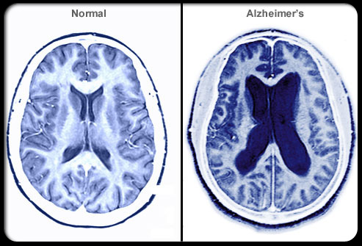
Alzheimer’s Disease

Slide 2
Alzheimer's disease
It is a degenerative brain disorder of unknown etiology which is the most common form of dementia.
usually starts in late middle age or in old age, results in progressive memory loss, impaired thinking, disorientation, and changes in personality and mood.
There is degeneration of brain neurons especially in the cerebral cortex and presence of neurofibrillary tangles and plaques containing beta-amyloid cells.

Slide 3
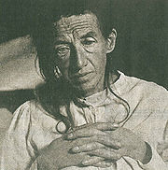
Origin of Alzheimer's Disease
The disease was first described by Dr. Alois Alzheimer, a German physician, in 1906. Alzheimer had a patient named Auguste D, in her fifties who suffered from what seemed to be a mental illness. But when she died in 1906, an autopsy revealed dense deposits, now called neuritic plaques, outside and around the nerve cells in her brain. Inside the cells were twisted strands of fiber, or neurofibrillary tangles. Since Dr. Alois Alzheimer's was the first person who discovered the disease, AD was named after him.
Auguste D

Slide 4
Alzheimer’s disease is a chronic, irreversible disease that affects the cells of the brain and causes impairment of intellectual functioning.
Alzheimer's disease is a brain disorder which gradually destroys the ability to reason, remember, imagine, and learn.

Slide 5
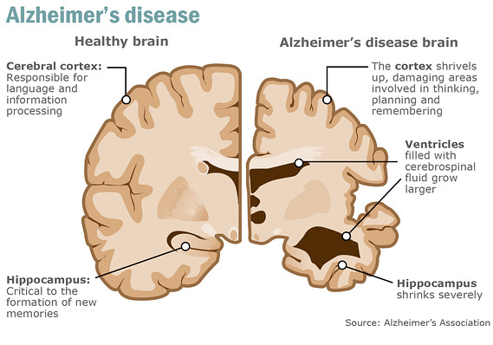

Slide 6
INCIDENCE
About 3 percent of men and women ages 65 to 74 have AD, and nearly half of those age 85 and older may have the disease.
About 360,000 new cases of Alzheimer’s are diagnosed each year.

Slide 7
CAUSES
There is no precise cause of Alzheimer’s disease known.
However, several factors are thought to be implicated in this disease:

Slide 8
Neurochemical Factors
a) Acetylcholine.
b) Somatostatin.
c) Substance P.
d) Norepinephrine

Slide 9
Environmental factors
A number of environmental factors are associated with an increased risk of AD, including:
Age
Decreased reserve capacity of the brain (reduced brain size, low educational level, and reduced mental and physical activity in late life.
Head injury.
Risk factors for vascular disease (hypercholesterolemia, hypertension, atherosclerosis, coronary heart disease, smoking, obesity, and diabetes).
Infections.

Slide 10
Genetic & immunological Factors
The majority and most aggressive early onset cases are attributed to mutations of a gene located on chromosome 14, which produces a protein called presenilin.
A structurally similar protein, presenilin 2, is produced by a gene on chromosome 1.
Both presenilin 1 and presenilin 2 encode for membrane proteins that may be involved in amyloid precursor protein (APP) processing.

Slide 11
Risk Factors
a) Down's syndrome.
b) Family History.
c) Chronic high BP.
d) Head injuries.
e) Gender.
f) Smoking and Drinking

Slide 12
PATHOPHYSIOLOGY
Alzheimer's disease attacks nerves and brain cells as well as neurotransmitters.
The destruction of these parts causes clumps of protein to form around the brain's cells. These clumps are known as 'plaques' and 'bundles'. The presence of the 'plaques' and 'bundles' start to destroy more connections between the brain cells, which makes the condition worse.

Slide 13
Pathophysiology
The signature lesions in AD are neuritic plaques and neurofibrillary tangles (NFTs) located in the cortical areas and medial temporal lobe structures of the brain.
Along with these lesions, degeneration of neurons and synapses, as well as cortical atrophy, occurs.

Slide 14
Pathophysiology
Amyloid Cascade
Neuritic plaques (also termed amyloid or senile plaques) are extracellular lesions found in the brain and cerebral vasculature. Plaques from AD brains largely consist of a protein called β-amyloid peptide (βAP) βAP, which is produced via processing of a larger protein, APP.
Specific APP physiologic roles are not entirely clear, but in a general sense it is felt to contribute to proper neuronal function and perhaps cerebral development.

Slide 15
Pathophysiology
Neurofibrillary Tangle
NFTs are commonly found in the cells of the hippocampus and cerebral cortex in persons with AD and are composed of abnormally hyperphosphorylated tau protein.
Tau protein provides structural support to microtubules, the cell’s transportation and skeletal support system.
When tau filaments undergo abnormal phosphorylation at a specific site, they cannot bind effectively to microtubules, and the microtubules collapse.

Slide 16
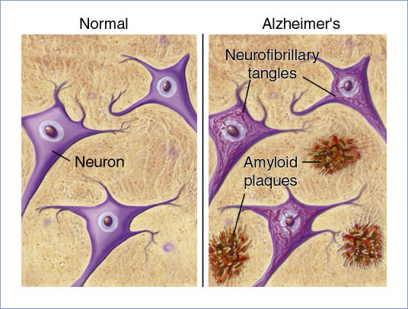

Slide 17
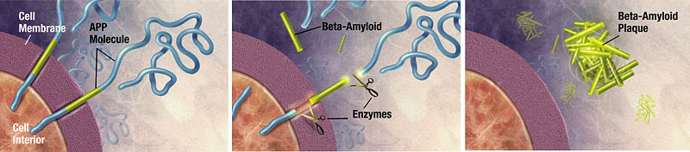
Enzymes act on the APP (amyloid precursor protein) and cut it into fragments. The beta-amyloid fragment is crucial in the formation of senile plaques in AD

Slide 18
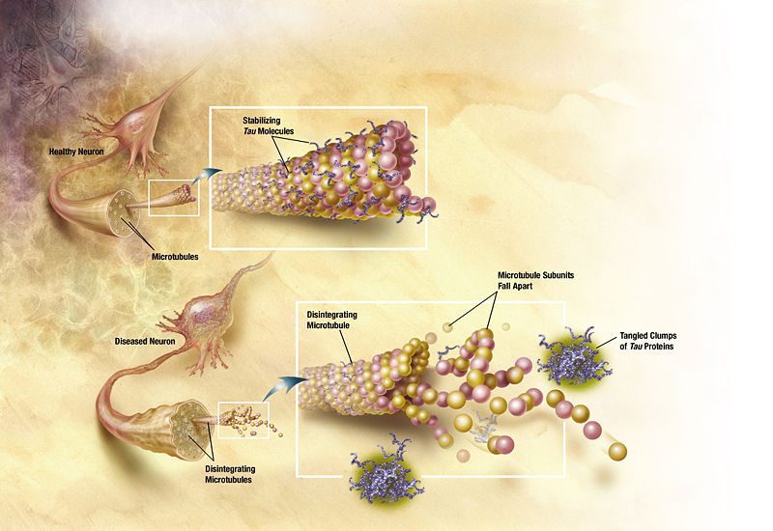
Tau proteins are proteins that stabilize microtubules
Alzheimer's disease, are associated with tau proteins that have become defective and no longer stabilize microtubules properly.

Slide 19
Pathophysiology
Inflammatory Mediators
Inflammatory or immunologic paradigms are often viewed as a corollary of the amyloid cascade hypothesis. Certainly, brain amyloid deposition associates with local inflammatory and immunologic alterations.
This line of observation led some to propose that inflammation is relevant to AD neurodegeneration.

Slide 20
Pathophysiology
The Cholinergic Hypothesis
Multiple neuronal pathways are destroyed in AD. There is variety of neurotransmitter deficits, with cholinergic abnormalities being the most prominent. Loss of cholinergic activity correlates with AD severity.
In late AD, the number of cholinergic neurons is reduced, and there is loss of nicotinic receptors in the hippocampus and cortex. Presynaptic nicotinic receptors control the release of acetylcholine, as well as other neurotransmitters important for memory and mood, including glutamate, serotonin, and norepinephrine

Slide 21
Pathophysiology
Other Neurotransmitter Abnormalities
Serotonergic neurons of the raphe nuclei and noradrenergic cells of the locus ceruleus are lost, while monoamine oxidase type B activity is increased. Monoamine oxidase type B is found predominantly in the brain and in platelets, and is responsible for metabolizing dopamine.
In addition, abnormalities appear in glutamate pathways of the cortex and limbic structures, where a loss of neurons leads to a focus on excitotoxicity models as possible contributing factors to AD pathology.

Slide 22
DUE TO THE ETIOLOGICAL FACTORS
CHANGES OCCUR IN THE PROTIENS OF THE NERVE CELLS
OF THE CEREBRAL CORTEX
ACCUMULATION OF NEUROFIBRILLARY TANGLES AND PLAQUES
GRANULO VASCULAR DEGENERATION
LOSS OF CHOLINERGIC NERVE CELLS
LOSS OF MEMORY, FUNCTION AND COGNITION

Slide 23
SIGNS
Ten warning signs of Alzheimer's disease
1) Memory loss
2) Difficulty to performing familiar tasks
3) Problems with language
4) Disorientation to time and place
5) Poor or decreased judgment
6) Problems with abstract thinking
7) Misplacing things
8) Changes in mood or behavior
9) Changes in personality
10) Loss of initiative

Slide 24
SYMPTOMS
Confusion
disturbances in short-term memory
problems with attention and spatial orientation
personality changes
language difficulties
unexplained mood swings

Slide 25
Diagnostic tests
Psychiatric assessments.
Mental status examination and neuropsychological assessment.
Laboratory tests.
Brain imaging .
* CT scan
* MRI
* PET (Positron emission tomography)
* SPECT (Single-photon emission computed tomography)
CSF Examination
Electro-encephalogram (EEG)
Electromyogram

Slide 26
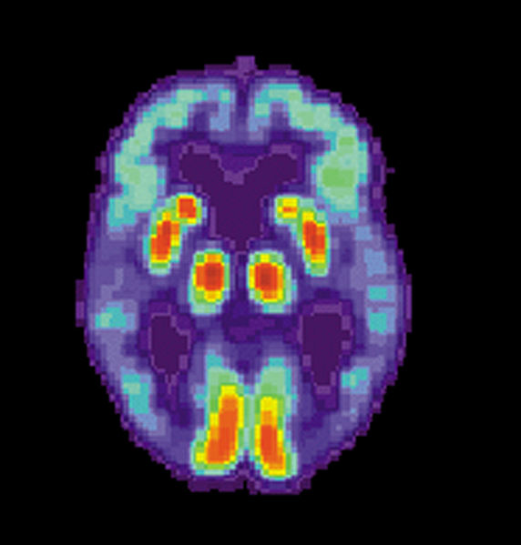
PET scan of the brain of a person with AD showing a loss of function in the temporal lobe

Slide 27
Treatment
DESIRED OUTCOMES
The primary goal of treatment in AD is to symptomatically treat cognitive difficulties and preserve patient function as long as possible.
Secondary goals include treating the psychiatric and behavioral sequelae that occur as a result of the disease.
Current AD treatments have not been shown to prolong life, cure AD, or halt or reverse the pathophysiologic processes of the disorder.

Slide 28
Pharmacological Intervention
In mild-moderate disease, consider therapy with a cholinesterase inhibitor:
Acetylcholinesterase inhibitors: prevent the breakdown of acetylcholine, a chemical messenger important for learning and memory
eg. Donepezil (Aricept)
Rivastigmine (Exelon)
Galantamine (Razadyne)

Slide 29
In moderate to severe disease, consider adding antiglutamatergic therapy:
N-Methyl d-aspartate Receptor Antagonist (NMDA)
E.g.: Memantine – blocks the NMDA receptor and inhibit their overstimulation by glutamate (neurotransmitter)
Antidepressents.
Anxiolytics.
Antipsychotics.
Anticonvulsants

Slide 30
Cholinesterase Inhibitors to enhance cholinergic activity in patients with AD by inhibiting the hydrolysis of acetylcholine through reversible inhibition of cholinesterase.
Tacrine was the first such drug. However, tacrine is fraught with significant side effects, including hepatotoxicity, that severely limit its usefulness. the use of tacrine has been replaced by the use of safer, more tolerable cholinesterase inhibitors.

Slide 31
Newer cholinesterase inhibitors donepezil, rivastigmine, and galantamine, show similar efficacy and are generally well tolerated.
The most frequent adverse events associated with these agents are mild to moderate gastrointestinal symptoms (nausea, vomiting, and diarrhea).
Other cholinergic side effects are generally dose-related and include urinary incontinence, dizziness, headache, syncope, bradycardia, muscle weakness, salivation, and sweating.
Gradual dose titration over several months can improve tolerability

Slide 32
Antiglutamatergic Therapy
Memantine is the only NMDA antagonist currently available.
Memantine blocks glutamatergic neurotransmission by antagonizing NMDA receptors.
Glutamate is an excitatory neurotransmitter in the brain implicated in long-term potentiation, a neuronal mechanism important for learning and memory.
By blocking NMDA receptors, excitotoxic reactions, which ultimately lead to cell death, may be prevented.

Slide 33
Memantine has been well tolerated in clinical trials. The most common adverse events associated with memantine include constipation, confusion, dizziness, headache, hallucinations, coughing, and hypertension.
Memantine is likely to be used as monotherapy and also in combination with cholinesterase inhibitors in patients with moderate to severe AD.
Memantine should be initiated at 5 mg once a day and increased weekly by 5 mg a day to the effective dose of 10 mg twice daily.

Slide 34
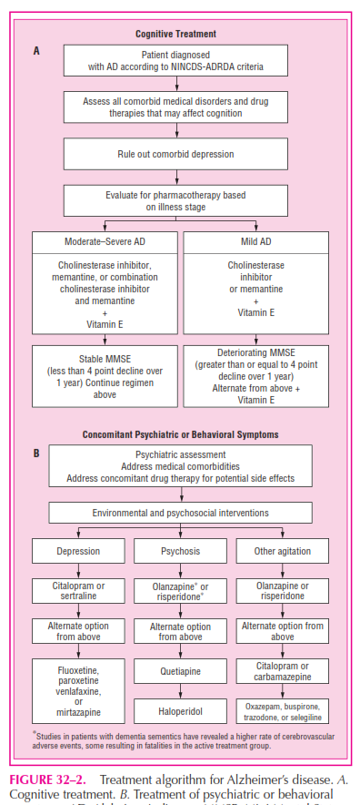

Slide 35
Non-conventional Pharmacologic Treatment
Vitamin E; The antioxidant vitamin E has been proposed as a treatment for AD because of the association of oxygen free radicals with AD
Estrogen; There is clinical evidence that loss of estrogen after menopause is associated with subclinical impairment in some aspects of neuropsychological function.
NASIDs; Antiinflammatory Agents Epidemiologic studies suggest a protective effect against AD in patients who have taken NSAIDs.
Statins; pravastatin and lovastatin, but not simvastatin, were associated with a lower prevalence of AD.
(3-hydroxy-3-methylglutaryl-CoA reductase inhibitors)

Slide 36
Non-conventional Pharmacologic Treatment
Ginkgo biloba; mechanisms of action in AD include:
increasing blood flow, decreasing the viscosity of blood
antagonizing platelet activating factor receptors
increasing tolerance to anoxia
inhibiting monoamine oxidase
Anti-infective properties
preventing the damage of membranes caused by free radicals.
Ginkgo biloba may also inhibit catecholamine-O-methyl transferase

Slide 37
Medications Used for Noncognitive Symptoms
Antipsychotics: Psychosis: (hallucinations, delusions, Disruptive behaviors: agitation, aggression)
Haloperidol, Olanzapine, Quetiapine, Risperidone, Ziprasidone
Antidepressants Depression: (poor appetite, insomnia, hopelessness, anhedonia, suicidal thoughts, agitation, anxiety)
Citalopram, Escitalopram, Fluoxetine, Paroxetine, Sertraline, Venlafaxine, Trazodone
Anticonvulsants : (Agitation or aggression)
Carbamazepine and Valproic Acid

Slide 38

Psychosocial intervention
Behavioral approach
Emotion oriented approach
-Remnisence therapy
-Validation therapy
-supportive psychotherapy
-sensory integration
-stimulated presence therapy
Cognition oriented approach
Stimulation oriented approach
snoezelen;

Slide 39
Caregiving
Since Alzheimer's has no cure and it gradually renders people incapable of tending for their own needs, caregiving essentially is the treatment and must be carefully managed over the course of the disease.

Slide 40
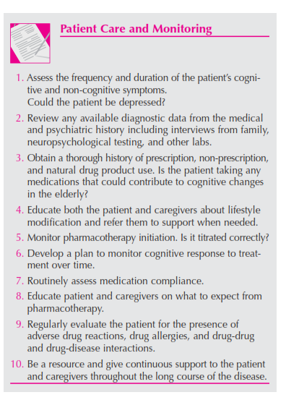

Slide 41


