Slide 1
Mixing (2)
Lab -8-

Slide 3
Depending upon relationship between shear rate and the applied shear stress, the fluids may be divided into
Newtonian Fluids
Non-Newtonian Fluids

Slide 4
Liquid mixing mechanisms
Bulk transport
Turbulent flow
Laminar flow
Molecular diffusion

Slide 5
1. Bulk transport
The movement of relatively large portion of material being mixed from one location in the system to another.
Bulk transport accomplished by means of paddles, revolving blades, or other devices within the mixer arranged so as to move adjacent volumes of fluid in different direction (3D shuffling).

Slide 6
2. Turbulent mixing
It is a direct result of turbulent fluid flow which is characterized by a random fluctuation of the fluid velocity at any given point within the system.
In turbulent flow, the fluid has a different instantaneous velocities at different location at same instant in time.
Turbulent flow visualized as (eddies) with various sizes [portion of fluid moving as a unit in a direction contrary to that of general flow]. Larger eddies breakup forming smaller and smaller size eddies until are no longer distinguished.

Slide 7
3. Laminar mixing
Streamline or laminar flow is frequently encountered when highly viscous fluid are being processed.
occur with gentle stirring and adjacent to stationary surfaces in vessels where turbulent flow is predominant.
when two dissimilar liquids are mixed through laminar flow, the shear generated stretches the interface between them.

Slide 8
4. Molecular diffusion
Mixing at the molecular level by diffusion resulting from thermal motion of molecules.
Occurs in conjugation with laminar flow that tends to reduce sharp discontinuities at the interface between the fluid layers which leads to complete mixing after sufficient time.

Slide 9
Equipments
Equipments
A-Batch mixing
Impellers
Air stream
B-Continuous mixing
Liquid jet

Slide 10
A. Batch Mixing
Parts
Tank or container
energy supplier
Mixing is limited in volume contained in suitable mixer
Also used to direct the flow within vessel like baffles, Vanes or ducts
Liquid jet
Impellers
Air straem

Slide 11
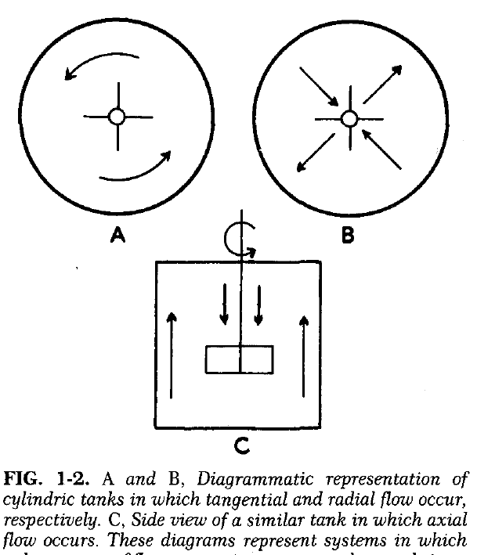
Impeller types
Types of impeller depend on
1- type of flow (radial, axial, tangential)
2- shape and pitch of blades

Slide 12
Impeller types
Propellers
produce flow parallel to their axis.
Turbine
produce axial or tangential flow or combination
blades have constant pitch throughout their length and used for very viscous liquids.
Paddles
Circulation is primarily tangential
Operate at a very low speed and used to mix low viscosity liquids and semisolids.
- High efficient with low viscosity liquids

Slide 13
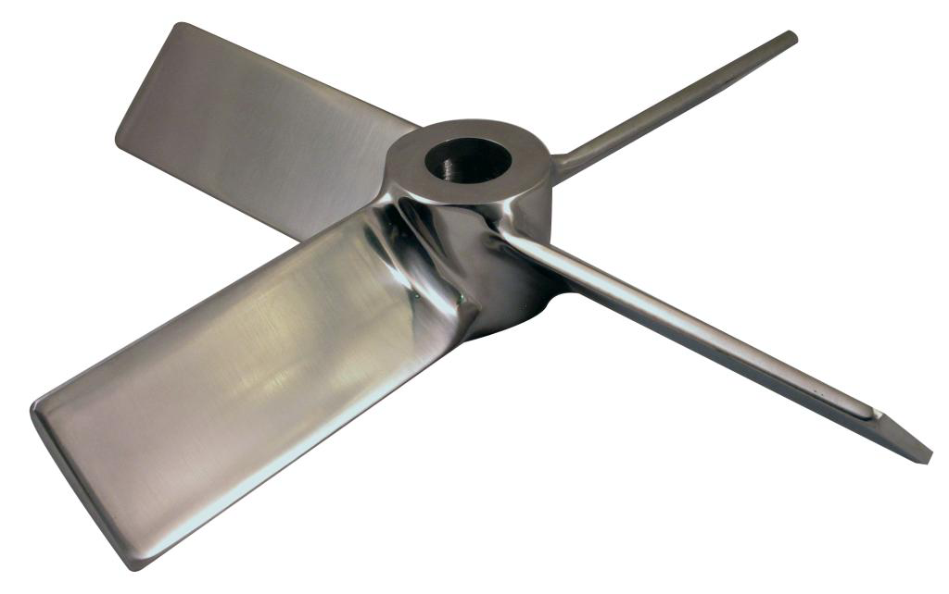
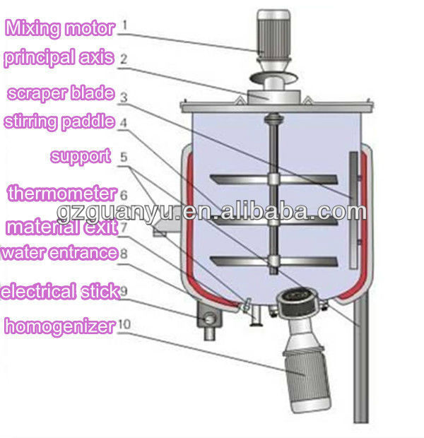
Impeller types

Slide 14
Factors affecting mixer selection
1. Physical properties of material to be mixed (density, viscosity and miscibility).
2. Economic consideration regarding processing (time for mixing and powder expenditure).
3. Cost of equipment and its maintenance.

Slide 15
Mixers in polyphase systems
Liquid –liquid mixing
Mixing of two immiscible liquids requires subdivision of one of the phases into globules which then distributed throughout bulk of fluid forming a stable emulsion.
Solid-liquid mixing
Mixing of Finely divided solid with liquid of low viscosity in the production of suspension depends on separation of aggregates into primary particles and the distribution of these particles throughout the fluid.

