Slide 1
Lecture 5
Delivery of Proteins:
Routes of Administration and Absorption Enhancement

Slide 2
The parenteral Route of Administration
Parenteral administration is defined as administration via those routes where a needle is used, including intravenous (IV), intramuscular (IM), subcutaneous (SC) and intraperitoneal (IP) injections.
The blood half-life of biotech products can vary over a wide range.
For example, the circulation half-life of t-PA is a few minutes, while monoclonal antibodies (MAB) have half-lives of a few days

Slide 3
One reason to develop modified proteins through site directed mutagenesis
To enhance circulation half-life.
By expanding the mean residence time for short half-life proteins (switch from IV to IM or SC administration).
1- changes in disposition,
2- with a significant impact on the therapeutic performance of the drug.

Slide 4
The term site-directed mutagenesis or protein engineering :
facilitates the generation of engineered therapeutic proteins displaying some clinical advantage over the native protein product.
Techniques such as site-directed mutagenesis facilitate the logical introduction of predeﬁned changes in a protein’s amino acid sequence. Such changes can be as minimal as the insertion, deletion or alteration of a single amino acid residue, or can be more substantial (e.g. the alteration/deletion of an entire domain, or the generation of a novel hybrid protein).
This is made by controlled alteration of the nucleotide sequence coding for the polypeptide of interest such that speciﬁc, predetermined changes in amino acid sequence are introduced.. Site-directed mutagenesis is now most often undertaken by using a variant of the basic PCR method, known as ‘overlap PCR’, in which primers of altered nucleotide sequences are used for the PCR reactions.

Slide 5
These changes are related to:
The prolonged residence time at the IM or SC site of injection compared to IV administration
enhanced exposure to degradation reactions (peptidases).
Differences in disposition.

Slide 6
Regarding point 1 (Prolonged residence time at IM or SC site of injection and the enhanced exposure to degradation reactions.)
A- For instance, diabetics can become “insulin resistant” through high tissue dipeptidyl peptidase {DPP-IV} activity .
B- Other factors that can contribute to absorption variation are related to differences in exercise level of the muscle at the injection site.
C- The state of the tissue, for instance the occurrence of pathological conditions, may be important as well.

Slide 7
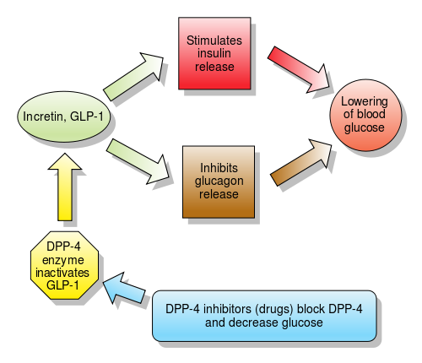
Inhibit pancreatic β-cell apoptosis and stimulate the proliferation and differentiation of insulin-secreting β-cells
By
Engagement of a specific G protein-coupled receptor

Slide 8
Regarding point 2 (Differences in disposition).
Upon administration, the protein may be transported to the blood circulation
or
through the lymphatics
through the capillary wall at the site of injection.
Note: The fraction of the administered dose taking this lymphatic route is molecular weight dependent.

Slide 9
Routes of uptake of SC or IM injected drugs
Blood
Capillary wall
Low Mwt drugs
Site of injection
lymph
High Mwt drugs

Slide 10
Molecular weight of different proteins
rIFN alpha-2a (Mw 19 kDa)
Cytochrome C (Mw 12.3 kDa)
Inulin (Mw 5.2 kDa)
FUdR (Mw 256.2 Da)
The following Figure shows:
Cumulative recovery in the efferent lymph from the right popliteal lymph node following SC administration into the lower part of the right hind leg of sheep

Slide 11
Correlation between the molecular weight and cumulative recovery

Slide 12
Lymphatic transport takes time (hours) and uptake in the blood circulation is highly dependent on the injection site.
On its way to the blood, the lymph passes through draining lymph nodes and contact is possible between lymph contents and cells of the immune system such as macrophages, B- and T-lymphocytes residing in the lymph nodes.

Slide 13
The Oral Route of Administration
Oral delivery of protein drugs would be preferable because:
It is patient friendly
No intervention by a healthcare professional is necessary to administer the drug.
Not Preferable:
Oral bioavailability is usually very low.

Slide 14
The two mean reasons for failure of uptake after oral administration
Protein degradation in the gastrointestinal (GI) tract.
Poor permeability of the wall of the GI tract in case of a passive transport process.

Slide 15
Regarding point 1 (protein degradation in the GI tract).
The human body has developed a very efficient system to break down proteins in our food to amino acids, or di- or tri-peptides.
These building stones for body proteins are actively absorbed for use wherever necessary in the body.

Slide 16
In the stomach pepsins (a family of aspartic proteases) are secreted. They are particularly active between pH 3 and 5 and lose activity at higher pH values.
Pepsins are endopeptidases capable of cleaving peptide bonds distant from the ends of the peptide chain. They preferentially (cleave peptide bonds between two hydrophobic amino acids).

Slide 17
Other endopeptidases are active in the GI tract at neutral pH values, e.g., trypsin, chymotrypsin, and elastase.
They have different peptide bond cleavage characteristics that more or less complement each other.
Exopeptidases, proteases degrading peptide chains from their ends, are present as well. Examples are carboxypeptidase A and B.

Slide 18
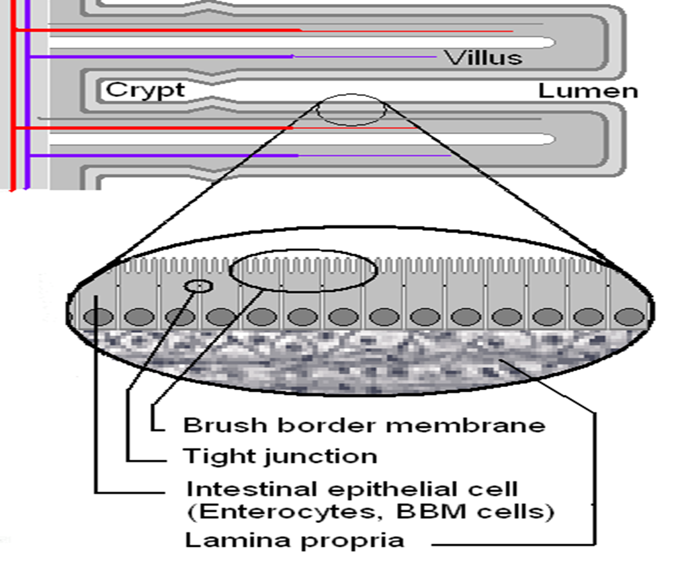
In the GI lumen the proteins are cut into fragments that effectively further break down to amino acids, di- and tri-peptides by brush border (microvillus) and cytoplasmic proteases of the enterocytes (intestinal absorptive cells).

Slide 19
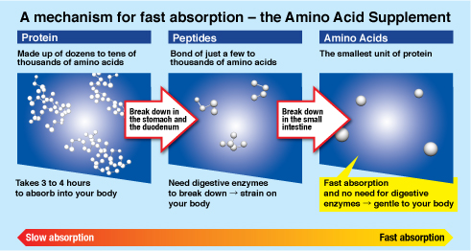

Slide 20
Regarding point 2 (permeability).
High molecular weight molecules do not readily penetrate the intact and mature epithelial barrier if diffusion is the sole driving force for mass transfer.
Their diffusion coefficient decreases with increasing molecule size.
Protein are no exception to this rule.
Active transport of intact therapeutic recombinant proteins over the GI-epithelium has not been described yet.

Slide 21
Conclusion
The above analysis leads to the conclusion that nature, unfortunately, does not allow us to use the oral route of administration for therapeutic protein if high (or at least constant) bioavailability is required.

Slide 22
However, for the category of oral vaccines the above-mentioned hurdles (walls) of degradation and permeation are not necessarily prohibitive.
Ex: For oral immunization, only a (small) fraction of the antigen (protein) has to reach its target site to elicit an immune response.

Slide 23
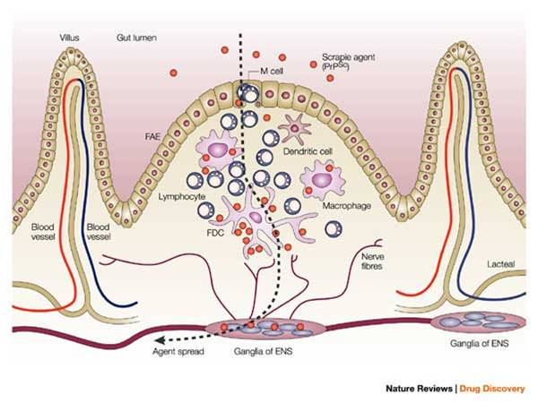
The target cells are B-lymphocyte cells that produce secretory IgA antibodies.
and antigen presenting accessory cells located in Peyer’s patches (macroscopically identifiable follicular structures located in the wall of the GI tract).

Slide 24
Peyer’s patches are overlaid with microfold (M) cells (separate the luminal contents from the lymphocytes).
These M cells have little lysosomal degradation capacity and allow for antigen sampling by the underlying lymphocytes.
Moreover, mucus producing goblet cell density is reduced over Peyer’s patches.
This reduces mucus production and facilitates access to the M cell surface for luminal contents.

Slide 25
Attempts to improve antigene delivery via the Peyer’s patches and to enhance the immune response are made by using microspheres, liposomes or modified live vectors, such as attenuated bacteria and viruses.

