Slide 1
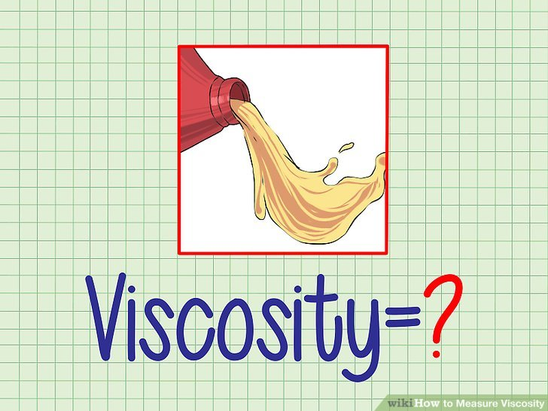
Physical pharmacy
Lab (6)
Viscosity

Slide 2
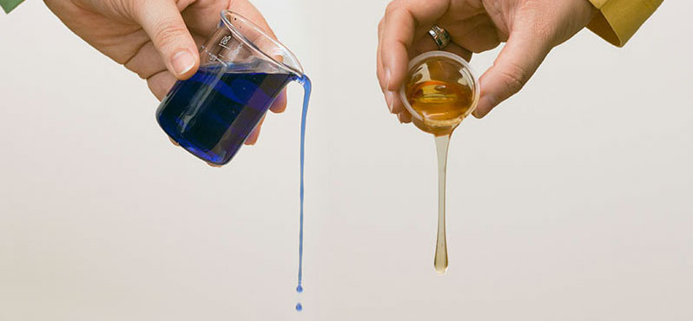
Viscosity: is an expression of the resistance to flow of a system under an applied stress. The more viscous a liquid ,the greater the applied force is required to make it flow at a particular rate. This lab is concerned with the flow properties of dilute colloidal systems and the manner in which viscosity data can be used to obtain the molecular weight of material comprising the disperse phase. Viscosity studies also provide information regarding the shape of the particles in solution.

Slide 3
Materials classify according to the type of flow and deformation into:
Newtonian. 2- Non Newtonian systems.
The classification depends on whether or not their flow properties are according to the Newton's law of flow.
Example of Newtonian system: water or any simple liquid (gelatin solution, olive oil, glycerin, castor oil, chloroform, ethyl alcohol).
Example of Non Newtonian system: complex liquid or systems which contain polymers ( colloidal solution, emulsion, liquid suspension and ointments).

Slide 4
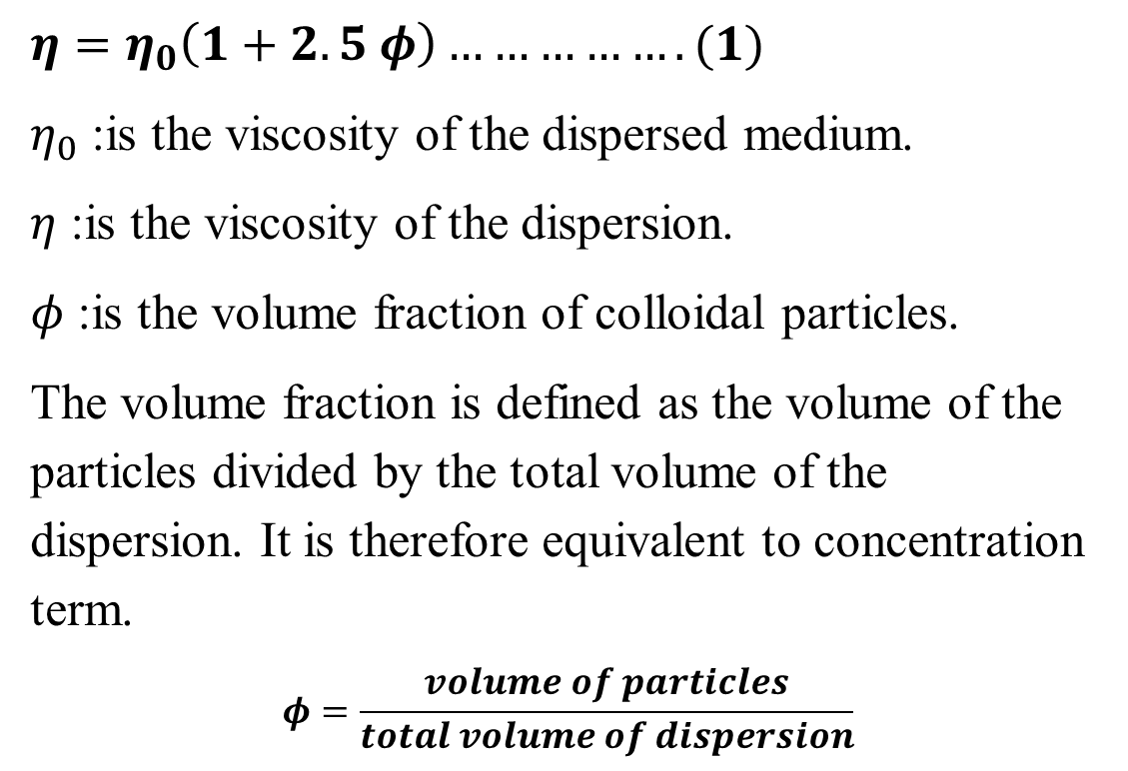
Einstein equation
$η=η_{0}\left(1+2.5 φ\right)…………….(1)$
$η_{0}$ :is the viscosity of the dispersed medium.
$η$ :is the viscosity of the dispersion.
$φ$ :is the volume fraction of colloidal particles.
The volume fraction is defined as the volume of the particles divided by the total volume of the dispersion. It is therefore equivalent to concentration term.
$$φ=\frac{volume of particles}{total volume of dispersion}$$

Slide 5
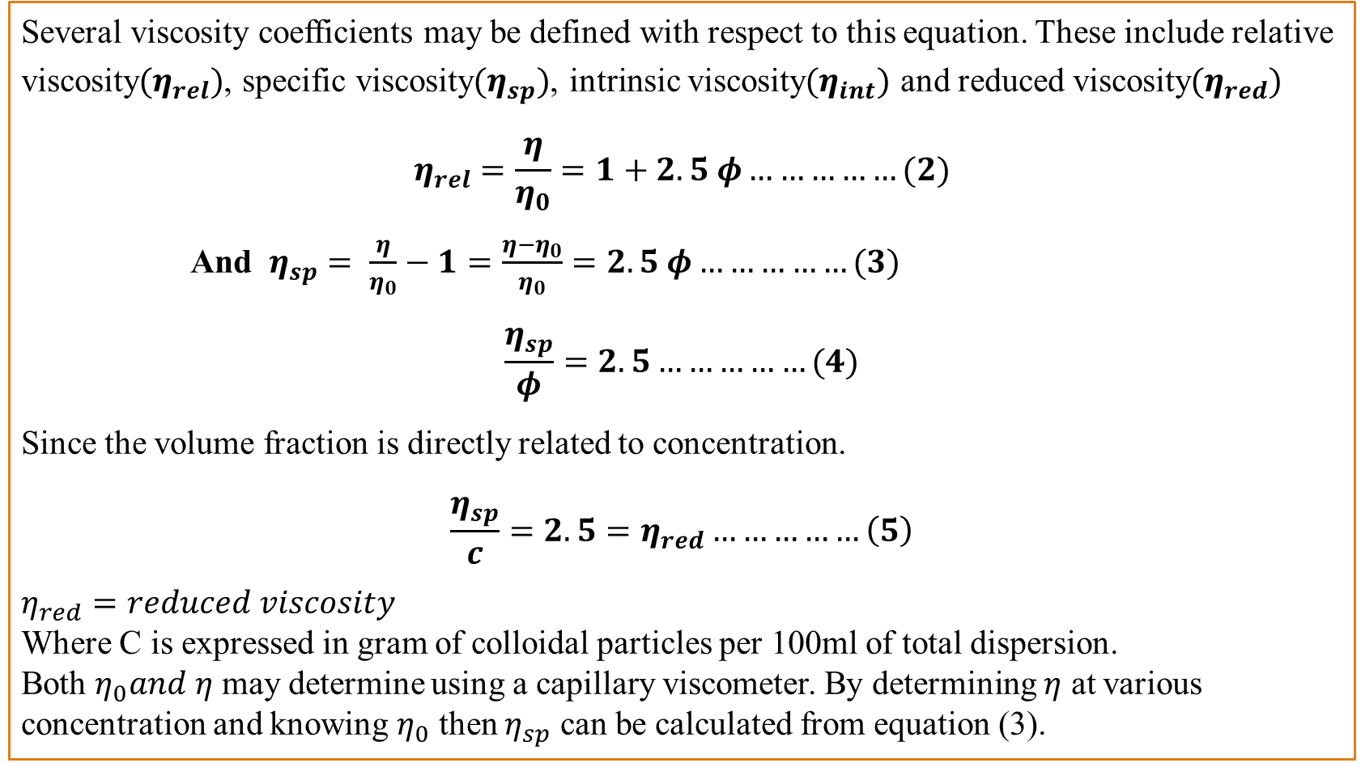
Several viscosity coefficients may be defined with respect to this equation. These include relative viscosity$(η_{rel})$, specific viscosity$(η_{sp})$, intrinsic viscosity$(η_{int})$ and reduced viscosity$(η_{red})$
$$η_{rel}=\frac{η}{η_{0}}=1+2.5 φ……………(2)$$
And $η_{sp}= \frac{η}{η_{0}}−1=\frac{η−η_{0}}{η_{0}}=2.5 φ……………(3)$
$$\frac{η_{sp}}{φ}=2.5……………(4)$$
Since the volume fraction is directly related to concentration.
$$\frac{η_{sp}}{c}=2.5=η_{red}……………\left(5\right)$$
$η_{red}=reduced viscosity$ Where C is expressed in gram of colloidal particles per 100ml of total dispersion. Both $η_{0}and η$ may determine using a capillary viscometer. By determining $η$ at various concentration and knowing $η_{0}$ then $η_{sp}$ can be calculated from equation (3).

Slide 6
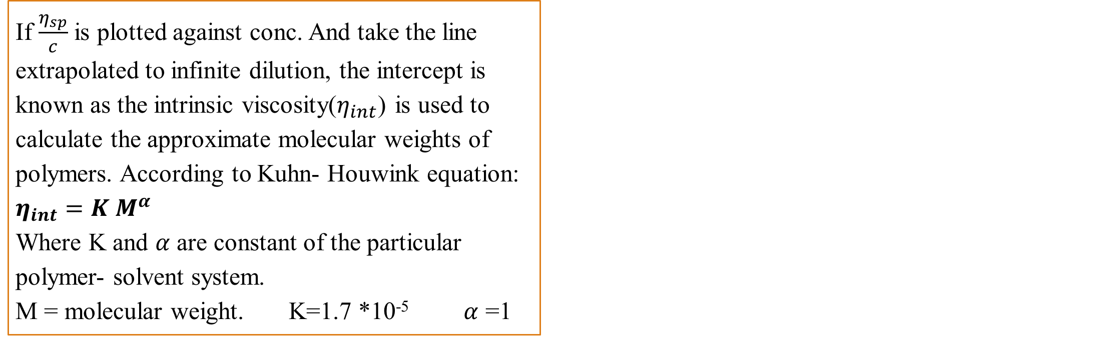
If $\frac{η_{sp}}{c}$ is plotted against conc. And take the line extrapolated to infinite dilution, the intercept is known as the intrinsic viscosity($η_{int}$) is used to calculate the approximate molecular weights of polymers. According to Kuhn- Houwink equation: $η_{int}=K M^{α}$ Where K and $α$ are constant of the particular polymer- solvent system. M = molecular weight. K=1.7 *10⁻⁵ $α$ =1
Figure (1)

Slide 7
For high polymeric materials dispersed in the medium, the equation is expressed as:
K1= intrinsic viscosity, K2= Huggins constant is referred to as the Huggins constant a+nd is equal to the slope of the plot as shown in the figure (1).
Its value gives an indication of the interaction between the polymer and the solvent such that a positive slope is produced for a polymer which interacts weakly with the solvent and the slope becomes less positives as the interaction increases. A change in the value of the Huggins constant can be used to evaluate the interaction of drug molecules with polymers.

Slide 8
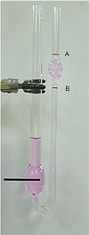
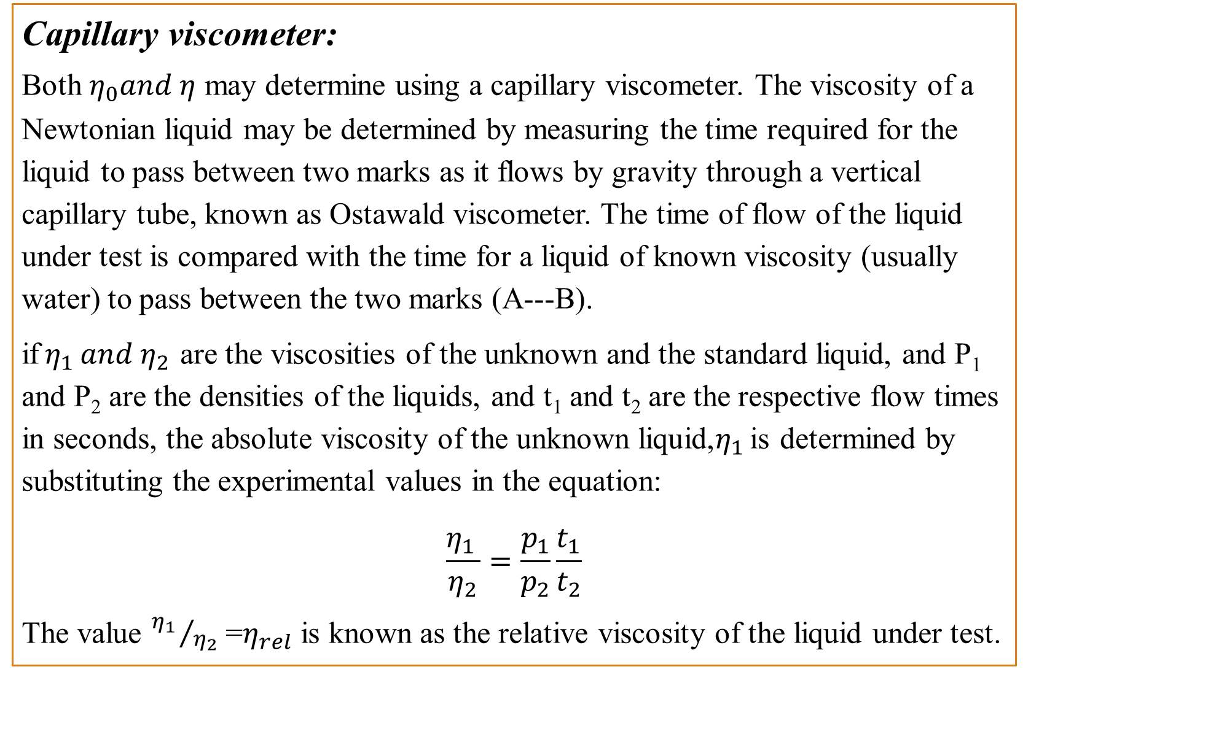
Capillary viscometer: Both $η_{0}and η$ may determine using a capillary viscometer. The viscosity of a Newtonian liquid may be determined by measuring the time required for the liquid to pass between two marks as it flows by gravity through a vertical capillary tube, known as Ostawald viscometer. The time of flow of the liquid under test is compared with the time for a liquid of known viscosity (usually water) to pass between the two marks (A---B).
if$η_{1 }and η_{2}$ are the viscosities of the unknown and the standard liquid, and P₁ and P₂ are the densities of the liquids, and t₁ and t₂ are the respective flow times in seconds, the absolute viscosity of the unknown liquid,$η_{1 }$is determined by substituting the experimental values in the equation:
$$\frac{η_{1 }}{η_{2}}=\frac{p_{1}}{p_{2}}\frac{t_{1}}{t_{2}}$$
The value ${η_{1 }}/{η_{2}}$ =$η_{rel}$ is known as the relative viscosity of the liquid under test.

Slide 9
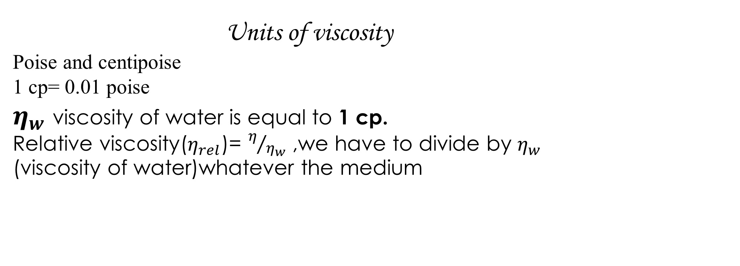
Units of viscosity
Poise and centipoise 1 cp= 0.01 poise
$η_{w}$ viscosity of water is equal to 1 cp.
Relative viscosity($η_{rel}$)= $η/{η_{w}}$ ,we have to divide by $η_{w}$ (viscosity of water)whatever the medium
Experimental work
Part l: bring water, glycerin, 1% gelatin solution and prepare volumetric flask (50cc), pipette, capillary viscometer (suspended level viscometer).

Slide 10
Part ll:
A: To determine the concentration of unknown.
Procedure: 1. Prepare different concentrations w/w of glycerin in water 2%, 5%, 10%, 15%, 20% and 25% (50 ml of each one)
2. Measure the 𝜂 of these solutions by the viscometer knowing the density of each solution 1.003, 1.005, 1.018, 1.03, 1.037, 1.044 respectively. Then find 𝜂𝑟𝑒𝑙 and draw curve by plotting 𝜂𝑟𝑒𝑙 against conc. (w/w).
3. Find out the concentration of unknown from the curve by measuring its 𝜂𝑟
4. The line started from 1 since the viscosity of water is equal to 1 cp. The density of glycerine is 1.26 and water = 1.

Slide 11
Part ll:
B: To determine the radius of particle by plotting 𝜂𝑟𝑒𝑙 against molar concentration
Procedure: Prepare different concentrations of glycerine (w/v) then find 𝜂𝑟𝑒𝑙 of each concentration. Finally, find the radius from slope.

Slide 12
Part ll:
C: To find the molecular weight of gelatine
Procedure: 1. Prepare 50ml different concentration of gelatine (w/v) 0.2%, 0.4%, 0.6%, 0.8% from 1% (w/v) gelatine stock solution.
2. Find the 𝜂 𝑎𝑛𝑑 𝜂𝑟𝑒𝑙 of each solution by using viscometer knowing that the density of each solution are 1.05, 1.08, 1.11, 1.2 respectively.
3. Plot 𝜂𝑠𝑝 which is equal to (𝜂𝑟𝑒𝑙 -1)/ concentration versus concentration (w/v) the resulted line is then extrapolated to infinite dilution to find the intrinsic viscosity which is equal to intercept of line with y axis.
4. Find the molecular weight of gelatine from the equation
𝜂𝑖𝑛𝑡=𝐾 𝑀𝛼 , K=1.7 *10-5𝛼 =1.

