Slide 1

Mixing
Lab 7

Slide 2
Definition
Mixing
A process that results in a randomization of dissimilar particles within a system.

Slide 3
Solid Mixing and their mechanisms

Slide 4

The variables effecting solid mixing:
1- Particle size and particle size distribution (Particles with P.S. <100 Micron is free flowing)
2- Particle density, elasticity, surface roughness and shape.

Slide 5
Mixing mechanisms
Solid mixing proceeds by the combination of one or more mechanism:
Convective mixing
Shear mixing
Diffusive mixing

Slide 6
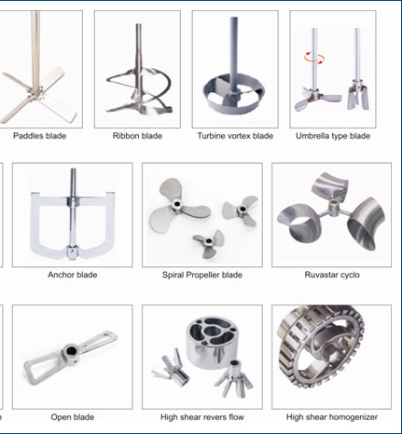
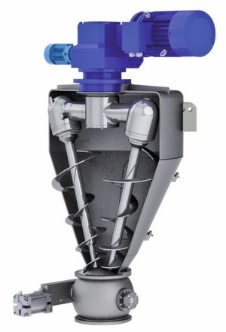
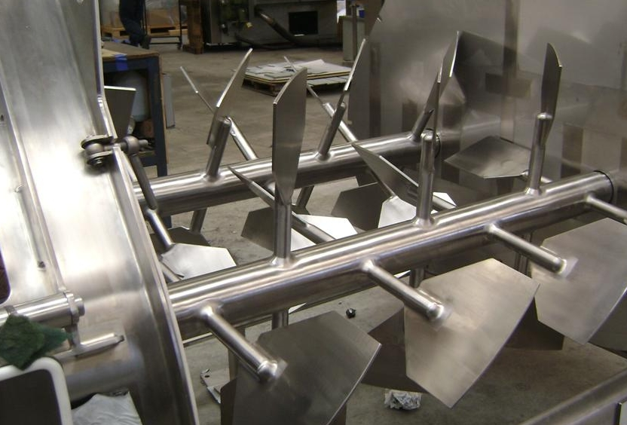
1. Convective mixing
Mechanism analogous to bulk transport
Convective (bulk) mixing occurred by: Inversion of powder bed
By the aid of:
A- Blades or peddles
B- Revolving screw
C- Any method of moving large mass of material from one part of powder bed to another.

Slide 7
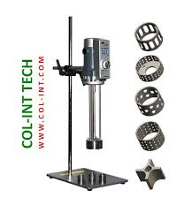
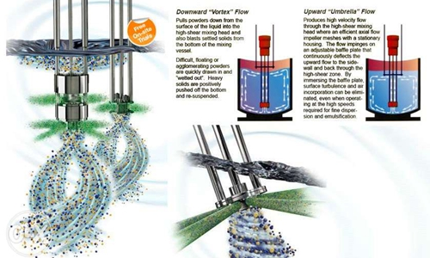
2. Shear mixing
As a result of forces within mass
slip planes
Depending on the flow characteristic of powder, that can occur in such a way to give rise to [laminar flow]
When shear occurs between regions of different composition and parallel to their interface.
Reduce the scale of segregation by thinning the dissimilar layers

Slide 8
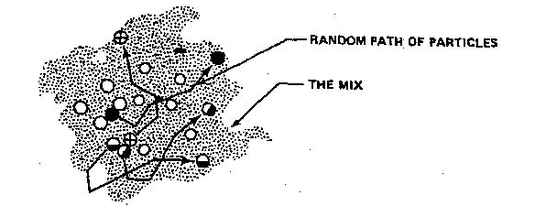
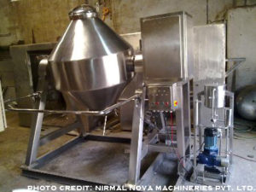
3- Diffusive mixing
Random motion of particles within a powder bed
Change position by single particles relative to one another
Reduction intensity of segregation

Slide 9
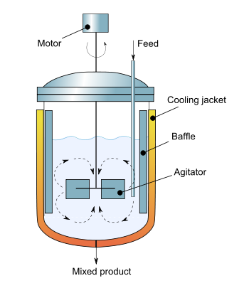
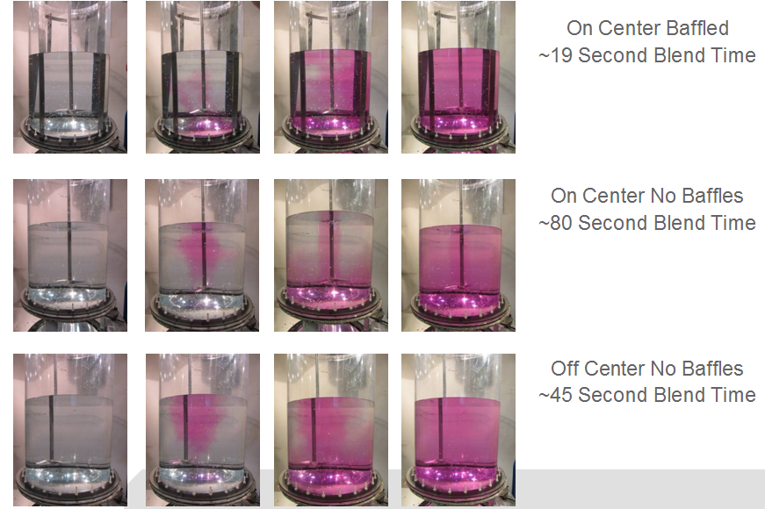
Equipment For solid mixing
Batch Mixing
Mixers consist of containers of one or several geometric forms (mounted and rotated about an axis).
Tumbling motion by baffles or by virtue of shape of container

Slide 10
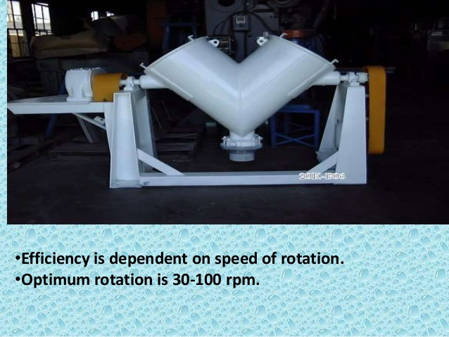
1- twin-shell blender/tumbling mixers
(form V-shape mixers)
Effective because it mechanism of mixing is:
Bulk transport and shear.
Efficiency is dependent on speed of rotation.
Optimum rotation (30 - 100 rpm)

Slide 11

2- Stationary container type:
Employs stationary container to hold the material and bring mixing by moving screws, peddles or blades.
Useful in mixing solids that have been wetted and therefore are in sticky or plastic state.

Slide 12
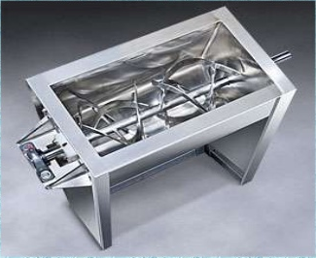
Well know mixers include:
Ribbon blender (consist of horizontal cylidrical tank usually opening at the top and fitted with helical blades).
{Blades mounted on the shaft through the long axis of tank and have both right and left hand twist}

Slide 13
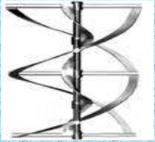
Helical flight mixers
      Powders are lifted by a centrally located vertical screw and allowed to cascade to the bottom of the tank.

Slide 14
Mixer selection
Mixer selection and evaluation depend on:
1- Measuring degree of mixing
[according to the function of mixer that indicates the uniformity of powder bed].
2- Power requirements
[power required to produce good mixture with appropriate time]
Since long mixing time unmixing and segregation
{1- improper mixing operation or wrong mixer or both}
{2- after prolong mixing the milling occur because of abrasion of particles}
Due to

Slide 15


