Slide 1
Milling
Lab-6-

Slide 2
Introduction
Crushing
Disintegration
Dispersion
Grinding
Pulverization
Milling: Is a mechanical process of reducing particle size of solids.
Milling also termed synonymously as comminution which represent:
All of these depend on product, equipment and process.

Slide 3
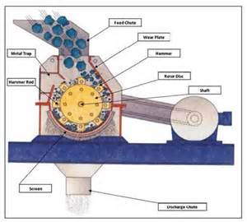
Introduction- Milling equipment
Milling equipment classified according to the size of the milled product into:
Coarse milling (particles > 20-mesh)
Intermediate (particles 200- 20 mesh [74-840 micron])
Fine (particles < 200 mesh)
Note: Size expressed in term of mesh (number of openings per linear inch of a screen).

Slide 4
Pharmaceutical Applications
1- Increasing therapeutic efficacy of low solubility drugs due to increasing specific surface area (S.A per unit wt) increasing area of contact with dissolving fluid, e.g griseofulvin.
2- Facilitate drying of wet masses due to increase surface area and reduce the distance the moisture travel within particle to reach outer surface, e.g granulation of wet mass in tablet preparation.
3- Facilitate easier and uniform mixing or blending
The ingredients are approximately of same size.

Slide 5
Pharmaceutical Applications
4- Solid dosage form that is artificially colored are often milled (to ensure that the mixture is not mottled and is uniform from batch to batch).
5-Lubricants should be milled to fine powder (to ensure their ability to coat surface of powder or granules).
6- Milling in ointments, creams and pastes provide smooth texture, better appearance and improve physical stability.

Slide 6
Size Distribution and Measurement
In naturally occurring particulate solids and milled solids
The shape of particle is irregular, and size varies from largest to smallest size
Size distribution used instead of particle size
Which represents % frequency of each particle size (i.e what size present in what proportion)
%
Bell shape structure

Slide 7
Methods of Measurement of Size Distribution
1- Microscopy
2- Sieving
3- Sedimentation
4- Other methods (sorption, electrical conductivity, light and x-ray scattering, permeametry, and particle trajectory).

Slide 8
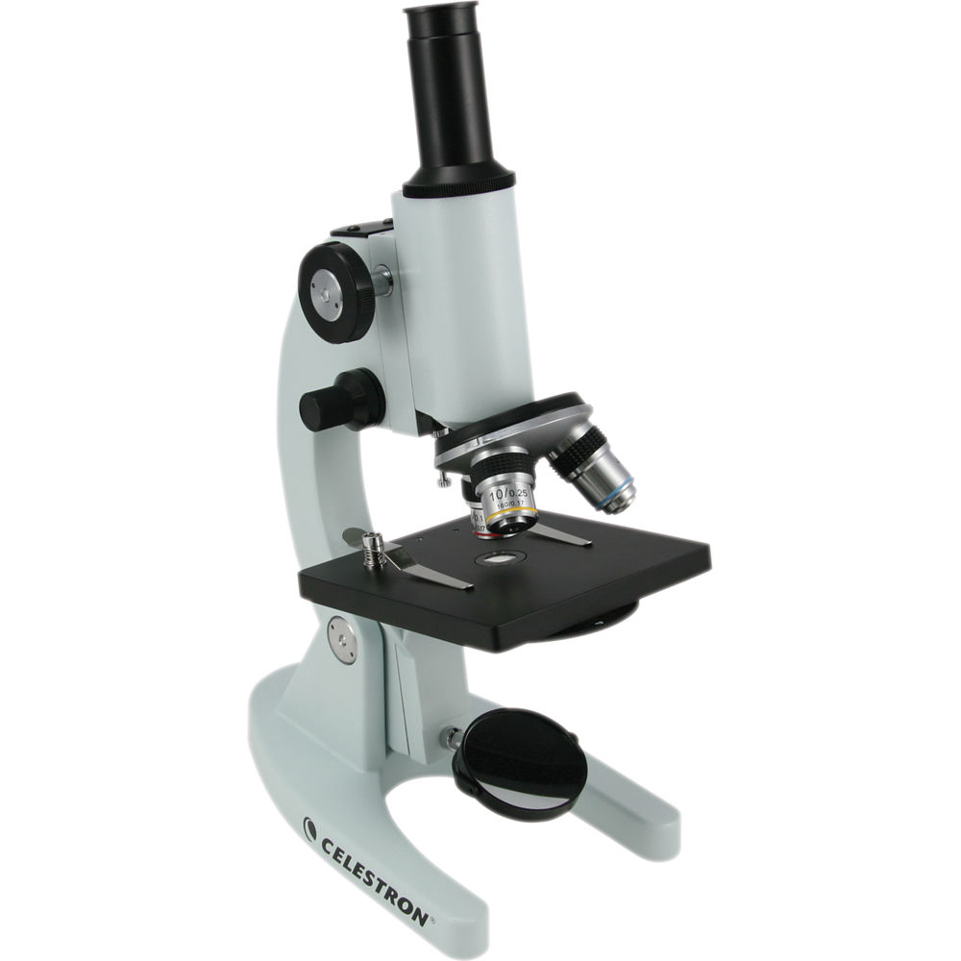
1- Microscopy
Direct Method for measuring P.S. distribution.
Disadvantages: can’t resolve particles if it’s size is close to the wave length of the light source.

Slide 9
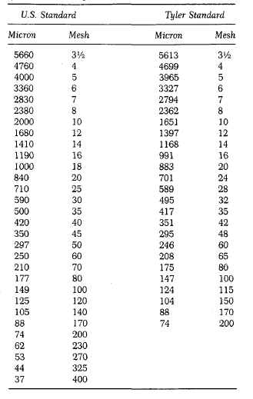
2- Sieving
It is pan with bottom of wire cloth with square openings.
Most widely method for measuring P.S. distribution.
Advantages: Inexpensive, simple, rapid, limited variation between operators.

Slide 10
2- Sieving
Measuring diameter of powder bypass series of sieves:
30-mesh and retained on 45-mesh (diameter= 590 + 350)/2 or 470 microns.
Size of distribution effected by
1- No. of Sieves
(by passing powder through series of smaller sieves and weighing portion retained on each sieve).
2- Motion of sieve (vibratory, side-tap, bottom-tap, rotary-tab, rotary).
3- Time of sieving.
4- Load or thickness of powder (proportional to time).

Slide 11
Milling operations
A- open-circuit milling:
Materials is reduced to the desired size by passing it through the mill.
B- closed-circuit milling:
Materials discharge from mill pass through classifier or size-separation device, and the oversize are returned to the grinding chamber for further reduction in size.

Slide 12
Parts of mills
2- Grinding part (milling chamber)
3- Discharge part (Receiver)
1- Feed part

Slide 13
Important Note
The rate of discharge should be equal to the rate of feed.
A- If rate of feed is slow
B- If rate of feed is fast
the product discharge readily and the amount of undersize or fines is minimized.
the material remain in the milling chamber for long time because its discharge is impeded by large amount of material leads to greater size reduction and lower mill capacity.

Slide 14
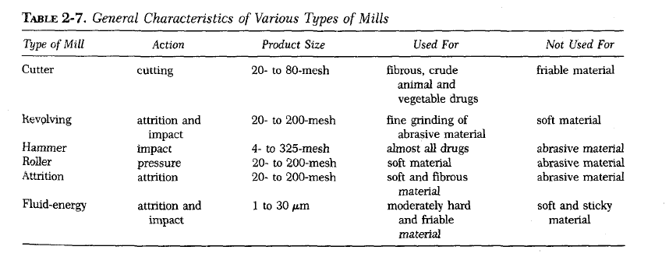
Types of Mills

Slide 15
Mechanism of size reduction
Cutting: materials cut by sharp blades
Compression: materials is crushed by pressure.
Impact: stationary materials hit moving materials at high speed or strikes a stationary surface (case of machine) shatters of materials to small pieces.
Attrition: materials subjected to pressure and surfaces are moving relative to each other shear forces which breaks particles.

Slide 16
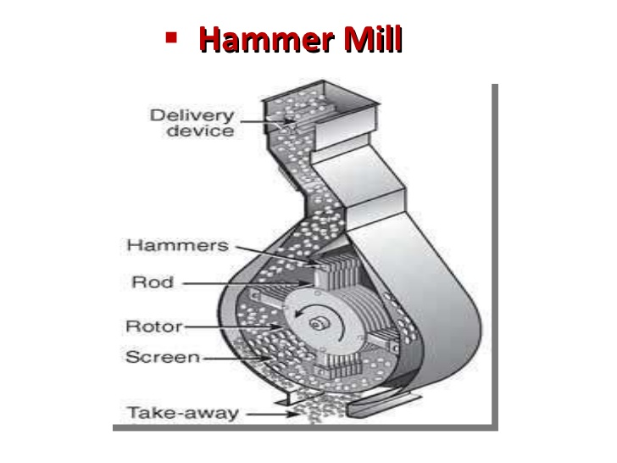
Hammer mill
Principle:
Operates as an impact between rapidly moving hammers mounted on the rotor and the powder material.
Used for almost any type of size reduction (dry material, wet filter-press cakes, ointment, slurries).
It is popular in pharmaceutical industry because of versatility

Slide 17
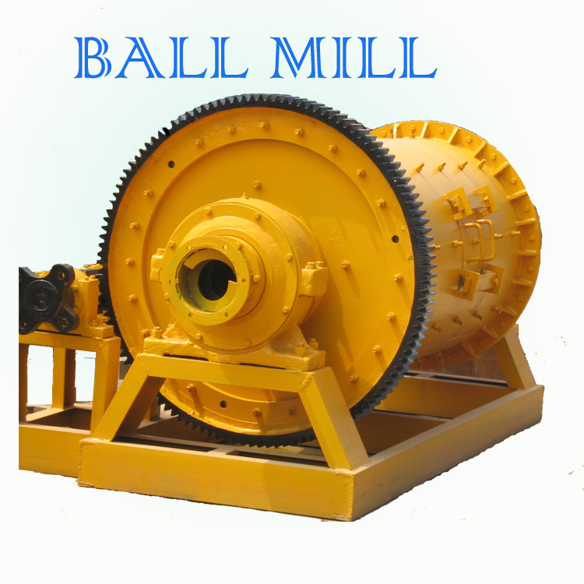
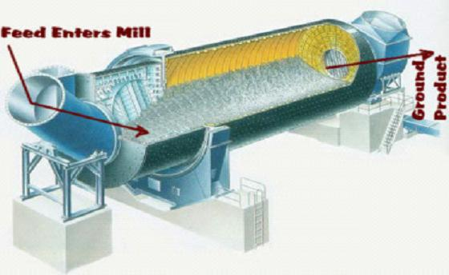
Ball mill
Principle:
Combination of impact and attrition.
A horizontal rotating hollow vessel of cylindrical shape filled with balls of steel or pebbles (grinding medium).
It includes
A- Pebble mill
B- Rods or bars mill

Slide 18
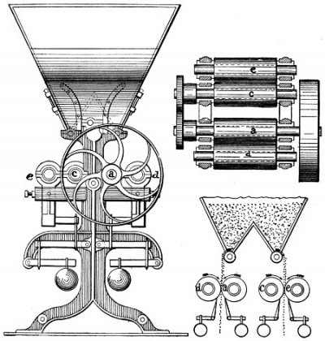
roller mill
Principle:
combination of compression and shearing action.
Mechanism of action:
2-5 smooth rollers operating at different speed.

Slide 19
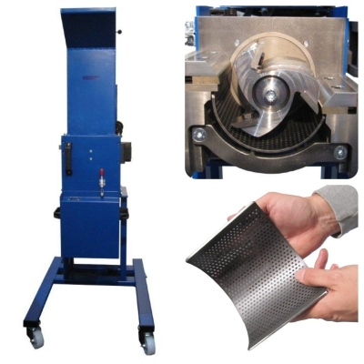
cutting mill
Principle: cutting and shearing action
Uses: for fibrous and tough material.
Types: single and double runner disc mills.

Slide 20


