Slide 1
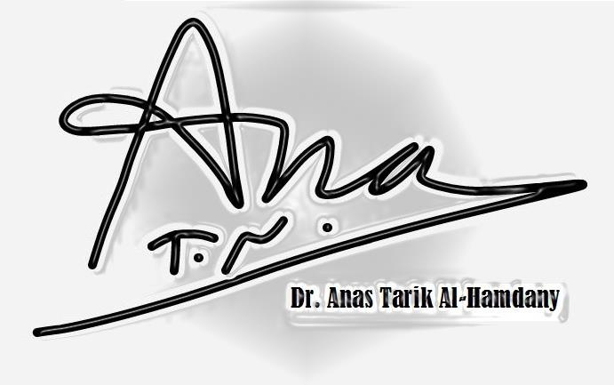
Industrial Pharmacy
Sterilization
Part 2

Slide 2
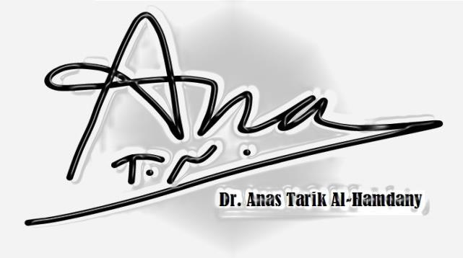
Moist Heat
It is more effective than dry heat for thermal sterilization.
But: normal moist heat cycles do not destroy pyrogens.
Moist heat causes the coagulation of cell protein at a much lower temperature than dry heat. How????
1- Thermal capacity of steam is much greater than that of hot air.
At the point of condensation (dew point), steam liberates thermal energy equal to its heat of vaporization.
[540 calories per gram at 100°C and 524 calories per gram at 121°C].
While heat energy liberated by hot dry air is equivalent 1 calorie per gram of air for each 1°C of cooling.
The object is heated much more rapidly by steam.
Thus

Slide 3
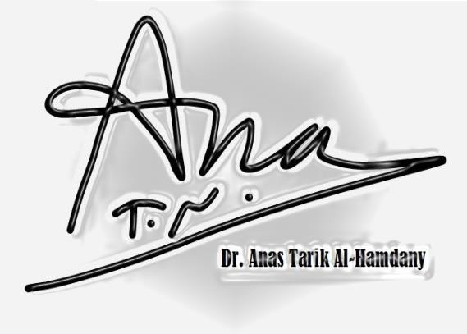
Continue moist Heat
2- Steam under pressure is employed
Rapidly change in heat-laden vapor that is applied to the object being heated.
A- Pressure under which steam is applied.
B- Partial vacuum produced at the site where steam is condensed.
shrinks in volume by about 99% as it condenses.
This is due to
Application of moist heat is the Autoclave

Slide 4
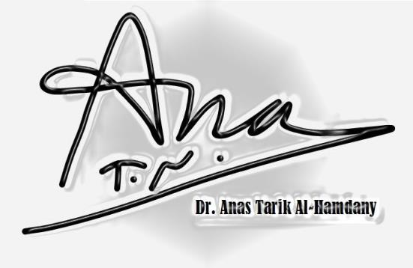
Air Displacement in autoclave
The density of steam is lower than that of air
Steam enters an autoclave chamber and rises to the top, displacing air downward.
[Objects must be placed in the chamber with adequate circulation space around each object air can be displaced downward and out of the exhaust line from the chamber]
Note: 1- Any trapped air in containers with continuous sides and bottoms or in tightly wrapped packs, prevents penetration of the steam to these areas and thus prevents sterilization
The air trapped in this manner is heated to the temperature of the steam.
2- Hot air in oven at a temp. of 120°C requires a cycle time of 60 hrs to ensure a lethal effect on spores thus 20-min exposure at this temp. with hot dry air would be inadequate.
Solution???

Slide 5
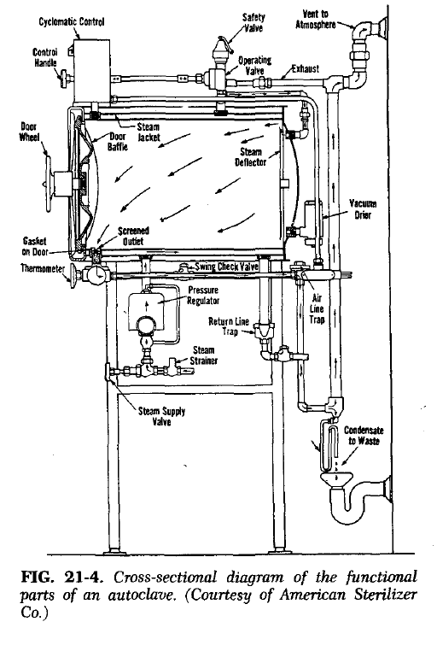
Factors Determining Cycle Time
Spores and vegetative forms of bacteria were effectively destroyed in an autoclave employing steam under pressure
20 min at 15 pounds pressure (121°C)
3 min at 27 pounds pressure (132°C).
[Based on the assumption that:
1- steam has reached the innermost point of the material to be sterilized
2- temp. of the material is held for at least one half of that time interval].
Exposure time

Slide 6
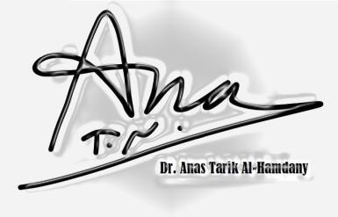
Ex: Bottles of solution, the heat conducted through the wall of the container, raise the temp. of the solution to that of its environment, and generate steam within the container from the water therein.
A significant lag time is involved before the solution reaches the sterilizing temperature.
The most important factor: lag time
[its inclusion in the planned total cycle time is no less important for moist heat sterilization than for hot air sterilization].
Ex: 1200 ampoules, each containing 5 ml of a solution sterilized in an autoclave at 121°C during an exposure time of 20 min.
While single bottle containing the same total volume of solution (6 L) required an exposure of 60 min at 121 °C
Considering that:

Slide 7
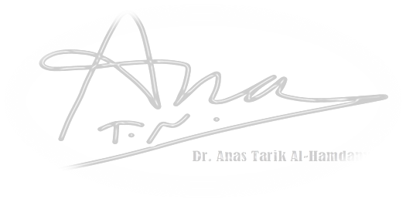
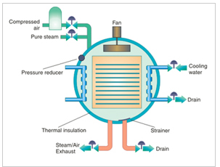
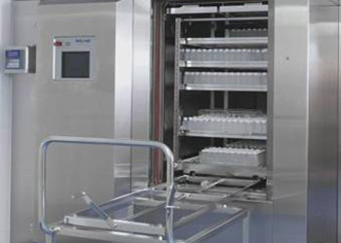
Air-Steam Mixtures
Benefits: air-steam mixtures have a lower temp. and lower thermal capacity than pure steam, but presence of air control the pressure in the chamber when flexible-walled containers are sterilized.
Ex: plastic bags of large-volume parenterals (LVPs)
swell and burst in an autoclave utilizing steam only, particularly during the cooling phase.
Solutions?? air is mixed with the steam and the pressure is independently controlled pressure applied to the outside of the containers can be adjusted to equal the internal pressure so that the containers do not burst. [Because of the tendency of steam and air to align].

Slide 8
Approaches to Reduction of Cycle Time
Prolonged heating of objects is detrimental to the material.
EX: 1- fabrics and rubber parts deteriorate with loss of tensile strength.
2- solutions undergo adverse chemical changes
3- metal objects become pitted.
Approach: The total cycle time should be controlled
heating period is not unnecessarily prolonged
(accomplished by shortening the cooling period)

Slide 9
Example of easily reduction and problems in the reduction of cycling time:
1- Non-sealed items of equipment or containers that do not contain solutions, the steam may be exhausted to the outside rapidly at the end of the sterilizing cycle.
Objects cooled rapidly, particularly if removed from the autoclave chamber.
2- Such a procedure cannot be employed for solutions (sealed or unsealed in containers) because:
A- Rapid release of chamber pressure would cause violent boiling of the hot solution spattering of the contents of unsealed containers
B- Explosion of sealed containers.

Slide 10
Approaches to reduce cycling time:
1- Rapid extraction of heat from sealed solution containers [spray the containers with gradually cooling water while the pressure in the chamber is concurrently reduced].
Benefit: cooling time for a load of 200 one-liter bottles of solution may be reduced from about 20 hours to about 20 min.
2- Accelerated cooling method [short pulses of high pressure steam introduced into loaded chamber steam expands in the chamber extracts heat from the solution containers steam is exhausted from the chamber with a gradual reduction of the pressure concurrent with the temperature reduction].
Note: These methods introduce pulses of air into the chamber to replace all or part of the steam pressure around the containers is not reduced too rapidly.
3- A new approach [precycle vacuum of at least 20 mm Hg is drawn or double vacuum drawn prior to the heating cycle removes air from porous materials
rapid penetration of heat with complete elimination of air pockets total heating period is reduced due to reduction in the temp. increment time].
Benefit: suited to operate room packs in hospitals where the total cycle time for large packs reduced from about 78 min to 14 min.
Cannot be used: solutions or other objects that cannot withstand the high vacuum.

Slide 11
Lower Temperature Sterilization.
Moist heat is used for lower temperature sterilization procedures.
Temperatures of 100°C or lower [called marginal or fractional methods].
Marginal (questionable reliability of the processes).
[This method of sterilization is reserved for substances that must be processed by a thermal method but cannot withstand higher temperatures without degradation. The assurance of sterility is comparatively low].
Fractional (processes are normally performed by two or three exposures to moist heat, alternated with intervals during which the material is held at room or incubator temperatures).
Fractional methods of sterilization:
A- Tyndallization [temp. of 100°C]
B- Inspissation [temp. as low as 60°C]
(Are relatively effective in reducing the number of vegetative forms of microorganisms, but are unreliable against spores).
Effectiveness improved by the inclusion of a bacteriostatic agent.

Slide 12
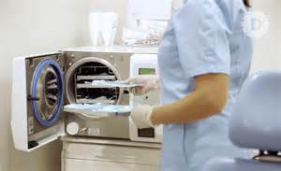
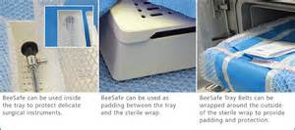
Wrapping Materials
During Sterilization: wrappings for equipment and supplies subjected to moist heat sterilization.
1- permit easy penetration of steam and escape of air.
2- possess sufficient wet strength so that they will not tear or burst during the process.
After sterilization: Maintenance of sterility.
1-wrapping provide an efficient bacterial barrier so that equipment remains sterile for a reasonable time until used [i.e. complete coverage of the contents of the pack]
2- drying of the wrapping after the process
3- static air state within.
Ex: Acceptable disposable process wrapping materials: (Kraft paper, special parchment paper, and Tyvek).
Reusable types (close-weave nylon and Dacron).

Slide 13
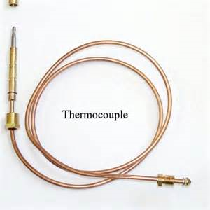
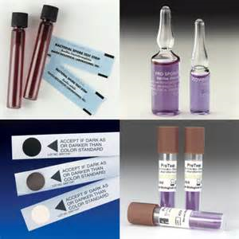
Indicators for Evaluating the Sterilization Process
Dry heat:
Most widely used indicator (thermocouple). [connected to recorders so that a continuous record of the actual temp. at the location of the thermocouple can be obtained].
Autoclave sterilization:
1- wax or chemical pellets that melt at 121°c
2- paper strips impregnated with chemicals that change color under the influence of moisture and heat.
3- Resistant bacterial spores in sealed ampoules or impregnated in dry paper strips are used as biologic indicators. [Their destruction is evidence of a sterilization process].

Slide 14
Application of Thermal Methods of Sterilization
A- Sterilization with the use of moist heat under pressure
1- Aqueous pharmaceutical preparations in hermetically sealed containers [withstand temp. of autoclaving can be rendered sterile and remain indefinitely unless tampering with the seal occurs].
Not applied: Non-aqueous preparations in sealed containers (because no water is present within the container to generate steam and thereby effect sterilization).
2- Equipment and supplies such as rubber closures, glassware, and other equipment with rubber attachments; filters of various types; and uniforms.
To be effective [air pockets must be eliminated that requires the items to be wet when placed in the autoclave].
Note: when dry equipment is required and it must be sterilized by autoclaving, the equipment may be dried in a vacuum oven before use.

Slide 15
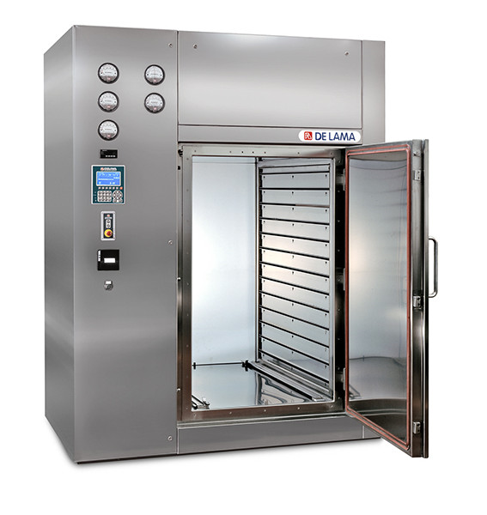
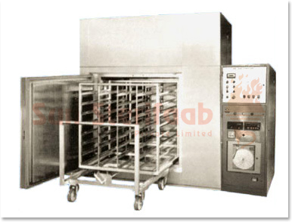
B- Dry heat sterilization
1- Used for containers and equipment because an adequate cycle results in sterile and dry equipment.
High-speed hot-air tunnel for the continuous sterilization of glass containers [heated by IR lamps or by electrically heated, filtered, circulating air].
Not applied: Rubber and cellulosic materials undergo degradation.
2- Chemicals and oleaginous vehicles, to be used in sterile pharmaceutical preparations are sterilized (140°C or less).
Note: A- heating cycle has no deleterious effects on the ingredients during cycle time to achieve sterilization.
B- carefully protected after sterilization until incorporated aseptically in the product to prevent contamination from the environment.

Slide 16
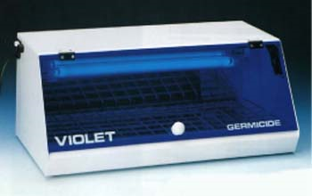
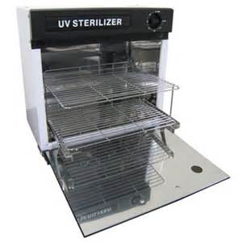
Non-thermal Methods
Ultraviolet Light
It aids in the reduction of contamination in the air and on surfaces within the processing environment.
Ex: The germicidal light produced by mercury vapor lamps is emitted almost exclusively at a wave length of 2537 Angstrom units.
Places of effectiveness:
Ultraviolet light penetrates clean air and pure water well.
Places of ineffectiveness:
But an increase in the salt content and/or the suspended matter in water or air causes a rapid decrease in the degree of penetration.

Slide 17
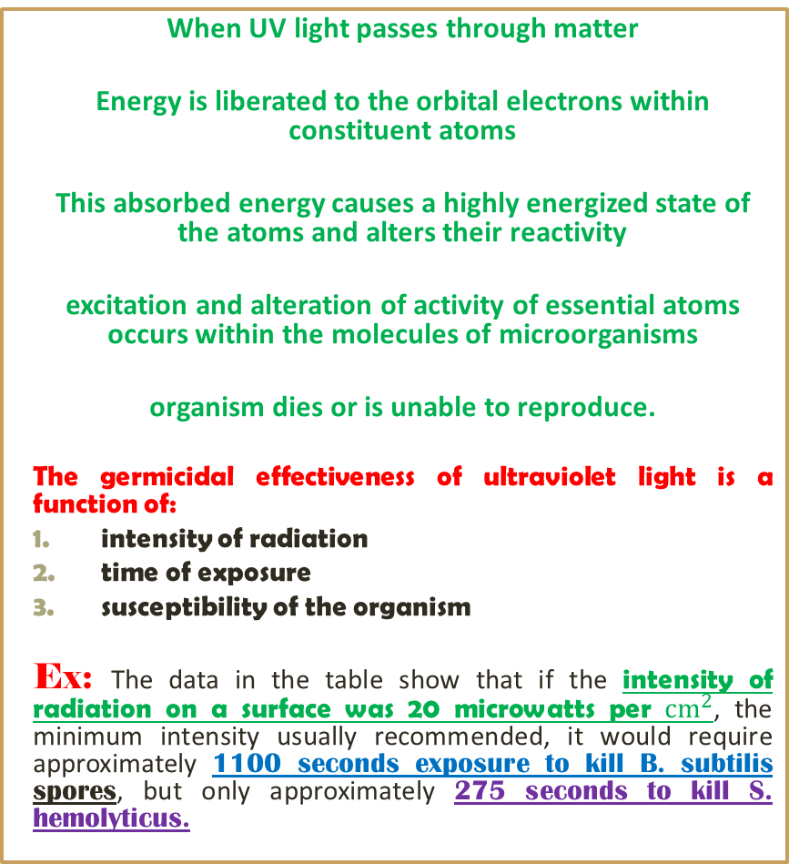
Lethal action of UV sterilization
When UV light passes through matter
Energy is liberated to the orbital electrons within constituent atoms
This absorbed energy causes a highly energized state of the atoms and alters their reactivity
excitation and alteration of activity of essential atoms occurs within the molecules of microorganisms
organism dies or is unable to reproduce.
The germicidal effectiveness of ultraviolet light is a function of:
intensity of radiation
time of exposure
susceptibility of the organism
Ex: The data in the table show that if the intensity of radiation on a surface was 20 microwatts per ${cm}^{2}$, the minimum intensity usually recommended, it would require approximately 1100 seconds exposure to kill B. subtilis spores, but only approximately 275 seconds to kill S. hemolyticus.

Slide 18
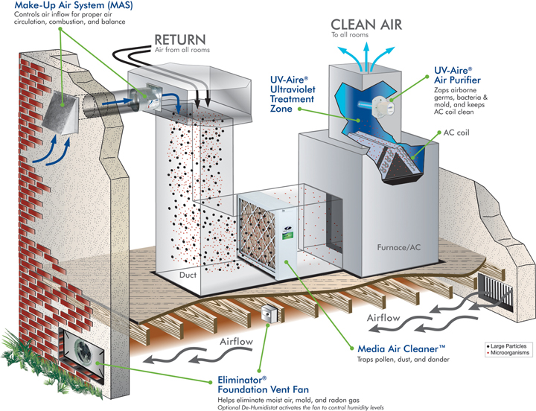
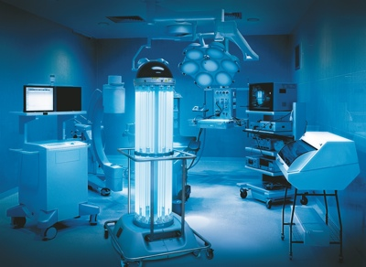
Maintenance, Uses and installation of UV light
Maintenance: to maintain maximum effectiveness.
UV lamps must be kept free from dust, grease, and scratches [because of the large reduction in emission intensity will occur].
Replaced when emission levels decrease (about 30 to 50%) [owing to energy-induced changes in the glass that inhibits the emission].
Uses: UV lamps are used primarily:
Germicidal effect on surfaces
Penetrating effect through clean air and water.
Installation:
Rooms
Air ducts
Large equipment in which the radiation can pass through and irradiate the air, and also reach exposed surfaces
Water supplies

Slide 19
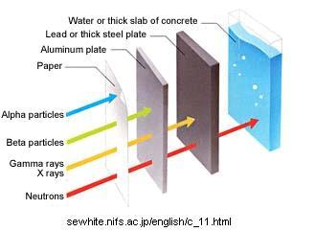
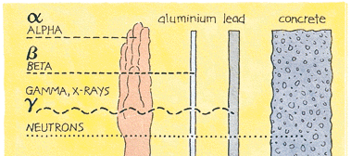
Ionizing Radiations
Ionizing radiations type:
Gamma rays: high-energy radiations emitted from radioactive isotopes such as cobalt-60.
Cathode rays and beta rays: mechanical acceleration of electrons that reaches to very high velocities and energies.
Gamma rays
Advantages
Absolutely reliable, no mechanical breakdown
Providing a higher and more uniform dose rate output.
Disadvantages
Their source (radioactive material) is relatively expensive
Emission cannot be shut off as it can from the mechanical source of accelerated electrons.

Slide 20
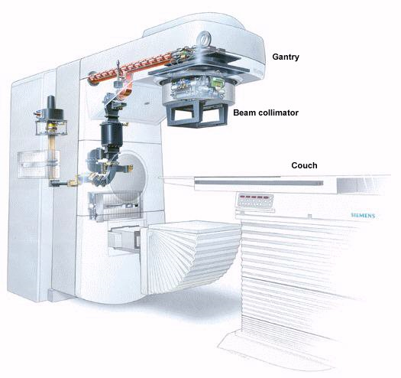
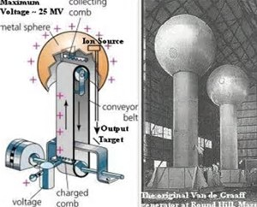
Electron Accelerators
Electron accelerators are of two general types:
linear accelerators
Principle: very high-frequency microwaves (radar) collect electrons from a cathode
Accelerate electrons as they travel through the vacuum tube reaching the speed of light
The electrons are emitted and directed to the target at an energy range of 3 to 9 million electron volts (meV).
The Van de Graaff accelerators
Are capable of energy potentials up to 3 meV.
Principle: utilize the force exerted on a charged particle by a high voltage potential in an electric field as a means of direct particle acceleration.

Slide 21

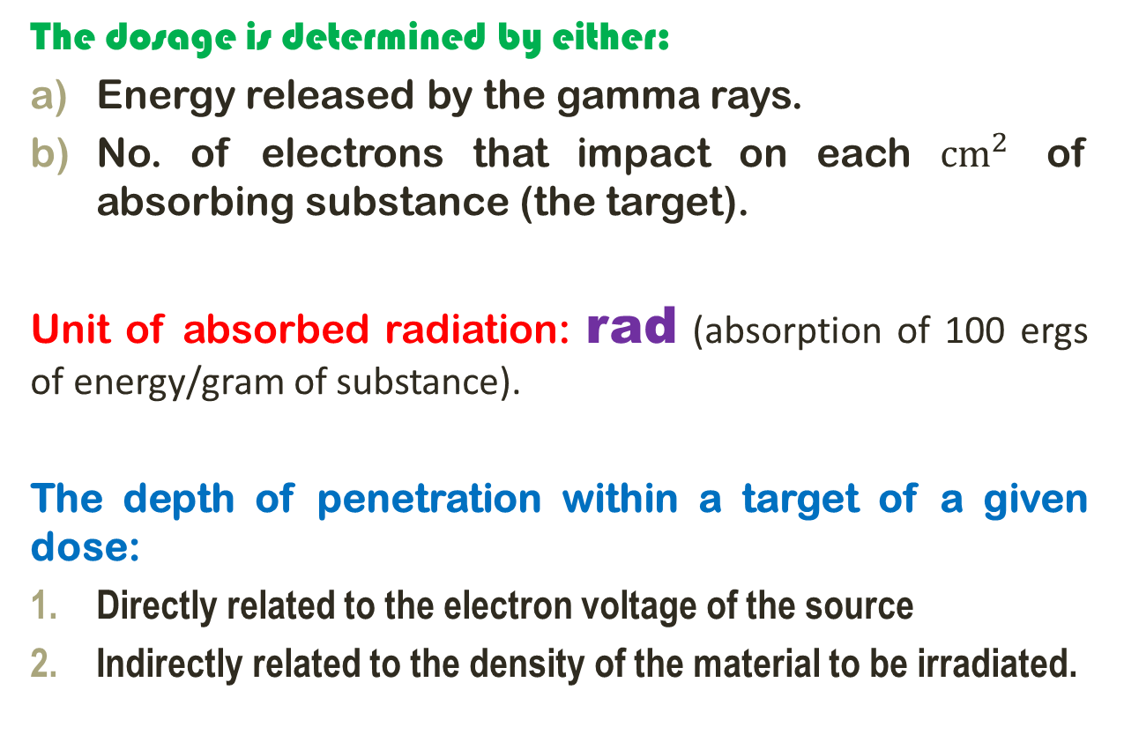
Determination of Dosage
The dosage is determined by either:
Energy released by the gamma rays.
No. of electrons that impact on each ${cm}^{2}$ of absorbing substance (the target).
Unit of absorbed radiation: rad (absorption of 100 ergs of energy/gram of substance).
The depth of penetration within a target of a given dose:
Directly related to the electron voltage of the source
Indirectly related to the density of the material to be irradiated.

Slide 22
Lethal Action and Dosage
Lethal action: ionizing radiations destroy M.O. by stopping reproduction as a result of lethal mutations.
Mutations by direct-hit theory [transfer of radiation beam energies to receptive molecules in their path].
Mutations by indirect action [water molecules are transformed into highly energized entities such as hydrogen and hydroxyl ions].
Bring energy changes in nucleic acids and other molecules
eliminating their availability for the metabolism of the bacterial cell.
Differences of Ionizing radiations from UV rays in their effects on matter:
Primarily are of a higher energy level by producing ionization of constituent atoms.
Dose: Bacterial spores and viruses are generally four to five times more resistant than vegetating bacteria and molds.
A dose of 2 to 2.5 megarads, is adequate to ensure sterility.
Both 1 and 2

Slide 23
Applications for Sterilization
Note: A) Accelerated electrons or gamma rays used to sterilize select products by a continuous process.
B) Most other product sterilization procedures performed in batches.
Assurance of adequate dose delivery determined by:
Effect of the absorbed energy at the maximum depth of penetration, on photographic film
Biologic indicator Bacillus pumilus.
Application of radiation:
Sterilization of medical plastic devices.
No. of vitamins, antibiotics, and hormones in the dry state.
Not Applied: Liquid pharmaceuticals are difficult to sterilize
[Because of the potential effect of the radiations on the vehicle system as well as the drug].

Slide 24


