Slide 1
Sterilization
Industrial Pharmacy
Lecture.1
Assistant Lecturer Anas Tarik

Slide 2
Sterilization
Is the process designed to produce a sterile state.
Absolute condition of total destruction or elimination of all living microorganisms.
Ex: sterilization of a parenteral product, particularly steam under pressure
a probability of no more than one non-sterile unit in a million (${10}^{−6})$is readily achievable.

Slide 3
Aseptic
Indicates a controlled process or condition in which the level of microbial contamination is reduced to the degree that microorganisms can be excluded from a product during processing.
It describes an "apparently“ sterile state.
Important note: It is necessary to compromise between most effective sterilization procedure and one that will not have a significant adverse effect upon the material to be sterilized.
For example, adding an antibacterial agent to a thermally sensitive product to enhance the effectiveness of a low-temperature sterilization process; thereby decomposition is prevented while the combined effect of the antibacterial and the heat provide reasonable assurance that the product will be sterilized.

Slide 4
Microorganisms exhibit varying resistance to sterilization procedures.
For example: spores, the form that preserves certain organisms during adverse conditions, are more resistant than vegetative forms of the organism.
The conditions required for a sterilization process must be planned to be lethal to the most resistant spores of microorganisms, with additional treatment designed to provide a margin of safety against a sterilization failure.
Putting principles of microbial death and their relationship to validation of sterilization processes.

Slide 5
Validation of Sterilization Processes
Different types of sterilization processes
(thermal, chemical, radiation, and filtration)
Designed to destroy or eliminate microbiologic contaminants present in a product.
The official test for sterility of the product is a destructive test on a selected sample proving that all units of a product are sterile must involve the employment of probability statistics.
The statistics of probability depend on:
length or degree of exposure to the sterilant
type and number of microorganisms present
desired level of microbial destruction or elimination
resistance of M.O. presented to the sterilization process.

Slide 6
To be continue:
In recent years, FDA stated in its current good manufacturing practice (cGMP) regulations that sterilization procedures must be validated pertaining to:
Validation of sterilization processes can be facilitated by using quantitative, theoretically principles such as:
Microbial Death Kinetic Expressions.
(1) design of the equipment and the process used to produce batch sterilization
(2) confirmation with reproducible data of a given probability level of residual microbial contamination upon completion of the sterilization process.

Slide 7
Microbial Death Kinetic Terms
D value: microbial death kinetics for heat, chemical, and radiation sterilization.
The D value is the time (for heat or chemical exposure) or the dose (for radiation exposure) required for the microbial population to decline by one decimal point (a 90%, or one logarithmic unit, reduction).
U exposure time or exposure dose, under specific conditions
$N_{0}$initial microbial population (product bioburden).
$N_{u}$microbial population after receiving U time or dose units of sterilant exposure.

Slide 8
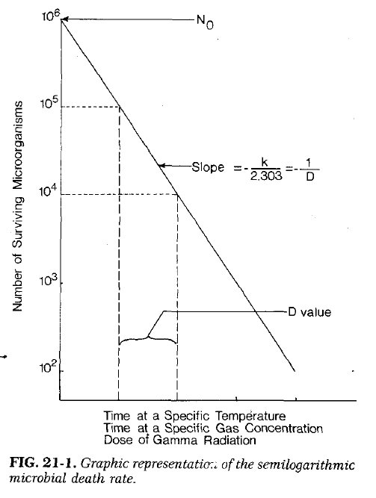
For example:
After 5 min of product exposure to a temperature of 121°C, the microbial population was reduced from 2 x ${10}^{5}$ to 6 x${ 10}^{3}$. Then, the D value at 121°c is:
Thus, at 121°c, the microbial population is decreased by 90% every 3.28 min.

Slide 9
Where to estimate or not for D-value:
D values defined for various M.O. contained in certain environments (liquids and solid surfaces) at specific temperatures for heat sterilization and at direct exposure to cobalt-60 irradiation.
D values not be defined precisely for M.O. exposed to such gases as ethylene oxide because of the complex interaction of heat, concentration of gas, and relative humidity.
But: D value estimated for gas sterilization when it is possible to keep heat and humidity values constant, varying only the concentration of gas.

Slide 10
Other key terms used in the determination of microbial death rates include:

Slide 11
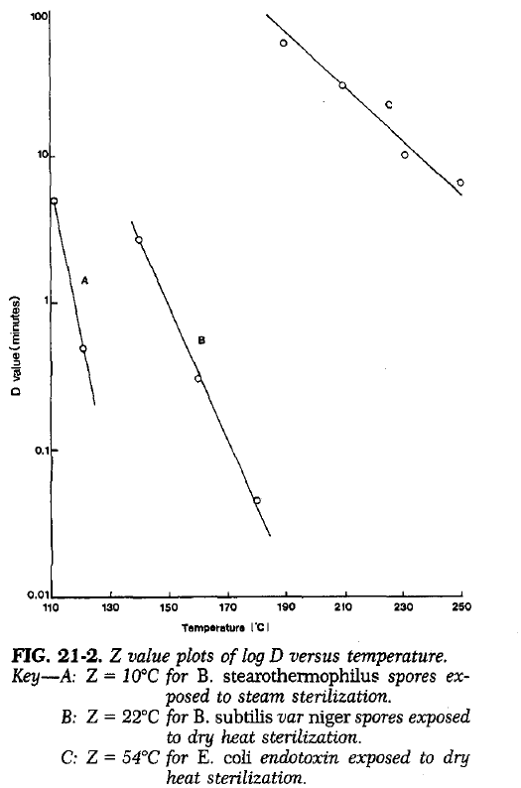
The $F_{0}$value can be defined by the following two equations:
Note: when $F_{0}$ value is used, the Z value is 10°C.
This mean that for every 10°C increase in product temperature, the D value is decreased by 90%, or 1 log unit.

Slide 12
F Value Applications
The importance of $F_{0}$ values in steam sterilization cycle validation:
The importance of F_0 values in steam sterilization cycle validation:
1. $F_{0}$ relates killing efficiency at any temp. to the killing effect at the desired sterilization temperature of 121°C.
1. F_0 relates killing efficiency at any temp. to the killing effect at the desired sterilization temperature of 121°C.
2. $F_{0}$ describing the thermal exposure time to which the product was exposed equivalent to 121°C.
2. F_0 describing the thermal exposure time to which the product was exposed equivalent to 121°C.
3. $F_{0}$ incorporates the contribution of the heating and cooling portions of the temp. time profile with the overall lethal effect of heat upon M.O.
3. F_0 incorporates the contribution of the heating and cooling portions of the temp. time profile with the overall lethal effect of heat upon M.O.
4. $F_{0}$describe the lethal effect upon M.O. at the coolest location in the sterilizer, represents the most conservative estimate of the degree of destruction of M.O., and thus the safest conditions for determining cycle time.
4. F_0 describe the lethal effect upon M.O. at the coolest location in the sterilizer, represents the most conservative estimate of the degree of destruction of M.O., and thus the safest conditions for determining cycle time.

Slide 13
Factors affect the $F_{0}$ value.
(1) Container characteristics: size, geometry, and heat transfer coefficient.
(2) Product volume and viscosity.
(3) Size and configuration of the batch load in the sterilizer.
Important note:
F value equations can be applied to dry heat sterilization (but most materials sterilized by dry heat can be subjected to overkill temperature- time cycles).
1- The reference temperature $T_{0}$ would not be 121°c but it probably would be 170°C
2- The Z value would not be 10°C, but would be in the range of 22°C for the destruction of B. subtilis var niger spores on glass to 54°C for the destruction of endotoxin.

Slide 14
Aseptic processing
Aseptic processing also requires validation (to assure batch to batch consistency in producing a given probability of product sterility but D and $F_{0}$ values cannot be applied)
Probability of non-sterility levels can be obtained by [process simulation testing] using:
1- Microbiologic growth medium
2- Suitable type and number of challenge microorganisms
3- Relevant number of containers.
The percent contamination level (% C) is calculated as follows:
$N_{G}$ no. of undamaged containers with microbial growth.
$N_{T}$ total no. of containers filled
$N_{D}$ no. of damaged contaminated containers.

Slide 15
Steam Sterilization Validation Steps
The validation procedure for a steam sterilization process may involve:
1. Certify that the sterilizer has been mechanically checked and qualified.
2. Select appropriate biologic indicator M.O. possessing the desired resistance to steam heat, while realizing the advantages and hazards of bioindicators.
3. Experimentally determine the D value and Z value of the selected bioindicator.
4. Determine the distribution of heat in the empty sterilizer, and identify the coolest location.
5. Determine the distribution of heat of a defined loading size and configuration and identify the coolest location.
6. Determine the penetration of heat into the product units at the coolest location and at suspected locations where heat penetration will be slowest.

Slide 16
To be continue:
7. Evaluate the effect of cycle parameters as time, temperature, and load configuration on the destruction of the bioindicator and the magnitude of the $F_{0}$value.
7. Evaluate the effect of cycle parameters as time, temperature, and load configuration on the destruction of the bioindicator and the magnitude of the F_0value.
8. Determine the sterilization process time required to achieve the desired $F_{0}$value and/or the desired probability level of bioindicator destruction.
8. Determine the sterilization process time required to achieve the desired F_0value and/or the desired probability level of bioindicator destruction.
9. Repeat the process until satisfactory and reliable replication is obtained.
10. Establish a monitoring program for periodic requalification of the sterilization cycle.
11. Finalize standard operating procedures and action levels should changes or problems develop in the future.

Slide 17
Aseptic filtration validation procedure
The validation procedure for an aseptic filtration process may involve:
1. Properly evaluate the facility and critical areas for proper equipment function, air quality, and other engineering criteria.
2. Perform air and surface microbial tests in the filling area to know reliably the background microbial contamination level.
3. Select a sensitive microbial growth medium.
4. Select the most appropriate challenge microorganism for aseptic filtration validation.
5. Sterilize growth medium and all filtration equipment by sterilization methods previously validated.

Slide 18
To be continue:
6. Conduct a process simulation test by filtering a desired volume of microbial growth medium containing a known concentration of challenge microorganism into an appropriate number of previously sterilized containers.
7. Incubate the filled containers at the proper conditions with proper controls.
8. Determine the percent contamination level.
9. Repeat the process.
10. If percent contamination level is unacceptable, for example, >0.1 %, review all environmental test results, sterilization records, and other data to determine what action needs to be taken to attain a percent contamination level of less than 0.1%.

Slide 19
Physical Processes of Sterilization Thermal Methods
Lethal effectiveness of heat on M.O. depends upon:
Degree of heat
Exposure period
Moisture present.
Thermal methods of sterilization may conveniently be divided into:
Dry heat and moist heat.
Note: time required to produce a lethal effect is inversely proportional to the temp. employed.
For example, sterilization may be accomplished in 1 hour with dry heat at a temperature of 170°C, but may require as much as 3 hours at a temperature of 140°C.

Slide 20
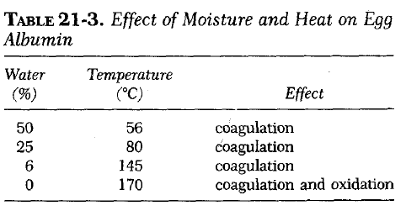
Identifications:
cycle times (maximum temperature hold time)
total heat input (F values)
lethal effect (time during which the entire mass of the material is heated).
Note:
- The mechanism by which M.O. are killed by heat is the coagulation of the protein of the living cell.
- The temperature required is inversely related to the moisture present.

Slide 21
Dry Heat
Substances that resist degradation at temp. above 140°C may be rendered sterile by means of dry heat.
2 hr exposure to a temperature of 180°C or 45 min at 260°C
kill spores as well as vegetative forms of all microorganisms.
Note: total sterilizing cycle time normally includes:
1- reasonable lag time for the substance to reach the sterilizing temp. of the oven chamber
2- appropriate hold period to achieve sterilization
3- cooling period for the material to return to room temperature.

Slide 22
Factors in Determining Cycle Time
The cycle time is composed of three parts:
The time required for all of the material to "catch up" with the temperature of the chamber is longer with:
(1) Thermal increment time of both the chamber and the load of material to be sterilized, assuming both start at room temperature
(2) Hold period at the maximum temperature
(3) Cooling time.
Larger quantities of material
Poorer thermal conductance properties of the material
Lower heat capacity.

Slide 23
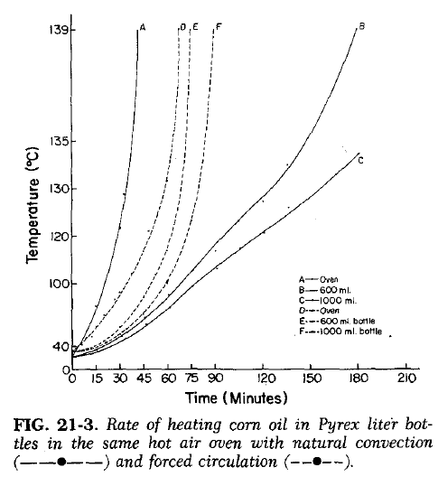
Sterilizer Types
Natural convection oven: circulation depends upon the currents produced by the rise of hot air and fall of cool air.
easily blocked with containers, resulting in poor heat distribution efficiency. Differences in temp. of 20°C or more may be found in different shelf areas.
Forced convection ovens: provide a blower to circulate the heated air around the objects in the chamber. Efficiency is greatly improved over natural convection. Temp. differences at various locations on the shelves may be reduced to as low as ± 1 °C.
The lag times of the load material also reduced because fresh hot air is circulated rapidly around the objects.
Tunnel unit oven: with a moving belt, designed to thermally sterilize glass bottles and similar items as they move through the tunnel. The items are cooled with clean air before they exit the tunnel, usually directly into an aseptic room and linked in a continuous line with a filling machine.

Slide 24
Effect on Materials
The elevated temperatures required for effective hot air sterilization in a reasonable length of time have an adverse effect on many substances:
Cellulose materials (paper and cloth) begin to char at a temperature of about 160°C.
At these temperatures, many chemicals are decomposed, rubber is rapidly oxidized, and thermoplastic materials melt.
Expansion of materials that heated from room to sterilizing temperatures, glassware must not be wedged tightly in the oven chamber, containers for oils must be large enough to permit expansion of the oil.

Slide 25
Advantage of dry heat:
This method of sterilization is reserved largely for glassware, metalware, and anhydrous oils and chemicals that can withstand the elevated temperature ranges without degradation.
Anhydrous state achieved to provide dry glassware and metalware at the end of an adequate heating cycle.
Dry heat effectively destroys pyrogens, usually requiring about twice the hold time for sterilization.

Slide 26
Conditions to maintain a sterility after sterilization
Environmental contamination must be excluded:
The openings of equipment must be covered with a barrier material such as aluminum foil.
As an alternative, items to be sterilized may be placed in a covered stainless steel box or similar protective container.

