Slide 1

LAB5 (physical pharmacy)

Slide 2
Kinetic
this lab is used to demonstrate the way at which the break down of the product occurs at elevated temperature. which is used to forecast the rate at witch activity deteriorates at temperature of storage & thus to estimate the shelf life of the product .

Slide 3
IMPORTANT DEFINITIONS
*kinetics:- is the studying of reaction rate & factors affecting it.
*Reaction rate:- is the velocity or the speed at which the reaction proceed ,it is given by ± dc/dt ,this expression gives + the increase or – the decrease of concentration dC within a given time interval dt.
*Reaction order:- is the number of atoms or molecules whose concentration determine the reaction rate . the reaction order shows the way of how the concentration Of reactant affecting the reaction rate.

Slide 4
Factors that may affecting reaction rate:
1-concentartion of reactant
2-temperature
3-catalysts
4-presence of solvents
5-light
6-pH

Slide 5
*orders of reaction:
A-zero order reaction:- the rate of reaction is independent on reactant conc.
So , -dc/dt=k˳
B-first order reaction:- A→B+C
So - dc/dt=k[A]
C-second order reaction:- A+B→C+D
So -dc/dt=k[A][B]
D-third order reaction:- 2A+B→C+2D
So, -c/dt=k[A]²[B]

Slide 6
*half life t 1/2% :- is the time required for the drug to decompose to one half its original concentration .
*shelf life t 90%:- is the time required for the drug to lose10% of it's original concentration .Or it’s the time required for the drug to degrade to 90% of it's original concentration.

Slide 7
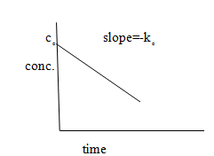
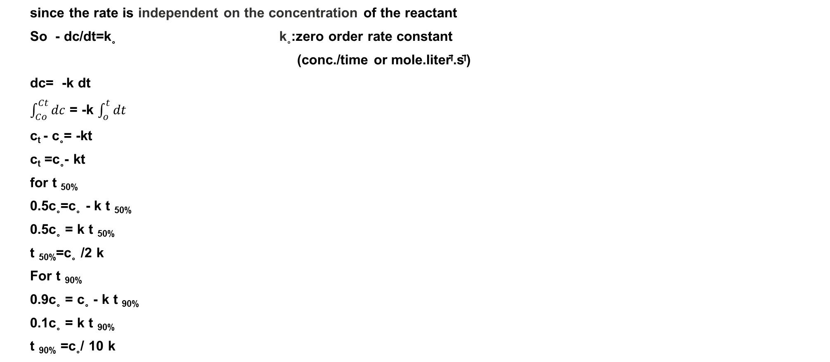
A-Zero order reaction:-
since the rate is independent on the concentration of the reactant
So - dc/dt=k˳ k˳:zero order rate constant
(conc./time or mole.liter̄ˡ.s̄ˡ)
dc= -k dt
$\int_{Co}^{Ct}{dc}$ = -k $\int_{o}^{t}{dt}$
c_{t} - c˳= -kt
c_{t} =c˳- kt
for t _{50%}
0.5c˳=c˳ - k t _{50%}
0.5c˳ = k t _{50%}
t _{50%}=c˳ /2 k
For t _{90%}
0.9c˳ = c˳ - k t _{90%}
0.1c˳ = k t _{90%}
t _{90%} =c˳/ 10 k

Slide 8
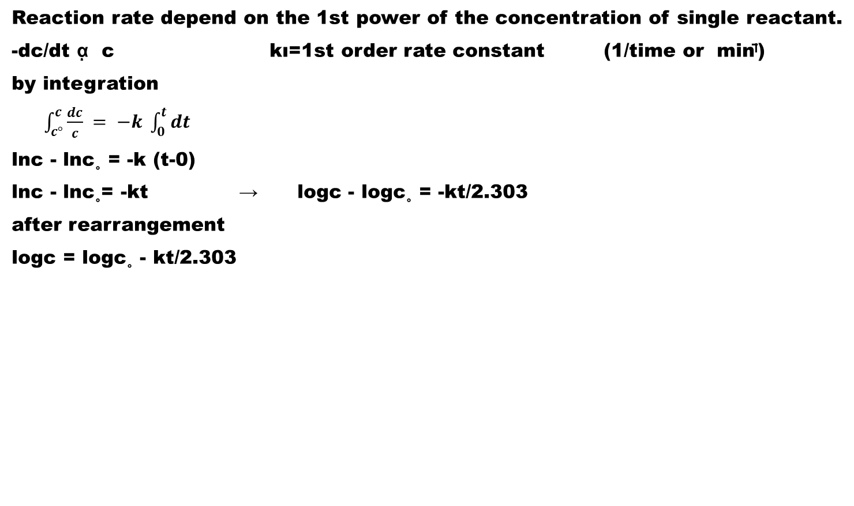
B-first order reaction :-
Reaction rate depend on the 1st power of the concentration of single reactant.
-dc/dt ᾳ c kı=1st order rate constant (1/time or min̄ˡ)
by integration
$\int_{c°}^{c}{\frac{dc}{c} = −k \int_{0}^{t}{dt}}$
lnc - lnc˳ = -k (t-0)
lnc - lnc˳= -kt → logc - logc˳ = -kt/2.303
after rearrangement
logc = logc˳ - kt/2.303

Slide 9
* to calculate t 50%
Log 0.5c˳ = log c˳ - kt 50%/2.303
Kt 50% /2.303 =logc˳ - log0.5c˳
Kt 50% / 2.303= log c˳/0.5c˳
kt 50% /2.303=log2
t50% = 0.693/ k
*To calculate t 90%
Log 0.9c˳ = logc˳-kt /2.303
Kt/2.303 =log c˳/0.9c˳
t 90% = 0.105 /k

Slide 10
First order
Note
both t50% & t90% are concentration Independent , thus for t50% it takes the same amount of time to reduce the concentration of drug from 100mM to 50 mM as it does from 50 mM to 25 mM.

Slide 11
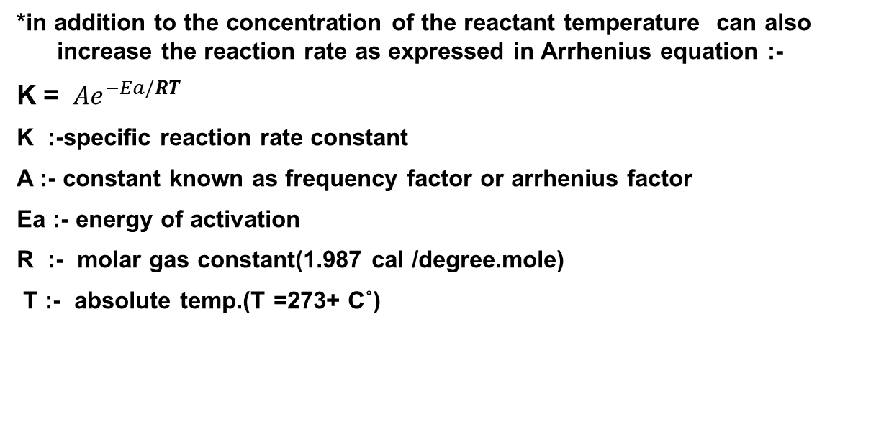
temperature
*in addition to the concentration of the reactant temperature can also increase the reaction rate as expressed in Arrhenius equation :-
K = $Ae^{−Ea/RT}$
K :-specific reaction rate constant
A :- constant known as frequency factor or arrhenius factor
Ea :- energy of activation
R :- molar gas constant(1.987 cal /degree.mole)
T :- absolute temp.(T =273+ C˚)

Slide 12
lnK = lnA – Ea/RT
→ 2.303 log K = 2.303 log A – Ea/RT
LogK = logA -Ea / 2.303 RT

Slide 13
Notes :
Note:-the constants A & Ea are obtained by determining k at several temperature & then plotting log k versus 1/T.
The slope of the resulting line equals –Ea/2.303R.the intercept on the vertical axis equals log A.
Note:-activation energy (Ea) is the amount of energy required to put the molecules in an activated state. molecules must be activated to react & as the temperature increases more molecules are activated & the reaction rate increase.
Note:-according to accelerated storage test k value for the hydrolysis of aspirin at various elevated temperature (40,55& 70 c˚) are obtained by plotting log concentration versus time. Then log k are plotted against the reciprocal of absolute temperature & the resulting line is extrapolated to room temperature

Slide 14
the plot known as Arrhenius plot for predicting stability at room temperature.
Note:-Arrhenius found that speed of many reactions increase about 2 or 3 time with each 10c˚rise in temperature .
So we can apply Arrhenius equation to find the reaction rate at temperature of storage.

Slide 15
Aim of experiment:-
studying the effect of temperature on the hydrolysis of aspirin (1st order kinetic) in order to use it as guide to estimate t50%,t90%
Materials & equipment:-
aspirin, trisodium citrate, NaOH
phenol red indicator ,N/20 NaOH solu.
conical flask(250cc)&conical flask(150,50 cc),pipette& burette
three water baths.

Slide 16
Procedure:-
1-prepare the following mixture in 250ml conical flask :
aspirin 4.5 gm
trisodium citrate 9gm
D.W. to 250ml
2-take 10ml from solution & titrate with N/20 NaOH solution. Using phenol red as indicator the end point is changing from yellow to pink .This End point.at zero time is represented by X which is the volume of NaOH equivalent to aspirin before hydrolysis .
3-label 3 flasks with the experimental temp. 40,55,70 c˚& place about 80 ml of mixture in each.
4-note the time & place the flask for the elevated temperature in water bath provided.
5-take 10ml sample from each flask every 15 min. for one hour titrate the sample with N/20 NaOH solution.
6-find the end point of each temperature at the time interval mentioned & represent item Y1,Y2,Y3,Y4 mL of N/20 NaOH.

Slide 17
Calculation
1- the initial titration figure of Xml N/20 NaOH will represent 100% potency & when aspirin is completely hydrolyzed to S.A.& acetic acid it required 2X ml N/20 NaOH .
Thus the amount of aspirin remaining after partial hydrolysis would be equivalent ( 2X-Y) ml N/20 NaOH where Y is the titration figure for partially hydrolyzed sample .
Thus percent potency is given by :-
Potency % =c%= ( 2X-Y/X) ˟ 100 ………………….percent of remaining aspirin
2-take log c% & plotted against time (min) for each temperature.
3-find the rate constant K for each temperature from the slope of the line .
K= - slope ˟ 2.303
4-take log K& plot against reciprocal tempreture ( 1/T) ( Arrhenius plot ) to find K at 25 c˚,t50%,t90% .
5- tabulate the result as follows :

