Slide 1
Infrared Spectroscopy
Dr. Basma M. Abd razik

Slide 2
IR Spectroscopy
Introduction
  Spectroscopy is the study of the interaction of matter with the electromagnetic spectrum
    Electromagnetic radiation displays the properties of both particles and waves
    The particle component is called a photon
    The energy (E) component of a photon is proportional to the frequency. Where h is Planck’s constant and ν is the frequency in Hertz (cycles per second)
    E = hν
    The term “photon” is implied to mean a small, massless particle that contains a small wave-packet of EM radiation/light – we will use this terminology in the course

Slide 3
IR Spectroscopy
Introduction
    Because the speed of light, c, is constant, the frequency, ν, (number of cycles of the wave per second) can complete in the same time, must be inversely proportional to how long the oscillation is, or wavelength:
    Amplitude, A, describes the wave height, or strength of the oscillation
    Because the atomic particles in matter also exhibit wave and particle properties (though opposite in how much) EM radiation can interact with matter in two ways:
      Collision – particle-to-particle – energy is lost as heat and movement
      Coupling – the wave property of the radiation matches the wave property of the particle and “couple” to the next higher quantum mechanical energy level
c
___
hc
ν =
___
 E = hν =
λ
λ
c = 3 x 10¹⁰ cm/s

Slide 4
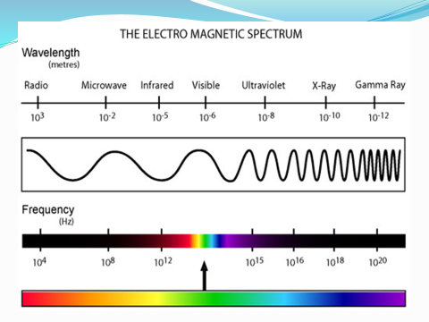

Slide 5
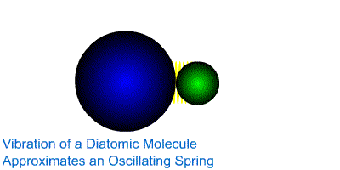
IR Spectroscopy
Introduction
  The IR Spectroscopic Process
    The quantum mechanical energy levels observed in IR spectroscopy are those of molecular vibration
    We perceive this vibration as heat
    When we say a covalent bond between two atoms is of a certain length, we are citing an average because the bond behaves as if it were a vibrating spring connecting the two atoms
    For a simple diatomic molecule, this model is easy to visualize:

Slide 6
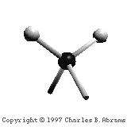
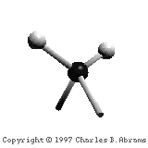
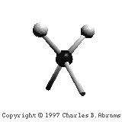
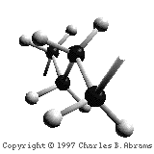
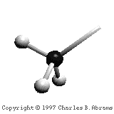
IR Spectroscopy
Introduction
  The IR Spectroscopic Process
    There are two types of bond vibration:
      Stretch – Vibration or oscillation along the line of the bond
      Bend – Vibration or oscillation not along the line of the bond
H
H
C
C
H
H
symmetric
asymmetric
H
H
H
H
C
C
C
C
C
C
C
C
H
H
H
H
scissor
rock
twist
wag
in plane
out of plane

Slide 7

Infrared Spectroscopy
The IR Spectroscopic Process
  As a covalent bond oscillates – due to the oscillation of the dipole of the molecule – a varying electromagnetic field is produced
  The greater the dipole moment change through the vibration, the more intense the EM field that is generated

Slide 8
Infrared Spectroscopy
The IR Spectroscopic Process
  When a wave of infrared light encounters this oscillating EM field generated by the oscillating dipole of the same frequency, the two waves couple, and IR light is absorbed
  The coupled wave now vibrates with twice the amplitude
IR beam from spectrometer
“coupled” wave
EM oscillating wave
from bond vibration

Slide 9
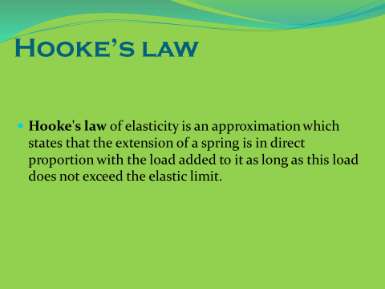

Slide 10
