Slide 1
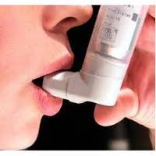
ASTHMA A CHRONIC RESPIRATORY DISEASE
Assist. Prof. Dr. Kadhim Ali Kadhim
PhD, in Clinical Pharmacy
Dept. of Clinical Pharmacy/ College of Pharmacy/University of AL-Mustansiriyah.
Pharma.drkaka75@uomustansiriyah.edu.iq
kadhimali_2011@yahoo.com
Date : 29/ 3 /2018

Slide 2
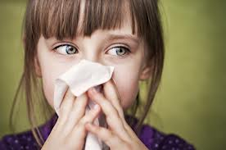
DEFINITION OF ASTHMA
A chronic lung disorder that is marked by recurring episodes of airway obstruction (as from bronchospasm) manifested by laboured breathing accompanied especially by wheezing and coughing and by a sense of constriction in the chest, and that is triggered by hyper reactivity to various stimuli.

Slide 3
Cont…
Asthma attacks all groups but often starts in childhood.
Characterized by recurrent attacks s of breathlessness and wheezing, which has different severity and frequency in each person.
Attack from hour to hour and day to day.
(

Slide 4
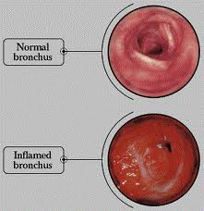
OBSTRUCTIVE or RESTRICTIVE ??

Slide 5
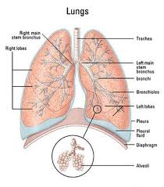
ANATOMY
Pathway of respiratory system:
Nostrils → nasopharynx → oral pharynx → glottis → trachea → right & left bronchi → bronchioles → alveoli
Figure 1: Lung anatomy

Slide 6
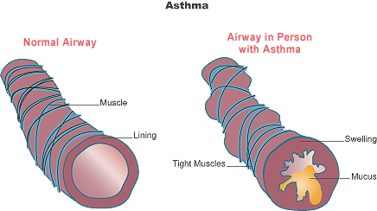
Narrowed bronchioles
(muscles spasms)
Figure 2: Differrence between normal airway and airway in person with asthma

Slide 7
PATHOLOGY
Inflammation of inner lining of airways
Muscle around airways tighten
Airways produce mucus due to inflammation
(clogged the shrunken tubes)

Slide 8
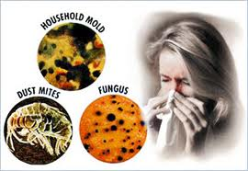
ETIOLOGY OF ASTHMA
Genetic factors
Environmental factors
House dust mites
Exposure to tobacco smoke.
Predisposed to animals, pollens moulds and dust.
Dietary changes – junk food and fast food contain MSG

Slide 9
Cont…
Lack of exercise - Less stretching of the airways
Occupational exposure
- Irritants in the workplace : chemicals, dusts, gases, moulds and pollens. These can be found in industries such as baking, spray painting of cars, woodworking, chemical production, and farming.

Slide 10
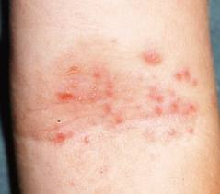
Cont…
Atopic diseases – eczema and allergic rhinitis.
Maternal status – both physical and mental conditions like anaemia and depression in the mother are associated with asthmatic stress for the child.
Early antibiotic use – babies who are given antibiotics may be 50% more likely to develop asthma by the age of six

Slide 11
DIAGNOSIS & TESTS
Initial exam (conducted by doctor):
Medical history
Asthma symptoms, how you feel, known asthma and allergy triggers, your activity level and diet, your home and work environment, and family history.
Then, some tests will be conducted to diagnose asthma

Slide 12
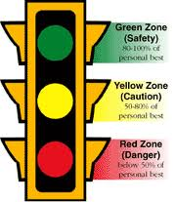
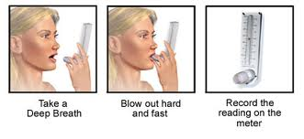
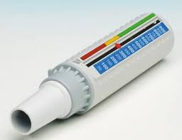
Peak Flow Testing
Peak expiratory flow rate (PEFR)
Peak Flow Meter
PEFR is used to assess the severity of wheezing in those who have asthma. PEFR measures how quickly a person can exhale air from the lungs

Slide 13
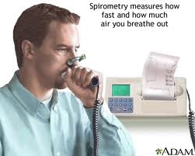
Spirometry (Lung function test)
It measures how much air you can exhale.
FEV1(force expiratory volume) > 80% = normal
Confirms the presence of airway obstruction and measure the degree of lung function impairment.
Monitor your response to asthma medications

Slide 14
Allergy-skin Test
A drop of liquid containing the allergen in placed on your skin (generally forearms is used).
A small lance with a pinpoint is poked through the liquid into the top layer of skin (prick test).
If you are allergic to the allergen, after about 2 minutes the skin begins to form a reaction (red, slightly swollen, and itchy: it makes a hive).
The size of the hive is measured and recorded.
The larger the hive, the more likely it is that you are allergic to the allergen tested.

Slide 15
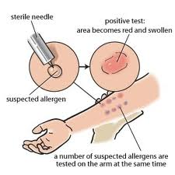
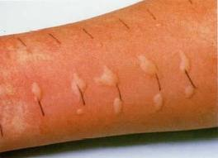
Allergy-skin test

Slide 16
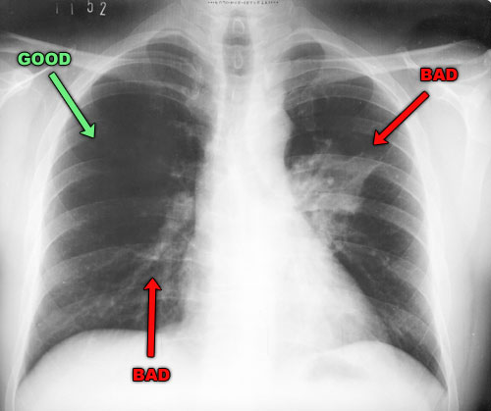
Chest X-Ray
If there are symptoms that may be caused by another condition such as pneumonia, your doctor may want to do a chest X-ray.
It also may help to clarify the problem if there is problem with asthma treatment.

Slide 17
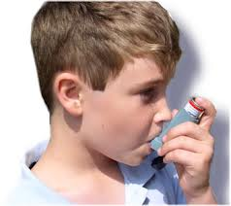
SIGNS AND SYMPTOMS
Common symptoms of asthma
Coughing, especially at night
Wheezing
Shortness of breath
Chest tightness, pain, or pressure

Slide 18
Symptoms of asthma attack
Mild asthma attack
Cough
Wheezing
Mild difficulty breathing during normal activities
Difficulty sleeping
Hiccups
Peak expiratory flow rate (PEFR) is 70 to 90% of personal best

Slide 19
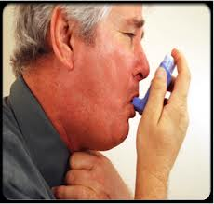
Moderate asthma attack
Severe cough
Moderate wheezing
Shortness of breath
Chest tightness
Usually worsens with exercise
Inability to sleep
Nasal congestion
PEFR is 50 to 70% of personal best

Slide 20
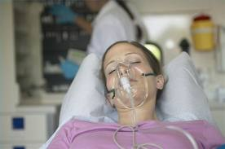
Severe asthma attack
Severe wheezing
Severe difficulty breathing
Inability to speak in complete sentences
Sentences are interrupted by breathing
Inability to lie down
Signs of severe difficulty breathing
Rib retractions: ribs are visible during each breath
Nasal flaring: nostrils open wide during each breath
Use of accessory muscles: neck muscles are prominent during each breath
Chest pain
Sharp, chest pain when taking a breath, coughing
PEFR is <50% of personal best
Confusion
Rapid pulse
Fatigue
Rapid breathing rate

Slide 21
TYPES OF ASTHMA
Allergic asthma (extrinsic)
Non-allergic asthma (intrinsic)
Cough variant asthma
Occupational asthma
Exercise induced asthma
Medication induced asthma
Nocturnal asthma

Slide 22
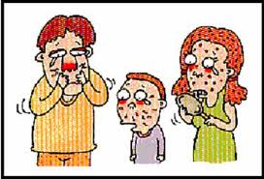
Allergic asthma (extrinsic)
It is triggered when you inhale one of the following allergens:
Tobacco smoke
Animal dander
Dust mites
Cockroaches
Molds
Pollens
Age onset over 40 y/o
Specific symptoms: runny nose, watery eyes, you are wheezing more, SOB, swollen nasal passages, excess mucus, and a scratchy throat. A cough may result from the constant postnasal drip

Slide 23
Non-allergic asthma (intrinsic)
Not triggered by allergens
Age onset under 40 y/o
Triggers:
Irritants- Tobacco smoke, wood smoke, room deodorizers, fresh paint, household cleaning products, cooking odours, workplace chemicals, perfumes, and outdoor air pollution, heartburn, changes in temperature.
Specific symptoms: Respiratory infections, such as the common cold, Influenza or a sinus infection.

Slide 24
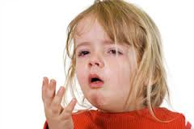
Cough variant asthma
When cough is the only asthma symptom, this is known as cough variant asthma (CVA)
Specific symptoms:
Chronic, non- productive cough
High sensitive cough reflex

Slide 25
Occupational asthma
A common respiratory condition that results from exposures in the workplace
Examples of the occupations and the potential irritants include:
Dental hygienists: latex
Bakers: flour
Roofers, insulators and painters: isocyanates (toluene)
Welders and metal workers: metals: metals (nickel, platinum and chromic acid)
Plastic manufacturers: glues and resins
Farmers and veterinarians: animal proteins
Carpenters: wood dust

Slide 26
Cont…
Specific symptoms:
Airway irritation, obstruction, and inflammation.
Worsening after arriving at work and improvement on weekends or during extended periods away from work.
Treatment :
Engineering controls (such as improved ventilation) to reduce or eliminate the substance
Use respiratory protective equipment

Slide 27
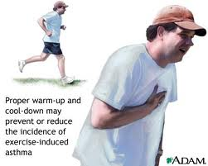
Exercise induced asthma
A type of asthma triggered by exercise or physical exertion
Specific symptoms:
SOB, chest tightness, and cough.
Symptoms may occur shortly after a brief episode of exercise or 10 to 15 minutes into a longer period of exercise.

Slide 28
Medication induced asthma
The asthma getting worse because of medication you take for another health condition.
Causes:
Anti- inflammatories for aches and pain: Motrin, Advil
Heart disease drugs :inderal, coreg (beta-blockers)
Glaucoma drugs: beta-blockers eyes drop
Hypertension and congestive heart failure drugs: angotensive converting enzyme inhibitors (ACE)

Slide 29
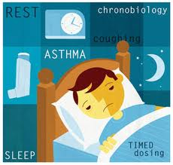
Nocturnal(night time) asthma
The chances of having asthma symptoms are much higher during sleep because asthma is powerfully influenced by the sleep-wake cycle (circadian rhythms)
Causes : Exposure to allergens, cooling of the airways, reclining position, hormone secretions that follow a circadian pattern, heartburn at night
Specific symptoms: wheezing, cough, and trouble breathing are common and dangerous, particularly at night time.

Slide 30
MEDICAL MANAGEMENT

Slide 31
Goals of Therapy
Minimal or no chronic symptoms day or night
Minimal or no exacerbations
No limitations on activities; no school/work missed
Maintain (near) normal pulmonary function
Minimal use of short-acting inhaled beta 2 agonist
Minimal or no adverse effects from medications

Slide 32
Long-term asthma control medication
Drugs | Function | Side effects
Inhaled corticosteroids (flovent, pulmicort, aerobid) | Reduce swelling and mucus production in airways | Poor growth, decreased bone density, varicella Infection (chickenpox that spreads to organs),cataracts & glaucoma
Long-acting beta agonists (LABA) : serevant, fulmoterol | Open the airways and reduce inflammation (need to be used with other combination inhalers) | Increases severity of asthma exacerbations and risk of fatal asthma episodes.
Leukotrine modifiers- oral medication (singulair,accolate) | Relieve asthma symptoms | Psychological reactions - agitation, aggression, hallucinations, depression & suicidal thinking/ headache, skin rashes

Slide 33
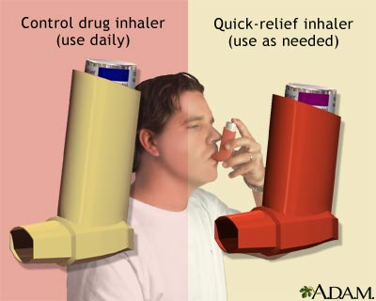
Bronchodilators
LABA

Slide 34
Quick-relief (rescue) medication
Drugs | Function | Side effects
Short-acting beta agonists (SABA) – albuterol, levalbulterol | -Can be taken using inhalers/nebulizers - Relax airway muscles | Appetite changes, dizziness, nausea nervousness, s inus pain, sore throat, tremor
Oral and intravenous corticosteroids (prednisone) | Relieve airway inflammation | Same as inhaled corticosteroids

Slide 35
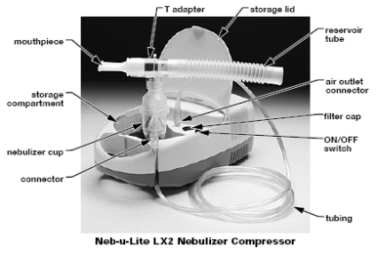
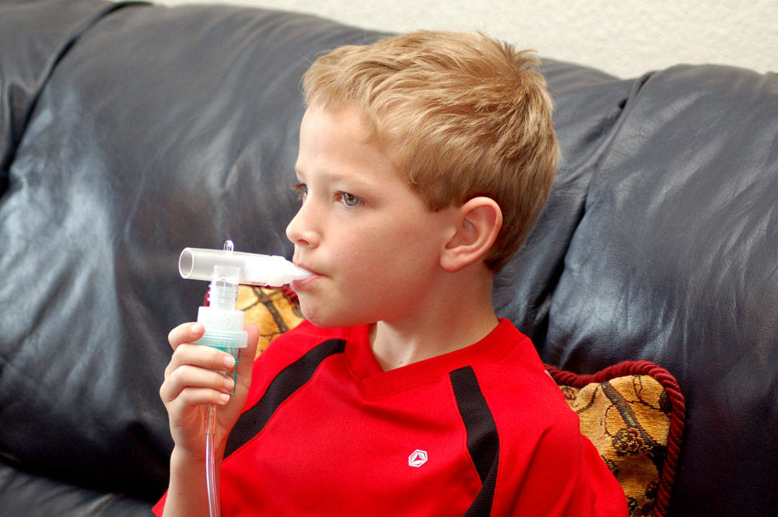
Asthma nebulizer
Changes asthma medications from a liquid to a mist, so that they can be more easily inhaled into the lungs.

Slide 36
Allergy medications
Drugs | Function | Side effects
Allergy shots (immunotherapy). | Reduce symptoms in people allergic to pollens, animal dander, dust mites, mold, and cockroaches | Redness, warmth at the shot site, low blood pressure
Omalizumab (Xolair). | - Given as an injection every two to four weeks (for people who have allergies,severe asthma) - Altering the immune system. | Sinusitis, headache, sore throat

Slide 37
Asthma control
Diet : eat diets higher in vitamins C and E, magnesium, and omega-3 fatty acids. Avoid seafood that may become allergens.
Exercise: short, intermittent periods of exertion
Stop smoking

Slide 38
Current Guidelines for Treatment

Slide 40
Mild Intermittent Asthma
Symptoms < 2 days/week
Symptoms < 2 nights/month
PEF or FEV₁ > 80%
PEF variability < 20%
No daily medication needed
PRN beta agonists
Course of systemic steroids for exacerbations

Slide 41
Mild Persistent Asthma
Symptoms > 2 days/wk but < 1x/day
> 2 nights/month
PEF or FEV₁ > 80%
PEF variability 20-30%
Preferred treatment low dose inhaled corticosteroids
Alternatives include cromolyn, leukotriene modifiers, necromodil, or sustained release theophylline

Slide 42
Moderate Persistent Asthma
Symptoms daily
> 1 night/week
PEF or FEV₁ > 60% and < 80%
PEF variability > 30%
Preferred treatment is low to medium dose inhaled corticosteroid and a long acting inhaled beta 2 agonist
Alternative includes increasing ICS within moderate dose range, or low to medium dose ICS with either leukotriene modifier or theophylline

Slide 43
Severe Persistent Asthma
Continual symptoms
Frequent nocturnal attacks
PEF or FEV₁ < 60%
PEF variability > 30%
Preferred treatment is high dose inhaled corticosteroid and long acting beta 2 agonists
If needed, can add systemic corticosteroids

Slide 44
Stepwise Approach
Review treatment every 1 to 6 months, and gradually step down treatment
If asthma controlled not maintained, then a step up in treatment may be warranted

Slide 45
Reasons for Poor Asthma Control
Inhaler Technique
Compliance
Environment
Also assess for an alternative diagnosis
“All that wheezes is not asthma, and not all asthma wheezes”

Slide 46
Factors Affecting Compliance
Support of health care professional and family
Route of drug administration (inhaled vs. oral)
Complexity of drug regimens
Side effects of medications
$$ Cost $$

Slide 47
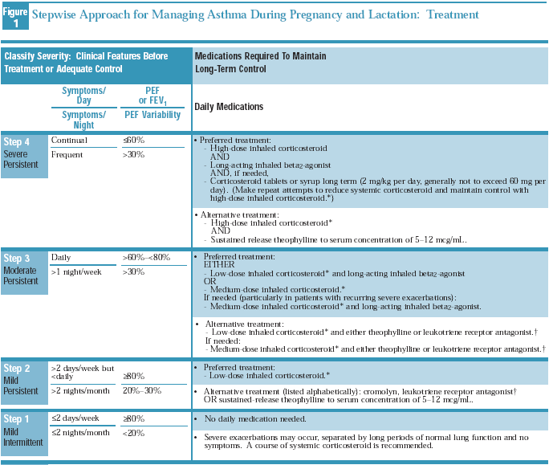

Slide 48
Patient care

