Slide 1
Al-mustansiryah University College of Pharmacy Dosage Form 0Design & Drug Delivery
Chapter-3
Current Good Compounding Practices
Fifth Stage
Ashti M.H. Saeed
Msc Drug Delivery

Slide 2
National Association of Boards of Pharmacy:
It discusses the following recommendations , include:
General provisions, provides two important definitions:
“Compounding” means the preparation, mixing, assembling, packaging, or labeling of a drug or device as well as it includes preparation of drug or device to fit the unique need of a patient.
“Manufacturing” means the production, preparation, propagation, conversion, or processing of a drug or device. It also includes preparation and promotion of commercially available products from bulk compounds for resale by practitioners, pharmacies or other persons.

Slide 3
Packaging, Labeling, and Storage of Pharmaceuticals
CONTAINER
It must provide adequate drug stability. Depending on the intended use and type of container, among the qualities tested are the following :-
Physicochemical properties
Light-transmission for glass or plastic
Drug compatibility
Leaching and/or migration
Vapour transmission for plastics
Moisture barrier
Toxicity for plastics
Valve, actuator, metered dose, particle size, spray characteristics, and leaks for aerosols
Sterility and permeation for parenteral containers
Drug stability for all packaging

Slide 4
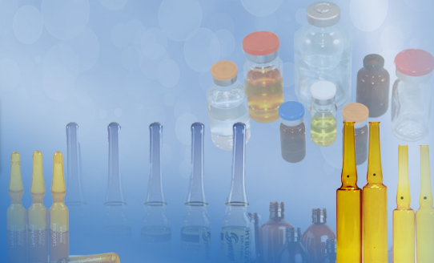
According to the USP,
a container is “that which holds the article and is
or may be in direct contact with the article.”
The immediate container
is “that which is in direct contact with the article at all times.” The closure is part of the container.
The container, including the closure, should be clean and dry before it is filled with the drug. And it must not interact physically or chemically with the drug so as to alter its strength, quality, or purity beyond the official requirements.

Slide 5
The USP classified containers to their ability to protect their contents from external conditions, as following:
1. A well- closed container: protects contents from solids and from loss under ordinary conditions of handling, shipment, storage, and distribution.
2. A tight container
3. A hermetic container: is impervious to air or any other gas under the ordinary conditions of handling, shipment, storage, and distribution.
4. A sterile hermetic container

Slide 6
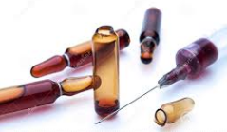
Vials are commonly the containers with a single-unit dose or a multiple-dose .
A single unit dose: is one that holds a quantity of drug intended as a single dose when opened cannot be resealed with assurance that sterility has been maintained. It includes fusion-sealed ampoules and prefilled system and cartridges.
A multiple dose container: is a hermetic container that permits withdrawal of successive portions of contents without changing the strength of endangering the quality or
purity of the remaining portion.

Slide 7
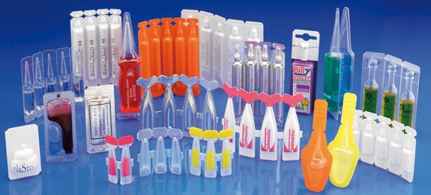
However, today most pharmaceutical products are packaged in plastic use of glass containers. The modern compact-type container used for oral contraceptives, which contains sufficient tablets for a monthly cycle of administration and permits the scheduled removal of one tablet at a time, is a prime example of contemporary plastic packaging.
Plastic bags for intravenous fluids, plastic ointment tubes, plastic film-protected suppositories, and plastic tablet and capsule vials are other examples.

Slide 8
Unit dose package
positive identification of each dosage unit and reduction of errors, reduced contamination of the drug.
packaging materials may be combinations of paper, foil, plastic, or cellophane.
Oral liquids
dispensed in single units in paper, plastic, or foil cups or prepackaged and dispensed in glass containers having threaded caps or crimped aluminum caps.
disposable plastic oral syringes with rubber or plastic tips on the orifice for closure.
suppositories, powders, ointments, creams, and ophthalmic solutions, are also commonly found in single-unit packages.
The quantity of drug product prescribed is packaged in a container Ex: if certain antibiotic capsules are prescribed to be taken 4 times a day for 10 days, unit-of-use packaging would contain 40 capsules. Other products may be packaged to contain a month's supply.

Slide 9
Light resistance container
Amber glass or a light-resistant opaque plastic will reduce light transmission sufficiently to protect a light-sensitive pharmaceutical.
ultraviolet absorbers may be added to plastic to decrease the transmission of short ultraviolet rays.
USP standards that define the acceptable limits of light transmission at any wavelength between 290 and 450 nm.
recent innovation in plastic packaging is the coextruded two-layer high-density polyethylene bottle, which has an inner layer of black polyethylene coextruded with an outer layer of white polyethylene.
The container provides:
light resistance.
moisture protection. -Increasingly being used in packaging of tablets and capsules.

Slide 10
Glass used in packaging pharmaceuticals
The glass used in packaging pharmaceuticals falls into four categories, depending on the chemical constitution of the glass and its ability to resist deterioration
Types I, II, and III intended for parenteral products, and type IV: NP is intended for other products.
Each type tested according to resistance to water attack.
Degree of attack is determined by amount of alkali released from glass in specified test conditions.
leaching of alkali from glass to preparation could alter pH and/or Stability of product.
Type I is most resistant glass of 4 categories.

Slide 11
The widespread use of plastic containers arose from a number of factors, including the following:
Its advantage over glass in lightness of weight and resistance to impact, which reduces transportation costs and losses due to container damage
The versatility in container design and consumer acceptance
Consumer preference for plastic squeeze bottles in administration of ophthalmic, nasal sprays, and lotions.
The popularity of blister packaging and unit-dose dispensing, particularly in health care institutions.

Slide 12
THANK YOU

