Slide 1
Preformulation
Industrial pharmacy
Part 2

Slide 2
Solubility Analysis
Preformulation solubility studies focus on:
Drug-solvent systems that could occur during the delivery of a drug candidate.
E.g.: a drug for oral administration should be examined for solubility in media having isotonic chloride ion concentration and acidic pH.
understanding drug's solubility profile and possible solubilization mechanisms that provides a basis for later formulation work.
Preformulation solubility studies usually include:
Determination of pka
Temp. dependence
pH solubility profile
Solubility products
Solubilization mechanisms
Rate of dissolution.

Slide 3
Analytic methods useful for solubility measurements include:
HPLC (reverse phase HPLC used for most drugs)
UV spectroscopy
Fluorescence spectroscopy
Gas chromatography.
Factors affecting solubility and dissolution experiments:
Advantages:
1- Direct analysis of aqueous samples
2- High sensitivity
3- Specific determination of drug conc. due to chromatographic separation of drug from impurities or degradation products.
pH
Temperature
Ionic strength
Buffer concentrations.

Slide 4
Equilibrium solubility determination:
1- An excess amount of drug is dispersed in a solvent that is agitated at a constant temperature.
2-Samples are: a- withdrawn as a function of time, b- clarified by centrifugation, c- and assayed to establish a plateau concentration.
Problem of this method:
A- Sample may involve adsorption or incomplete removal of the excess drug during filtration or centrifugation steps.
B- If excess drug is not a solid but an oil, sample preparation may be even more difficult.
C- Drugs capable of ionization may require different methods of removing excess drug, owing to altered adsorption properties.

Slide 5
Characterization of samples:
Filtered saturated solutions examined using a high-intensity light beam to detect the presence of a finely dispersed oil or solid.
Solutions examined conveniently with a light microscope (particles or droplets of 1 ϻ or greater can be distinguished if present in sufficient concentration).
Note: 1- Solubility values that are useful in a candidate's early development are those in: D.W., 0.9% NaCl, 0.01M HCl, 0.1M HCl, and 0.1M NaOH, all at room temp. as well as at pH 7.4 buffer at 37°C.
Developing suspensions or solutions for toxicological and pharmacological studies.
Identify candidates with a potential for bioavailability problems.
2- Drugs having limited solubility (< 1%) in the fluids of GIT often exhibit poor or erratic absorption unless D.F. are specifically tailored for the drug.

Slide 6
pKa Determinations
Determination of the dissociation constant for a drug capable of ionization within a pH range of 1 to 10 is important?
since solubility and consequently absorption can be altered by orders of magnitude with changing pH.
The Henderson Hasselbalch equation provides an estimate of the ionized and un-ionized drug concentration at a particular pH.
For acidic compounds For basic compounds:

Slide 7

For a weakly acidic drug with pKa value greater than 3: the un-ionized form is present within the acidic contents of the stomach, but the drug is ionized predominately in the neutral media of the intestine.
For basic drugs such as erythromycin and papaverine (pKa 8 to 9): the ionized form is predominant in both the stomach and intestine.
Important note: The un-ionized drug molecule is the species absorbed from GIT
But: rate of dissolution, lipid solubility, common ion effects, and metabolism in the GIT can shift or reverse predictions of the extent and site of absorption based on pH alone.
Percent Ionized Formula
where x = -1 if acid drug or 1 if basic drug

Slide 8
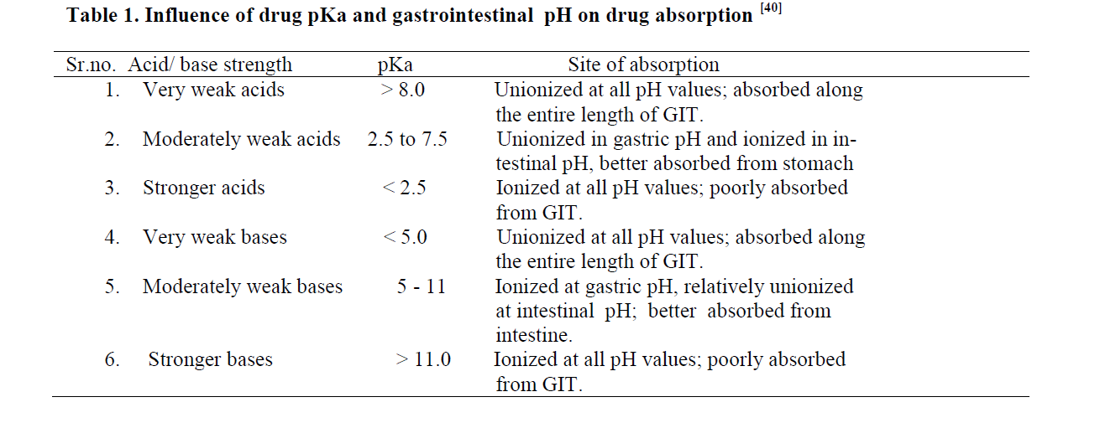

Slide 9
A pKa value can be determined by a variety of analytic methods:
Preferred methods for detection of spectral shifts:
1- Ultraviolet (UV) and Visible spectroscopy
2- Second method, potentiometric titration:
Buffer
Temperature
Ionic strength
Cosolvent affect.
since dilute aqueous solutions analyzed directly.
offers Max. sensitivity for compounds with pKa values (3-10) but is often hindered by ppt. of the un-ionized form during titration since a high drug conc. is required to obtain a significant titration curve.

Slide 10
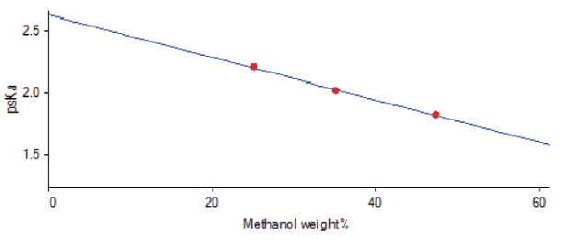
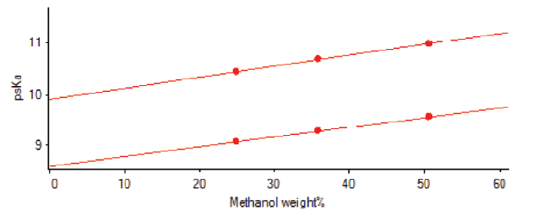
Solving problem of ppt: Cosolvent (methanol or dimethylsulfoxide) incorporated to maintain sufficient solubility for the un-ionized species, and the pKa value is extrapolated from titration data collected for various cosolvent conc.
The use of cosolvent yields higher pKa values for acids and lower values for bases than does pure water (Increasing the cosolvent ratio lowers the dielectric constant of the medium. This stabilizes the neutral species relative to the ionized species)
For this third method, pKa corresponds to the pH of the solution (where the equilibrium solubility is twice the value for the intrinsic solubility of the un-ionized form) so increase solubility of insoluble drugs.
Fig: Variation in apparent pKa with methanol ratio for benzocaine, a weak base (up) and hydrochlorothiazide, a weak acid (down). In general, base pKas decrease and acid pKas increase with increasing solvent ratio.

Slide 11
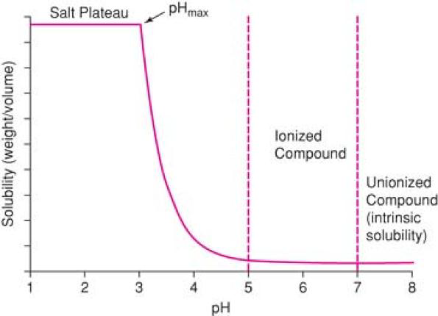

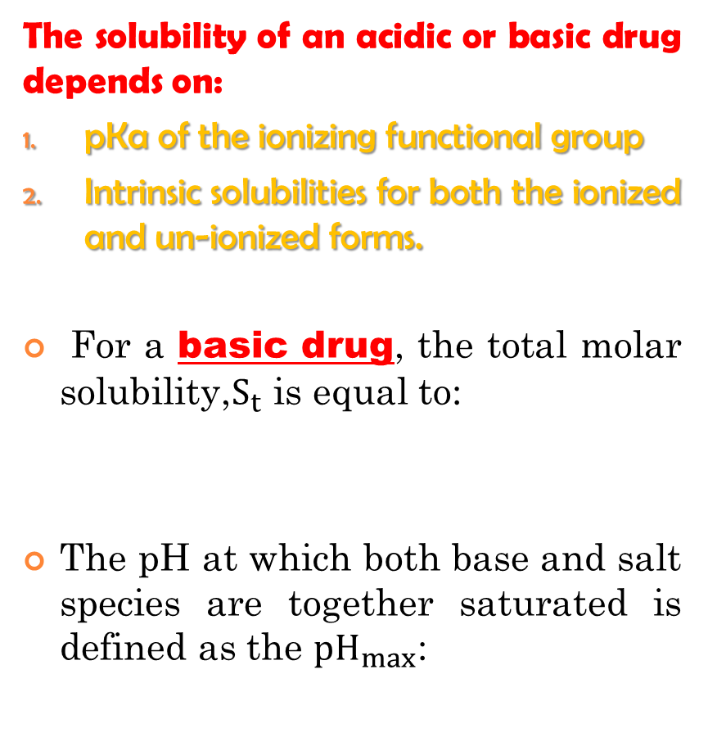
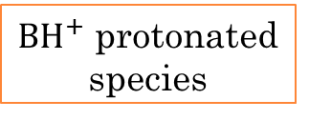
pH Solubility Profile and Common Ion Effects
The solubility of an acidic or basic drug depends on:
pKa of the ionizing functional group
Intrinsic solubilities for both the ionized and un-ionized forms.
For a basic drug, the total molar solubility,$S_{t}$ is equal to:
The pH at which both base and salt species are together saturated is defined as the ${pH}_{max}$:
${BH}^{+}$ protonated species
B free base

Slide 12
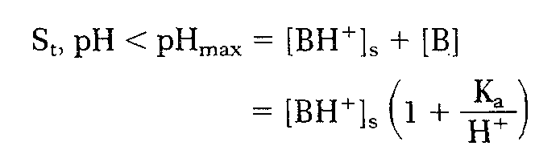
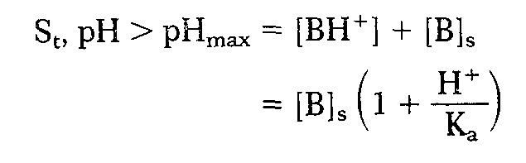
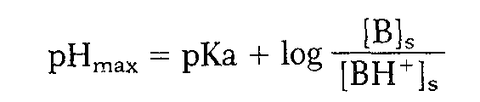
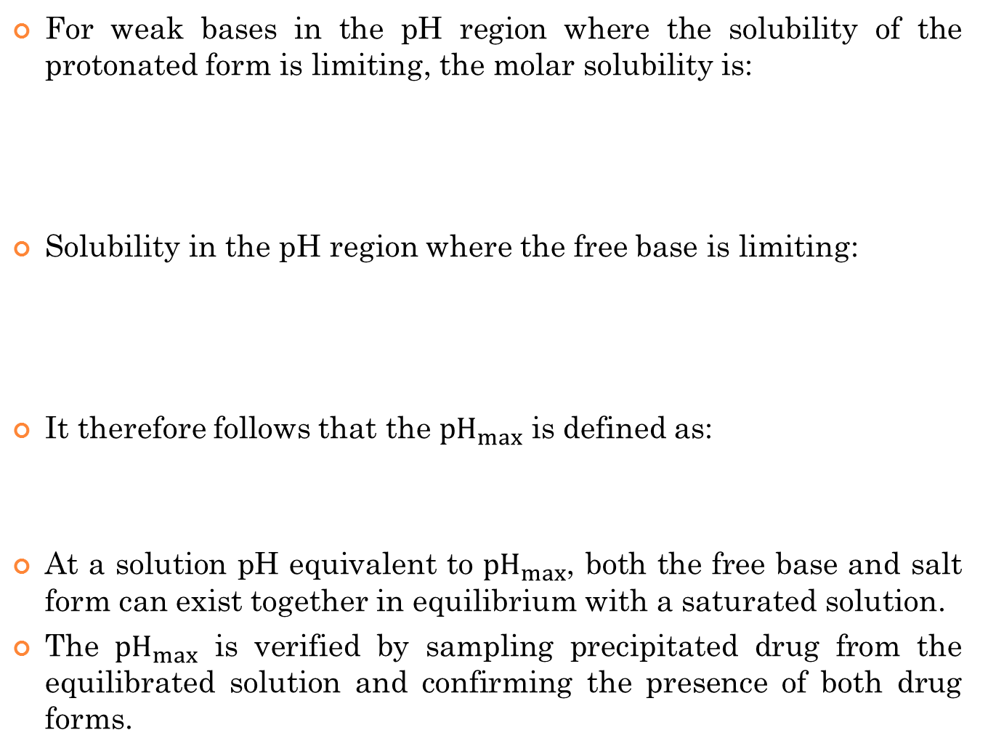
For weak bases in the pH region where the solubility of the protonated form is limiting, the molar solubility is:
Solubility in the pH region where the free base is limiting:
It therefore follows that the ${pH}_{max}$ is defined as:
At a solution pH equivalent to ${pH}_{max}$, both the free base and salt form can exist together in equilibrium with a saturated solution.
The ${pH}_{max}$ is verified by sampling precipitated drug from the equilibrated solution and confirming the presence of both drug forms.

Slide 13
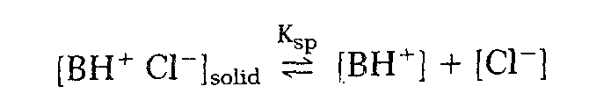


When the ionized or salt form of a drug is the solubility-limiting species in solution, the concentration of the paired counter ion is usually the solubility determining factor.
Ex: For a hydrochloride salt of a basic amine, the equilibrium between the solid and ionized species in solution is approximated by the following expression:
where Ksp is the solubility product for the protonated species and chloride counter ion, or:
If the contribution of the un-ionized species is negligible as compared with the protonated form the total drug solubility decreases as the chlorlde ion concentration increases. In this case, the apparent solubility product is defined as:
Experimental determination of a solubility product should include measurement of pH as well as assays of both drug and counter ion concentrations.

Slide 14

Summary: Variables affecting aqueous solubility profiles for ionizable compounds over large pH ranges with varying counter ion concentrations for an organic amine drug:
These parameters also depend on ionic strength, temperature, and the aq. media composition.
Note: pH solubility profiles can appear dramatically different for compounds with similar functional groups.
Ex: The pH solubility profile for doxycycline (pKa 3.4) with a common ion effect for an amine hydrochloride salt.
The solubility in aqueous medium with pH 2 or less logarithmically decreased as a function of pH (which was adjusted with hydrochloric acid) because of corresponding increases in the chloride ion concentration.
In gastric juice, where the pH can range from 1 to 2 and the chloride ion concentration is between 0.lM and 0.15M, doxycycline hydrochloride dihydrate has a solubility of ~4 mg/ml, which is a factor of 7 less than its solubility in distilled water.

Slide 15
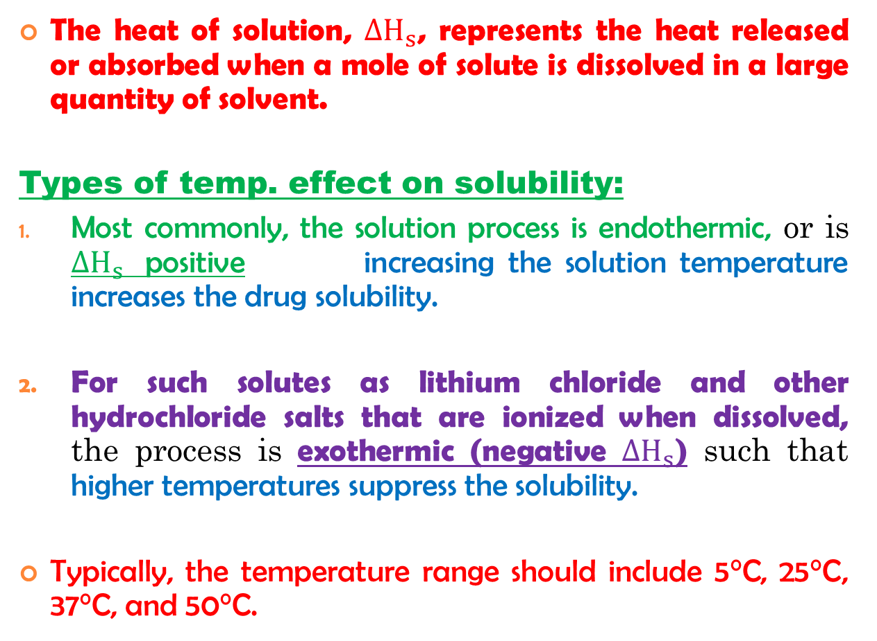
Effect of Temperature
The heat of solution, ${ΔH}_{s}$, represents the heat released or absorbed when a mole of solute is dissolved in a large quantity of solvent.
Types of temp. effect on solubility:
Most commonly, the solution process is endothermic, or is ${ΔH}_{s}$ positive increasing the solution temperature increases the drug solubility.
For such solutes as lithium chloride and other hydrochloride salts that are ionized when dissolved, the process is exothermic (negative ${ΔH}_{s}$) such that higher temperatures suppress the solubility.
Typically, the temperature range should include 5°C, 25°C, 37°C, and 50°C.

Slide 16
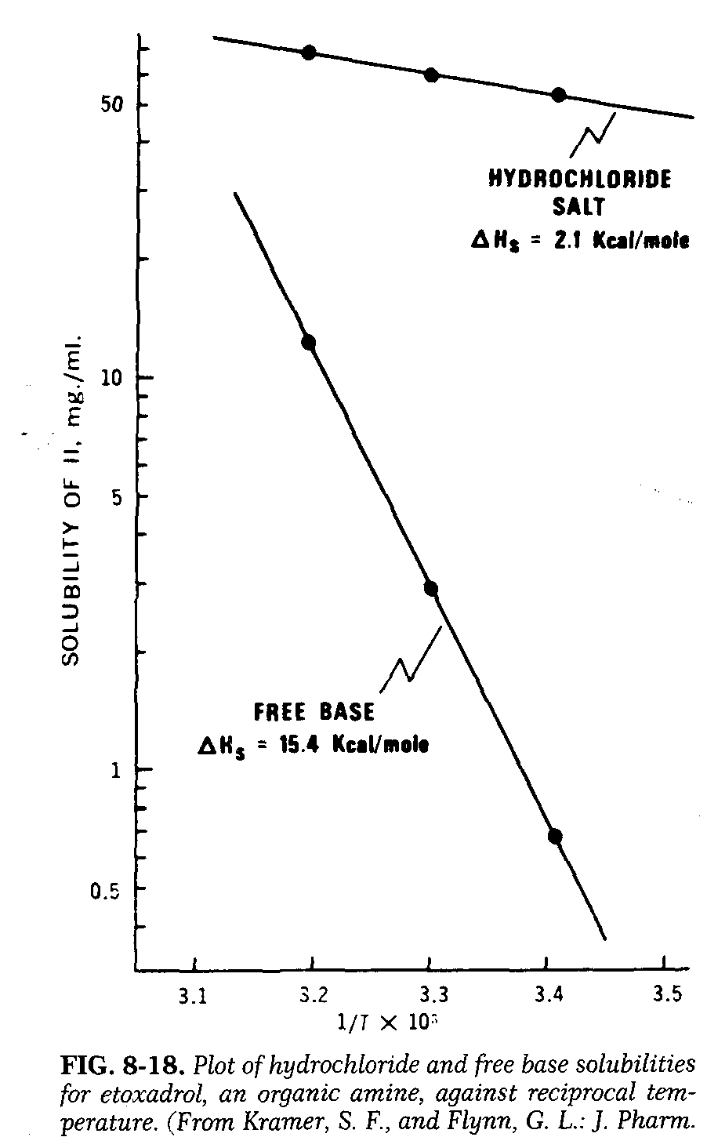
For nonelectrolytes and un-ionized forms of weak acids and bases dissolved in water, heats of solution are in the range of 4 - 8 kcal/mole.
Salt forms of drugs are less sensitive to temperature and may have heats of solution between -2 and 2 kcal/mole.
Note: 10° change in temperature produces a fivefold change in solubility.
Affect solution dosage form design and storage conditions.

Slide 17
Solubilization
A general means of increasing solubility is the addition of a cosolvent to the aqueous system (For drug candidates with either poor water solubility or insufficient solubility for projected solution dosage forms).
Ex: The Solubility of poorly soluble nonelectrolytes can be improved by orders of magnitude with suitable cosolvents (ethanol, propylene glycol, and glycerin).
Mechanism: These cosolvents solubilize drug molecules by disrupting the hydrophobic interactions of water at the nonpolar solute/water interfaces.
Depends on the chemical structure of the drug (more nonpolar the solute, the greater is the solubilization achieved).

Slide 18
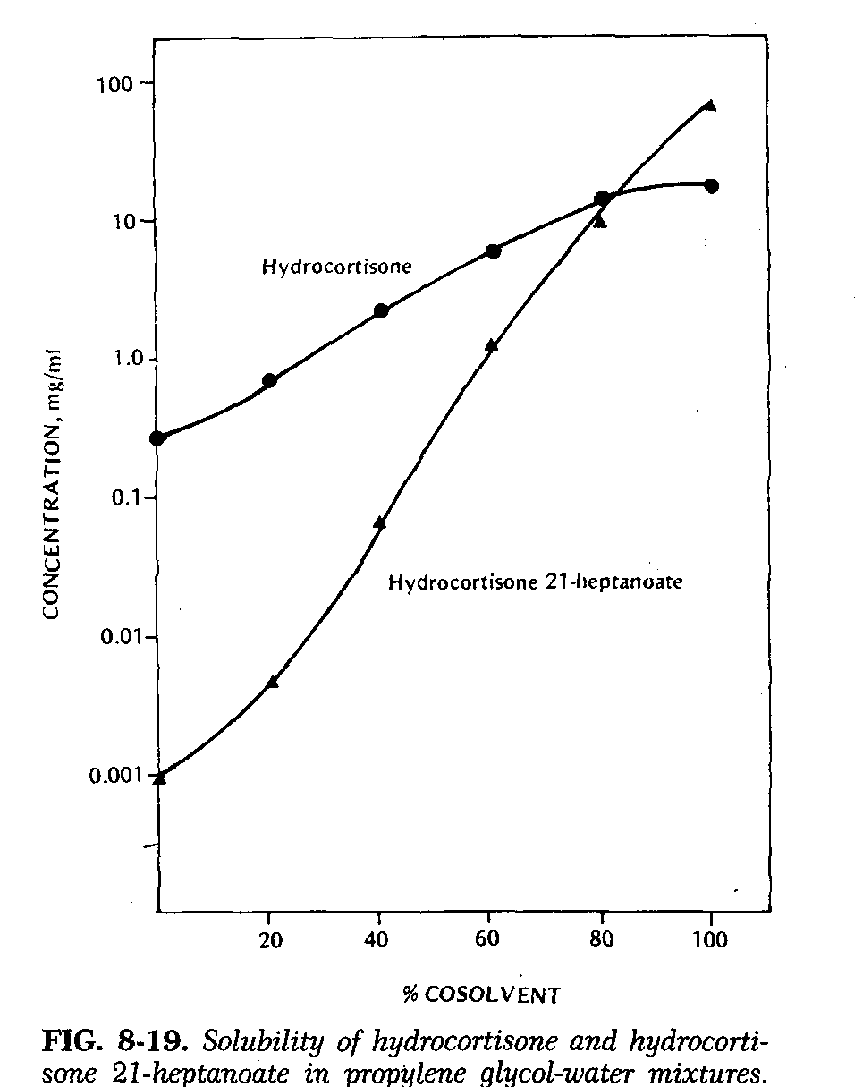
For hydrocortisone and hydrocortisone 21-heptanoate (lipophilic ester) is solubilized to a greater extent by additions of propylene glycol than by the more polar parent compound.
Other ways of solubilizing poorly soluble drugs:
Micellar solutions such as 0.0lM Tween 20
Molecular complexes as with caffeine.

Slide 19

Partition Coefficient
A measurement of a drug's lipophilicity and an indication of its ability to cross cell membranes is the oil/water P.C. in systems such as octanol/water and chloroform/water.
P.C. is defined as the ratio of un-ionized drug distributed between the organic phases and aqueous phases at equilibrium.
For drug delivery, the lipophilic/hydrophilic balance has been shown to be a contributing factor for the rate and extent of drug absorption.

Slide 20
Dissolution
Dissolution of a drug particle is controlled by several physicochemical properties including:
Dissolution equilibrium solubility data
Identify potential bioavailability problem areas.
Chemical form
Crystal habit
Particle size
Solubility
Surface area
wetting properties

Slide 21

Ex: dissolution of solvate and polymorphic forms of a drug can have a significant impact on bioavailability and drug delivery.
The dissolution rate of a drug substance in which S.A. is constant during dissolution described by the modified Noyes-Whitney eq.:
Note: 1- If S.A. of the drug is held constant and Cs > > C
2- Constant surface area is obtained by compressing powder into a disc of known area with a die and punch apparatus (Problem with this method: Transformations of the crystal form (polymorphic transformations or desolvation) during its compression into a pellet or during the dissolution experiment).

Slide 22
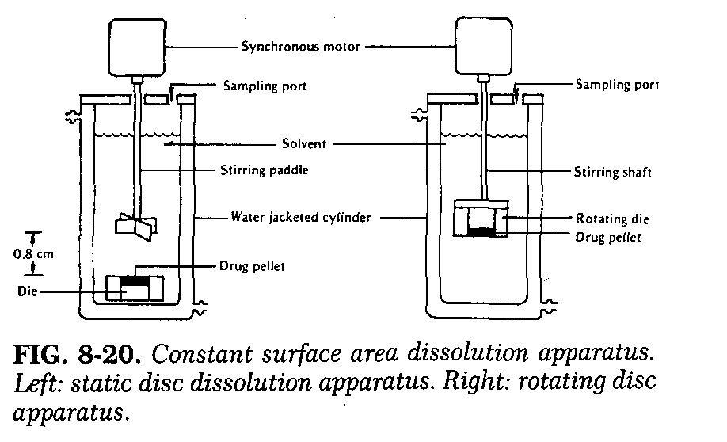
Two systems can be used to maintain uniform hydrodynamic conditions (k constant):
The rotating disc method or Wood's apparatus permits the hydrodynamics of the system to be varied in a mathematically well-defined manner.
The static disc method is used because it is conveniently available.
But it contains an element of undefined turbulence, which necessitates calibration with standards.

Slide 23
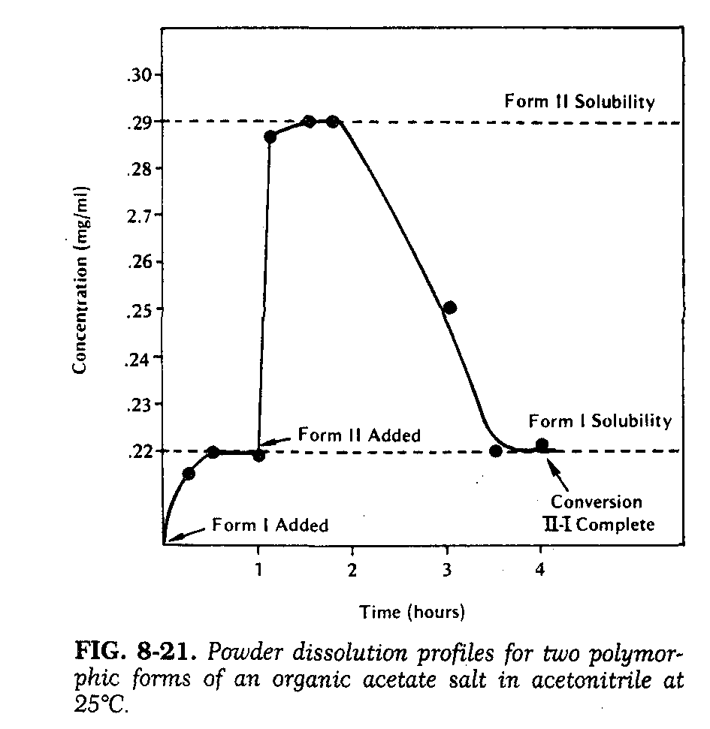
Dissolution with drug suspensions are complicated by:
changing surface area
changing surface crystal morphology
interstitial wetting.
However, dissolution profiles with excess drug can be used to characterize metastable polymorphs or solvates.
Ex in the figure: conversion of the metastable form II to form I (thermodynamically stable form at room temperature) is shown to occur in an organic solvent medium
Static pellet dissolution rates also substantiated that form II was the higher energy form since its dissolution rate was significantly greater.

Slide 24
Stability Analysis
These studies include both solution and solid state experiments under conditions typical for: handling, formulation, storage, and administration of a drug candidate.
High-performance liquid chromatography has emerged as the analytic method of choice for specificity and quantitation
Solution Stability
These studies include the effect of: (pH, ionic strength, cosolvent, light, temperature, and oxygen).
1- Solution stability investigations experiments to confirm decay at the extremes of pH and temp. (e.g.: 0.1 N HCI, water and 0.1 N NaOH all at 90°C).
A- These degraded samples confirm assay specificity as well as to provide estimates for Max. rates of degradation.
B- Followed by a complete pH-rate profile to identify the pH of Max. stability.

Slide 25
Aq. buffers are used to: produce solutions over a wide range of pH values with constant levels of drug, cosolvent, and ionic strength.
2- Solution for parenteral routes of administration: should have an initial pH-rate study at a constant ionic strength that is compatible with physiologic media (The ionic strength (ϻ) of an isotonic 0.9% sodium chloride solution is 0.15).
Important note: all ionic species (even the drug molecules) in the buffer solution must be considered in computing ionic strength.

Slide 26
Cosolvents may be needed to achieve drug conc. for analytic sensitivity, or to produce a defined initial condition.
If several cosolvent levels are used
Decay rates may vary linearly with the reciprocal of the resulting solution dielectric constant. The apparent pH of a buffer solution also varies, owing to the presence of cosolvent.
Application: stability solutions are prepared by: aliquots are placed in flint glass ampules, flame sealed to prevent evaporation, and stored at constant temperatures not exceeding the boiling point of the most volatile cosolvent or its azeotrope.
Note: Some of ampules stored at a variety of temp. to provide data for calculating activation energies.

Slide 27
Light stability test of solution samples
Application: protective packaging in amber and yellow-green glass containers.
Control samples for this light test stored in cardboard packages or wrapped in aluminum foil.
Oxidation is initially unknown, some of the solution samples should also be subjected to further testing:
excessive headspace of oxygen
headspace of an inert gas such as helium or nitrogen
inorganic antioxidant such as sodium metabisulfite
organic antioxidant such as butylated hydroxytoluene- BHT.
Ex: Headspace composition can be controlled if the samples are stored in vials for injection that are capped with Teflon-coated rubber stoppers.
After penetrating the stoppers with needles, the headspace is flooded with the desired atmosphere, and the resulting needle holes are sealed with wax to prevent degassing.

Slide 28
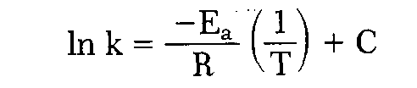
Note: An Arrhenius plot is constructed by plotting the logarithm of the apparent decay rate constant versus the reciprocal of the absolute temperature at which each particular buffer solution was stored during the stability test. stability storage temp. should be selected that incrementally (Δt ~ 10°C) approach the anticipated "use" temp.
If this relationship is linear, one may assume a constant decay mechanism over this temperature range and calculate an activation energy (Ea) from the slope (-Ea/R) of the line described by:
where C is a constant of integration and R is the gas constant.
A broken or nonlinear Arrhenius plot suggests a change in the rate-limiting step of the reaction or a change in decay mechanism, thus making extrapolation unreliable.
In a Solution-state oxidation reaction, for example, the apparent decay rate constant decreases with elevation of temperature? because the solubility of oxygen in water decreases.

Slide 29
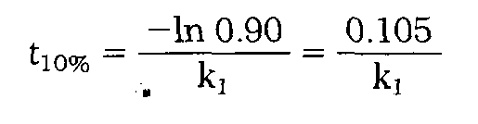
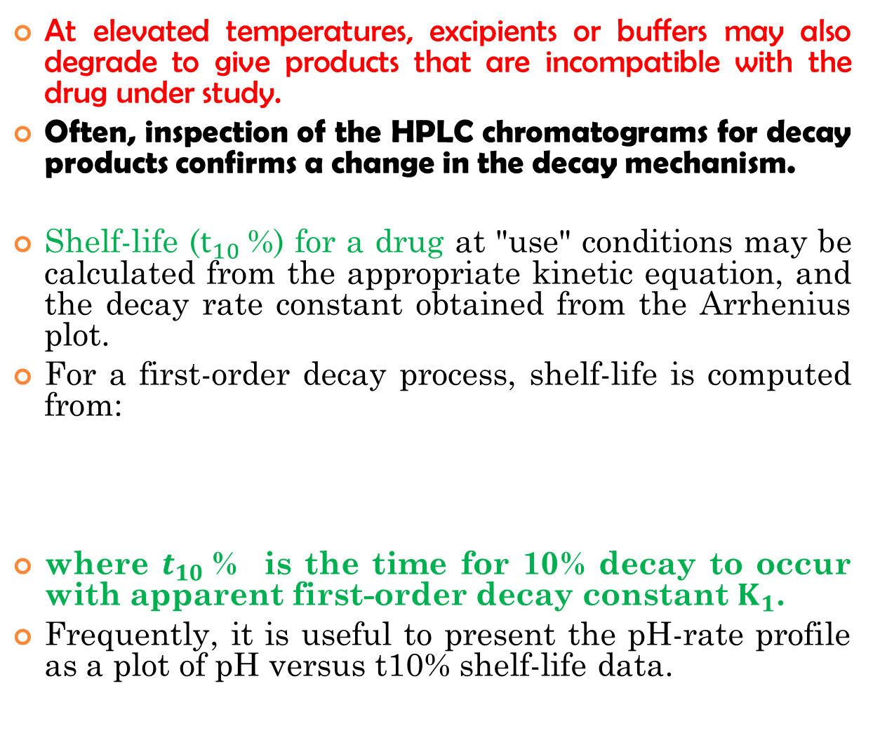
At elevated temperatures, excipients or buffers may also degrade to give products that are incompatible with the drug under study.
Often, inspection of the HPLC chromatograms for decay products confirms a change in the decay mechanism.
Shelf-life ($t_{10}$%) for a drug at "use" conditions may be calculated from the appropriate kinetic equation, and the decay rate constant obtained from the Arrhenius plot.
For a first-order decay process, shelf-life is computed from:
where $t_{10}$% is the time for 10% decay to occur with apparent first-order decay constant $K_{1}$.
Frequently, it is useful to present the pH-rate profile as a plot of pH versus t10% shelf-life data.

Slide 30
Solid State Stability
Primary objectives of this investigation:
Identification of stable storage conditions for drug in the solid state.
Identification of compatible excipients for a formulation.
Contrary to the solution stability profile, these solid state studies severely affected by changes in purity and crystallinity.
Solid state reactions are much slower and more difficult to interpret than solution state reactions?
Answer: 1- owing to a reduced no. of molecular contacts between drug and excipient molecules.
2- occurrence of multiple phase reactions.

Slide 31
Important note on studying the solid state stability study:
Solid state analysis of slow solid state degradation based on: Retention of intact drug (that may fail to quantitate clearly the compound's shelf-life)
Assay variation may equal or exceed the limited apparent degradation, particularly at the low temp. (room-temp. shelf-life).
Correction:
Analysis of the appearance of decay product(s), which may total only 1 to 5% of the sample.
Additional analytic data by (TLC, fluorescence, or UV/VIS spectroscopy) to determine precisely the kinetics of decay product(s) appearance, and to establish a room-temperature shelf-life for the drug candidate.

Slide 32
Assay of solid state reactions studies for the intact compound.
Polymorphic changes, detected by DSC or IR.
Surface discoloration (due to oxidation or reaction with excipients), surface reflectance measurements on tri-stimulus or diffuse reflectance equipment may be more sensitive than HPLC assay.
Application 1: To determine the solid state stability profile of a new compound
Weighed samples are placed in open screw cap vials and are exposed directly to a variety of temp., humidities, and light intensities for up to 12 weeks.
Samples consist of three 5-10 mg weighed samples at each data point for HPLC analysis and approximately 10 to 50 mg of sample for polymorph evaluation by DSC and IR ( ~2 mg in KBr and -20 mg in Nujol).

Slide 33
Application 2: surface oxidation test
Samples stored in large (25-ml) vials for injection capped with a Teflon-lined rubber stopper and the headspace flooded with dry oxygen.
A second set of vials tested in which the atmosphere is flooded with dry nitrogen (to confirm that the decay observed is due solely to oxygen rather than to reduced humidity).
After a fixed exposure time (samples removed and analyzed by multiple methods to check for chemical stability, polymorphic changes, and discoloration).
Results of the decay process may be analyzed by:
Either zero-order or first-order kinetics (if the amount of decay is less than 15 to 20%).
The same kinetic order should be used to analyze the data at each temperature if possible.
Samples exposed to oxygen, light, and humidity may suggest the need for a follow up stability test.

Slide 34
Important note:
If humidity is not a factor in drug stability
Arrhenius plot may be constructed (if linear, it may be extrapolated to "use" conditions for predicting a shelf-life).
If humidity directly affects drug stability
Conc. of water in the atmosphere may be determined from the relative humidity and temperature by using psychrometric charts.

Slide 35
Compatibility between bulk drug with excipients stability studies:
Must be established during production of solid D.F.
No. of excipients may be reduced by considering the results of the solid state and solution stability profiles.
E.g. 1- compound with bulk instability at high humidity formulated with anhydrous excipients.
2- pH of Max. drug stability should match the pH of an aqueous suspension or solution of the drug and excipient.

Slide 36
Application:
Excipient blended with the drug at levels with respect to a final dosage form (e.g., 10:1 drug to disintegrant and 1:1 drug to filler such as lactose).
Each blend is then divided into weighed aliquots (tested for stability at elevated temp. (50°C) but lower than the M.P. of ingredients.
Early inspection (ΔT≈ 2 days) of these stability samples may allow removing or select of those samples with a phase change and allow for re-testing at a lower temp.
Note: In addition small batches of hypothetical capsule or tablet (2 or more) should be prepared and tested in the same stability protocol (to check for possible incompatibilities arising from a multicomponent formulation).

Slide 37
Solid granulation formulations stability study:
Application: Checked by excessive wet down and drying (in a 50°C forced air oven for 48 hours) of samples of the unformulated bulk, excipient-drug blends and the hypothetic formulations.
Note: These wet downs should utilize only pharmaceutically acceptable solvents with and without such approved binders as methylcellulose and PVP.
Besides chemical stability, the unformulated bulk samples exposed to each granulation solvent should be checked for:
Crystallinity, polymorph conversion, and solvate formation
severely alter dissolution or bioavailability.

Slide 38
