Slide 1
Preformulation
Industrial pharmacy
Part 1

Slide 2
Prefeormulation
These studies that focus on physicochemical properties of the new compound affect drug performance and development of an efficacious dosage form.
Preliminary evaluation and molecular optimization
Once a pharmacologically active compound has been identified
The project team consisting of representatives from the disciplines has responsibility for assuring that the compound enters the development process in its optimum molecular form.
The physical pharmacist must focus on how the product will be formulated and administered to patients.

Slide 3
If the first quality sample of the new drug is available
(probing experiments should be conducted to determine for each suspected problem area).
If a deficiency is detected
The project team should decide on the molecular modification(s) to improve the drug's properties.
Ex: Salts, prodrugs, solvates, polymorphs.

Slide 4
Salts:
Salts of organic compounds are formed by the addition or removal of a proton to form an ionize drug molecule, which is then neutralized with a counter ion.
Ex: Ephedrine hydrochloride (organic salts that is more water-soluble than the corresponding un-ionized molecule, and having more dissolution rates, and possibly improving bioavailability).
Problems associated with salt formation:
1- poor crystallinity
2- various degrees of solvation or hydration
3- hygroscopicity
4- instability due to an unfavorable pH in the crystalline microenvironment.

Slide 6
Prodrugs:
Formed with any organic molecule having a chemically reactive functional group.
Prodrugs: synthetic derivatives (e.g., esters and amides) of drug molecules that may have intrinsic pharmacologic activity but usually must undergo some transformation in vivo to liberate the active drug molecule.
Note: through the formation of a prodrug, a variety of side chains or functional groups may be added (to improve the biologic and/or pharmaceutical properties of a compound).

Slide 7
Biological response parameters that altered by prodrug formation are:
Absorption due to increased lipophilicity or increased water solubility
Duration of action via blockade of a key metabolic site
Distribution to organs due to changes in lipophilicity.
Ex: steroid and prostaglandin prodrug
Pharmaceutical improvements resulting from prodrug formation include:
Stabilization
Increase or decrease in solubility
Crystallinity
Taste
Odor
Reduced pain on injection.

Slide 8
Ex: Erythromycin estolate (prodrug with improved pharmaceutical properties)
Problem: In aqueous solutions, protonated erythromycin is water-soluble, has a bitter taste, and is rapidly hydrolyzed in gastric acid (t10% = 9 sec) to yield inactive decay products.
Solution: water-insoluble lauryl sulfate salt of the propionate ester prodrug (estolate) was formed for use in both suspension and capsule dosage forms. But: Erythromycin propionate is inactive as an antimicrobial and must undergo ester hydrolysis to yield bioactive erythromycin.
Ex: In an oral q.i.d. bioavailability comparison between enteric coated tablet of erythromycin base and non enteric capsule erythromycin estolate.
lipophilic ester prodrug was absorbed four times more efficiently than the formulated free base, but hydrolyzed only 24% in serum to produce equivalent plasma levels of bioactive erythromycin base.
prodrug was used to overcome a pharmaceutical formulation problem without compromising bioavailability.

Slide 9
Problem of prodrug:
Prodrugs that have been esters or amides designed to increase lipophilicity.
Decreases water solubility and thus decreases the concentration gradient across the cell membrane, which controls the rate of drug absorption.
Solution: making of water soluble prodrugs by adding selected amino acids (ex: lysine ester prodrug of estrone) that are substrates for enzymes located in the intestinal brush border.
Assuming that enzyme cleavage was not rate-limiting, and that the liberated drug molecule would remain in the lipophilic membrane, then the resulting membrane transport of the parent compound should be very rapid, owing to the large concentration gradient of liberated drug across the membrane.

Slide 10
Once the optimum molecular form of a drug has been selected
Formulation development initiates
Prompts other disciplines to begin their task in the drug development process
The objective of this phase is the quantitation of those physical chemical properties that will assist in developing a stable, safe, and effective formulation with maximum bioavailability.

Slide 11
Bulk Characterization
Bulk properties for the solid form, such has particle size, bulk density and surface morphology, are also likely to change during process development.
1. Crystallinity and Polymorphism
Crystal habit and the internal structure of a drug can affect bulk and physicochemical properties, which range from flowability to chemical stability.
Crystal habit: is the description of the outer appearance of a crystal.
Internal structure: is the molecular arrangement within the solid.

Slide 12
A single internal structure for a compound can have several different habits, depending on the environment for growing crystals.
Changes with internal structure usually alter the crystal habit while such chemical changes as conversion of a sodium salt to its free acid form produce both a change in internal structure and crystal habit.
Characterization of a solid form involves:
(1) verifying that the solid is the expected chemical compound
(2) characterizing the internal structure
(3) describing the habit of the crystal.

Slide 13
The internal structure of a solid can be classified as:
crystalline or amorphous
Crystals: are characterized by repetitious spacing of constituent atoms or molecules in a 3D array.
Amorphous forms: have atoms or molecules randomly placed as in a liquid.
Note: amorphous forms are usually of higher thermodynamic energy than crystalline forms
solubilities as well as dissolution rates are greater.
Disadv. of amorphous : Upon storage, amorphous solids tend to revert to more stable forms thermodynamic instability, which occur during bulk processing or within dosage forms.

Slide 14
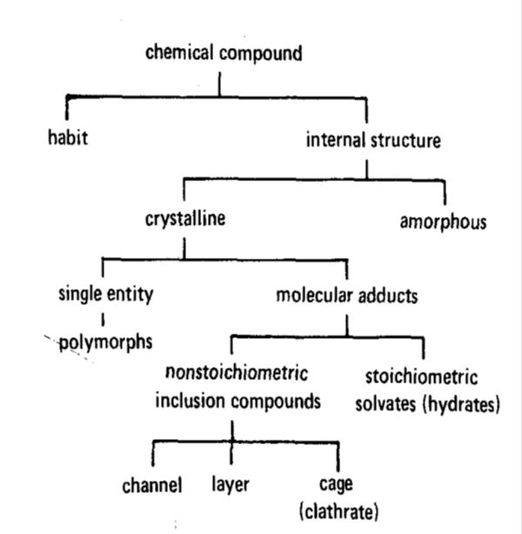
A crystalline compound contain either: stoichiometric or nonstoichiometric amount of crystallization solvent.
Nonstoichiometric adducts (inclusions or clathrates) involve entrapped solvent molecules within the crystal lattice.
Disadv: undesirable, owing to its lack of reproducibility, and should be avoided for development.
Stoichiometric adduct (solvate) crystallizing solvent molecules incorporated into specific sites within the crystal lattice.
Note: When the incorporated solvent is water, the complex is called a hydrate, and the terms hemihydrate, monohydrate, and dihydrate describes hydrated forms while if a compound is not containing any water within its crystal structure is termed anhydrous.

Slide 15
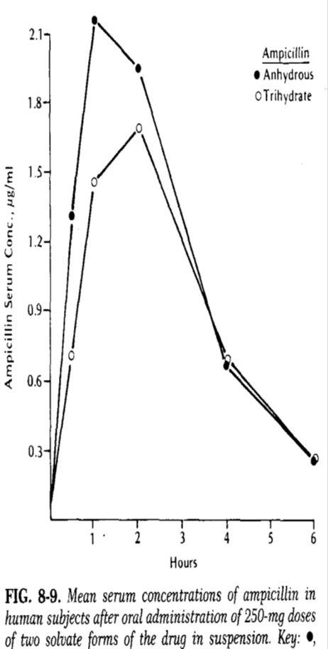
Note and example
Hydrate compounds have aqueous solubilities less than their anhydrous forms.
Conversion of an anhydrous compound to a hydrate within the dosage form
reduce the dissolution rate and extent of drug absorption.

Slide 16
Polymorphism: ability of a compound or element to crystalize as more than one distinct crystalline species with different internal lattices.
Change in chemical stability and solubility
impact a drug's bioavailability and its development program.
Ex: Chloramphenicol palmitate exists in three crystalline polymorphic forms (A, B, and C) and an amorphous form.
The relative absorption of polymorphic forms A and B from oral suspensions; represent an increase in a "peak" serum levels as a the percentage of form B polymorph increase (more soluble polymorph).
Many physicochemical properties may vary with the internal structure of the solid including:
(M.P., density, hardness, crystal shape, optical properties and vapor pressure).

Slide 17
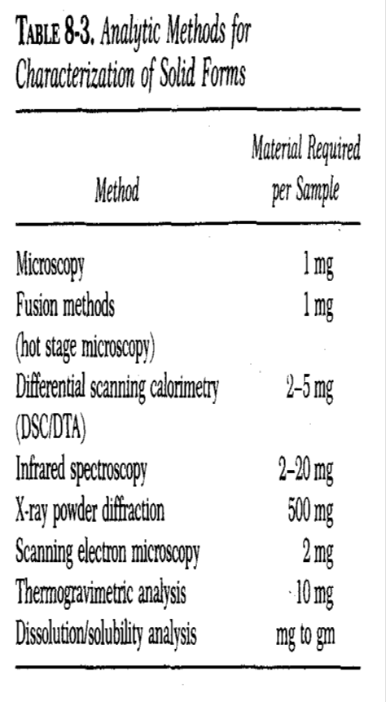
Characterization of polymorphic and solvated form involve:
1- Microscopy All substances that are transparent when examined under a microscope that has crossed polarizing filters are either isotropic or anisotropic.
Isotropic materials: amorphous substances, such as supercooled glasses and non-crystalline solid organic compounds, or substances with cubic crystal lattices, such as sodium chloride (have a single refractive index and do not transmit light, and they appear black).
Anisotropic materials: contain more than one refractive index and appear bright with brilliant colors against the black polarized background.
Note: 1- Interference colors depend upon: crystal thickness and differences in refractive indices.
2- Anisotropic substances are either uniaxial, having two refractive indices, or biaxial, having three refractive indices (most drugs).

Slide 18
2- Thermal analysis
Differential scanning calorimetry (DSC) and differential thermal analysis (DTA) measure the heat loss or gain (resulting from physical or chemical changes) within a sample as a function of temperature.
Endothermic (heat-absorbing) processes: are fusion, boiling, sublimation, vaporization, desolvation, solid-solid transitions and chemical degradation.
Exothermic processes: crystallization and degradation.
Application in preformulation studies including: purity, polymorphism, solvation, degradation and excipient compatibility.

Slide 19
Note:
1- A sharp, symmetric melting endotherm can indicate relative purity.
2- A broad, asymmetric curves suggest impurities or more than one thermal process.
Application: Desolvation of a dihydrate species
releases water vapor
if unvented can generate degradation prior to the melting point of the anhydrous form.

Slide 20
Thermogravimetric analysis (TGA):
1- measures changes in sample weight as a function of time (isothermal) or temperature.
Desolvation and decomposition processes
2- used to quantitate the presence of a solvated species within a bulk drug sample.
DSC and TGA have significant variables in these methods include:
sample homogeneity
sample size
particle size
heating rate
sample atmosphere
sample preparation.

Slide 21
Application:
1- Dihydrate form of an acetate salt loses two moles of water via an endothermic transition between 70° and 90°C.
2- The second endotherm at 155°C corresponds to the melting process, with the accompanying weight loss due to vaporization of acetic acid as well as to decomposition.

Slide 22
3- X-Ray
x-ray powder diffraction: an important technique for establishing batch-to-batch reproducibility of a crystalline form.
Application: random orientation of a crystal lattice in a powder sample x-rays scatter in a reproducible pattern of peak intensities at distinct angles (ϴ)relative to the incident beam.
Note: 1- Each diffraction pattern is characteristic of a specific crystalline lattice for a given compound.
2- An amorphous form does not produce a pattern.
3- Mixtures of different crystalline forms can be analyzed using normalized intensities at specific angles, which are unique for each crystalline form.

Slide 23
Polymorphism
Polymorphs can be classified as one of two types:
1- Enatiotropic (one polymorph can be reversibly changed into another by varying temperature or pressure, e.g., sulfur).
2- Monotropic (one polymorphic form is unstable at all temperatures and pressures, e.g., glyceryl stearates).
Note:
At a specified pressure (1 atmosphere), the temperature at which two polymorphs have identical free energies is the transition temperature (in which both forms can coexist and have identical solubilities in any solvent as well as identical vapor pressures).
Below the solid melting temperatures, the polymorph with the lower free energy, corresponding to the lower solubility or vapor pressure, is the thermodynamically stable form.

Slide 24
Important notes: 1- During preformulation, it is important to identify the polymorph that is stable at room temperature and to determine whether polymorphic transitions are possible within the temperature range used for stability studies and during processing (drying, milling, etc.).
2- Difficulty in polymorphism is the determination of the relative stability of metastable polymorph and prediction of its rate of conversion within a dosage form which depends on the factor of the presence and absence of seed crystals of the stable polymorphic form
Ex1: In suspension D.F., the rate of conversion can depend on several variables including: drug solubility within the vehicle, presence of nucleation seed for the stable form, temperature, agitation, and particle size.
Ex2: In capsules and tablets SDF have similar complications due to the influence of particle size, moisture, and excipients.

Slide 25
Hygroscopicity
Many drug substances, particularly water-soluble salt forms, have a tendency to adsorb atmospheric moisture.
Adsorption and equilibrium moisture content can depend upon:
Humidity, temp., S.A., exposure, and the mechanism for moisture uptake.
Deliquescent materials: adsorb sufficient water to dissolve completely (e.g. NaCl) on a humid day.
Other hygroscopic substances: adsorb water because of hydrate formation or specific site adsorption.
Effect of humidity: In most hygroscopic materials, the changes in moisture level can greatly influence many important parameters: such as chemical stability, flowability, and compatibility.

Slide 26
Application: To test for hygroscopicity:
1- Samples of bulk drug are placed in open containers with a thin powder bed to assure maximum atmospheric exposure.
2- Then exposed to a range of controlled relative humidity environments prepared with saturated aqueous salt solutions.
3- Moisture uptake should be monitored at time points representative of handling (0 to 24 hours) and storage (0 to 12 weeks).
Method of measurement: Analytic methods for monitoring the moisture level (i.e., gravimetry, TGA, or gas chromatography) depend upon the desired precision and the amount of moisture adsorbed onto the drug sample.
Unit: Normalized (mg H20/g sample) or percentage of weight gain data from these hygroscopic studies are plotted against time.

Slide 27
Fine Particle Characterization
Bulk flow, formulation homogeneity, and S.A. controlled processes such as dissolution and chemical reactivity are directly affected by:
1- Size
2- Shape
3- Surface morphology of the drug particles.
In preformulation the smallest particle size as is practical to facilitate preparation of homogeneous samples and maximize the drug's S.A. for interactions.
Light microscope (with a calibrated grid to provides adequate size and shape characterization for drug particles)
Application: Sampling and preparation of the microscopic slide must be preformed on several hundred particles, and the resulting mean and range of sizes reported as a histogram.
Disadvantages: time-consuming and few restrictions on particle shape.

Slide 28
2- Coulter counter and HIAC counter
(convenient method for characterizing the size distribution of a compound).
Application:
Samples are prepared for analysis by dispersing the material in a conducting medium (isotonic saline) with the aid of ultrasound and a few drops of surfactant.
A known volume (0.5 to 2 ml) of this suspension is then drawn into a tube through a small aperture (0.4 to 800 microns in diameter), across which a voltage is applied.
As each particle passes through the hole, it is counted and sized according to the resistance generated by displacing that particle's volume of conducting medium.
The counter provides a histogram output (frequency versus size) within the limits of that particular aperture tube.

Slide 29
Advantages:
Quick and statistically meaningful
Disadvantages:
Resistance arises from a spherical particle; thus, nonspheres are sized inaccurately.
Tendency of needle-shaped crystals to block the aperture hole.
Dissolution of compound in the aqueous conducting medium.
Stratification of particles within the suspension.

Slide 30
3- Sieve methods: are used primarily for large samples of relatively large particles (100 microns).
4- Computer interfacing of image analysis techniques:
Offers greatest promise for particle size analysis.
4- Scanning electron microscopy (SEM): Determine physical observation related to surface area (surface morphology).
Application: sample is exposed to high vacuum during the gold coating process, to make the samples conductive, and concomitant removal of water or other solvents may result in a false picture of the surface morphology.

Slide 31
Bulk Density
Bulk density of a compound varies substantially with:
method of crystallization, milling, or formulation.
Density problem is corrected by:
milling
Slugging
formulation.
Bulk density is of great importance for:
considers the size of a high-dose capsule
homogeneity of a low-dose formulation when there are large differences in drug and excipient densities.
Apparent bulk density (g/ml) is determined by:
Pouring presieved (40-mesh) bulk drug into a graduated cylinder via a large funnel and measuring the volume and weight.

Slide 32
Tapped density is determined by:
Placing a graduated cylinder containing a known mass of drug or formulation on a mechanical tapper apparatus, which is operated for a fixed no. of taps (~1000) until the powder bed volume has reached a minimum.
True density of a powder: for computation of void volume or porosity of packed powder beds.
Experimentally, the true density is determined by suspending drug particles in solvents of various densities and in which the compound is insoluble.
Instrument used to measure: calibrated pycnometer

Slide 33
Powder Flow Properties
Pharmaceutical powders may be broadly classified as free- flowing or cohesive (non-free-flowing).
Most flow properties are affected by:
particle size
density
shape
electrostatic charge
an adsorbed moisture
Powder flow improvement and direction for the formulation development through:
granulation
densification via slugging
special auger feed equipment.

Slide 34
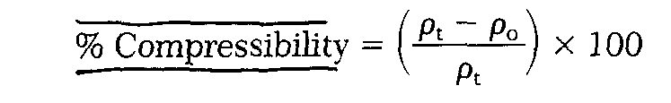
Characterization of freely flowing powder:
Simple flow rate apparatus
consisting of grounded metal tube from which drug flows through an orifice onto an electronic balance, which is connected to a strip chart recorder.
Several flow rate (g/sec) determinations at each of a variety of orifice sizes (1/8 to 1/2 inches) should be made.
Another measurement of a free-flowing powder is compressibility, as computed from powder density:
Characterization of cohesive powders:
Through tensile testing or evaluated in a shear cell.

Slide 35


