Slide 1
Lecture-4
Buffer components
Preservatives and osmotic agents

Slide 2
4. Buffer components
Buffer selection is an important part of the formulation process, because of the pH dependence of protein solubility and physical and chemical stability.
Buffer systems regularly encountered in biotech formulations are:
phosphate
citrate
acetate

Slide 3
The isoelectric point (pI)
pH of a solution at which the net primary charge of a protein becomes zero.
At a solution pH that is above the pI the surface of the protein is predominantly negatively charged and like-charged molecules will exhibit repulsive forces.
At a solution pH that is below the pI, the surface of the protein is predominantly positively charged and repulsion between proteins occurs.
At the pI the negative and positive charges cancel, repulsive electrostatic forces are reduced and the attraction forces predominate. The attraction forces will cause aggregation and precipitation.
The pI of most proteins is in the pH range of 4-6.

Slide 4
A good example of importance of the isoelectric point (its negative logarithm [pH] is equal to pI) is the solubility profile of human growth hormone (hGH, pI around 5) as presented in Figure 1:
20
10
[hGH] mg/ml
Circles = recombinant hGH
Triangles = Met-hGH
Squares = pituitary hGH
5
+ve charge
-ve charge
pI: is the pH at a particular molecule carries no net electrical charges (overall charge).
Thus molecule is affected by pH of its surrounding environment and can become more positively or negatively charged due to the gain or loss, respectively, of (H⁺).
Such molecules have minimum solubility in water or salt solutions at the pH that corresponds to their pI and often ppt. out of solution.
1
3
4
5
6
7
pH
Figure 1. A plot of the solubility of various forms
of hGH as a function of pH. The closed symbols mean that precipitate was present in the dialysis tube after equilibration, whereas open symbols mean that no solid material was present, and thus the solubility is at least this amount.

Slide 5
Even short, temporary pH changes can cause aggregation. Explain why?
These conditions can occur, for example, during the freeze-drying process, when one of the buffer components is crystallizing and the other is not.
In a phosphate buffer, Na₂HPO₄ crystallizes faster than NaH₂PO₄.
drop in pH during the freezing step.
While other buffer components do not crystallize, but form amorphous systems and then pH changes are minimized.

Slide 6
5. Preservatives and Anti-oxidants
Antioxidants
Methionine, cysteine, tryptophane, tyrosine and histidine are amino acids that are readily oxidized.
Proteins rich in these amino acids are susceptible to oxidative degradation.
The solution !!!
Replacement of oxygen by inert gases in the vials helps to reduce oxidative stress.
Addition of anti-oxidant such as ascorbic acid or sodium formaldehyde sulfoxylate can be considered.

Slide 7
Preservatives
Certain proteins are formulated in the container designed for multiple injection schemes.
After administering the first dose, contamination with microorganism may occur and the preservatives are needed to minimize growth.
Usually, these preservatives are present in concentrations that are bacteriostatic rather than bactericide in nature.
Antimicrobial agents mentioned in the USP XXIV are the mercury-containing pheylmercuric nitrate, thimerosal, p-hydroxybenzoic acids, phenol, benzyl alcohol and chlorobutanol.

Slide 8
6. Osmotic Agents
For proteins, adjusting the tonicity-of parenteral products by using (Saline and mono- or disaccharide solutions).
These excipients may not be inert; they may influence protein structural stability.
E.g. sugars and polyhydric alcohol can stabilize the protein structure through the principle of preferential exclusion.
Enhance the interaction of the solvent (water structure promoters) with the protein and are themselves excluded from the protein surface layer; the protein is preferentially hydrated.
This phenomenon can be monitored through an increased thermal stability of the protein.
But

Slide 9
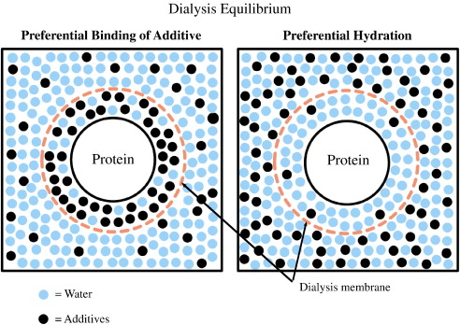

Slide 10
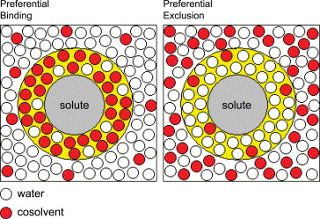

Slide 11
Shelf Life of Protein Based Pharmaceuticals
Protein can be stored:
(1) as an aqueous solution
(2) in freeze-dried form
(3) in dried form in a compacted state (tablet).
The stability of protein solutions strongly depends on factors such as pH, ionic strength, temperature, and the presence of stabilizers.
E.g.: Figure 2 shows the pH dependence of α₁-antitrypsin and clearly demonstrates the critical importance of pH on the shelf-life of proteins.

Slide 12
3
2.5
2
K (%/wk)
1.5
≈
6
7
8
9
pH
Figure 2 pH stability profile (at 25ºC) of monomeric recombinant α₁-antitrypsin (rAAT) by size exclusion-HPLC assay. K = degradation rate constant. Monomeric rAAT decreased rapidly in concentration both under acidic and basic conditions. Optimal stability occurred at pH 7.5.

Slide 13
Freeze-Drying of Proteins
Proteins in solution often do not meet the preferred stability requirements for industrially pharmaceutical products (>2 years), even when kept permanently under refrigerator conditions (cold chain).
The abundant presence of water promotes chemical and physical degradation processes.

Slide 14
Importance of Freeze Drying
Freeze-drying may provide the desired stability by extending shelf life. During freeze-drying water is removed via sublimation and not by evaporation.
it works by freezing the material, then reducing the pressure and adding heat to allow the frozen water in the material to sublimate.
Three stages can be discerned in the freeze-drying process:
(1) freezing step
(2) primary drying step
(3) secondary drying step.

Slide 15
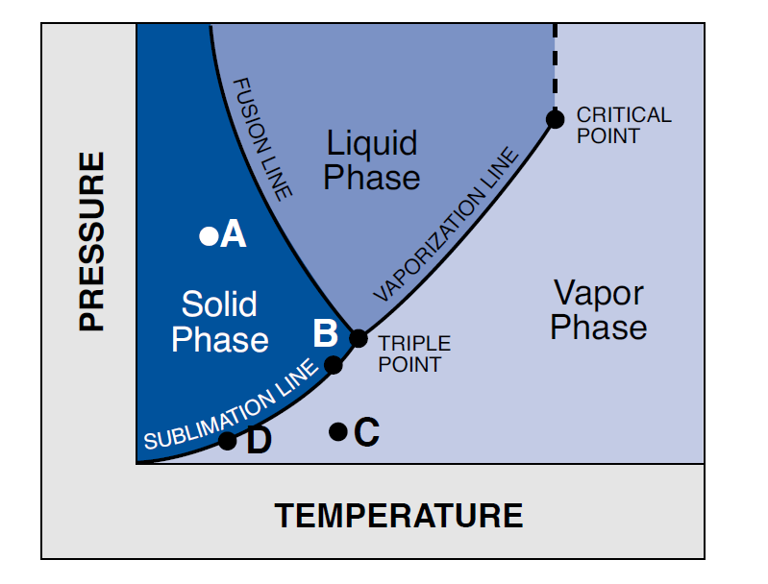

Slide 16
Table 1. Three stages in the freeze drying process of protein formulations.
Freezing
The temperature of the product is reduced from ambient temperature to a temperature below the eutectic temperature (Te), or below the glass transition temperature (Tg) of the system. A Tg is encountered if amorphous phases are present.
Primary drying
Crystallized and water not bound to protein/excipients is removed by sublimation. The temperature is below the Te or Tg; the temperature is for example -40ºC and reduced pressures are used.
Secondary drying
Removal of water interacting with the protein and excipients. The temperature in the chamber is kept below Tg and rises gradually, e.g., from -40ºC to 20ºC.

Slide 17
Table 4.3. typical excipients in a freeze-dried protein formulation
The freeze-drying of a protein solution without the proper excipients causes, as a rule, irreversible damage to the protein.
Table 4.3 lists excipients typically encountered in successfully freeze-drying protein products.
Bulking agents: mannitol/ glycine
Reason: elegance/ blowout prevention
Blowout is the loss of material taken away by the water vapor that leaves the vial. It occurs when little solid material is present in the vial.
Collapse temperature modifier: dextran, albumin/ gelatine
Reason: prevent increase collapse temperature
Lyoprotectant: sugars, albumin
Reason: protection of the physical structure of the protein.
Mechanism of action of lyoprotectants is not fully understood. Factors that might play a role are:

Slide 18
Mechanisms of action of lyoprotectants
Lyoprotectants replace water as stabilizing agent (water replacement theory),
Lyoprotectants increase the Tg of the cake/ frozen system
Lyoprotectants will absorb moisture from the stoppers
Lyoprotectants slow down the secondary drying process and minimize the chances for overdrying of the protein. Overdrying might occur when residual water levels after secondary drying become too low.

Slide 19
Figure 6 Example of freeze-drying protocol for systems with crystallizing water. Abbreviations: T, temperature; P, pressure.
P
(Pa)
T
(°C)
freezing
Primary drying
Secondary drying

Slide 20


