Slide 1
Toxic responses of the liver
Fourth Stage
Toxicology Lab.4
march, 2018
Assist. Lec. Amani Anees Abbody

Slide 2
The liver is the main organ where chemicals are metabolized and excreated. so, the liver cells are exposed to these chemicals which can results in liver dysfunction, cell injury and liver failure.

Slide 3
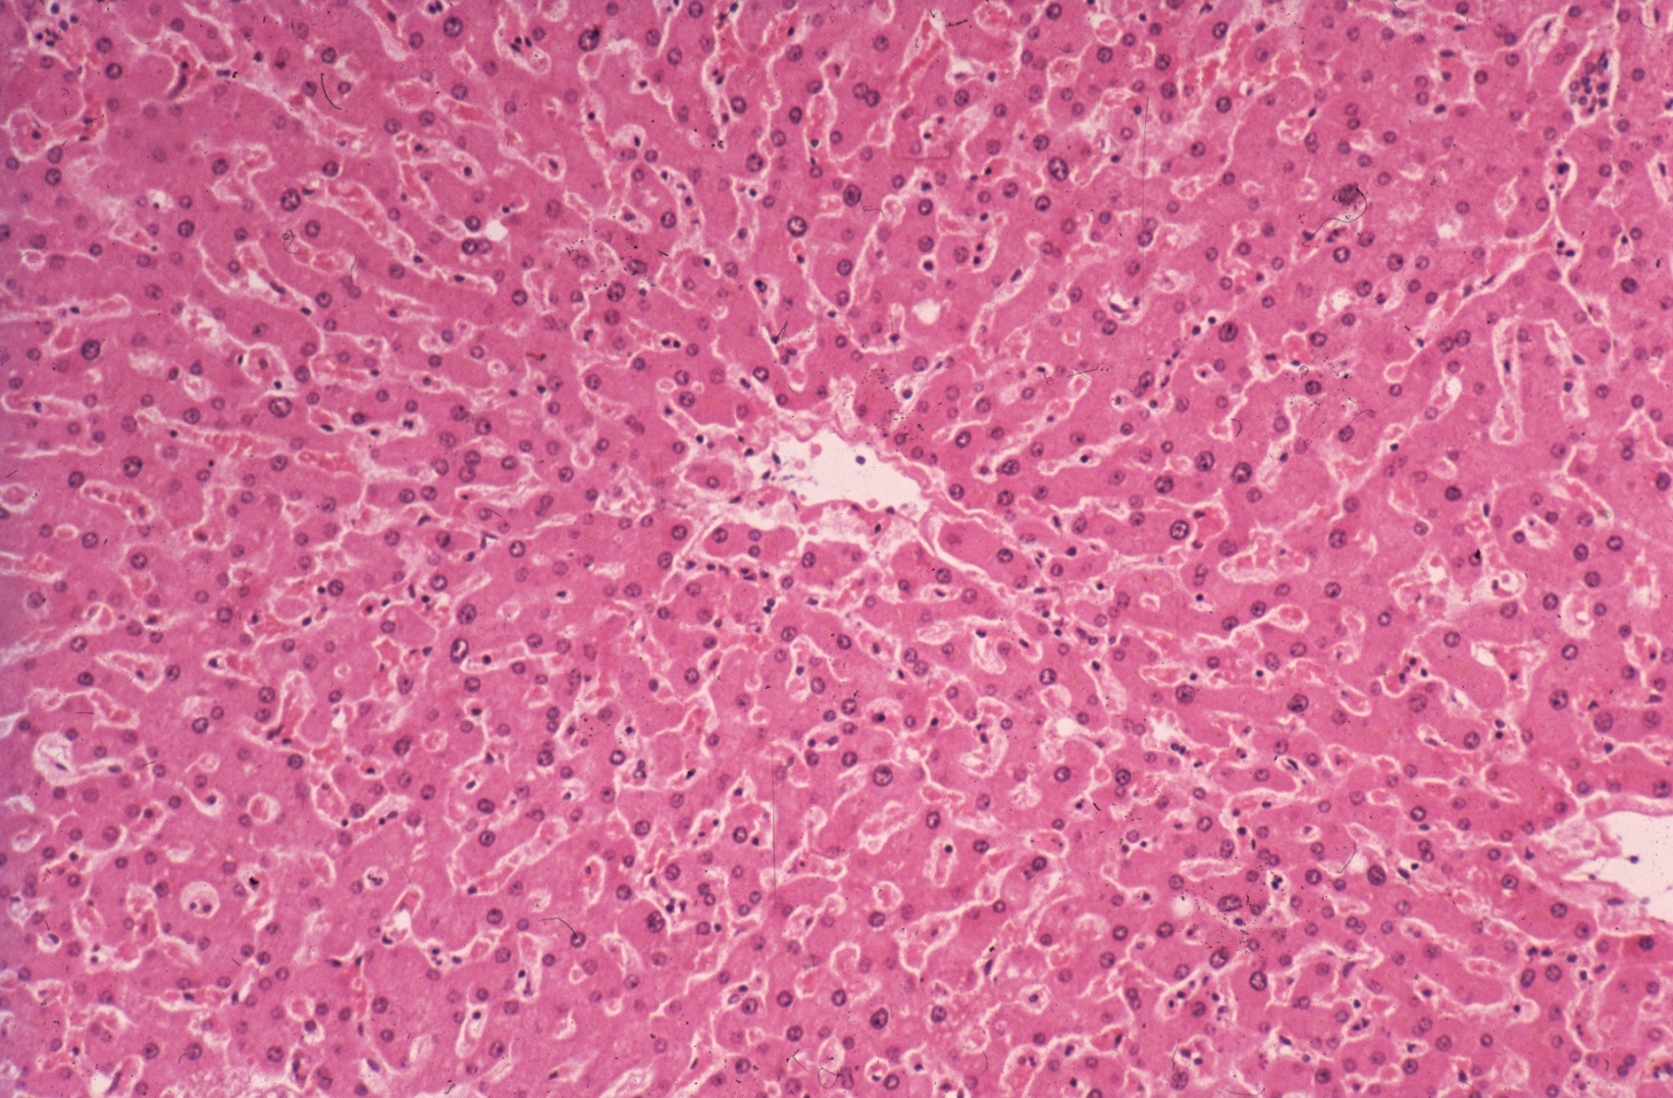
Normal liver section

Slide 4
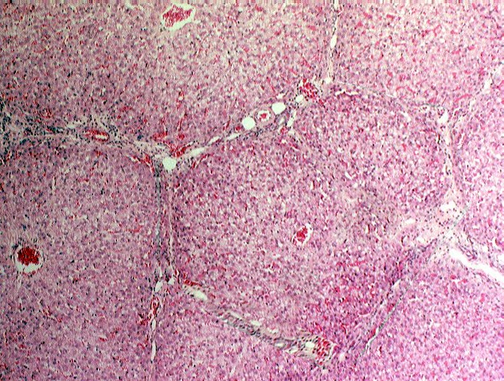
Hexagonal lobule

Slide 5
Types of the liver injury:
The liver injury caused by chemicals (hepatotoxicity) is not a single entity, thus the lesion observed does not depend only on the chemical agent involved, but also on the nature of exposure (acute or chronic, reversible or irreversible), mechanism of toxicity, number & type of the cells affected & localization within liver (periportal, mid or transient & centrilobular zones).
Accordingly, injuries divided into the following major types:
Steatosis (fatty liver),
Necrosis,
Apoptosis,
Fibrosis,
Cirrhosis,
Cholestasis,
Hepatitis,
Carcinogenesis.

Slide 6
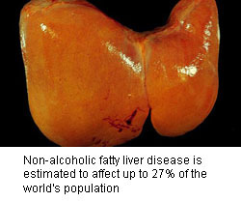
Steatosis (fatty liver):
Is accumulation of abnormal amount of lipids (mainly triglycerides) as vacuoles & droplets within hepatocytes; as a result of imbalance between rate of synthesis & release of these lipids by liver cells into circulation.
In general, chemicals-induced steatosis is often reversible & doesn't necessary lead to hepatocytes death and it is an acute response to many but not all hepatotoxicants.

Slide 7
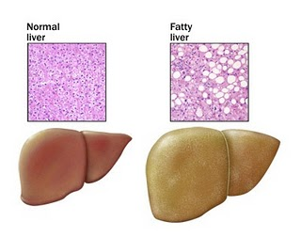

Slide 8
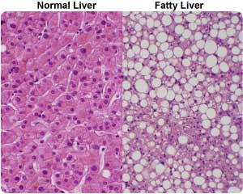

Slide 9
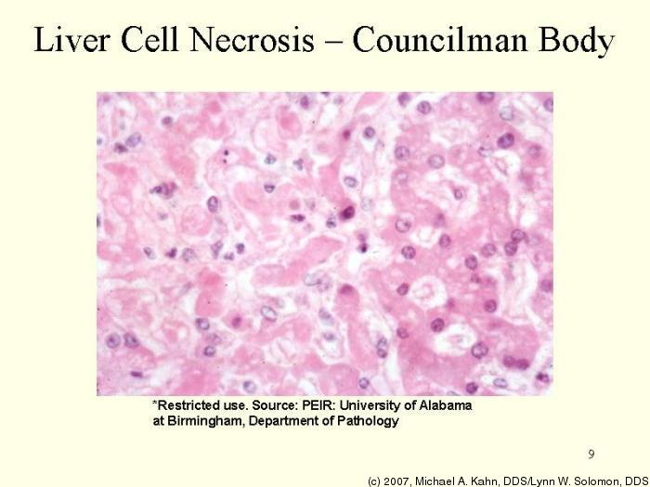
2. Necrosis (cell death):
Is an acute response of liver injury associated with cell swelling, leakage of nuclear material and influx of inflammatory cells as a result of plasma membrane damage, alteration in calcium homeostasis, lipid peroxidation, disruption to cytoskeleton and damage to cell organelles.

Slide 10
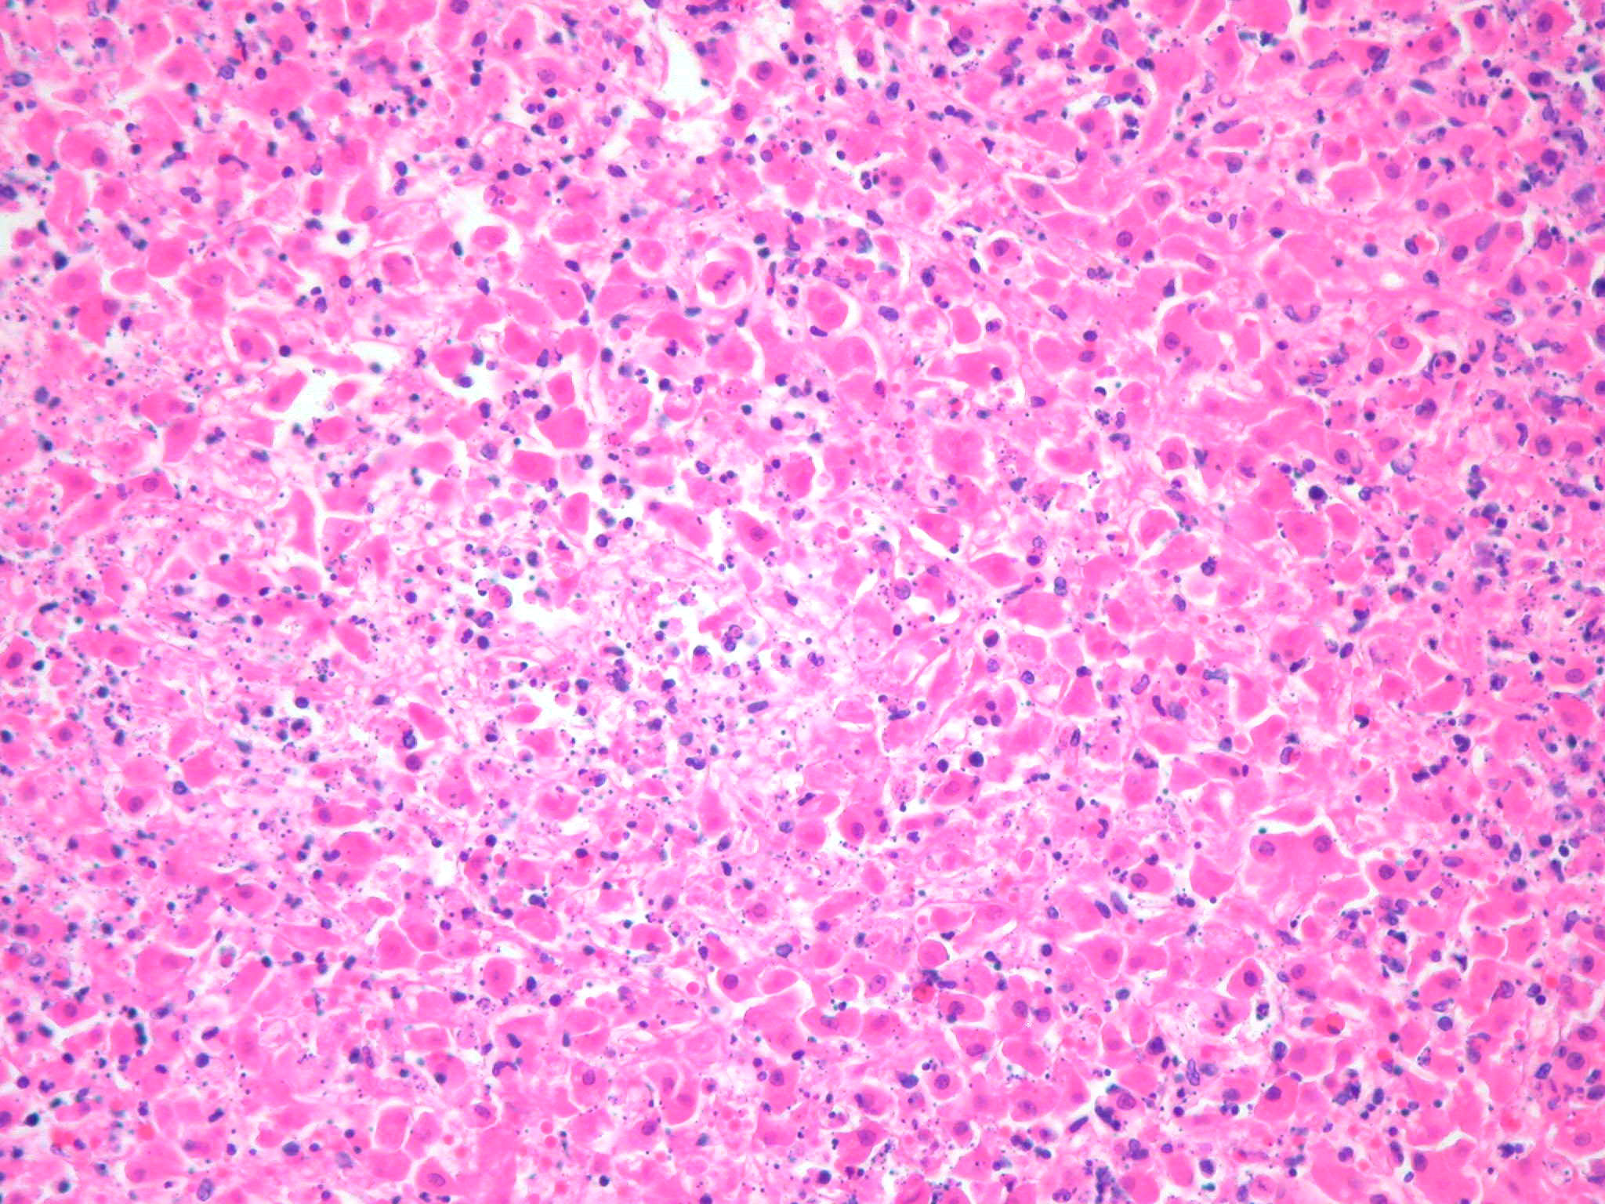
Liver necrosis

Slide 11
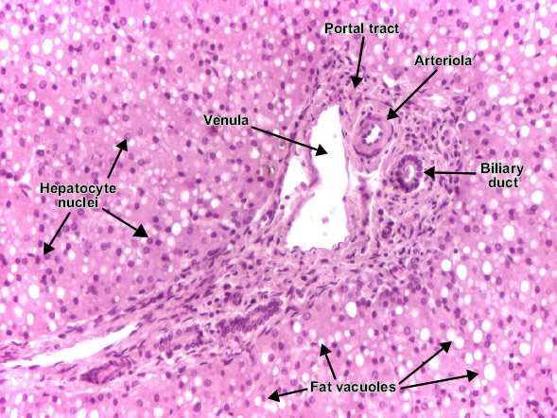
Necrosis with steatosis

Slide 12
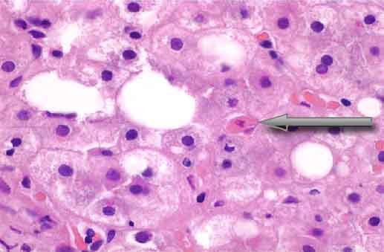
3. Apoptosis (cell death):
Characterized by cell shrinkage, nuclear fragmentation, formation of apoptotic bodies, & lack of inflammation.
Apoptosis is more difficult to be detected histologically because of the rapid removal of affected cells.
Apoptotic body

Slide 13
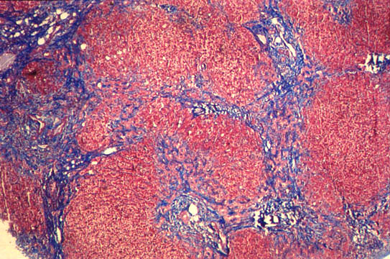
4. Fibrosis:
Chronic type of liver injury, usually results from long-term & multiple exposures to a toxic chemical that cause destruction to the hepatic cells with replacement by collagen fibers. With continuing collagen deposition, the architecture of the liver is disrupted by interconnecting fibrous scars.
Fibrotic tissue

Slide 14
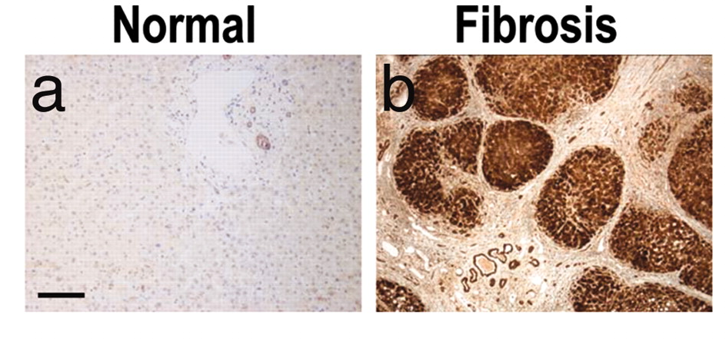
Fibrous tissue

Slide 15
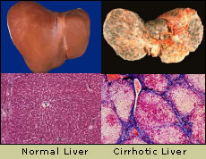
5. Cirrhosis:
Cirrhosis is an irreversible damage result mainly from alcohol induced fatty liver & has a poor prognosis of survival.

Slide 16
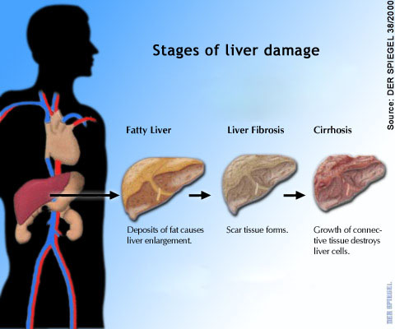
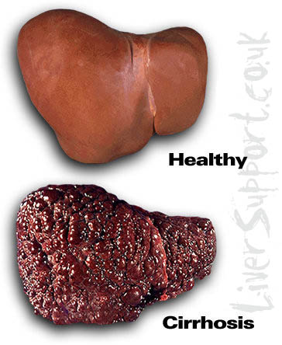

Slide 17
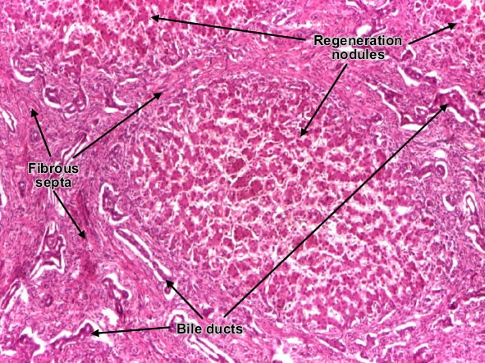
6. Cholestasis:
Characterized by decreased volume of bile formed or impaired secretion of specific solute into bile leads to increase level of cpds in blood that are normally concentrated in bile, particularly bile acids & bilirubin due to either hepatic disorders (Canalicular) or biliary duct damage (cholangiodestructive).
Cholestasis could be acute or chronic response, & it’s result from many different types of chemicals that cause cholestasis.

Slide 18
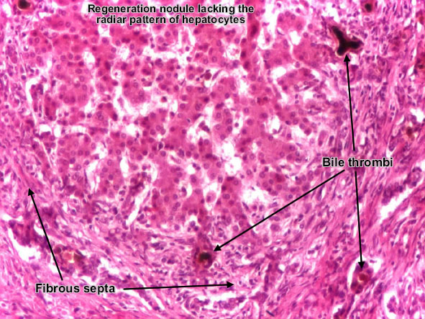
Cholestasis

Slide 19
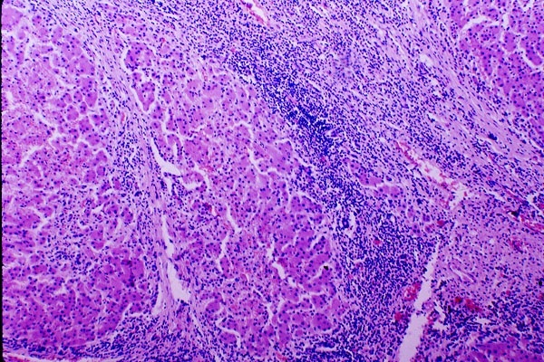
7. Hepatitis:
Is inflammation of liver caused by many factors including drugs, toxins, bacteria & viruses. It is characterized by emigration of neutrophils, lymphocytes & other inflammatory cells into region of damaged hepatocytes.
Immunoresponse of liver cells to some types of chemical agents can resulted after their biotransformation, binding with liver proteins & leak out of injured hepatocytes serve as an antigen that stimulate the production of antibodies.
Hepatitis could be an acute or chronic type.

Slide 20
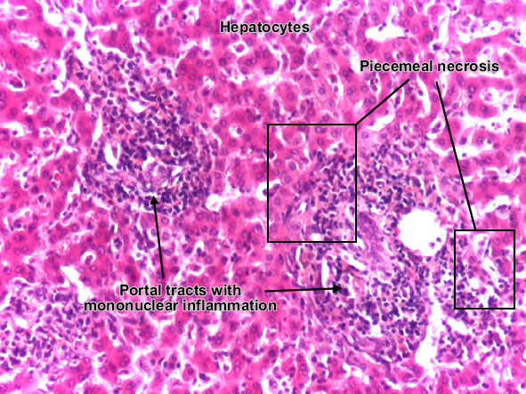
viral_hepatitis

Slide 21
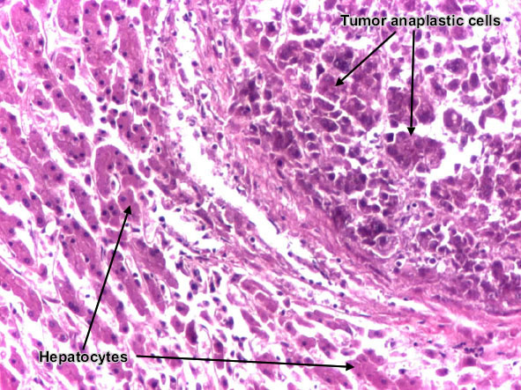
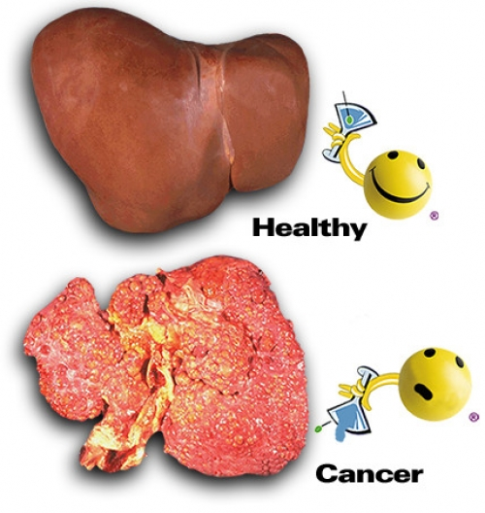
8. Carcinogenesis:
Tumor of hepatic tissue caused by chemicals that undergo metabolic conversion to more toxic intermediates before they exert their carcinogenicity by interaction with nuclear materials, mainly the DNA, results in alterations in the genetic machinery causing mutations & initiation of a chain of events that result in cancer formation. It’s a chronic type of liver injury.

