Slide 1
Red Blood Cell (RBC) Count

Slide 2
Introduction
Red blood cells make up almost 45 percent of the blood volume.
Their primary function is to carry oxygen from the lungs to every cell in the body.
Red blood cells are composed predominantly of a protein and iron compound, called hemoglobin, that captures oxygen molecules as the blood moves through the lungs, giving blood its red color.
As blood passes through body tissues, hemoglobin then releases the oxygen to cells throughout the body.
Red blood cells are so packed with hemoglobin that they lack many components, including a nucleus, found in other cells.

Slide 3
Principle:-
The red blood cell count:- is the number of red blood cells per unit volume of whole blood.
Normal red blood cells values at various ages are:
Newborn: 4.8-7.2 million
Adults (males): 4.9-5.5 million
(Females): 4.4-5.0 million
Pregnancy: slightly lower than normal adult values
Children: 3.8-5.5 million

Slide 4
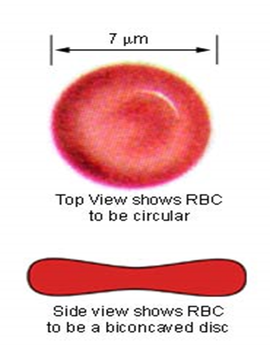
Each RBC is a biconcave disc having a diameter of 7.2 microns and a thickness of 2.2 microns
These cells contain the pigment hemoglobin which enables them to transport oxygen around the circulation. They also contain the enzyme carbonic anhydrase which enables them to carry CO2.

Slide 5
Aim of the experiment
RBC count is done to determine whether there is an adequate number of RBC in the circulation or not.

Slide 6
Methods
1- Manual method
2-Electronic cell counting

Slide 7
Manual red blood cell count material and instruments
Anticoagulated whole (using EDTA or heparin as an anticoagulant) or capillary blood can be used.
Hayem’s solution (diluting fluid) composed of:
Hgcl2 0.05 g
Na2so4 2.5 g
Nacl 0.5 g
Distilled water 100 ml

Slide 8
RBC pipette which is composed of a stem & a mixing chamber with a red bead, it is function is to mix blood with the substance and for differentiation from the WBC pipette.
Haemocytometer “ Neubauer” chamber is counting chamber with a cover slip. The same counting chamber is used also for counting total white blood cells.
Microscope
Lancet
Alcohol 70%
Cotton

Slide 9
Procedure
Wipe your partener”s finger with cotton soaked with alcohol and allow it to dry. With a sterile disposable lancet do small prick on the finger tip, when a drop of reasonable size has collected, hold the red blood cell pipette slightly tilted from the vertical position, apply its tip to the drop and aspirate blood to the mark 0.5.

Slide 10
Wipe off any blood adhering to its outer side. If the blood gets beyond 0.5 marks tap the tip gently till the blood is exactly at the mark. Never allow the blood to clot inside the pipette. If the blood clots in the pipette blow the sample out, clean the pipette and begin all over again.
Aspirate diluting Hayem’s solution to the 101 mark, thus making 1:200 dilution of blood.
Hold the pipette horizontally and role it with both hands between finger and thumb.

Slide 13
Blow out a quarter of the content to remove the pure diluting fluid in the stem.
Prepare the counting chamber and cover it with a cover slip. Hold the pipette 45 & touch its tip gently on the surface of the counting platfrom where it projects beyond the cover slip and a small amount of solution will be drawn under the cover slip.
Place the Neubauer chamber on the stage of the microscope and allow 2 minutes for the cells to settle.

Slide 14
Neubauer Hemocytometer

Slide 15
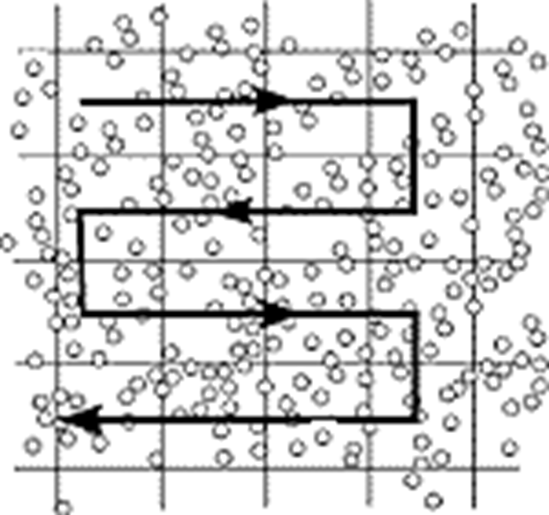
Scan the counting area with 10x objective lens.
Use the 40x objective, include all cells lying on the lower and left lines of any square; omit the cells on the upper & right hand lines.

Slide 16
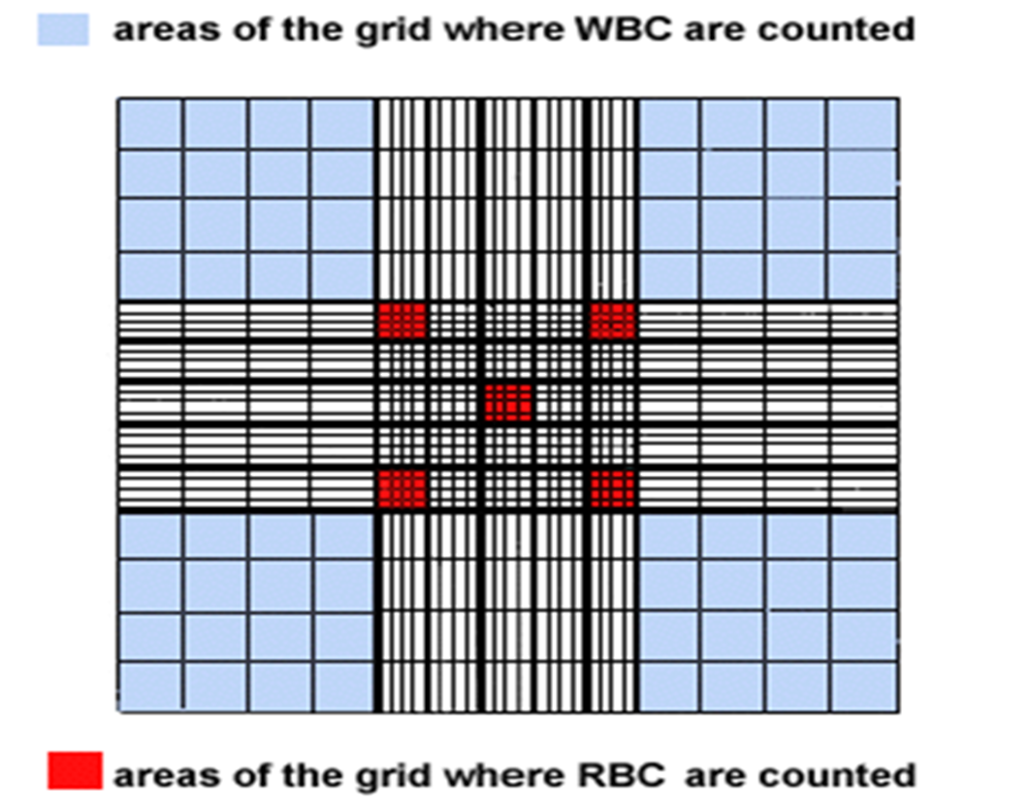
Count the cells in 5 medium squares of 16 small squares i.e. 80 squares, one at each corner and one in the center.
Hemocytometer Chamber

Slide 17
calculation
Count the number (N) of cells in 80 small squares located in 5 middle-sizes squares (four located at the four corner and one in the middle). The size of 80 small squares in which “N” number of cells are found is:
1/20 x 1/20 x 1/10 x 80 = 1/50 mm3
Where 1/20 mm:- is the slid line of the square.
1/10 mm:- is the depth of the counting chamber between cover slip and the ruling.
80:- is the number of small squares used to count.

Slide 18
The total number of cells in 1mm3 are =N x 50 (before diluting the sample)
The actual total number of cells after dilution should be = N x 50 x 200= N x 10000

Slide 19
Medical considerations
Pathological conditions:-
Polycythemia is a disease of unknown origin that results in an abnormal increase in red blood cells due to over production of red blood cells in the bone marrow not caused by physiologic need (primary polycythemia vera), while secondary polycythemia vera occur in response to hypoxia.

Slide 20
Anemia: is a general term that refers to a decrease in red blood cells.
Anemia can occur from either a decrease in the number of red blood cells, a decrease in the hemoglobin content, or both.
A lower than normal RBC can result from a number of causes, including:
Massive RBC loss, such as acute hemorrhage
Abnormal destruction of RBC
Lack of substances needed for RBC production
Chemotherapy or radiation side effect from treatment of bone marrow malignancies such as leukemia can result in bone marrow suppression.

Slide 21
normal physiological conditions
A normal physiological increase in the RBC count occurs at high altitudes or after strenuous physical training.
The drugs gentamicin and methyldopa have been associated with increasing the number of red blood cells.
Smokers also have a higher number of red blood cells than non smokers

Slide 22
Thank you

