Slide 1
White blood cell count

Slide 2
Introduction
The white blood cell count denotes the number of white blood cells per unit volume of whole blood. Normal WBC count range from 5000-11000 cell / cubic mm this count varies with age.
WBC count is useful to indicate infection or may be employed to follow the progress of certain disease.
WBC in the circulation are not white in the sense that a sheet of white paper is white, but in the sense that they are transparent and not colored. White cells are fewer in number than red cells.

Slide 3
Methods
1-Manual method
2-Electronic cell counting

Slide 4
Materials & instrument
1-Anticoagulated whole blood or capillary blood can be used.
2-Turk’s diluting fluid composed of:-
Glacial acetic acid (3ml) to hemolysed RBCs
Aqueous gention violet (1% w/v) (1ml) to color the nuclei of WBC
Distilled water up to 100 ml.

Slide 5
3- WBC pipette, which is composed of a stem, mixing chamber, white bead inside the mixing chamber, aspiration tube (rubber sucking tube)
4- Haemocytometer (Neubauer’s counting chamber) with a cover slip.
5- Microscope
6- Lancet
7- Cotton

Slide 6
procedure
Obtain a drop of blood in the same manner as in RBC count. Draw blood up to the mark 0.5 using WBC pipette.
Aspirate diluting fluid up to mark 11. the dilution is 1:20.
Remove blood from outside of the pipette with clean gauze.
Gently rotate the pipette horizontally with your hand to ensure a proper amount of mixing for 3 minutes.

Slide 7
After mixing discard the first four drops of the mixture.
Fill the counting chamber with diluted blood by holding the pipette at 45 with the slide and allow the mixture to seep under the cover slip, the filled chamber should be allowed to stand for a minute prior to counting.
Count the WBC using the low power 10x objectives.

Slide 8
Count all WBCs in four large corner squares and add the result together to obtain the total number of cells counted. In counting the cells that touch the outside lines of the large square, count only those that touch the left and lower outside margin.
The WBCs look like black dots.

Slide 9
calculation
Count the number (N) of cells in 4 large squares located at the four corners of the chamber. The size 4 large squares in which
“N” numbers of cells are found is:
1x1x1/10x4= 4/10 mm3
Where 1mm:- is the sideline of the large square
1/10 :- is the depth of the counting chamber between cover slip and the ruling
4:- is the number of large squares used to count

Slide 10
The total numbers of cells in 1mm3 are =
Nx10/4 (before dilution of the sample)
The actual total numbers of cells after dilution should be=
Nx10/4x20=Nx50

Slide 11
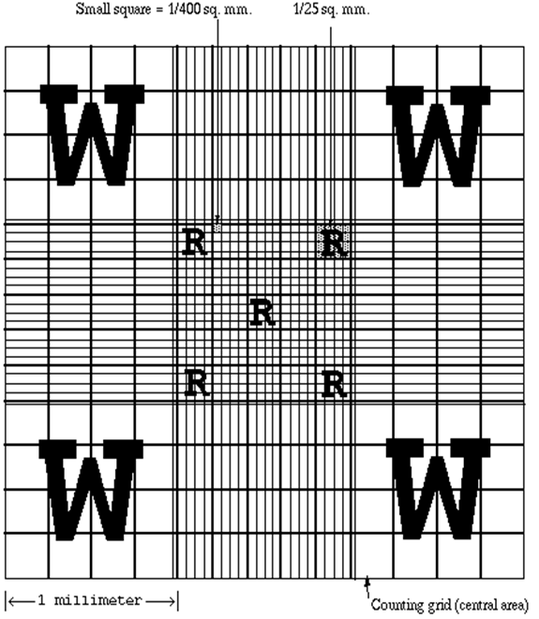

Slide 12
Medical consideration
Leucocytosis is the increased number of WBCs, this condition occurs in infection.
Leucocytosis could also be physiological. People who have had their spleen removed (spleenctomy) will always have a slightly higher number of WBCs
Eating, physical activity and stress can cause an increased WBC count.
Pregnancy in the final month and labor may be associated with incraesed in WBC level.

Slide 13
Leucopenia is a condition of decreased number of WBCs .
The WBC count tend to be lower in the morning and higher in the late afternoon.
WBC count are age related.
On average, normal newborns and infant have higher WBC counts than adults.
It is not uncommon for the elderly to fail to develop leukocytosis as a response to infection.
There are many drugs that cause both increased and decreased WBC count.

Slide 14
Leukemia is a group of malignant disorders of the haemopoietic tissue associated with an increase in the no. of primitive WBCs (blast cell) in the bone marrow and there will be a failure of cell maturation and the accumulation of useless cells which take up the bone marrow space and eventually this proliferation spills into the blood.

