Slide 1
Interaction of EMR
with Matter

Slide 6
Principles of uv –visible spectroscopy

Slide 7
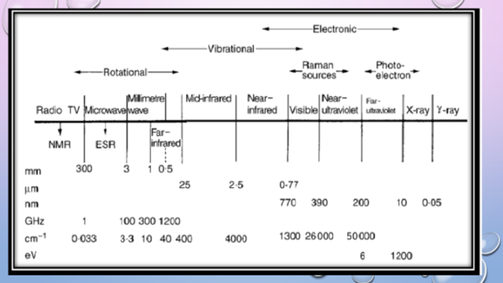

Slide 8
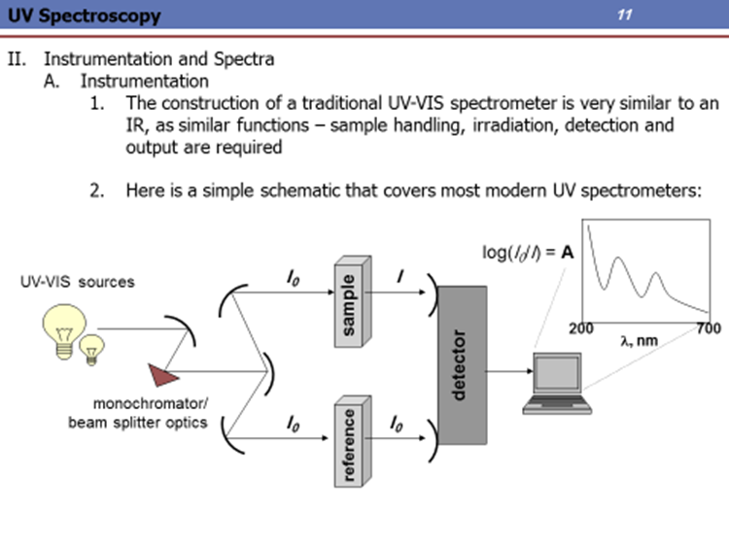

Slide 9
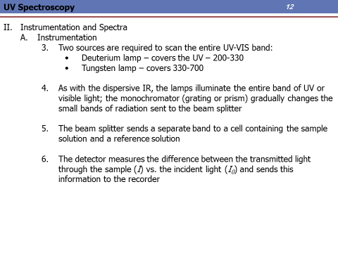

Slide 10
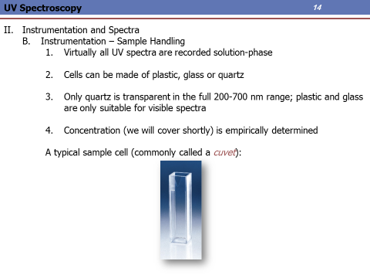

Slide 11
