Slide 1
Lecture 4
Mixing

Slide 2
Definition
Mixing
a process that results in a randomization of dissimilar particles within a system.

Slide 3
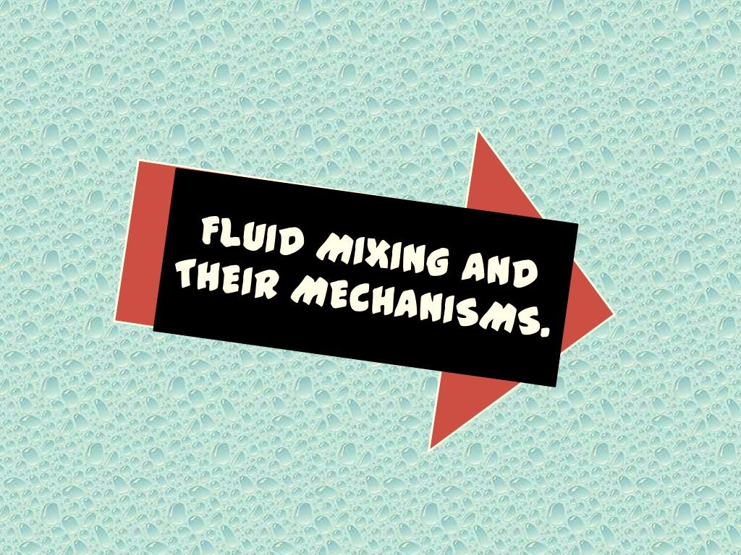

A- Flow characteristics
Depending upon relationship between shear rate and the applied shear stress, the fluids may be divided into:
Newtonian Fluids
Non-Newtonian Fluids

Slide 4
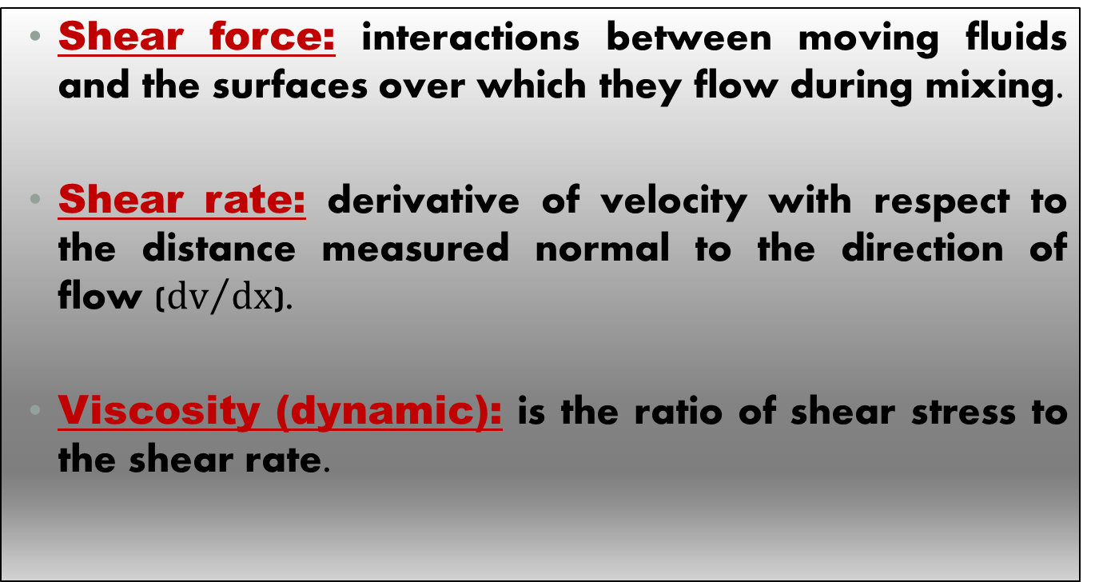
Important definitions
Shear force: interactions between moving fluids and the surfaces over which they flow during mixing.
Shear rate: derivative of velocity with respect to the distance measured normal to the direction of flow (${dv}/{dx}$).
Viscosity (dynamic): is the ratio of shear stress to the shear rate.

Slide 5
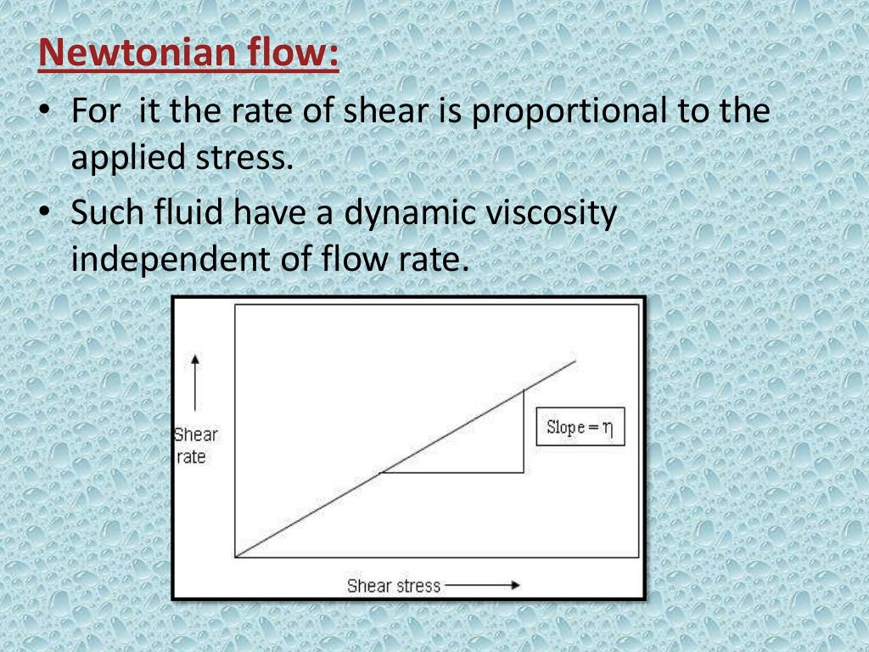

Slide 6
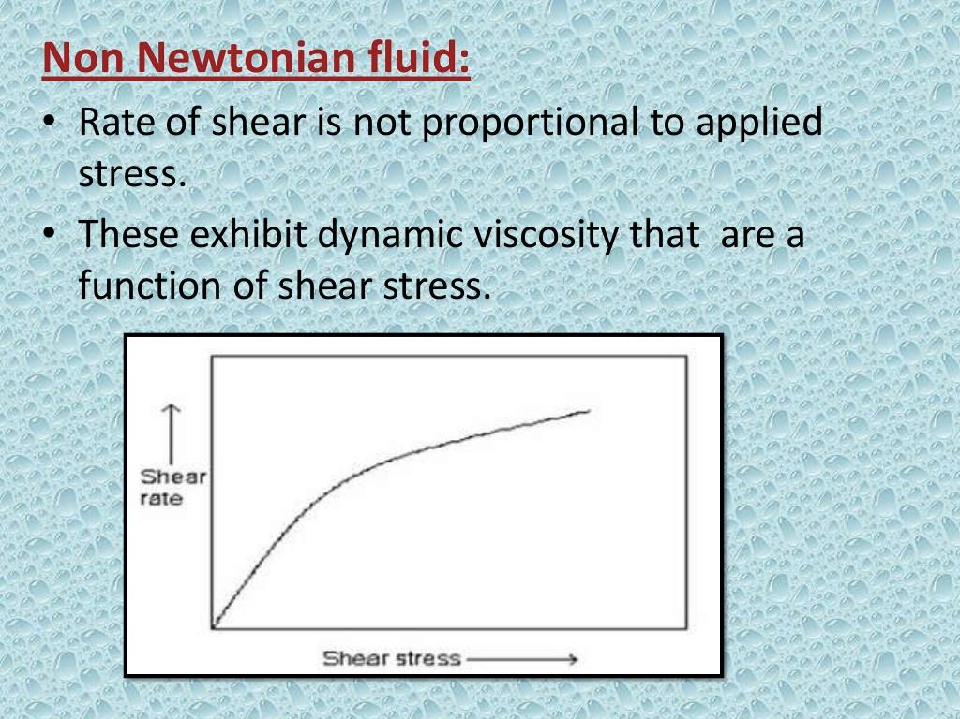

Slide 7
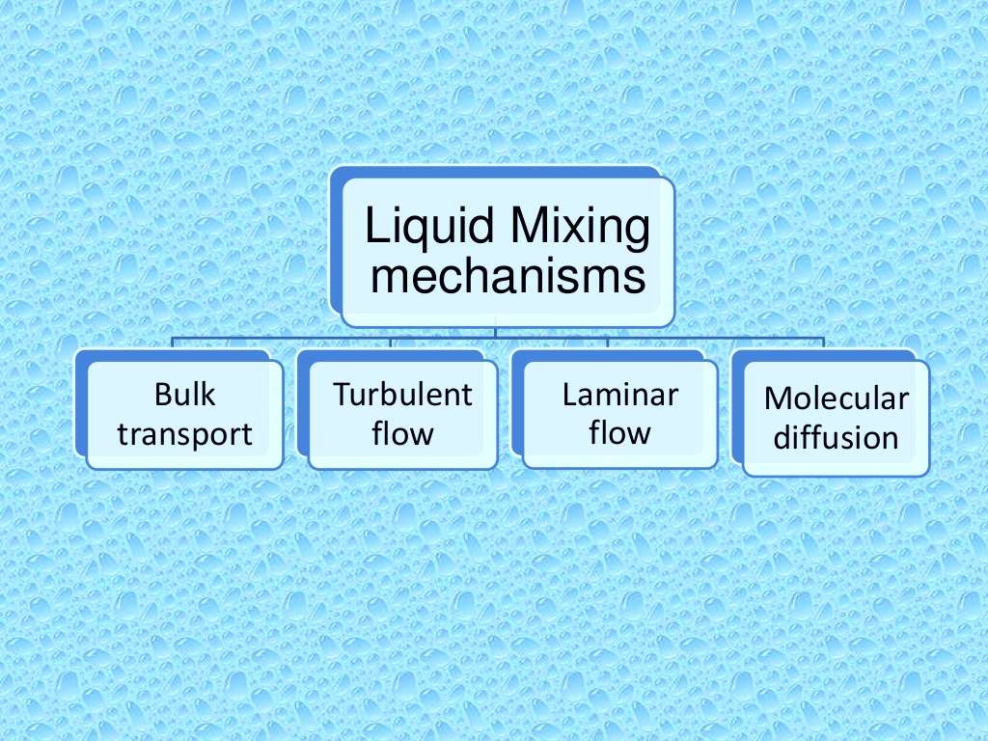
2- Mixing mechanisms

Slide 8
1. Bulk transport
The movement of relatively large portion of material being mixed from one location in the system to another.
Bulk transport (rearrangement or permutation)
Accomplished by means of paddles, revolving blades, or other devices within the mixer arranged so as to move adjacent volumes of fluid in different direction (3D shuffling).

Slide 9
2. Turbulent mixing
It is a direct result of turbulent fluid flow which is characterized by a random fluctuation of the fluid velocity at any given point within the system.
The fluid velocity at a given instant may be expressed as the vector sum of its component in the X, Y and Z direction.
In turbulent flow, the fluid has a different instantaneous velocities at different location at same instant in time.

Slide 10
Larger eddies breakup forming smaller and smaller size eddies until are no longer distinguished.
Size of distribution of eddies with turbulent region known as (scale of turbulence).
Turbulent flow visualized as (eddies) with various sizes [portion of fluid moving as a unit in a direction contrary to that of general flow].
Note: 1.Turbulence come from:
Difference between temporal and spatial velocity within a body of fluid
Randomization of fluid particles
Mixing
2. Intensity (additional characteristic for turbulent flow) related to velocity of moved eddies.

Slide 11
3. Laminar mixing
Streamline or laminar flow is frequently encountered when highly viscous fluid are being processed.
[occur with gentle stirring and adjacent to stationary surfaces in vessels where turbulent flow is predominant].
Occur when two dissimilar liquids are mixed through laminar flow, the shear generated stretches the interface between them.
If the mixer employed folds, the layers back upon themselves, the no. of layers and hence the interfacial area increase exponentially with time.

Slide 12
4. Molecular diffusion
Mixing at the molecular level by diffusion resulting from thermal motion of molecules.
Occurs in conjugation with laminar flow that tends to reduce sharp discontinuities at the interface between the fluid layers.
Complete mixing
Sufficient time

Slide 13
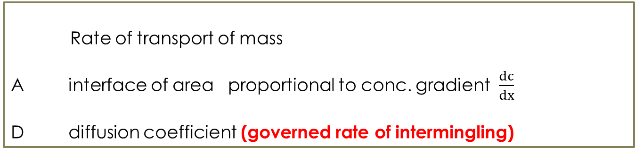
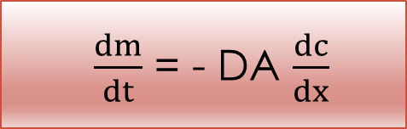
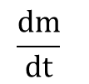
Molecular diffusion follows:
Fick’s first law
$\frac{dm}{dt}$ = - DA $\frac{dc}{dx}$
Conc. Gradient decrease with time as mixing complete
Rate of transport of mass
A interface of area proportional to conc. gradient $\frac{dc}{dx}$
D diffusion coefficient (governed rate of intermingling)
$$\frac{dm}{dt}$$
Effect by
Fluid viscosity
Size of diffused molecules

Slide 14
5. Scale and intensity of segregation
Quality of mixture judged upon random distribution of their components.
Bulk transport, turbulent flow and laminar flow
Intermingling of lumps of liquid to be mixed
Size and shape of lumps depend on
1. Mechanism contribute to overall process
2. Time of mixing
While molecular diffusion discontinuously of lumps from one to next
(lumps retains constant and uniform internal composition)
Liquid, gas and powder eliminate conc. gradients between lumps

Slide 15
Note: Danckwerts (degree of mixing quantities)
Scale of segregation (scale of turbulence)
Intensity of segregation
Measures variation in composition among various portions of mixture (reaches zero when mixing complete)
Expressed in 2 ways
Linear scale
Average value of diameter of lump
Volume scale
Average lump volume

Slide 16
6. time dependence
Mechanisms that are active in mixing and are relative to the proceed in mixing process.
E.g. Diffusion is necessary for effective reduction of intensity of segregation to reach zero when time of mixing is complete.

Slide 17
equipment
A. Batch Mixing
Mixing is limited in volume contained in suitable mixer (most feasible)
Parts of mixer:
1- Tank or container (hold the material being mixed)
2- energy supplier (for rapid mixing)
A- main (impeller, air stream, liquid jet) [direct flow of material within vessel]
B- sub. (baffles, vanes, ducts) [bulk movement of material in mixer so increase efficiency].

Slide 18
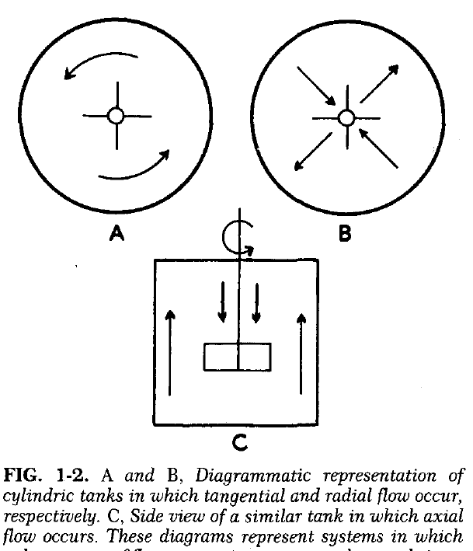
1. Impellers (Pushers)
Types depend on:
1- type of flow (radial, axial, tangential–touchable-)
2- shape and pitch of blades
Single or in combination

Slide 19
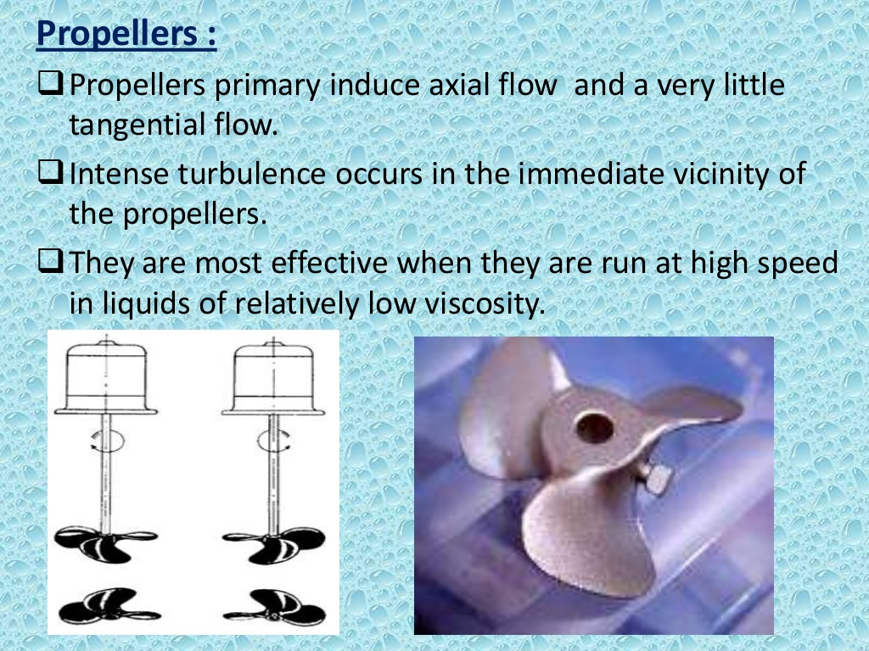
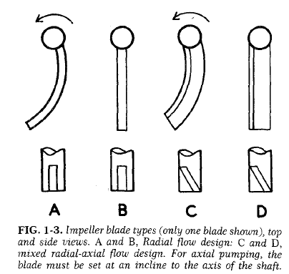
Blades of propellers (Fans)
1- Propellers:
(produce flow parallel to their axis)
- High efficient with low viscosity liquids
2- Turbines (produce axial or tangential flow or combination).
Distinguish from propellers: blades don’t have constant pitch throughout their length.

Slide 20
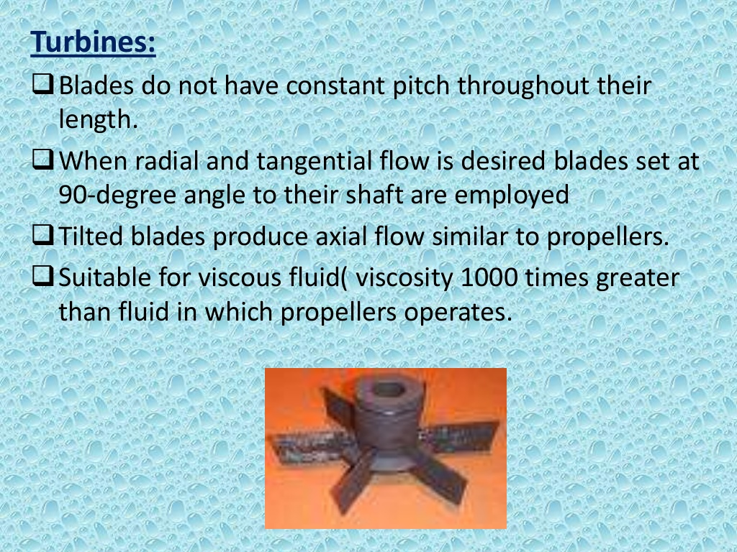
In turbines:
1- Radial-tangential flow (A,B): turbines with blades set as 90-degree angle to shaft.
2- Axial flow (C,D): turbines with tilted [not straight] blades (rugged design)
Used for very viscous fluids (1000 times more viscous than propeller can be used).

Slide 21
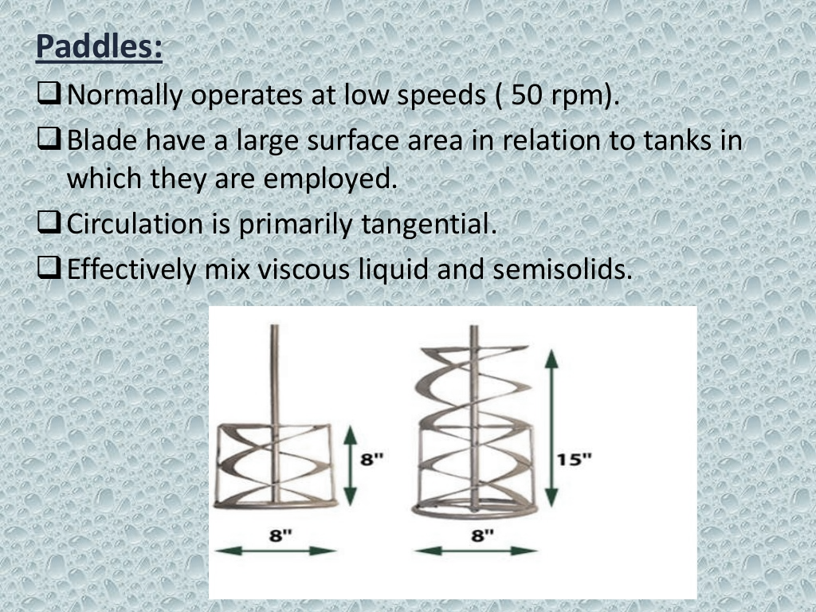
3- Peddles

Slide 22
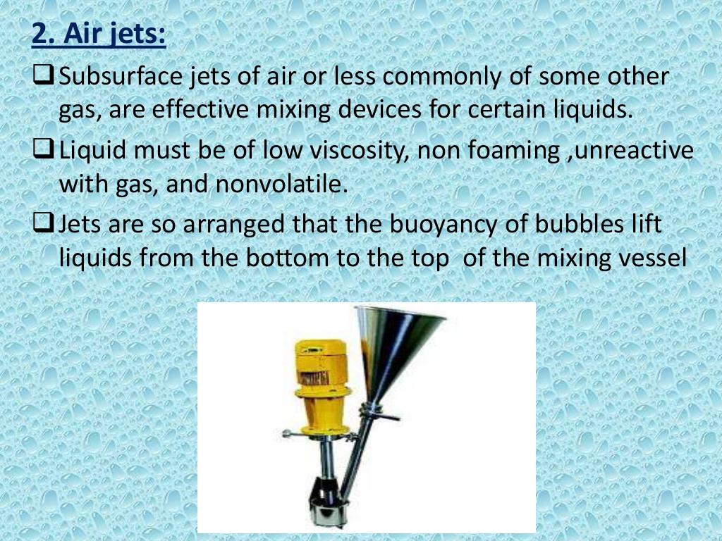
2. Air jets

Slide 23
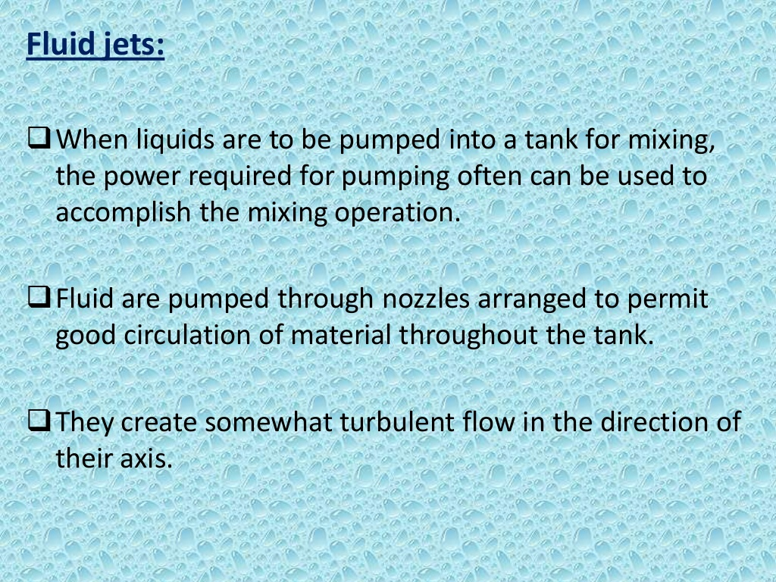
3. Fluid jets

Slide 24
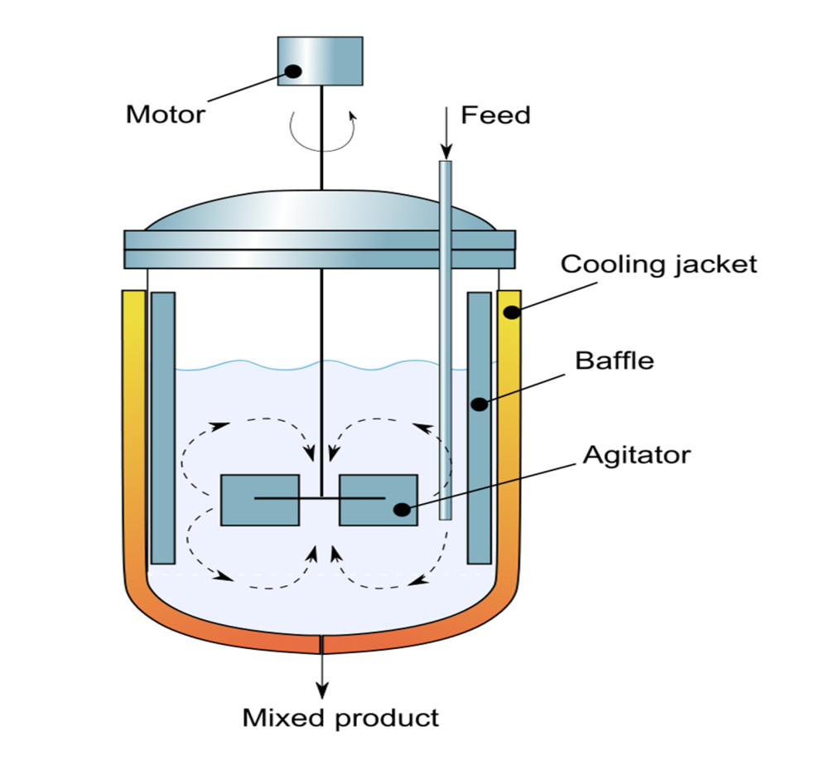
4. Baffles
Bulk transport is important in initial mixing when segregation present on large scale.
Intermingling between materials from remote regions in the mixer.
Note: Baffle plates directing flow of fluid and depends largely on type of agitator.

Slide 25
B. Continuous Mixing
Benefits:
1- freshly mixed materials
2- very large volume of materials.
Accomplished in two ways
1- Tubes or pipes (very little back flow or recirculation)
2- Chamber (holdup or recirculation)

Slide 26
1- Mixing tube
(having vanes, baffles, screws, grids or combinations)
Mass transport direct with primary flow
Lack of recirculation
Conc. Gradient along the pipe (tube)
2- Mixing tank
(when input rate difficult to control and fluctuations are unavoidable)
Avoided in final mixture by dilution of material in tank

Slide 27
Important note:
Avoiding fluctuation in conc. and having same holdup:
1- using series of tanks with half volume.
2- turbine agitated tank (having vertical sidewall baffles and turbine impeller in middle of tank) thus form 2 regions of mixing [above and below impeller for transport of materials between zones].

Slide 28
Mixer selection
Factors for selection:
1. Physical properties of material to be mixed (density, viscosity and miscibility).
2. Economic consideration regarding processing (time for mixing and powder expenditure).
3. Cost of equipment and its maintenance.

Slide 29
General guidelines for mixer selection
Monophase systems
(viscosity and density of fluid)
Type of flow and nature of mixing mechanisms
effect
E.g. A- Low viscous fluids (turbulent and circulate mass of material)
Air jets, fluid jets and high speed impellers.
B- Thick creams, ointments and pastes (high viscosity) [laminar , bulk mixing and molecular diffusion]
Turbine of flat blade

Slide 30
2. Polyphase systems
Composed of several liquids or solids
Subdivision or deaggregation
One or more phase formed
Dispersals of mass material
(process of mixing is homogenization, suspension formation and emulsification)
E.g. Mixing of two immiscible liquids requires subdivision of one of the phases into globules distributed throughout bulk of fluid.

Slide 31
Notes:
1. Selection of equipment
(viscosity of liquids and mechanism of intense shearing force generated).
2. Mixing finely divided solids with low viscosity liquid to produce (suspension)
separation of aggregates into primary particles and then distribution throughout the fluid.
Depend on
Depend on

Slide 32


