Slide 1
Lecture 3
Milling

Slide 2
Factors Influencing Milling
The properties of solids determine:
2- Ability to resist size reduction.
1- choice equipment of milling.
e.g. Hard material (iodine) is abrasive
rapid wear of mill parts immediately during size reduction.

Slide 3
1- Physical nature of material
2- Hygroscopic materials (${CaCl}_{2}$) rapidly sorb moisture wet mass sticks and clogs the mill.
2- Hygroscopic materials (CaCl_2) rapidly sorb moisture wet mass sticks and clogs the mill.
E.g. A- fibrous material (glycyrrhiza) crushed by cutting (cannot be crushed by pressure or impact).
B- Friable materials (sucrose) fracture by attrition, impact, pressure.
E.g. A- Materials contain > 5% water produce sticky mass in fine powder rather than large particles.
B- Materials contain > 50% water produce slurry or fluid suspension
(wet milling for size reduction).
Note: Increase moisture
decrease rate of milling to a specified product size
Alter crystalline structure and chemical changes in some materials (crystal growth and caking).
E.g.: Cortisone acetate equilibrate with aq. vehicle)

Slide 4
3- Heat [during milling]
softens and melts materials with low melting points
E.g. A- Synthetic gums, waxes and resins becomes soft and plastic.
B- Heat sensitive drugs degraded or charred.
C- Pigments (sienna) change their shade of color in excessive temp.
D- Unstable and fine powders ignite and explode at high temp.
4- Shape of milled particles
E.g. A- Impact mill (produce sharp or irregular particles) [not flow readily]
B- Attrition mill (produce spherical particles) [free-flow]

Slide 5
Selection of a Mill
Materials used in pharmaceuticals reduced in particle size less than 40 mesh size by (Hammer, ball, roller, fluid-energy mills)
Choice of mill based on:
1- Product specification
Size range
particle size distribution
shape
moisture content
physical and chemical properties of materials
2- Capacity of mill and production rate requirements.

Slide 6
3- Versatility of operation
Wet and dry milling
Rapid change of speed and screen
Safety features
4- Dust control
Loss of costly drugs
Health hazards
Contamination of plant
5- Sanitation
Ease of cleaning
sterilization

Slide 7
6- Auxiliary equipment
Cooling system
Dust collectors
Forced feeding
Stage reduction
7- Batch or continuous operation
8- Economical factors
Cost
Power consumption
Space occupied
Labor cost

Slide 8
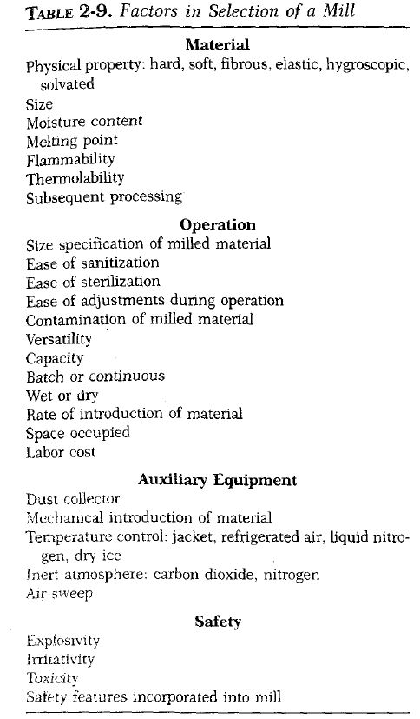

Slide 9
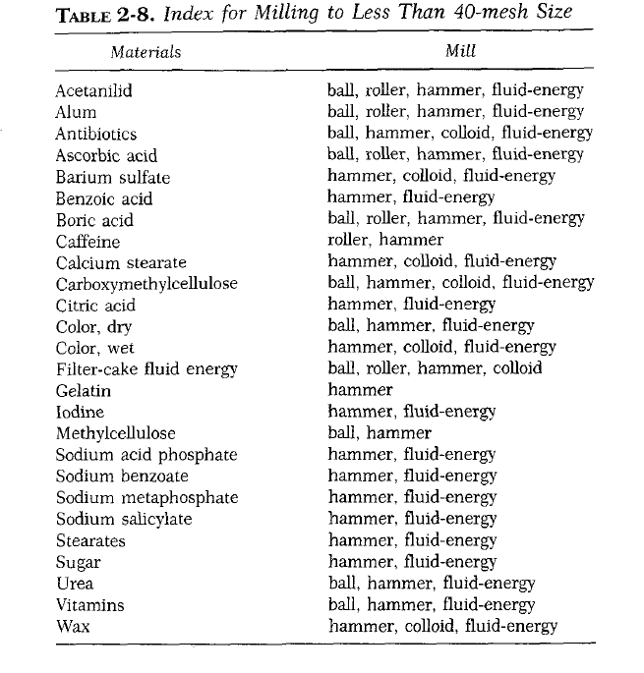

Slide 10
Techniques of milling
Standard adjustments of milling process
Speed
Screen size
Design of rotor
Load
Special atmosphere
E.g. A-Hygroscopic materials (closed system with dehumidifier air).
B- Thermolabile, easily oxidized, combustible materials (closed system with inert atmosphere of ${CO}_{2}$or nitrogen.
B- Thermolabile, easily oxidized, combustible materials (closed system with inert atmosphere of CO_2or nitrogen.
C- Fine dust like sulfur is potential explosive (explosion proof and the mill grounded).

Slide 11
6. Temp. Control
(Bulk of energy is converted into heat unless controlled because solid will melt, decompose or explode).
[To avoid this, the milling chamber cooled by cooling jacket or heat exchanger].
E.g. Waxes and low melting point materials (beeswax and stearic acid) chilled before milling (with hammer mill to 100 mesh size) and if not sufficient add dry ice with feeder.
7. Pretreatment
(Mills operate satisfactory when the feed is in the proper size and enter at a fairly uniform rate).
E.g. Pretreatment of fibrous materials with high-pressure rolls or cutters facilitates comminution.

Slide 12
8. Subsequent Treatment
(Extreme control of size is necessary to recycle large particles) in 2 ways:
Simply screening discharge and returning oversized particles for 2nd milling
Using air-separation equipment in a closed circuit to return oversized particles automatically to the milling chamber.
9. Dual Process
(Milling process is simultaneously as a mixing process)
E.g. Fluid-energy mill (used for size reduction and dispersion)
Hot gas circulated through the mill to comminute and to dry moist solids after coating with monomolecular film by premixing with 0.25% coating agent simultaneously.

Slide 13
10. Wet and Dry Milling
(Choosing milling type depends on the use of the product and subsequent processing).
A- Dry Milling (for the products undergoes physical and chemical changes in water -fineness in the region of 100 micron-).
B- Wet Milling (for further reducing the size but flocculation lowers the limit to 10 micron).
Benefits: Eliminate dust hazards and done in low speed that consumes low power.
Note: Dispersing agents in dry grinding (calcium stearate and oleic acid) useful in revolving of mill if coating of balls occur.
Note: Dispersing agents in wet grinding like (Silicate and phosphates).

