Slide 1
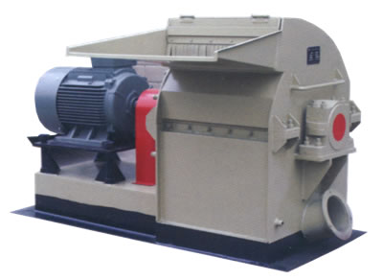
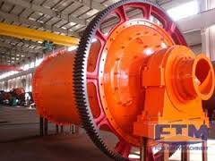
Milling
Lecture 2

Slide 2
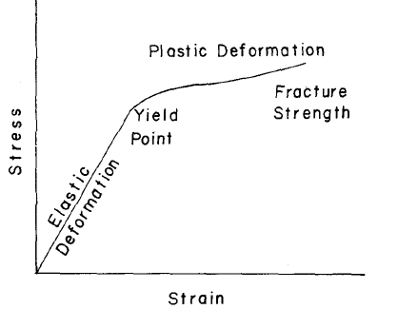
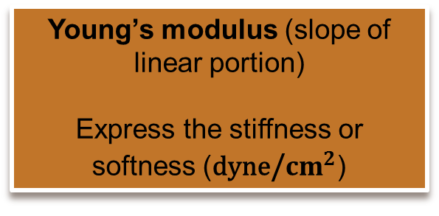
Theory of Comminution (Milling)
Behavior of solids under stress
Strained and deformed
Initial portion {region}
(Hook’s Law)
(Stress proportional to strain)
1- Force of impact not exceed the elastic limit reversible stress or deformation
(particle return to original position) {energy of stress appears as heat}.
2- Force of impact that exceeds the elastic limit
fracture the particle.
Note
Young’s modulus (slope of linear portion)
Express the stiffness or softness (dyne/${cm}^{2}$)

Slide 3
The region of greater stress (measure impact strength of material)
Here in Yield point (Non-linear stress-strain curve)
AUC represents (Energy of Fraction)
Fractured particles
1. large
2.Intermediate
3.small
Size depend on comminution
Size depend on internal structure
Measure of resistance of permanent deformation

Slide 4
Irregular particle:
A- Force on high portion of surface (stress and temp.)
B- New Surface appear supplied by energy from stress.
Flaw: Structural weakness develop into crack under strain
Large particles (with numerous cracks)
1
Large particles requires lower energy:
A- Small S.A.
B- Numerous cracks
2
Small particles requires more energy:
A- Increased S.A.
B- Need energy to initiate cracks
Small milled particles (with few cracks)

Slide 5
Energy of Fracture
Many particles receive minimum energy (impact) that are not sufficient to fracture.
Mills utilize < 1% of energy to fracture particles and produce new surfaces.
1- Elastic deformation of unfractured particles.
2- Transport of material within milling chamber.
3- Friction between particles.
4- Friction between particles and mill.
5- Heat.
6- Vibration and Noise.
7- Inefficiency of transmission and motor.
Rest of energy dissipated in:

Slide 6
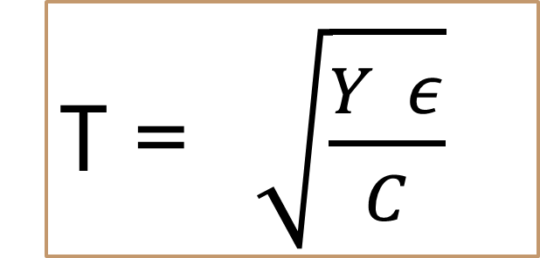
Griffith Theory
States that: “ All solids have flaws and microscopic cracks, thus increasing the applied force according to the crack length and focus stress at the atomic bond of the crack apex”.
T =$\sqrt{\frac{Y ε}{C}}$
T: tensile stress
Y: Young’s modulus
Є: surface energy of wall of crack
C: critical crack depth required for fracture

Slide 7
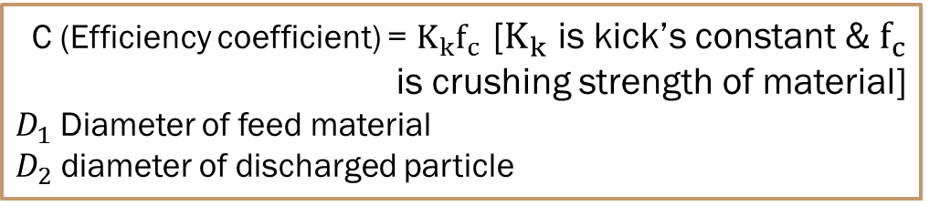
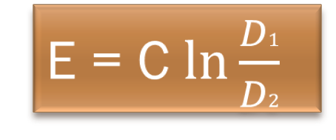
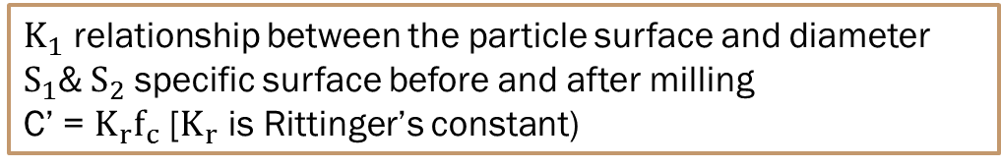
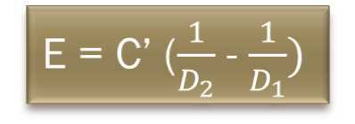
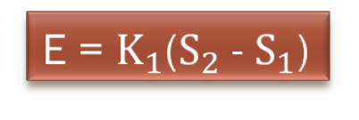
Energy of Comminution
Kick’s Law: Energy (E) required for size reduction is directly proportional to reductional ratio (D1/D2)
C (Efficiency coefficient) = $K_{k}f_{c}$ [$K_{k}$ is kick’s constant & $f_{c}$ is crushing strength of material]
$D_{1}$ Diameter of feed material
$D_{2}$ diameter of discharged particle
E = C $\ln{\frac{D1}{D2}}$
Rittinger’s Law: Energy required for size reduction is directly proportional to increase in surface (for brittle material)
E = $K_{1}$($S_{2}$ - $S_{1}$)
$K_{1}$ relationship between the particle surface and diameter
$S_{1}$&${ S}_{2}$ specific surface before and after milling
C’ = $K_{r}f_{c}$ [$K_{r}$ is Rittinger’s constant)
E = C’ ($\frac{1}{D_{2}}$ - $\frac{1}{D_{1}})$

Slide 8
Milling Rate
Milling rate represents decay constant ($λ)$ varies with:
Milling rate represents decay constant (λ) varies with:
1- Mass & size of material (particle) introduced into the mill.
2- Size of grinding medium in a mill
3- Time of milling

Slide 9
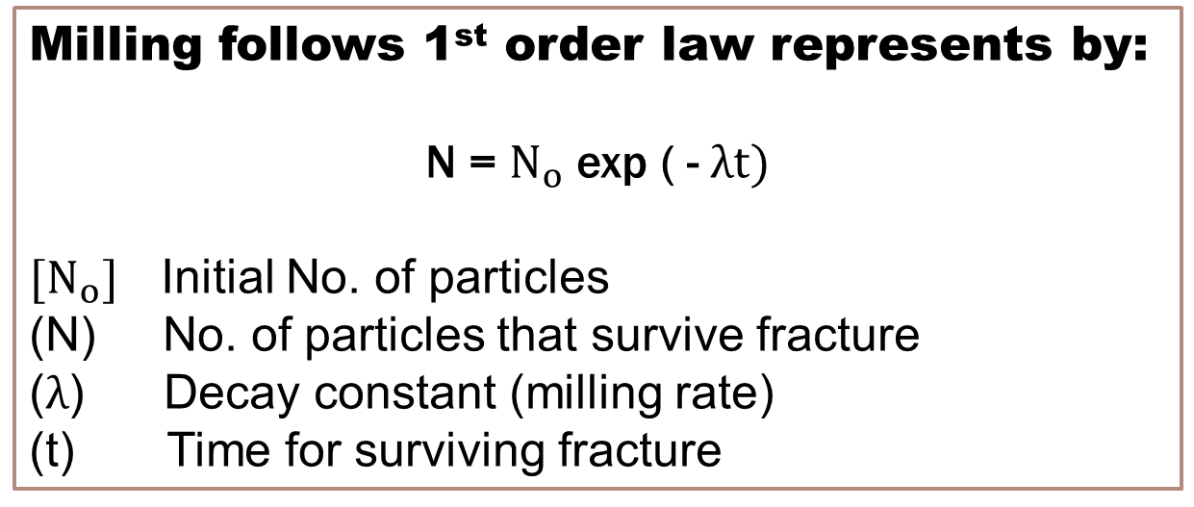
Milling of brittle material in small mills follows (first-order law)
Milling follows 1st order law represents by:
N = $N_{o}$ exp ( - $λt)$
${[N}_{o}]$ Initial No. of particles
No. of particles that survive fracture
($λ$) Decay constant (milling rate)
(t) Time for surviving fracture

Slide 10
Mills
Mill consist of:
1- Feed part
2- Grinding part (milling chamber)
3- Discharge part (Receiver)

Slide 11
Important Note:
A- If rate of feed is slow
the product discharge readily and the amount of undersize or fines is minimized.
The rate of discharge should be equal to the rate of feed.
B- If rate of feed is fast
the material remain in the milling chamber for long time because its discharge is impeded by large amount of material
greater size reduction and lower mill capacity.

Slide 12
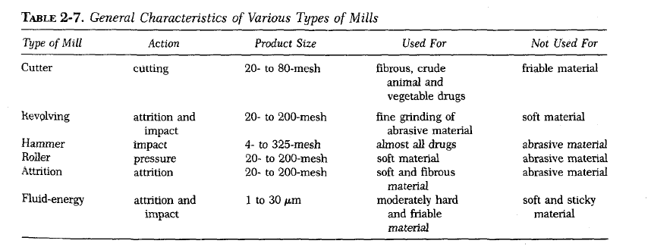
Types of Mills

Slide 13
Milling operations
A- open-circuit milling:
Materials is reduced to the desired size by passing it through the mill.
B- closed-circuit milling:
Materials discharge from mill pass through classifier or size-separation device, and the oversize are returned to the grinding chamber for further reduction in size.
Most valuable in reduction to fine and ultrafine size

Slide 14
Mechanism of size reduction
Cutting:
materials cut by sharp blades
Compression:
materials is crushed by pressure.
Impact:
stationary materials hit moving materials at high speed or strikes a stationary surface (case of machine)
shatters of materials to small pieces.
Attrition:
materials subjected to pressure and surfaces are moving relative to each other
shear forces which breaks particles.
Most widely used in pharmaceutical practice separately or in combination

Slide 15
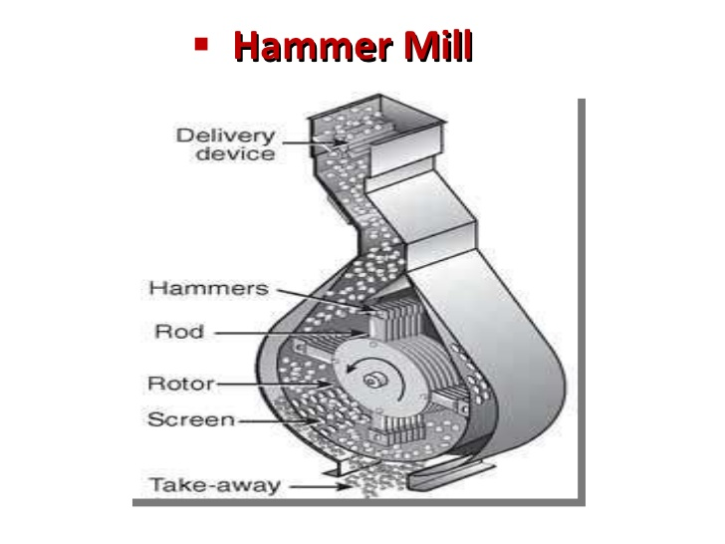
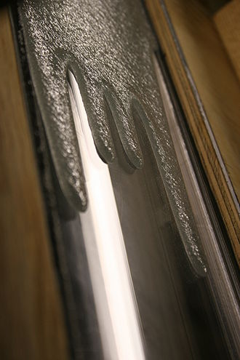
Hammer mill
Principle:
Operates as an impact between rapidly moving hammers mounted on the rotor and the powder material.
Used for almost any type of size reduction (dry material, wet filter-press cakes, ointment, slurries).

Slide 16
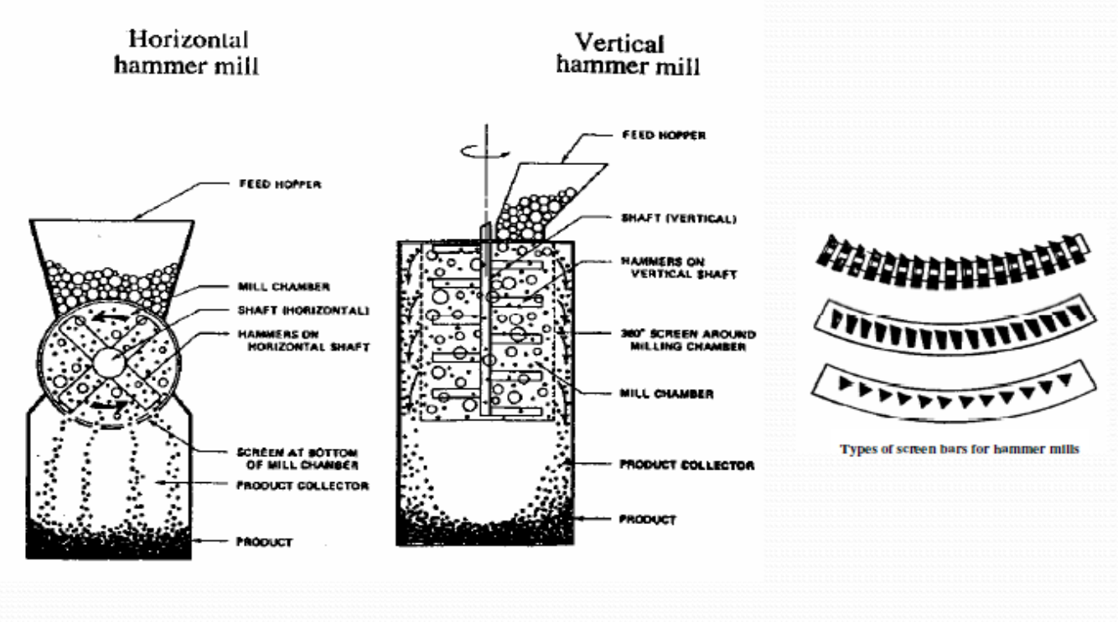
Hammer mill is:
Popular in pharmaceutical industry because of versatility

Slide 17
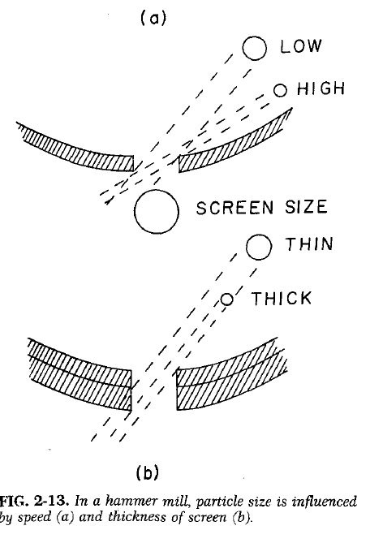
Hammer mill controls Size of product
1- Speed of hammer mill
2- Size & type of screen
Advantages:
1- Rapid in action (grind many types of materials)
2- Easy to operate and install, operation continuous.
3- Little contamination with abraded metal.
4- Control P.S. by changing speed of rotor, hammer type, shape & size of screen.

Slide 18
Disadvantages:
1- Heat buildup during milling, therefore product degradation is possible.
2- Cannot be employed to mill (sticky, fibrous and hard materials).
3- Screens get clogged (closed).
4- Wearing of mill and screen is more with abrasive materials.

Slide 19
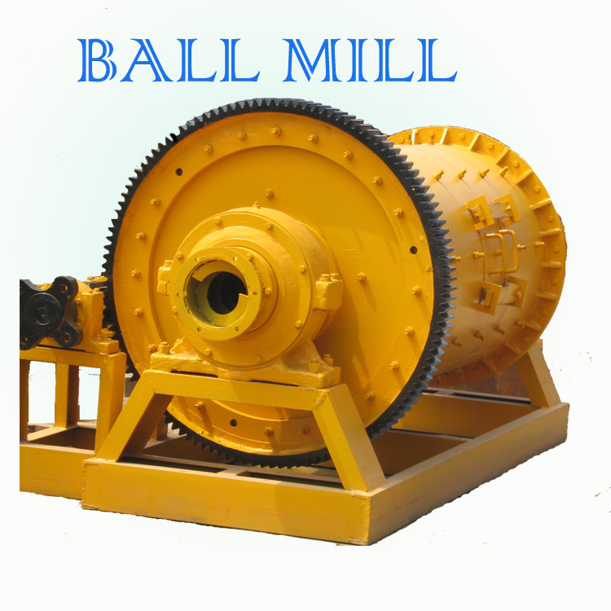
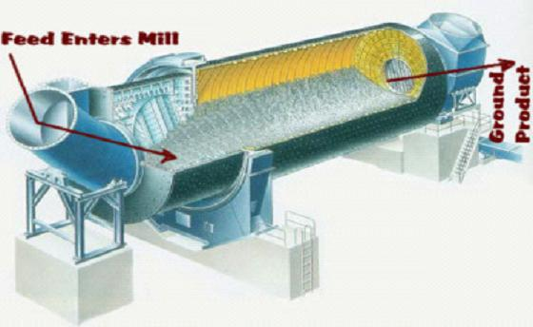
Ball Mill
Horizontal rotating hollow vessel of cylindrical shape filled with balls of steel or pebbles (grinding medium).
Ball mill types:
A- Pebble mill (Not used for sticky materials because it will hold together)
B- Rods or bars mill (used for sticky materials because of greater weight causes them to pull apart)

Slide 20
Increasing Efficiency of ball mill
(Increasing fineness of powder)
1- By increasing No. of balls
2- By using balls containing material with higher density (50% of volume of mill).
A- steel balls (fast grinding)
B- porcelain balls (Non-sparking for explosive materials)
C- Stainless balls (for ophthalmic and parenteral because of less contamination)

Slide 21
Type of milling in Ball mill
1- Dry milling (Moisture < 2%) very fine particles.
2- Wet milling (using wetting agents) 200 mesh particles
Size reduction and reduce aggregation
(by nullifying electrostatic forces & increasing efficiency of milling and physical stability of product).

Slide 22
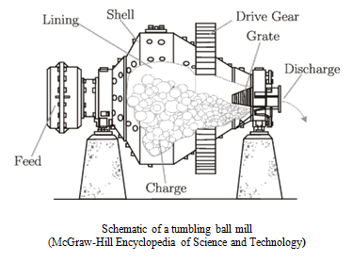
C- Tumbling mill
Principle:
Impact between rapidly moving balls and powder material.
At low speed (balls roll over each other and attrition is predominate [rubbing action])
Thus attrition and impact responsible for size reduction

Slide 23
advantages:
1- Produce very fine particles.
2- Dry and wet grinding process.
3- Toxic substances ground (closed system).
4- Rods or bars as a grinding media (reducing size of sticky materials).
5- Low install, operation and labour.
Disadvantages:
1- Noisy machine.
2- Slow process.
3- Soft, fibrous material cannot be milled.

Slide 24
Fluid energy mill (Micronizer)
Materials is suspended and conveyed by air or stream passing through violent turbulence nozzles.
Reducing P.S. by impact and attrition (i.e. high velocity collisions between suspended particles)
Note: Air used to counteracts heat generated by milling (as compressed air expand at orifice)
Idea: Air used for thermolabile or low melting point pharmaceutical materials.

Slide 25
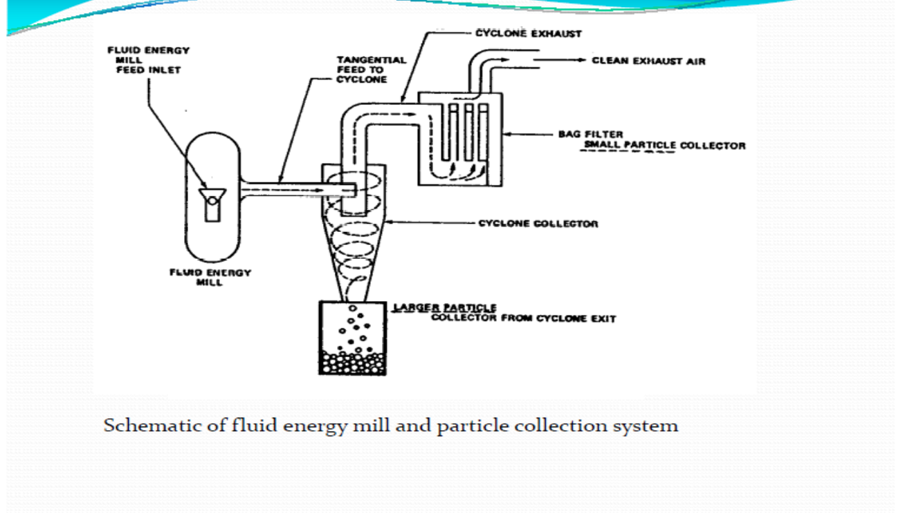
advantages:
1- Up to 6000 Kg/hr. feed is milled.
2- Feed particles of size 12 mm easily reduced.
3-No wear of mill, no contamination.
Disadvantages:
1- Not suitable for soft, tacky and fibrous material.
2-Expensive,need accessories as source of fluid energy and dust collection equipment.

Slide 26
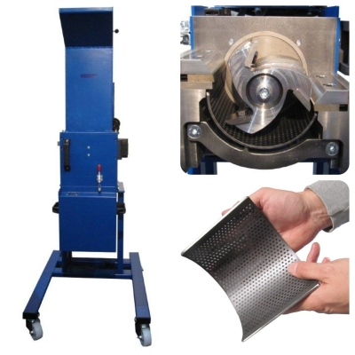
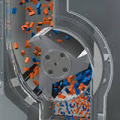
Cutting Mill
Principle: cutting and shearing action
Uses: for fibrous and tough material.
Types: single and double runner disc mills.
Procedure: Materials premilled to 40 mesh size and suspended in a stream of air or liquid when feed to the mill.

Slide 27
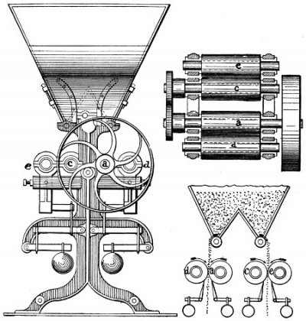
Roller mill
Principle:
combination of compression and shearing action.
Mechanism of action:
2-5 smooth rollers operating at different speed.

Slide 28
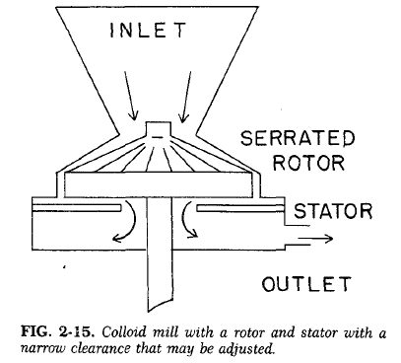
Colloid mill
Used for suspensions and emulsions (not for dry materials).
Premilled solids mixed with liquid vehicle before being introduced.
Disadvantages: Interfacial tension causes part of material adhere to, and to rotate with, the rotor.

Slide 29


