Slide 1
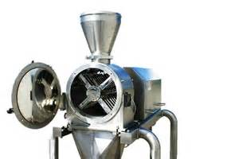
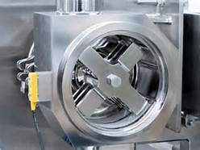
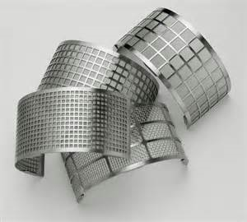
Lecture 1
Milling

Slide 2
Introduction
Milling: Is a mechanical process of reducing particle size of solids.
Milling also termed synonymously as comminution which represent:
Crushing
Disintegration
Dispersion
Grinding
Pulverization
Milling
All of these depend on product, equipment and process.

Slide 3
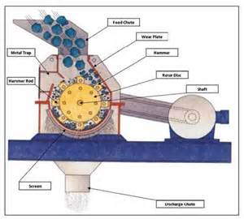
Introduction- Milling equipment
Milling equipment classified according to the size of the milled product into:
Coarse milling (particles > 20-mesh)
Intermediate (particles 200- 20 mesh [74-840 micron])
Fine (particles < 200 mesh)
Note: Size expressed in term of mesh (number of openings per linear inch of a screen).
e.g.: Hammer mill used to prepare a 16-mesh granulation and to mill a crystalline material to a 120-mesh powder.

Slide 4
Pharmaceutical Applications
Medicinal Powders
A given weight of a finely powdered medicinal compound dissolves in a shorter time than does the same weight of a coarser powder.
Specific surface (surface area per unit weight)
Increased by size reduction
By increasing the area of contact between solid and dissolving fluid Therapeutic efficiency of medicinal compounds that posses low solubility in body fluids.
Due to
which

Slide 5
Examples of Medicinal powders:
Controlling fineness of Griseofulvin powder
half (oral D.F.) regimen.
Controlling P.S. and specific surface of Penicillin G procaine I.M. suspension
Influence duration of adequate serum conc., rheology and product syringeability.
P.S. used in inhaled aerosols
determines the position and retention of particles in the bronchopulmonary system.
P.S. of oral suspensions
affect texture, taste and rheology.
Small solid particles used to prepare solutions
time required for dissolution is shorter.

Slide 6
Drying
Milling facilitate drying of wet masses
Increase surface area and reduce the distance the moisture travel within particle to reach outer surface.
E.g.: Manufacture of compressed tab., the granulation of wet mass result in more rapid and uniform drying
Dried tablet granulation is milled to a P.S. and distribution that will flow freely and produce tablet of uniform weight.
Mixing
Milling facilitate easier and uniform mixing or blending
The ingredients are approximately of same size

Slide 7
Colored
Pharmaceuticals are milled
To ensure that the mixture is not mottled and is uniform from batch to batch.
Lubricants
Lubricants Should be milled to fine powder
To ensure their ability to coat surface of powder or granules.
Ointments, creams and pastes
Milling provide smooth texture, better appearance and improve physical stability.

Slide 8
Size Distribution and Measurement
Natural particulate solids and milled solids
Irregular shape and size (large-small) usually equivalent sphere.
Choosing the large particles by using microscopy (with similar surface or volume)
1- Size of particle expressed in diameter (sphere)
2- Volume of particle determined by displaced liquid (equivalent to diameter)
Have
Thus
i.e.

Slide 9
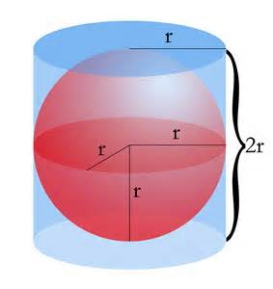
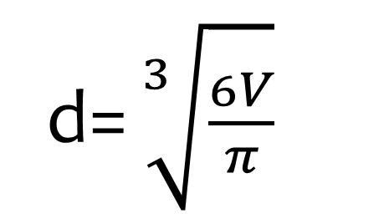
Sphere Volume = 4/3 * Pi * r³ = ( Pi *d³)/6
Equivalent diameter (Effective or Stock’s diameter)
of an irregular particle i.e. sphere particle
d= $\sqrt[3]{\frac{6V}{π}}$

Slide 10
Thus the effective or stock’s diameter used to determine rate of sedimentation
(the time required for particle to settle between two fixed points in a suitable liquid).
According to this the packing and flow of powder or granules depends on
volume (effecting by size of particles - i.e. surface diameter -)

Slide 11
Representation of Data
Milling of materials
Variety of particle sizes
Measurement of p.s.
Determine percentage frequency of p.s. distribution
Bell shape structure
%
Normal or Gaussian distribution (symmetric distribution about the vertical axis)
The exception in reducing P.S. Increase No. of particles Skewed distribution)

Slide 12
Methods of Measurement of Size Distribution
1- Microscopy
2- Sieving
3- Sedimentation
4- Other methods (sorption, electrical conductivity, light and x-ray scattering, permeametry, and particle trajectory).

Slide 13
1- Microscopy
Direct Method for measuring P.S. distribution.
Disadvantages: can’t resolve particles if it’s size is close to the wave length of the light source.

Slide 14
Types of Microscopes
(1) Ordinary microscope (white light):
measure particles 0.4 - 150 microns.
(3) Microscope with special lenses (UV light):
measure particles 0.1 micron.
(2)Ultramicroscope: measure particles 0.01 – 0.2 micron.

Slide 15
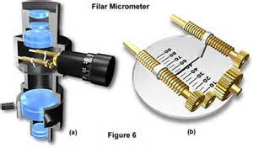
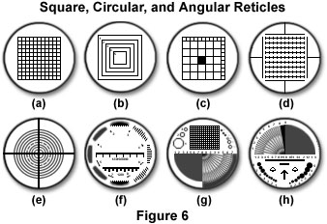
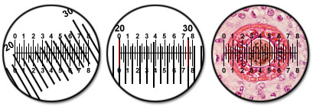
Measuring Size of Distribution by Microscope
1- Measuring size of particles (diameter) by using the calibrated filar micrometer eyepiece (graticule).
2- Measuring No. of particles with the same size.
3- Compare cross-sectional area of each particle (size of particles) through grids of circles or squares.
Note:
Recommended particles measured 625.
If size of distribution wide (increase No. of particles).
If not (narrow) few as 200 particle.

Slide 16
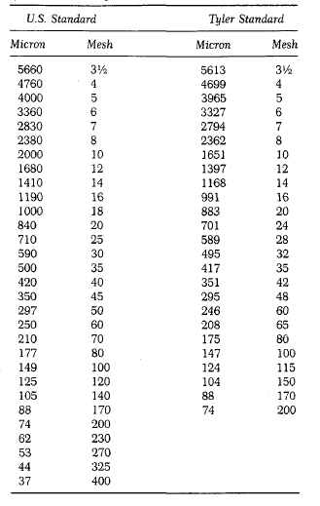
2- Sieving
Sieve: pan with bottom of wire cloth with square openings.
Most widely method for measuring P.S. distribution.
Advantages: Inexpensive, simple, rapid, limited variation between operators.
Lower limit Mesh (50 micron) Micromesh (10 micron).
Tyler standard [200 openings (mesh) per inch]
U.S. standard [18 mesh per mm]

Slide 17
Size of distribution effected by:
1- No. of Sieves
(by passing powder through series of smaller sieves and weighing portion retained on each sieve).
2- Motion of sieve (vibratory, side-tap, bottom-tap, rotary-tab, rotary).
3- Time of sieving.
4- Load or thickness of powder (proportional to time).
Measuring diameter of powder bypass series of sieves:
30-mesh and retained on 45-mesh (diameter= 590 + 350)/2 or 470 microns.

Slide 18

3- Sedimentation
Method used to measure P.S. 1-200 micron.
Advantages: to obtained size- weight distribution curve and measuring P.S.
This method depends on rate of sedimentation depends on P.S.
- d Stock’s: effective or stock’s diameter.
viscosity of dispersion fluid.
- x/t rate of sedimentation or distance of fall x in time t.
- g is the gravitational constant.
- p and po are the densities of the particle and the medium.

Slide 19
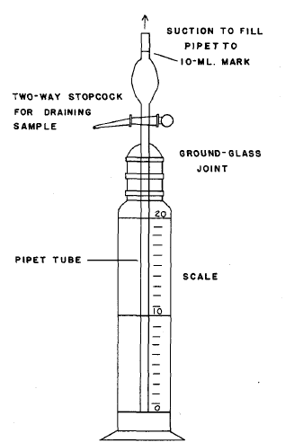
Pipet method (Anderson method)
- P.S. distribution -
Sphere particles
Sample not exceeding 2% suspension powder put in suitable liquid in pipet and withdrawn at time intervals from specified depth and allow to settle down.
(particles with different size fall at constant rate) with no interaction between particles that settle down.
Larger particles fall at faster rate than smaller particles
each time sample withdrawn has lower concentration and smaller particles in diameter than previous one.

Slide 20


