Slide 1
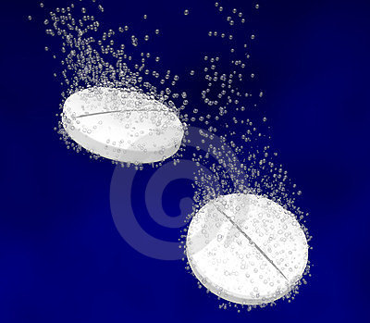
Lab. 2
Industrial pharmacy
Effervescent Granules

Slide 2
Granule dosage form
Small irregular particles ranging from 4-10 mesh size containing medicinal substances
Effervescent granules
Mixtures of medicinal agent with citric acid, tartaric acid and bicarbonate
Note: Granules may be non-medical: Deluse granules (dietary supplements)

Slide 3
Dispensing
Dissolving granules in water and take during taken during effervescence or immediately after.
Type of drugs used in effervescent granules:
Usually water soluble drugs
1- Alka seltzer: (Aspirin) minor aches, pains, inflammation, fever, headache.
2- Citrocarbonate: Urinary pH modifiers increase sulfonamide solubility and prevent crystallization that may lead to renal calculi or nephrotoxicity and to treat (GERED) and indigestion.

Slide 4
Important notes for using granules:
1- By using granules or coarse particles of mixed powders rather than small powder particles
the rate of solution is decreased
violent and uncontrollable effervescence is prevented.
2- Sudden and rapid effervescence could overflow the glass and leave little residual carbonation in the solution.

Slide 5
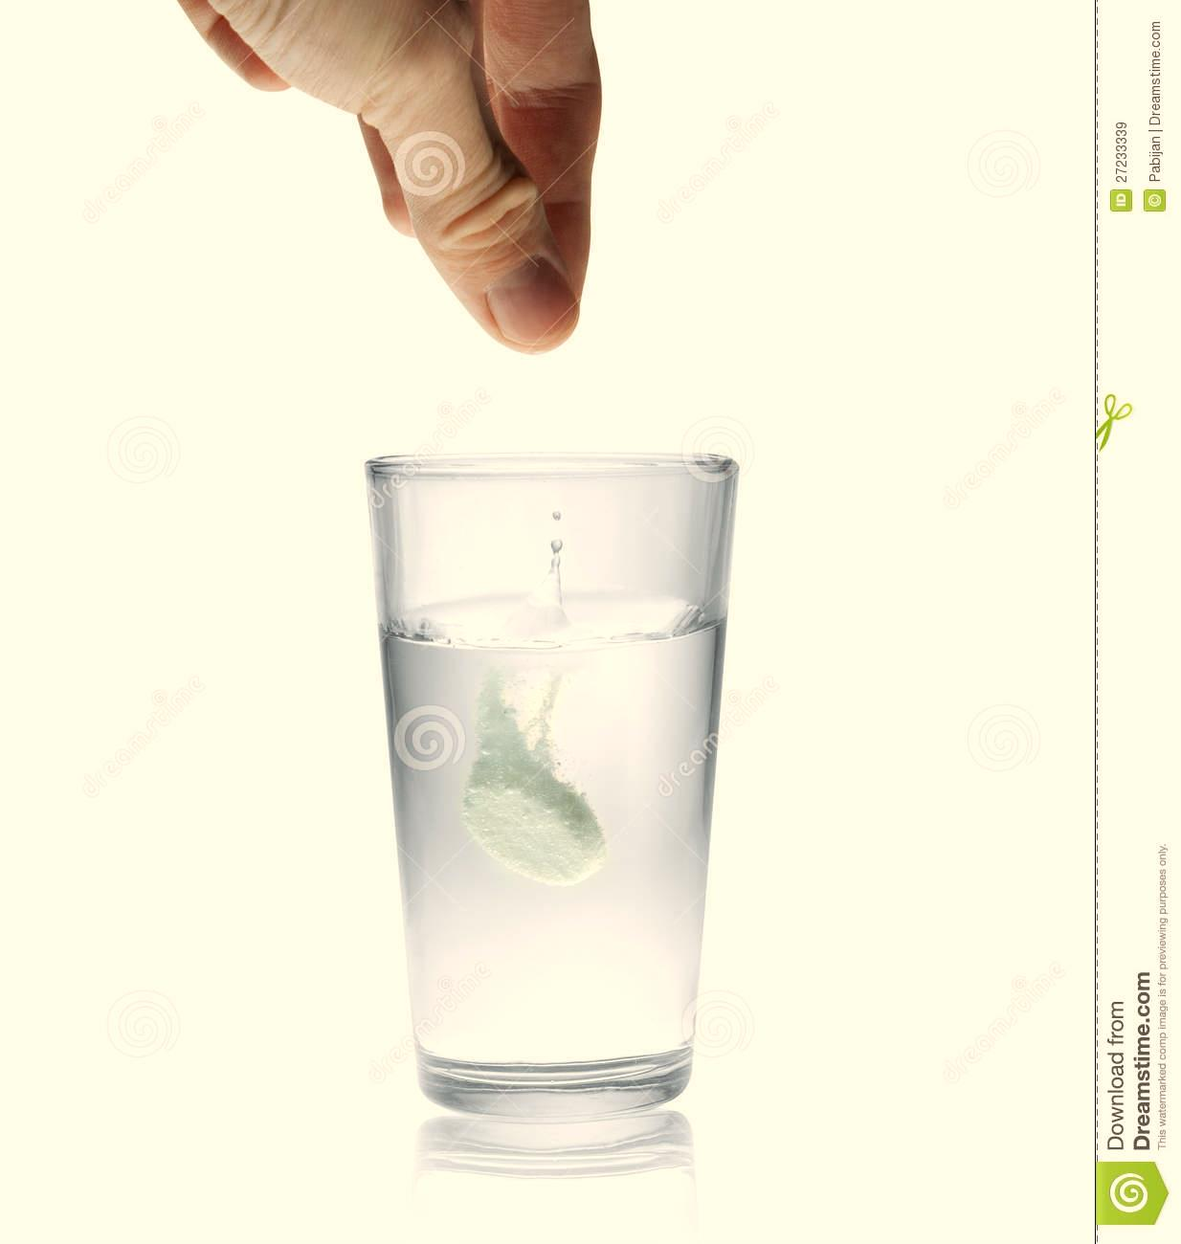
3- Combination of citric acid and tartaric acids rather than either acid alone to avoid certain difficulties:
A-Thus when using tartaric acid alone the resulting granules loss their firmness readily and crumble (Chalky and friable).
B- while using citric acid alone result in a sticky mixture difficult to granulate.

Slide 6
Advantages:
1. Rapid onset of action
(prepared as solution)
rapid disintegration and dissolution.
2. Pleasant taste
chemical reaction between acid and base lead to liberate CO2 which act as local anesthetic effect of oral cavity so mask the undesirable taste.
3. Psychological effect, patient comfort to it.
4. Provide alkaline solution, neutralization of a acidic drugs as aspirin (alkalinization of urine and increase excretion of drug which is acidic).

Slide 7
Disadvantages:
1. Unstable (absorb the water [moisture] from the atmosphere).
2. Not accurate dose estimation because the one who estimate the dose is the patient himself.
3. Sodium overload (these granules are not suitable for hypertensive patients)
4. Have many drug-drug interaction.
It can be overcome by packaging and compressing into tablet dosage form and put them in aluminum foil
(not in plastic foil because it allow the absorption of water from moisture).

Slide 8
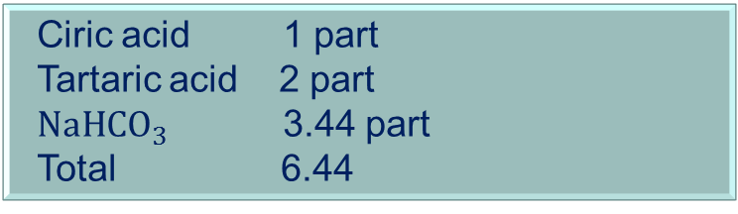
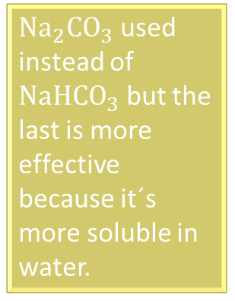
Sources of acids
1.Natural (food) acids (citric acid, tartaric acid, malic acid ,fumaric acid).
Highly soluble in water and thus widely use in preparation of effervescent.
2. Anhydride acids (anhydrous citric acid and anhydrous tartaric acid) .
when dissolved in water give hydrous acids.
3. Salts acids (disodium dihydrogen phosphate, and sodium disulfide).
soluble at pH 4.5 otherwise they are strong acids.
4. Effervescent base: used mainly in the preparation of effervescent granules.
${Na}_{2}{CO}_{3}$ used instead of ${NaHCO}_{3}$ but the last is more effective because it´s more soluble in water.
Ciric acid 1 part
Tartaric acid 2 part
${NaHCO}_{3}$ 3.44 part
Total 6.44

Slide 9
Method of effervescent granules production
1. Formulation:
a/ Amount of each material in the formula.
b/ Number of doses: usually we 1 tsp. as ordinary dose which is equal to 5 gm of effervescent.
No. of doses =total amount /wt .of each dose
c/ The physic-chemical properties of each component.
2. Mixing:
to get uniform distribution.

Slide 10
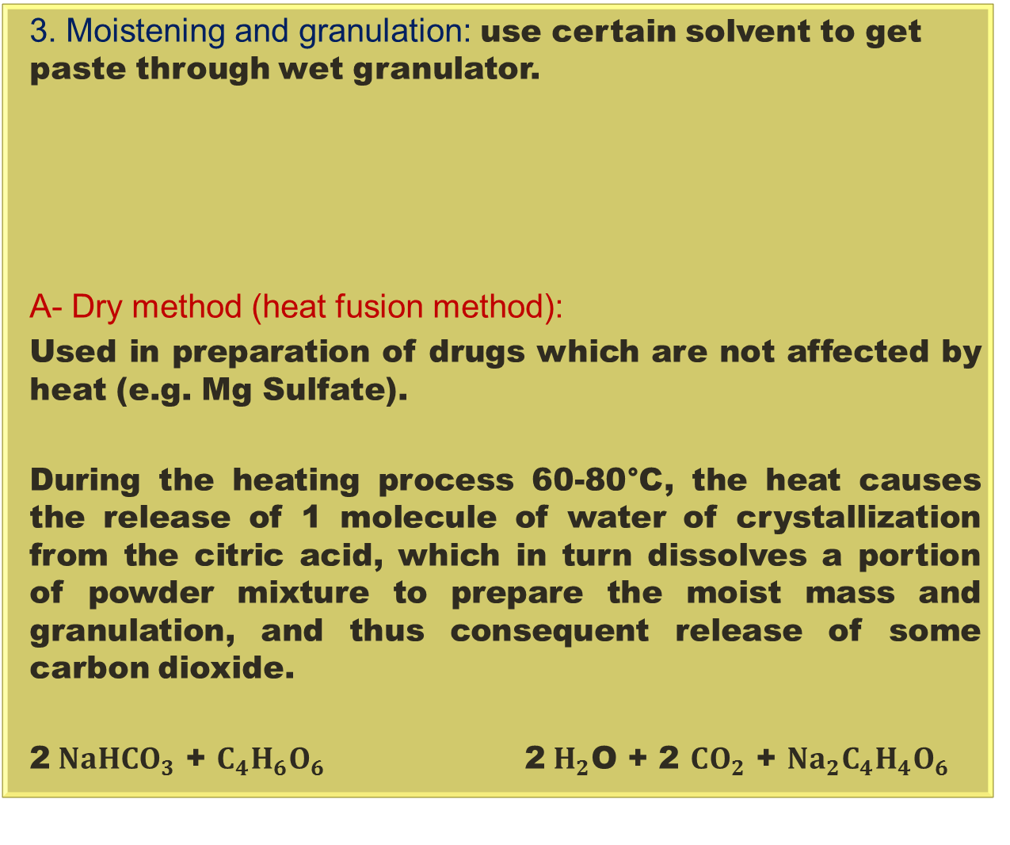
3. Moistening and granulation: use certain solvent to get paste through wet granulator.
A- Dry method (heat fusion method):
Used in preparation of drugs which are not affected by heat (e.g. Mg Sulfate).
During the heating process 60-80°C, the heat causes the release of 1 molecule of water of crystallization from the citric acid, which in turn dissolves a portion of powder mixture to prepare the moist mass and granulation, and thus consequent release of some carbon dioxide.
2${ NaHCO}_{3}$ + $C_{4}H_{6}O_{6}$ 2${ H}_{2}$O + 2 ${CO}_{2}$ + ${Na}_{2}C_{4}H_{4}O_{6}$
* In small amount we use sieve with suitable particle size instead of granulator.
Methods of moistening and granulation
Tartaric acid

Slide 11
B- Wet fusion method:
2- prepare compounds which are affected by heat.
Used to
1- prepare small amount of effervescent granules.
1st mix the powder together and then add ethanol as moisture to get wet mass.
Water can´t be used as moisture because it reacts directly and end the reaction.

Slide 12
4. Drying:
only for heat fusion method
By using tray dryer
5. Packaging and storage (cool and dry place):
Stored in a wide mouth bottle with colored glass, tightly closed and sealed to exclude air , and kept in a cool dry place.
Note: to get accurate dose
granules may be pressured into tablet dosage form (e.g. Vit. C).

Slide 13
Experimental work:
Prepare 25 gm of effervescent granules using 1.5 gm of Mg sulfate per dose as laxative.
As known that effervescent granules composed of effervescent base and active ingredient (Mg sulfate).
The steps of calculation:
Find no. of doses
No. of doses =total amount of granules /wt. of each dose
=25/5
=5
Find the amount of active ingredient added to the total amount of effervescent granules (25gm ):
5 × 1.5=7.5 gm of Mg sulfate should be added
3. Find the wt. of each active constituent of effervescent base that should be added to the added to the formula.
25 -7.5=17.5 gm amount of the base.

Slide 14
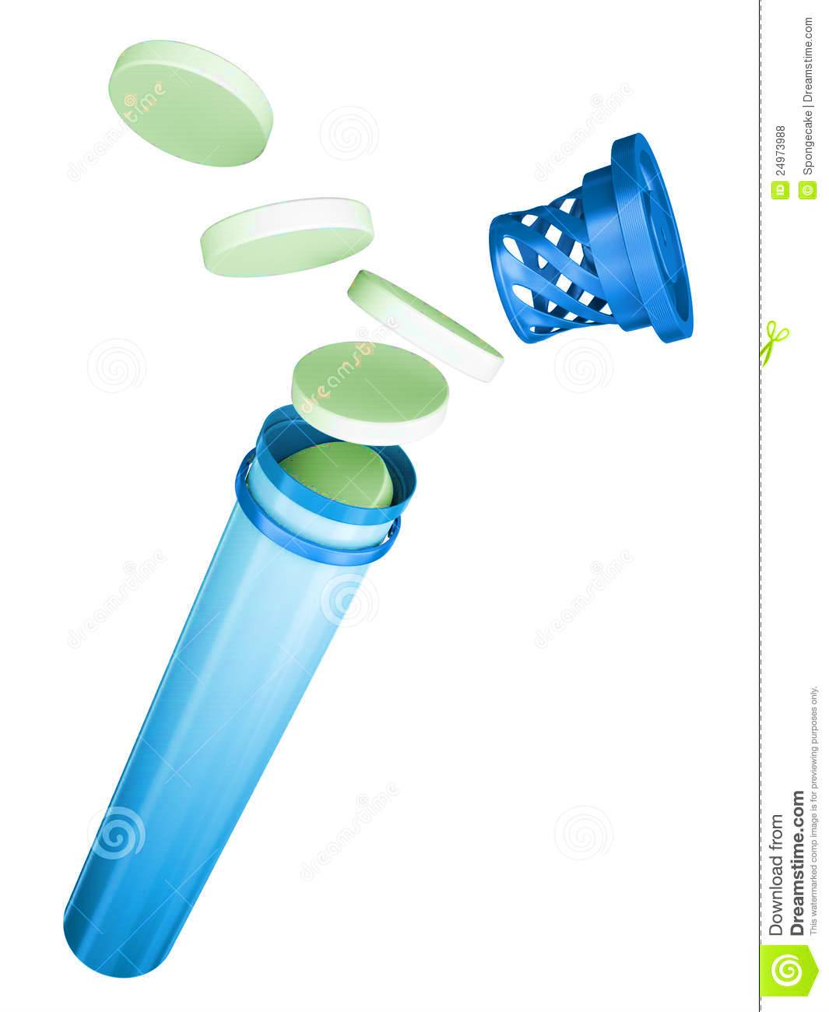
For Citric acid, for Tartaric acid and for NaHCO3:
x =2.7 gm
X =5.4 gm or 2 x 2.7 = 5.4 gm
x = 9.3 gm or 2.7 x 3.4=9.3
Total | gm of citric acid
6.4 | 1
17.5 | x
total | gm of tartaric acid
6.4 | 2
17.5 | x
Total | gm of NaHCO3
6.4 | 3.4
17.5 | x

Slide 15
Procedure
Heat fusion method:
1. Mix tartaric acid, NaHCO3, Mg sulfate together.
2. Heat citric acid water 60-80 c° to release water crystallization till it becomes warm.
3. Immediately and directly add the above mixture to dish of citric acid with rapid mixing by hand till get the wet paste.
4. Sieving.
5. Drying.

Slide 16
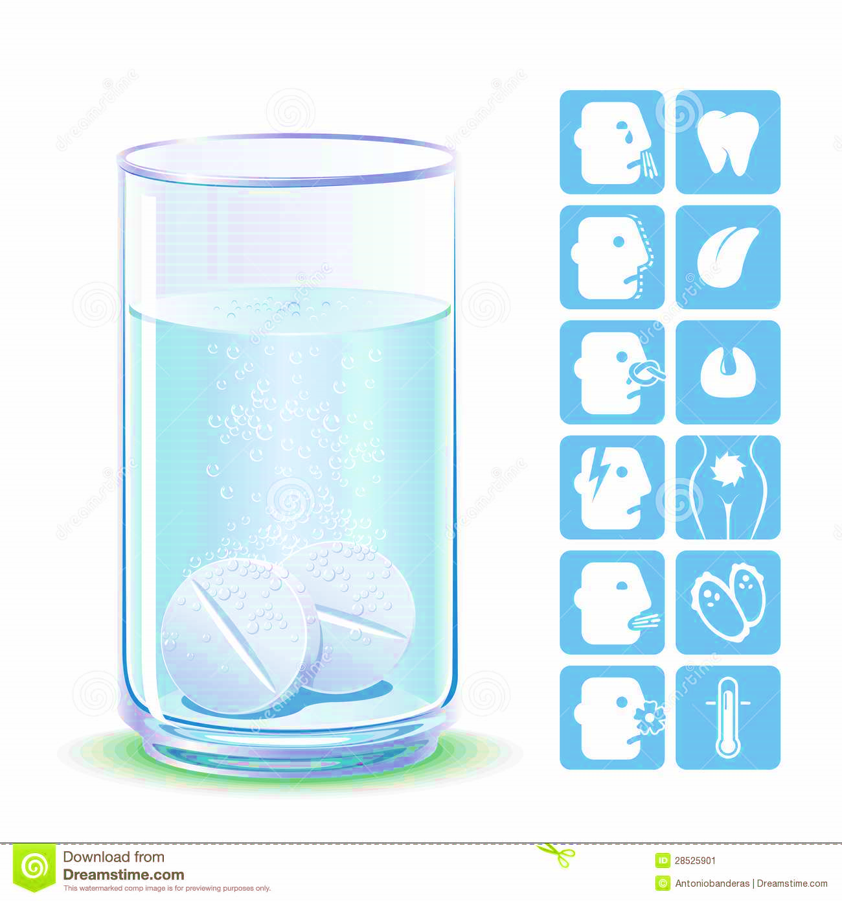
wet fusion method:
1. Mix all ingredients including Tartaric acid, Citric acid, NaHCO3, and the active ingredient Mg sulfate.
2. Add Alcohol (95%) drop by drop with the continuous mixing till we get a wet paste.
3. Sieving.
4. Drying.

Slide 17

