Slide 1
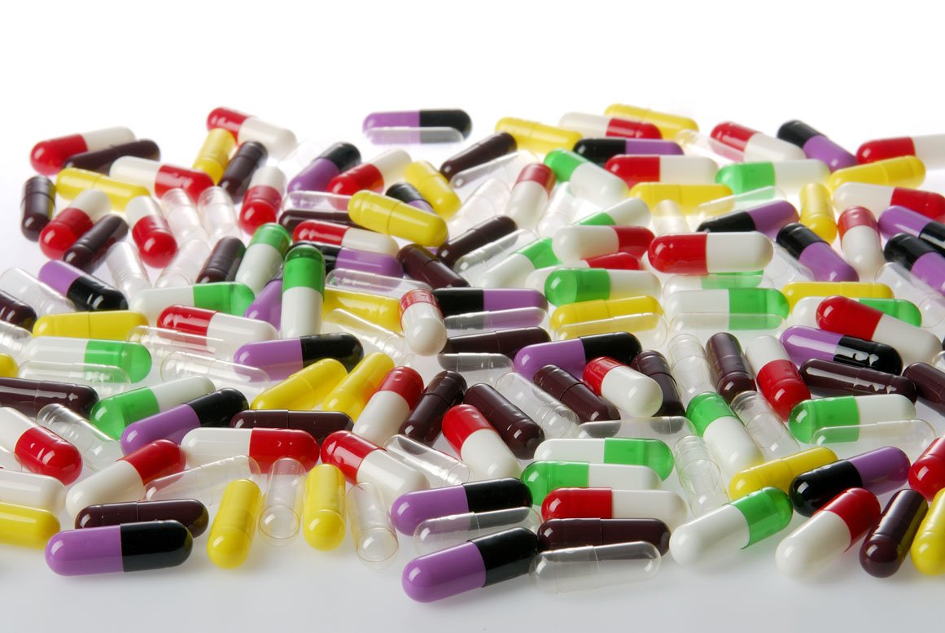
capsules
Assistant lecturer: Hiba Sabah

Slide 2
Hard gelatin Capsule
CAPSULES
Solid dosage form which the drug is enclosed within either a hard or soft shell.
Shell is typically made of gelatin blends (gelatin, sugar and water), small amount of certified dyes, opaquing agents, plasticizers and preservatives.
Advantages
Elegance, ease of use and portability
Provide a smooth, slippery, easily swallowed and tasteless shell for drugs (having unpleasant taste or odor.
economically produced in large quantities and in a wide range of colors.
Provide ready availability of the contained drug, since minimal excipient and little pressure are
required to compact the material, as is necessary in tableting.

Slide 3
Gelatin is a heterogeneous product derived by irreversible hydrolytic extraction of treated animal collagen
*Common sources of collagen are animal bones and frozen pork skin.
Disadvantages
Not usually used for administration of extremely soluble materials such as potassium chloride, potassium bromide and ammonium chloride since sudden release of such compounds (fluids) from capsule could results in irritating the stomach (N & V) by dissolving the salt and creating highly concentrated solution.
Not suitable containers for efflorescent materials (powders that contain water of hydration that dissolve gelatin when water is lost) especially when stored in low humidity conditions. Such as codeine phosphate.
Not to be used for deliquescent materials (adsorb or hygroscopic powders) since they may dry the capsule shell to excessive brittleness when moisture is extracted from shell into the powder to dissolve it and form solution. Such as phenobarbital sodium.
Materials
Capsules have been made with methylcellulose, polyvinyl alcohols, and denatured gelatin to modify their Solubility or produce an enteric effect.

Slide 4
There are two main types of gelatin:
• Type A: Derived from an acid treated precursor and exhibits an isoelectric point (with zero electrophoretic mobility related with pH and physical properties of gelatin molecules in
solution) in the region of pH (9).
• Type B: Derived from alkali treated precursor and exhibit isoelectric point in the region of pH (4.7).
Capsule may be made from both types of gelatin or as available and difference in physical properties of either types are slight.
✓ Blends of bone and pork skin gelatins of relatively high gel strength are normally used for hard capsule production.
✓ The bone gelatin produces tough , firm film but tend to be hazy and brittle.
✓ The pork skin gelatin contributes to plasticity and clarity to the blend , reducing haze or cloudiness in the finished capsule.

Slide 5
HARD CAPSULES
Method of production
Empty gelatin capsules are produced by completely automatic machine consists of mechanisms for automatically
dipping
spinning
drying
stripping
trimming
joining the capsules.

Slide 6

1) Dipping : Pairs of stainless steel mold pins are dipped into a gelatin solution of controlled viscosity to form caps and bodies .
2) Spinning : Pins are usually rotated to distribute gelatin uniformly, during which the gelatin may be set or gelled by a blast of cool air.

Slide 7
3) Drying: Pins are moved through a series
of controlled air drying kilns (Ovens) for
the gradual and precisely controlled
removal of water
4) Stripping : The capsules are stripped from the pins by bronze jaws.
5) Trimming : The capsules are trimmed to length by
stationary knives

Slide 8
Joining : the cap and body are joined and ejected
from the machine .
❖ The entire cycle take 45 min.
Thickness of the capsule wall is controlled by :
• Viscosity of the gelatin solution
• Speed and time of dipping
Other matters critical to the final dimensions are:
• mold pin dimensions,
• precise drying
• and machine control relating to cut length.

Slide 9
Moisture content in capsules:
* Empty capsules are usually received moisture content between 12% and 15%.
* Below 10% moisture content, they become brittle and may shrink to the point of no fitting into them filling equipment.
*Above 16% moisture content, they may cause problems in the filling equipment, plus a loss of mechanical strength.
Exposure to either heat or moisture extremes can distort empty capsules to the extent that they cannot be handled by automatic filling equipment

Slide 10
Filling Equipment's

Slide 11
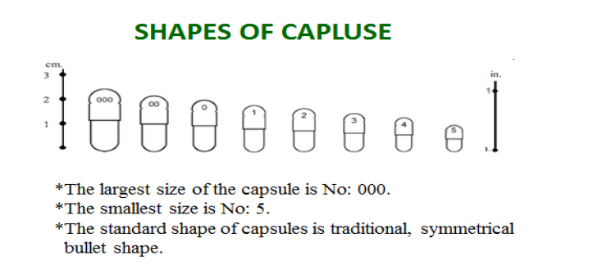
Mostly used capsule sizes for humans range from size 0; the largest to size 5; the smallest.

Slide 12
Formulations
The problems encountered in handling powders during mixing and filling are diverse. Two major ones can be listed:
1. After the powder ingredients have been homogenously blended by a suitable technique, the flow of the resultant mixture must be adequate to ensure delivery of sufficient powder to the capsules at the time of filling . De-mixing must not occur during the powder handling in the filling equipment itself.
2. Physical incompatibilities between active ingredients, diluents or between active ingredients and/or diluents and the capsule shell.

Slide 13
Three major considerations for capsule formulations:
1. The powder mix must have the type of flow characteristics required by the equipment. Lubricants such as metallic stearate may be used for such case. Particle sizes and powder densities of all ingredients should be matched as closely as possible to assist in the prevention of de –mixing .
2. Potential incompatibilities should be anticipated with each new mixture of materials. Reactions at elevated humilities and temperatures should be
studied.
3. The choice of excipients should be considered according to their use.
*Such these materials used for improvement of flow characteristics are (glidants and or lubricants) like talc, glycol ester, silicon dioxide and stearic acid.
* Other materials used to control dusting and additional cohesiveness are oils.

Slide 14
Determination of amount of diluents based on:
1. The total amount of material that can be possibly put in the capsule in relation to the amount of active ingredient to be supplied by the capsule.
2. The amounts of lubricant and/or oil (2% or less) that can be used.
Finishing (dusting and polishing):
1. Pan Polishing : Accela-cota pan is used to remove dust and polish. By putting cloth liner to trap the removed dust and gloss the capsules.
2. Cloth Dusting : Capsule are rubbed with cloth.
3. Brushing : Capsule are feed under soft rotating brush.

Slide 15
Storage
Finished capsules normally contain an equilibrium moisture content of 13-16%.
To maintain a relative humidity of 40-60% when handling and storing capsules
Special Techniques
1. Imprinting: operation best performed on empty capsules (to prevent
capsule damage) for product identification.
2. Special purpose capsules with special treatment to retard solubility
or delay absorption of active ingredient.
e.g.: solubility limits for capsules as follows:
A) water resistance- 20 to 30°C in 15 min.
B) Acid solubility- dissolve in < 5 min in 0.5% aq. HCl at 37°C.
a) Formalin treatment (modify gelatin capsule solubility) by formation of cross-linkage of the gelatin molecule initiated by the aldehyde and preventing complete solubility.
b) Various coating to provide modify solubility characteristics like
shellac, resins and cellulose acetate phthalate.

