Slide 1
Antihypertensive Drugs
Dr. Dalia Abd alkader
Ph.D Pharmacology

Slide 2
Hypertension is defined as either a sustained systolic blood pressure of greater than 140 mm Hg or a sustained diastolic blood pressure of greater than 90 mm Hg. Hypertension results from increased arteriolar resistance and reduced capacitance of the venous system.

Slide 3
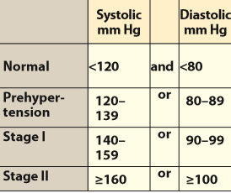
Classification of blood pressure

Slide 4
Although many patients have no symptoms, chronic hypertension can lead to heart disease and stroke, the top two causes of death in the world. Hypertension is also an important risk factor in the development of chronic kidney disease and heart failure.
The incidence of morbidity and mortality significantly decreases when hypertension is diagnosed early and is properly treated.

Slide 5
ETIOLOGY OF HYPERTENSION
Although hypertension may occur secondary to other disease processes, more than 90% of patients have essential hypertension (hypertension with no identifiable cause).
A family history of hypertension.
The prevalence of hypertension increases with age, but decreases with education and income level.

Slide 6
Non-Hispanic blacks have a higher incidence of hypertension than do both non-Hispanic whites and Hispanic whites.
Persons with diabetes, obesity, or disability status are all more likely to have hypertension than those without.
Environmental factors, such as a stressful lifestyle, high dietary intake of sodium, and smoking, may further predispose an individual to hypertension.

Slide 7
MECHANISMS FOR CONTROLLING BLOOD PRESSURE
Arterial blood pressure is directly proportional to cardiac output and peripheral vascular resistance.
Most antihypertensive drugs lower blood pressure by reducing cardiac output and/or decreasing peripheral resistance.
Cardiac output and peripheral resistance, in turn, are controlled mainly by two overlapping control mechanisms: the baroreflexes and the renin–angiotensin–aldosterone system .

Slide 8
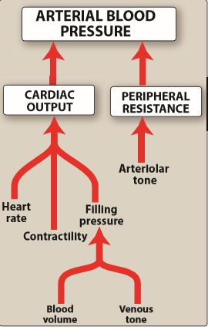
Major factors influencing blood pressure.

Slide 9
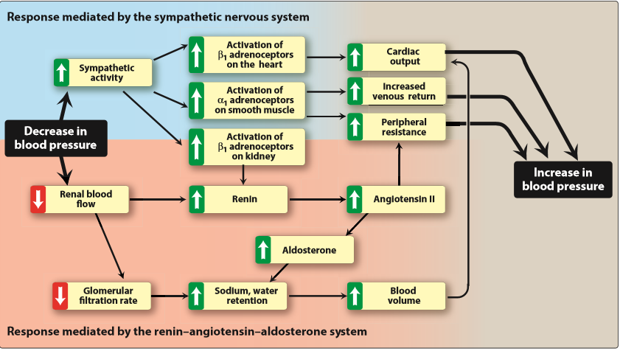
Response of the autonomic nervous system and the renin–angiotensin–aldosterone system to a decrease in blood pressure

Slide 10
A. Baroreceptors and the sympathetic nervous system
Baroreflexes act by changing the activity of the sympathetic nervous system. Therefore, they are responsible for the rapid, moment-to moment regulation of blood pressure. A fall in blood pressure causes pressure-sensitive neurons (baroreceptors in the aortic arch and carotid sinuses) to send fewer impulses to cardiovascular centers in the spinal cord.

Slide 11
This prompts a reflex response of increased sympathetic and decreased parasympathetic output to the heart and vasculature, resulting in vasoconstriction and increased cardiac output. These changes result in a compensatory rise in blood pressure.

Slide 12
B. Renin–angiotensin–aldosterone system
The kidney provides long-term control of blood pressure by altering the blood volume. Baroreceptors in the kidney respond to reduced arterial pressure (and to sympathetic stimulation of β1-adrenoceptors) by releasing the enzyme renin.

Slide 13
Low sodium intake and greater sodium loss also increase renin release. Renin converts angiotensinogen to angiotensin I, which is converted in turn to angiotensin II, in the presence of angiotensin-converting enzyme (ACE). Angiotensin II is a potent circulating vasoconstrictor, constricting both arterioles and veins, resulting in an increase in blood pressure.

Slide 14
Angiotensin II exerts a vasoconstrictor action on the efferent arterioles of the renal glomerulus, increasing glomerular filtration.
angiotensin II stimulates aldosterone secretion, leading to increased renal sodium reabsorption and increased blood volume, which contribute to a further increase in blood pressure. These effects of angiotensin II are mediated by stimulation of angiotensin II type 1 (AT1) receptors.

Slide 15
TREATMENT STRATEGIES
The goal of antihypertensive therapy is to reduce cardiovascular and renal morbidity and mortality.
The blood pressure goal when treating hypertension is a systolic blood pressure of less than 140 mm Hg and a diastolic blood pressure of less than 90 mm Hg.
Mild hypertension can sometimes be controlled with monotherapy
Current recommendations are to initiate therapy with a thiazide diuretic, ACE inhibitor, angiotensin receptor blocker (ARB), or calcium channel blocker

Slide 16
If blood pressure is inadequately controlled, a second drug should be added, with the selection based on minimizing the adverse effects of the combined regimen and achieving goal blood pressure.
Patients with systolic blood pressure greater than 160 mm Hg or diastolic blood pressure greater than 100 mm Hg (or systolic blood pressure greater than 20 mm Hg above goal or diastolic blood pressure more than 10 mm Hg above goal) should be started on two antihypertensives.

Slide 17
A. Individualized care Hypertension may coexist with other diseases that can be aggravated by some of the antihypertensive drugs or that may benefit from the use of some antihypertensive drugs independent of blood pressure control. In such cases, it is important to match antihypertensive drugs to the particular patient.

Slide 18
In addition to the choice of therapy, blood pressure goals may also be individualized based on concurrent disease states. For instance, in patients with diabetes, some experts recommend a blood pressure goal of less than 140/80 mm Hg. Likewise, in patients with chronic kidney disease and proteinuria, lower goals of less than 130/80 mm Hg may be considered. Elderly patients may have less rigid goals (for example, less than 150/90 mm Hg).

Slide 19
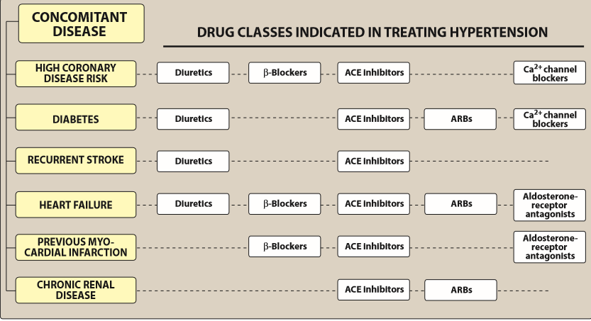
Treatment of hypertension in patients with concomitant diseases. [Note: Angiotensin receptor blockers (ARBs) are an alternative to angiotensin-converting enzyme (ACE) inhibitors.]

Slide 20
B. Patient compliance in antihypertensive therapy
Lack of patient compliance is the most common reason for failure of antihypertensive therapy. The hypertensive patient is usually asymptomatic and is diagnosed by routine screening before the occurrence of overt end-organ damage.
It is important to enhance compliance by selecting a drug regimen that reduces adverse effects and also minimizes the number of doses required daily. Combining two drug classes in a single pill, at a fixed-dose combination, has been shown to improve patient compliance and the number of patients achieving goal blood pressure.

Slide 21
DIURETICS
Thiazide diuretics can be used as initial drug therapy for hypertension
The initial mechanism of action of diuretics is based upon decreasing blood volume, which ultimately leads to decreased blood pressure.
Low-dose diuretic therapy is safe, inexpensive, and effective in preventing stroke, myocardial infarction, and heart failure.
Routine serum electrolyte monitoring should be done for all patients receiving diuretics.

Slide 22
A. Thiazide diuretics
hydrochlorothiazide and chlorthalidone
lower blood pressure initially by increasing sodium and water excretion.
useful in combination therapy with a variety of other antihypertensive agents, including β-blockers, ACE inhibitors, ARBs, and potassium-sparing diuretics.
With the exception of metolazone , thiazide diuretics are not effective in patients with inadequate kidney function. Loop diuretics may be required in these patients.
can induce hypokalemia, hyperuricemia and, to a lesser extent, hyperglycemia in some patients.

Slide 23
B. Loop diuretics
furosemide, torsemide, bumetanide, and ethacrynic acid
act by blocking sodium and chloride reabsorption in the kidneys, even in patients with poor renal function or those who have not responded to thiazide diuretics.
cause decreased renal vascular resistance and increased renal blood flow.

Slide 24
Like thiazides, they can cause hypokalemia. However, unlike thiazides, loop diuretics increase the Ca2+ content of urine, whereas thiazide diuretics decrease it. These agents are rarely used alone to treat hypertension, but they are commonly used to manage symptoms of heart failure and edema.

Slide 25
C. Potassium-sparing diuretics
Amiloride and triamterene (inhibitors of epithelial sodium transport at the late distal and collecting ducts)
spironolactone and eplerenone (aldosterone receptor antagonists) reduce potassium loss in the urine. Aldosterone antagonists have the additional benefit of diminishing the cardiac remodeling that occurs in heart failure. Potassium-sparing diuretics are sometimes used in combination with loop diuretics and thiazides to reduce the amount of potassium loss induced by these diuretics.

Slide 26
β-ADRENOCEPTOR–BLOCKING AGENTS
are a treatment option for hypertensive patients with concomitant heart disease or heart failure .
Actions
reduce blood pressure primarily by:
decreasing cardiac output
decrease sympathetic outflow from the CNS
inhibit release of renin from the kidneys, thus decreasing the formation of angiotensin II and the secretion of aldosterone.

Slide 27
The prototype β-blocker is propranolol, which acts at both β1 and β2 receptors. Selective blockers of β1 receptors, such as metoprolol and atenolol , are among the most commonly prescribed β-blockers. Nebivolol is a selective blocker of β1 receptors, which also increases the production of nitric oxide, leading to vasodilation.

Slide 28
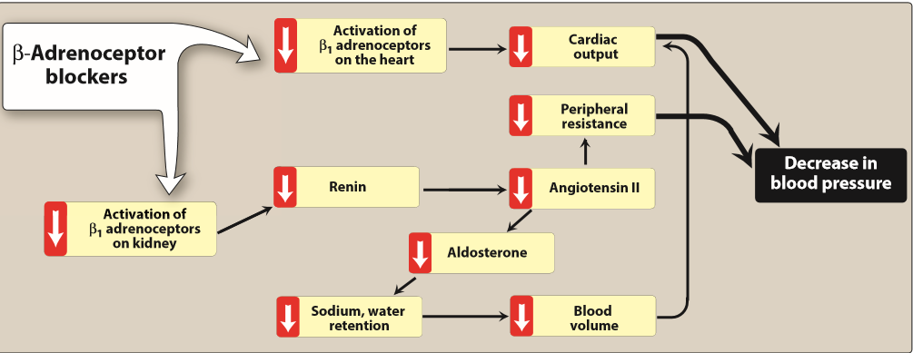
Actions of β-adrenoceptor–blocking agents

Slide 29
The selective β-blockers may be administered cautiously to hypertensive patients who also have asthma. The nonselective β-blockers, such as propranolol and nadolol, are contraindicated in patients with asthma due to their blockade of β2-mediated bronchodilation.
β-Blockers should be used cautiously in the treatment of patients with acute heart failure or peripheral vascular disease.

Slide 30
Therapeutic uses
hypertensive patients with concomitant heart disease, such as supraventricular tachyarrhythmia (for example, atrial fibrillation), previous myocardial infarction, angina pectoris, and chronic heart failure. Conditions that discourage the use of β-blockers include reversible bronchospastic disease such as asthma, second- and third-degree heart block, and severe peripheral vascular disease.

Slide 31
Pharmacokinetics
orally active.
Propranolol undergoes extensive and highly variable first-pass metabolism.
Oral β-blockers may take several weeks to develop their full effects.
Esmolol, metoprolol, and propranolol are available in intravenous formulations.

Slide 32
Adverse effects
1.Common effects:
bradycardia, hypotension, and CNS side effects such as
fatigue, lethargy, and insomnia.
The β-blockers may decrease libido and cause erectile
dysfunction, which can severely reduce patient compliance.
2. Alterations in serum lipid patterns: Noncardioselective β-
blockers may disturb lipid metabolism, decreasing high-
density lipoprotein cholesterol and increasing triglycerides.
3. Drug withdrawal: Abrupt withdrawal may induce angina, myocardial infarction, and even sudden death in patients with ischemic heart disease. Therefore, these drugs must be tapered over a few weeks in patients with hypertension and ischemic heart disease.

Slide 33
ACE INHIBITORS
Enalapril and lisinopril are recommended as first-line treatment of hypertension in patients with high coronary disease risk or history of diabetes, stroke, heart failure, myocardial infarction, or chronic kidney disease.

Slide 34
Actions
The ACE inhibitors lower blood pressure by reducing peripheral vascular resistance without reflexively increasing cardiac output, heart rate, or contractility.
These drugs block the enzyme ACE which cleaves angiotensin I to form the potent vasoconstrictor angiotensin II.

Slide 35
ACE is responsible for the breakdown of bradykinin, (a peptide that increases the production of nitric oxide and prostacyclin by the blood vessels). Both nitric oxide and prostacyclin are potent vasodilators.
ACE inhibitors decrease angiotensin II and increase bradykinin levels.
Vasodilation of both arterioles and veins occurs as a result of :
decreased vasoconstriction (from diminished levels of angiotensin II)
enhanced vasodilation (from increased bradykinin).
By reducing circulating angiotensin II levels, ACE inhibitors also decrease the secretion of aldosterone, resulting in decreased sodium and water retention.

Slide 36
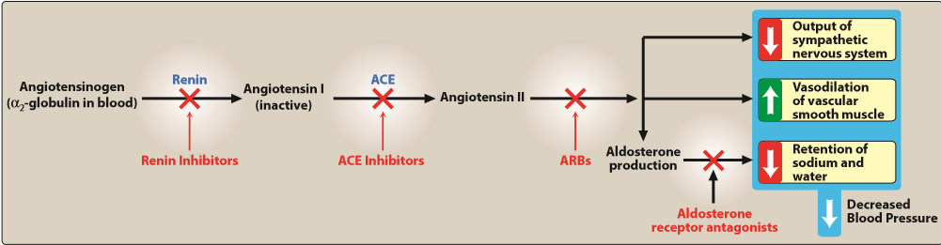
Effects of various drug classes on the renin–angiotensin–aldosterone system.

Slide 37
Therapeutic uses:
slow the progression of diabetic nephropathy and decrease albuminuria . Beneficial effects on renal function may result from decreasing intraglomerular pressures, due to efferent arteriolar vasodilation.
a standard in the care of a patient following a myocardial infarction and first-line agents in the treatment of patients with systolic dysfunction.
Chronic treatment with ACE inhibitors achieves sustained blood pressure reduction, regression of left ventricular hypertrophy, and prevention of ventricular remodeling after a myocardial infarction.
are first-line drugs for treating heart failure, hypertensive patients with chronic kidney disease, and patients at increased risk of coronary artery disease. All of the ACE inhibitors are equally effective in the treatment of hypertension at equivalent doses.

Slide 38
Pharmacokinetics
All of the ACE inhibitors are orally bioavailable as a drug or prodrug.
All but captopril and lisinopril undergo hepatic conversion to active metabolites, so these agents may be preferred in patients with severe hepatic impairment.
Fosinopril is the only ACE inhibitor that is not eliminated primarily by the kidneys and does not require dose adjustment in patients with renal impairment.
Enalaprilat is the only drug in this class available intravenously.

Slide 39
Adverse effects
Common side effects include dry cough, rash, fever, altered taste, hypotension (in hypovolemic states), and hyperkalemia . The dry cough, which occurs in up to 10% of patients, is thought to be due to increased levels of bradykinin and substance P in the pulmonary tree and resolves within a few days of discontinuation. The cough occurs more frequently in women.

Slide 40
Angioedema is a rare but potentially life-threatening reaction that may also be due to increased levels of bradykinin.
Potassium levels must be monitored while on ACE inhibitors, and potassium supplements and potassium-sparing diuretics should be used with caution due to the risk of hyperkalemia. Serum creatinine levels should also be monitored, particularly in patients with underlying renal disease.
ACE inhibitors can induce fetal malformations and should not be used by pregnant women.

Slide 41
ANGIOTENSIN II RECEPTOR BLOCKERS
The ARBs, such as losartan and irbesartan , are alternatives to the ACE inhibitors. These drugs block the AT1 receptors, decreasing the activation of AT1 receptors by angiotensin II. Their pharmacologic effects are similar to those of ACE inhibitors in that they produce arteriolar and venous dilation and block aldosterone secretion, thus lowering blood pressure and decreasing salt and water retention.

Slide 42
ARBs do not increase bradykinin levels.
They may be used as first-line agents for the treatment of hypertension, especially in patients with a compelling indication of diabetes, heart failure, or chronic kidney disease.
Adverse effects are similar to those of ACE inhibitors, although the risks of cough and angioedema are significantly decreased.
ARBs should not be combined with an ACE inhibitor for the treatment of hypertension due to similar mechanisms and adverse effects.
These agents are also teratogenic and should not be used by pregnant women.

Slide 43
RENIN INHIBITOR
A selective renin inhibitor, aliskiren , is available for the treatment of hypertension. Aliskiren directly inhibits renin and, thus, acts earlier in the renin–angiotensin–aldosterone system than ACE inhibitors or ARBs.
It lowers blood pressure about as effectively as ARBs, ACE inhibitors, and thiazides. Aliskiren should not be routinely combined with an ACE inhibitor or ARB.

Slide 44
Aliskiren can cause diarrhea, especially at higher doses, and can also cause cough and angioedema, but probably less often than ACE inhibitors. As with ACE inhibitors and ARBs, aliskiren is contraindicated during pregnancy. Aliskiren is metabolized by CYP 3A4 and is subject to many drug interactions.

Slide 45
CALCIUM CHANNEL BLOCKERS
are a recommended treatment option in hypertensive patients with diabetes or angina.
High doses of short-acting calcium channel blockers should be avoided because of increased risk of myocardial infarction due to excessive vasodilation and marked reflex cardiac stimulation.

Slide 46
Classes of calcium channel blockers
1. Diphenylalkylamines:
Verapamil is the least selective of any calcium channel blocker and has significant effects on both cardiac and vascular smooth muscle cells. It is also used to treat angina and supraventricular tachyarrhythmias and to prevent migraine and cluster headaches.
2. Benzothiazepines: diltiazem affects both cardiac and vascular smooth muscle cells, but it has a less pronounced negative inotropic effect on the heart compared to that of verapamil. Diltiazem has a favorable side effect profile.

Slide 47
3. Dihydropyridines:
includes nifedipine (the prototype), amlodipine, felodipine , isradipine , nicardipine , and nisoldipine .
have a much greater affinity for vascular calcium channels than for calcium channels in the heart. They are, therefore, particularly beneficial in treating hypertension.
have the advantage in that they show little interaction with other cardiovascular drugs, such as digoxin or warfarin, which are often used concomitantly with calcium channel blockers.

Slide 48
Actions
The intracellular concentration of calcium plays an important
role in maintaining the tone of smooth muscle and in the
contraction of the myocardium. Calcium enters muscle cells
through special voltage sensitive calcium channels.
Calcium channel antagonists block the inward movement of
calcium by binding to L-type calcium channels in the heart
and in smooth muscle of the coronary and peripheral
arteriolar vasculature. This causes vascular smooth muscle to
relax, dilating mainly arterioles.

Slide 49
Therapeutic uses
In the management of hypertension, they are useful in the treatment of hypertensive patients who also have asthma, diabetes, and/or peripheral vascular disease, because unlike β-blockers, they do not have the potential to adversely affect these conditions. All CCBs are useful in the treatment of angina. In addition, diltiazem and verapamil are used in the treatment of atrial fibrillation.
Pharmacokinetics
Most of these agents have short half-lives (3 to 8 hours) following an oral dose. Sustained-release preparations are available and permit once-daily dosing. Amlodipine has a very long half-life and does not require a sustained-release formulation.

Slide 50
Adverse effects
First-degree atrioventricular block and constipation are common dose dependent side effects of verapamil.
Verapamil and diltiazem should be avoided in patients with heart failure or with atrioventricular block due to their negative inotropic (force of cardiac muscle contraction) and dromotropic (velocity of conduction) effects.
Dizziness, headache, and a feeling of fatigue caused by a decrease in blood pressure are more frequent with dihydropyridines.
Peripheral edema is another commonly reported side effect of this class.
Nifedipine and other dihydropyridines may cause gingival hyperplasia.

Slide 51
α-ADRENOCEPTOR–BLOCKING AGENTS
Prazosin, doxazosin , and terazosin
competitive block of α1-adrenoceptors
decrease peripheral vascular resistance and lower arterial blood pressure by causing relaxation of both arterial and venous smooth muscle.
cause only minimal changes in cardiac output, renal blood flow, and glomerular filtration rate. Therefore, long-term tachycardia does not occur, but salt and water retention does.
Reflex tachycardia and postural hypotension often occur at the onset of treatment and with dose increases, requiring slow titration of the drug in divided doses.

Slide 52
α-/β-ADRENOCEPTOR–BLOCKING AGENTS
Labetalol and carvedilol block α1, β1, and β2 receptors.
Carvedilol, as well as metoprolol succinate, and bisoprolol have been shown to reduce morbidity and mortality associated with heart failure.
Labetalol is used in the management of gestational hypertension and hypertensive emergencies.

Slide 53
CENTRALLY ACTING ADRENERGIC DRUGS
A. Clonidine
acts centrally as an α2 agonist
leads to reduced total peripheral resistance and decreased blood pressure.
used primarily for the treatment of hypertension that has not responded adequately to treatment with two or more drugs.

Slide 54
does not decrease renal blood flow or glomerular filtration and, therefore, is useful in the treatment of hypertension complicated by renal disease.
absorbed well after oral administration and is excreted by the kidney. It is also available in a transdermal patch.
Adverse effects include sedation, dry mouth, and constipation.
Rebound hypertension occurs following abrupt withdrawal of clonidine. The drug should, therefore, be withdrawn slowly if discontinuation is required.

Slide 55
B. Methyldopa
is an α2 agonist that is converted to methylnorepinephrine centrally to diminish adrenergic outflow from the CNS.
The most common side effects are sedation and drowsiness. Its use is limited due to adverse effects and the need for multiple daily doses. It is mainly used for management of hypertension in pregnancy, where it has a record of safety.

Slide 56
VASODILATORS
The direct-acting smooth muscle relaxants, such as hydralazine and minoxidil , are not used as primary drugs to treat hypertension.
act by producing relaxation of vascular smooth muscle, primarily in arteries and arterioles.
This results in decreased peripheral resistance and, therefore, blood pressure. Both agents produce reflex stimulation of the heart, resulting in the competing reflexes of increased myocardial contractility, heart rate, and oxygen consumption. These actions may prompt angina pectoris, myocardial infarction, or cardiac failure in predisposed individuals. Vasodilators also increase plasma renin concentration, resulting in sodium and water retention. These undesirable side effects can be blocked by concomitant use of a diuretic and a β-blocker.

Slide 57
For example, hydralazine is almost always administered in combination with a β-blocker, such as propranolol, metoprolol, or atenolol (to balance the reflex tachycardia) and a diuretic (to decrease sodium retention). Together, the three drugs decrease cardiac output, plasma volume, and peripheral vascular resistance. Hydralazine is an accepted medication for controlling blood pressure in pregnancy induced hypertension.

Slide 58
Adverse effects of hydralazine include headache, tachycardia, nausea, sweating, arrhythmia, and precipitation of angina.
A lupus-like syndrome can occur with high dosages, but it is reversible upon discontinuation of the drug.
Minoxidil treatment causes hypertrichosis (the growth of body hair). This drug is used topically to treat male pattern baldness.

Slide 59
HYPERTENSIVE EMERGENCY
is a rare but life-threatening situation characterized by severe elevations in blood pressure (systolic greater than 180 mm Hg or diastolic greater than 120 mm Hg) with evidence of progressive target organ damage (for example, stroke, myocardial infarction).
[Note: A severe elevation in blood pressure without evidence of target organ damage is considered a hypertensive urgency.] Hypertensive emergencies require timely blood pressure reduction with treatment administered intravenously to prevent or limit target organ damage. A variety of medications are used, including calcium channel blockers (nicardipine and clevidipine), nitric oxide vasodilators (nitroprusside and nitroglycerin), adrenergic receptor antagonists (phentolamine, esmolol, and labetalol), the vasodilator hydralazine, and the dopamine agonist fenoldopam.

Slide 60
RESISTANT HYPERTENSION
Blood pressure that remains elevated (above goal) despite administration of an optimal three-drug regimen that includes a diuretic. The most common causes of resistant hypertension are poor compliance, excessive ethanol intake, concomitant conditions (diabetes, obesity, hyperaldosteronism, high salt intake, and/or metabolic syndrome), concomitant medications
( sympathomimetics, nonsteroidal anti-inflammatory drugs, or antidepressant medications), insufficient dose and/or drugs, and use of drugs with similar mechanisms of action

Slide 61
COMBINATION THERAPY
Combination therapy with separate agents or a fixed-dose combination pill may lower blood pressure more quickly with minimal adverse effects. Initiating therapy with two antihypertensive drugs should be considered in patients with blood pressures that are more than 20/10 mm Hg above the goal

Slide 62
Antianginal Drugs

Slide 63
Atherosclerotic disease of the coronary arteries, also known as coronary artery disease (CAD) or ischemic heart disease (IHD), is the most common cause of mortality worldwide. Atherosclerotic lesions in coronary arteries can obstruct blood flow, leading to an imbalance in myocardial oxygen supply and demand that presents as stable angina or an acute coronary syndrome (myocardial infarction [MI] or unstable angina).

Slide 64
All patients with IHD and angina should receive guideline-directed medical therapy with emphasis on lifestyle modifications (smoking cessation, physical activity, weight management) and management of modifiable risk factors (hypertension, diabetes, dyslipidemia) to reduce cardiovascular morbidity and mortality.

Slide 65
TYPES OF ANGINA
Angina pectoris has three patterns:
1) stable, effort-induced, classic, or typical angina
2) unstable angina
3) Prinzmetal, variant, vasospastic, or rest angina. They are caused by varying combinations of increased myocardial demand and decreased myocardial perfusion.

Slide 66
A. Stable angina, effort-induced angina, classic or typical angina
most common form of angina
characterized by a short-lasting burning, heavy, or squeezing feeling in the chest.
Some ischemic episodes may present “atypically”—with extreme fatigue, nausea, or diaphoresis—while others may not be associated with any symptoms (silent angina).
Atypical presentations are more common in women, diabetic patients, and the elderly.

Slide 67
Classic angina is caused by the reduction of coronary perfusion due to a fixed obstruction of a coronary artery produced by atherosclerosis. Due to the fixed obstruction, the blood supply cannot increase, and the heart becomes vulnerable to ischemia whenever there is increased demand, such as that produced by physical activity, emotional stress or any other cause of increased cardiac workload.
Typical angina pectoris is relieved by rest or nitroglycerin. When the pattern of the chest pains and the amount of effort needed to trigger the chest pains do not vary over time, the angina is named “stable angina.”

Slide 68
B. Unstable angina
is classified between stable angina and MI.
chest pain occurs with increased frequency, duration, and intensity and can be precipitated by progressively less effort.
Any episode of rest angina longer than 20 minutes, any new-onset angina, any increasing angina, or even sudden development of shortness of breath is suggestive of unstable angina.
The symptoms are not relieved by rest or nitroglycerin.
is a form of acute coronary syndrome and requires hospital admission and more aggressive therapy to prevent progression to MI and death.

Slide 69
C. Prinzmetal, variant, vasospastic, or rest angina
uncommon pattern of episodic angina that occurs at rest and is due to coronary artery spasm.
Symptoms are caused by decreased blood flow to the heart muscle from the spasm of the coronary artery.
Although individuals with this form of angina may have significant coronary atherosclerosis, the angina attacks are unrelated to physical activity, heart rate, or blood pressure. Prinzmetal angina generally responds to coronary vasodilators, such as nitroglycerin and calcium channel blockers.

Slide 70
D. Acute coronary syndrome
is an emergency that commonly results from rupture of an atherosclerotic plaque and partial or complete thrombosis of a coronary artery. Most cases occur from disruption of an atherosclerotic lesion, followed by platelet activation of the coagulation cascade and vasoconstriction. This process culminates in intraluminal thrombosis and vascular occlusion. If the thrombus occludes most of the blood vessel, and, if the occlusion is untreated, necrosis of the cardiac muscle may occure. MI (necrosis) is typified by increases in the serum levels of biomarkers such as troponins and creatine kinase. The acute coronary syndrome may present as ST-segment elevation myocardial infarction, non–ST-segment elevation myocardial infarction, or as unstable angina. [Note: In unstable angina, no increases of biomarkers of myocardial necrosis are present.]

Slide 71
TREATMENT STRATEGIES
Four types of drugs, used either alone or in combination, are commonly used to manage patients with stable angina: β-blockers, calcium channel blockers, organic nitrates, and the sodium channel–blocking drug, ranolazine.
These agents help to balance the cardiac oxygen supply and demand equation by affecting blood pressure, venous return, heart rate, and contractility.

Slide 72
𝛃-ADRENERGIC BLOCKERS
decrease the oxygen demands of the myocardium by blocking β1 receptors, resulting in decreased heart rate, contractility, cardiac output, and blood pressure.
reduce myocardial oxygen demand during exertion and at rest. As such, they can reduce both the frequency and severity of angina attacks.
used to increase exercise duration and tolerance in patients with effort-induced angina.
recommended as initial antianginal therapy in all patients unless contraindicated. [Note: The exception to this rule is vasospastic angina, in which β-blockers are ineffective and may actually worsen symptoms.]
reduce the risk of death and MI in patients who have had a prior MI

Slide 73
Agents with intrinsic sympathomimetic activity (ISA) such as pindolol should be avoided in patients with angina and those who have had a MI.
Metoprolol and atenolol, are preferred
[Note: All β-blockers are nonselective at high doses and can inhibit β2 receptors.]

Slide 74
CALCIUM CHANNEL BLOCKERS
The calcium channel blockers protect the tissue by inhibiting the entrance of calcium into cardiac and smooth muscle cells of the coronary and systemic arterial beds.
primarily affect the resistance of peripheral and coronary arteriolar smooth muscle. In the treatment of effort-induced angina, calcium channel blockers reduce myocardial oxygen consumption by decreasing vascular resistance. Their efficacy in vasospastic angina is due to relaxation of the coronary arteries.

Slide 75
A. Dihydropyridine calcium channel blockers Amlodipine ,an oral dihydropyridine, functions mainly as an arteriolar vasodilator. This drug has minimal effect on cardiac conduction. The vasodilatory effect of amlodipine is useful in the treatment of variant angina caused by spontaneous coronary spasm.
Nifedipine is another agent in this class; it is usually administered as an extended-release oral formulation.

Slide 76
B. Nondihydropyridine calcium channel blockers Verapamil slows atrioventricular (AV) conduction directly and decreases heart rate, contractility, blood pressure, and oxygen demand. Verapamil has greater negative inotropic effects than amlodipine, but it is a weaker vasodilator.
Verapamil is contraindicated in patients with preexisting depressed cardiac function or AV conduction abnormalities.
Diltiazem also slows AV conduction, decreases the rate of firing of the sinus node pacemaker, and is also a coronary artery vasodilator. Diltiazem can relieve coronary artery spasm and is particularly useful in patients with variant angina.

Slide 77
ORGANIC NITRATES
cause a reduction in myocardial oxygen demand, followed by relief of symptoms. They are effective in stable, unstable, and variant angina.

Slide 78
Mechanism of action
Organic nitrates relax vascular smooth muscle by their intracellular conversion to nitrite ions and then to nitric oxide, which activates guanylate cyclase and increases the cells’ cyclic guanosine monophosphate (cGMP). Elevated cGMP ultimately leads to dephosphorylation of the myosin light chain, resulting in vascular smooth muscle relaxation.
Nitrates such as nitroglycerin cause dilation of the large veins, which reduces preload (venous return to the heart) and, therefore, reduces the work of the heart. This is believed to be their main mechanism of action in the treatment of angina. Nitrates also dilate the coronary vasculature, providing an increased blood supply to the heart muscle.

Slide 79
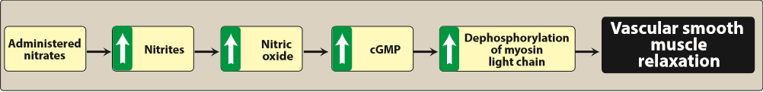
Effects of nitrates and nitrites on smooth muscle. cGMP, = cyclic guanosine 3′,5′-monophosphate

Slide 80
Pharmacokinetics
The onset of action varies from 1 minute for nitroglycerin to 30 minutes for isosorbide mononitrate .
For prompt relief of an angina attack precipitated by exercise or emotional stress, sublingual (or spray form) nitroglycerin is the drug of choice. All patients suffering from angina should have nitroglycerin on hand to treat acute angina attacks. Significant first-pass metabolism of nitroglycerin occurs in the liver. Therefore, it is commonly administered via the sublingual or transdermal route (patch or ointment), thereby avoiding the hepatic first-pass effect. Isosorbide mononitrate has good bioavailability and long duration of action to its stability against hepatic breakdown. Oral isosorbide dinitrate undergoes denitration to two mononitrates, both of which possess antianginal activity.

Slide 81
Adverse effects
Headache
High doses of nitrates can also cause postural hypotension, facial flushing, and tachycardia.
Phosphodiesterase type 5 inhibitors such as sildenafil potentiate the action of the nitrates. To preclude the dangerous hypotension that may occur, this combination is contraindicated.
Tolerance to the actions of nitrates develops rapidly as the blood vessels become desensitized to vasodilation. Tolerance can be overcome by providing a daily “nitrate-free interval” to restore sensitivity to the drug. This interval of 10 to 12 hours is usually taken at night because demand on the heart is decreased at that time. Nitroglycerin patches are worn for 12 hours and then removed for 12 hours. However, variant angina worsens early in the morning, perhaps due to circadian catecholamine surges. Therefore, the nitrate-free interval in these patients should occur in the late afternoon.

Slide 82
SODIUM CHANNEL BLOCKER
Ranolazine inhibits the late phase of the sodium current (late INa), improving the oxygen.
has antianginal as well as antiarrhythmic properties.

Slide 83
is extensively metabolized in the liver.
is subject to numerous drug interactions.
can prolong the QT interval and should be avoided with other drugs that cause QT prolongation.

