Slide 1
Biopharmaceutics
Chapter-6
Drug Elimination and Clearance

Slide 2
DRUG ELIMINATION
Drugs are removed from the body by various elimination processes. Drug elimination refers to the irreversible removal of drug from the body by all routes of elimination.
Drug elimination is usually divided into two major components:
excretion and biotransformation.

Slide 3
Drug excretion is the removal of the intact drug. Nonvolatile drugs are excreted mainly by renal excretion, a process in which the drug passes through the kidney to the bladder and ultimately into the urine.
Other pathways for drug excretion may include the excretion of drug into bile, sweat, saliva, milk (via lactation), or other body fluids.
Volatile drugs, such as gaseous anesthetics or drugs with high volatility, are excreted via the lungs into expired air.

Slide 4
Biotransformation or drug metabolism is the process by which the drug is chemically converted in the body to a metabolite. Biotransformation is usually an enzymatic process.
A few drugs may also be changed chemically by a nonenzymatic process (e.g., ester hydrolysis).
The enzymes involved in the biotransformation of drugs are located mainly in the liver. Other tissues such as kidney, lung, small intestine, and skin also contain biotransformation enzymes.

Slide 5
In this chapter, drug elimination is described in terms of clearance from a well-stirred compartment containing uniform drug distribution.
The term clearance describes the process of drug elimination from the body or from a single organ
without identifying the individual processes involved. Clearance may be defined as the volume of fluid cleared of drug from the body per unit of time.
The units for clearance are milliliters per minute (mL/min) or liters per hour (L/hr). The volume concept is simple and convenient, because all drugs are dissolved and distributed in the fluids of the body.

Slide 6
The advantage of the clearance approach is that
clearance applies to all elimination rate processes, regardless of the mechanism for elimination.
In addition, for first-order elimination processes, clearance is a constant, whereas drug elimination rate is not constant.
For example, clearance considers that a certain portion or percent of the distribution volume is cleared of drug over a given time period.

Slide 7
RENAL DRUG EXCRETION
Renal excretion is a major route of elimination for many drugs. Drugs that are nonvolatile, water soluble, have a low molecular weight (MW), or are slowly biotransformed by the liver are eliminated by renal excretion. The processes by which a drug is excreted via the kidneys may include any combination of the following:
Glomerular filtration
Active tubular secretion
Tubular reabsorption

Slide 8
Active tubular secretion
Active tubular secretion is an active transport process. As such, active renal secretion is a carrier-mediated system that requires energy input, because the drug is transported against a concentration gradient. The carrier system is capacity limited and may be saturated. Drugs with similar structures may compete for the same carrier system. Two active renal secretion systems have been identified, systems for (1) weak acids and (2) weak bases.
For example, probenecid competes with penicillin for the same carrier system (weak acids ).

Slide 9
For a drug that is excreted solely by glomerular filtration, the elimination half-life may change markedly in accordance with the binding affinity of the drug for plasma proteins.
In contrast, drug protein binding has very little effect on the elimination half-life of the drug excreted mostly by active secretion.
Because drug protein binding is reversible, drug bound to plasma protein rapidly dissociates as free drug is secreted by the kidneys.
For example, some of the penicillins are extensively protein bound, but their elimination half-lives are short due to rapid elimination by active secretion.

Slide 10
Tubular reabsorption
Tubular reabsorption occurs after the drug is filtered through the glomerulus and can be an active or a passive process.
If a drug is completely reabsorbed (e.g., glucose), then the value for the clearance of the drug is approximately zero. For drugs that are partially reabsorbed, clearance values are less than the GFR of 125-130 mL/min.

Slide 11
The reabsorption of drugs that are weak acids or weak bases is influenced by the pH of the fluid in the renal tubules (i.e., urine pH) and pka of the drug. Both factors together determine the percentage of dissociated (ionized) and undissociated (nonionozed) drug.
Genearly, the undissociated drug species is more lipid soluble (less water soluble) and has greater membrane permeability. The undissociated drug is easily reabsorbed from the renal tubule back into the body.
This process of drug reabsorption can significantly reduce the amount of drug excreted, depending on the pH of the urinary fluid and the pka of the drug. The pka of the drug is a constant, but the normal urinary pH may vary from 4.5 to 8.0 depending on diet, pathophysiology, and drug intake.

Slide 12
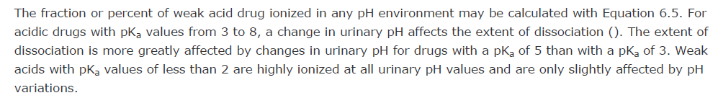
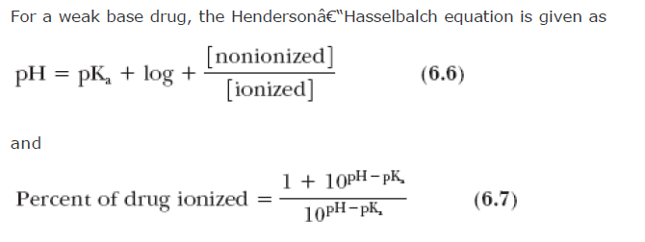

Slide 13
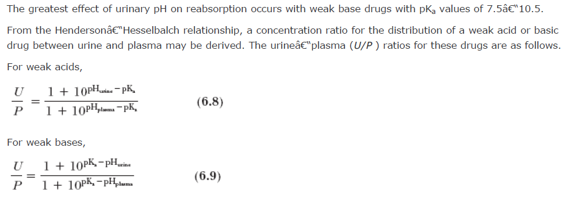
-
-
/

Slide 14
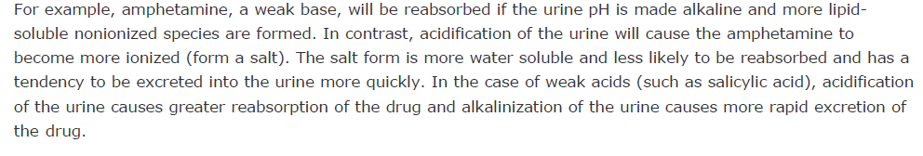

Slide 15
In addition to the pH of the urine, the rate of urine flow influences the amount of filtered drug that is reabsorbed.
The normal flow of urine is approximately 1-2 mL/min. Nonpolar and nonionized drugs, which are normally well reabsorbed in the renal tubules, are sensitive to changes in the rate of urine flow.
Drugs that increase urine flow, such as ethanol, large fluid intake, and methylxanthines (such as caffeine or theophylline), decrease the time for drug reabsorption and promote their excretion. Thus, forced diuresis through the use of diuretics may be a useful adjunct for removing excessive drug in an intoxicated patient, by increasing renal drug excretion.

Slide 16
DRUG CLEARANCE
Drug clearance is a pharmacokinetic term for describing drug elimination from the body without identifying the mechanism of the process.
Drug clearance (body clearance, total body clearance , or Cl_{T} ) considers the entire body as a single drug-eliminating system from which many unidentified elimination processes may occur.
Instead of describing the drug elimination rate in terms of amount of drug removed per time unit (e.g., mg/min), drug clearance is described in terms of volume of fluid clear of drug per time unit (e.g., mL/min).

Slide 17
There are several definitions of clearance, which are similarly based on volume of drug removed per unit time.
The simplest concept of clearance regards the body as a space that contains a definite volume of body fluid (apparent volume of distribution, V_{D} ) in which the drug is dissolved. Drug clearance is defined as the fixed volume of fluid (containing the drug) cleared of drug per unit of time. The units for clearance are volume/time
(e.g., mL/min, L/hr). For example, if the Cl_{T} of penicillin is 15 mL/min in a patient and penicillin has a V_{D} of 12 L, then from the clearance definition, 15 mL of the 12 L will be cleared of drug per minute.
Alternatively, Cl_{T} may be defined as the rate of drug elimination divided by the plasma drug concentration. This definition expresses drug elimination in terms of the volume of plasma eliminated of drug per unit time. This definition is a practical way to calculate clearance based on plasma drug concentration data.

Slide 18
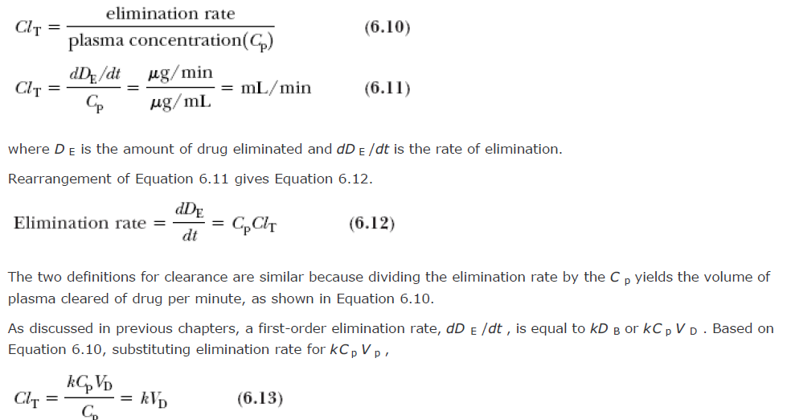

Slide 19
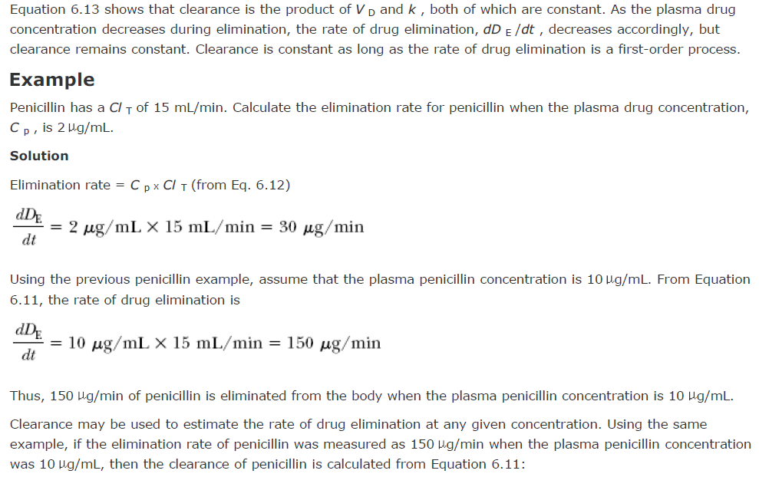


Slide 20
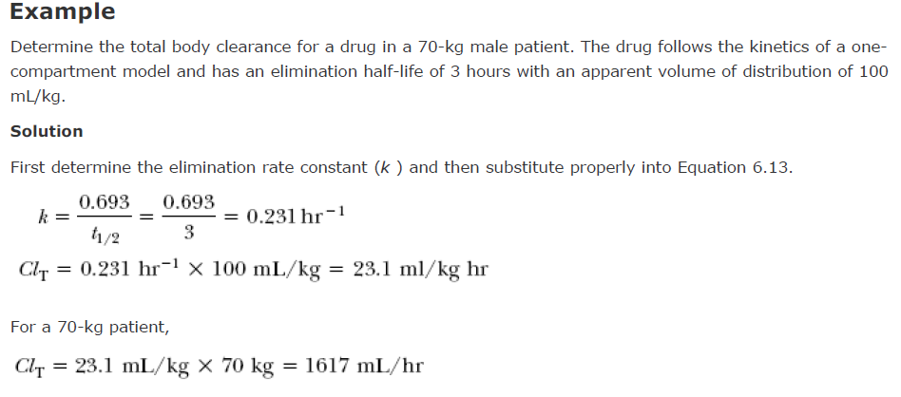

Slide 21
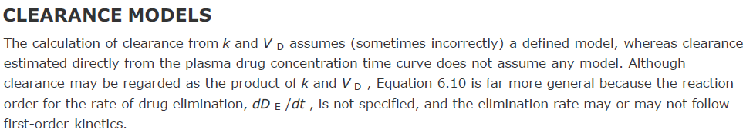



Slide 22
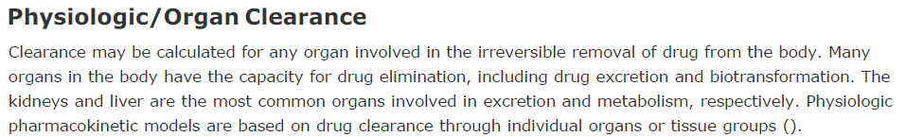
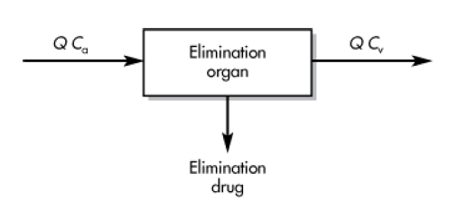

Slide 23
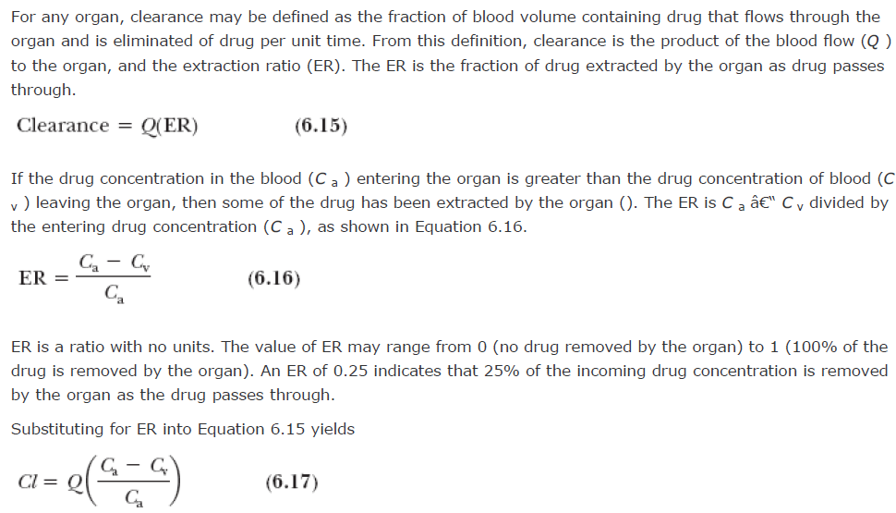
-

Slide 24
The physiologic approach to clearance shows that clearance depends on the blood flow rate and the ability of the
organ to eliminate drug, whereas the classical definitions of clearance is that a constant or static fraction of the volume in which the drug is contained is removed per unit time by the organ.
However, clearance measurements using the physiologic approach require invasive techniques to obtain measurements of blood flow and extraction ratio.
The physiologic approach has been used to describe hepatic clearance, which is discussed under hepatic
elimination (chapter11).
More classical definitions of clearance have been applied to renal clearance because direct measurements of plasma drug concentration and urinary drug excretion may be obtained.
The various approaches for estimating clearance are described in (Figure 6.7) .

Slide 25
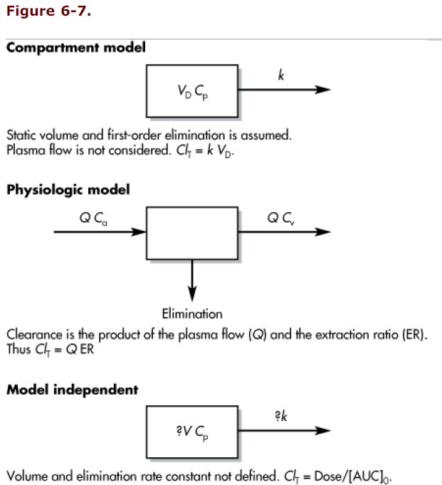

Slide 26
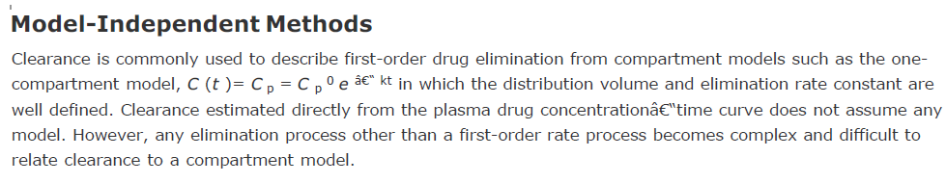
Model-independent methods are noncompartment model approaches used to calculate certain pharmacokinetic parameters such as clearance and bioavailability (F ).
The major advantage of model-independent methods is that no assumption for a specific compartment model is required to analyze the data. Moreover, the volume of distribution and the elimination rate constant need not be determined directly from the equation that best fits the plasma drug concentration-time curve.

Slide 27
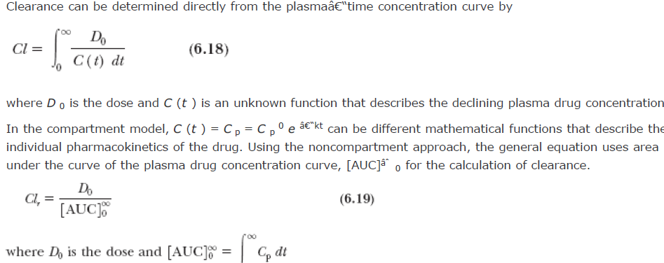
-
-
0

