Slide 1
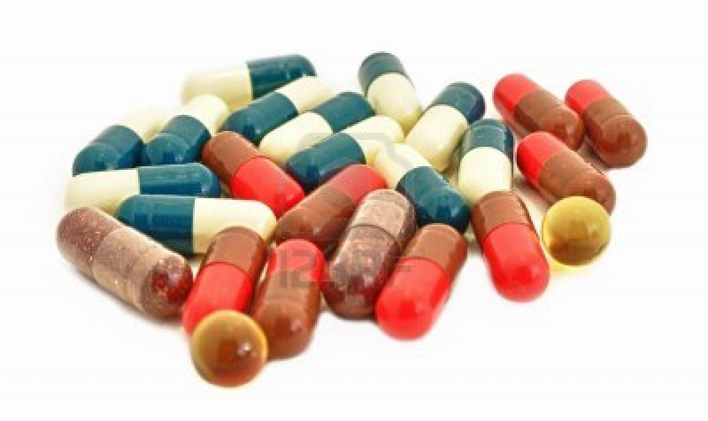
Lab -7-
Capsules

Slide 2
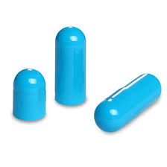
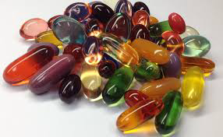
Capsules
Capsule is a solid dosage form consisting from gelatin shell filled with a blend of active ingredient and excipients which may be powder, semisolid or liquid that do not dissolve the gelatin shell.
There are two types of capsules:
Hard gelatin capsule (HGC)
Which consist of body and cap that filled with powder.
Soft gelatin capsule (SGC)
Which consist of one piece that is filled with liquid.

Slide 3
Capsules
Gelatin
Colorant
like soluble dyes or insoluble pigment
Plasticizer
PEG, glycerol and sorbitol that presents in higher conc. in SGC than HGC
Capsule shell
Preservative
Only in SGC to prevent contamination
Opaquing agent

Slide 4
Properties of the gelatin
1- Non-toxic and widely used in food.
2- Readily soluble in biological fluids and body tissues.
3-Good film forming that undergo reversible phase change from solid to gel in few temperature degree change.

Slide 5
Advantages of capsules over tablet
1- Mask bitter taste.
2- More convenient for the patient because it is more easily swallowed since they are smooth and slippery.
3- More elegant than tablet.
4- Used for photosensitive drugs.
5- More economic due to no compression required and less excipients used.

Slide 6
Advantages of capsules over tablet
6- No disintegrating agents added.
7- No binder added except with the rotary machine in which vegetable oil is used as a binder to prevent dusting.
8- Little lubricant used.
9- Diluents used to increase bulkiness or to improve flowability and compatibility.

Slide 7
Disadvantages of capsules
1- Not used for highly soluble drugs such as KBr and NH4Cl since the sudden release of such drugs in the stomach will cause high irritation.
2- Not used for efflorescentand deliquescent materials, since the efflorescent materials cause the capsule to soften, while deliquescent drugs may dry the capsule shell to excessive brittleness , which can be reduced by using small amount of inert oil in powder mixture.

Slide 8
Steps for preparation
A- Formulation:
Demixing or incompatibility can be prevented by
- The demixing can be prevented by using excipients or diluents with the same particle size and the density to prevent segregation.
- Prevent the incompatibility

Slide 9
Notes
- The amount of the diluents depends on the amount of the active ingredient and the size of the capsule.
- The hard gelatin capsule have different sizes (000, 00, 0, 1, 2, 3, 4, 5).
- The humidity (moisture content) of the capsule should range between (10-15%) since below 10% the capsule will be brittle and shrink to a point that it will not fit in the filling equipment, while when the moisture content is above 15% the capsule will be so soft and will cause size problems with the loss of mechanical strength.

Slide 10
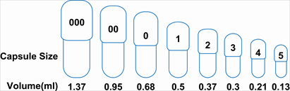
Hard gelatin capsules sizes

Slide 11
Steps for preparation
B- Filling
1- Electrical machine which is automatic.
2- Manual filling machine which is used for small scale the produce 20-36 capsules.
3- Hand filling by the dipping technique.

Slide 12
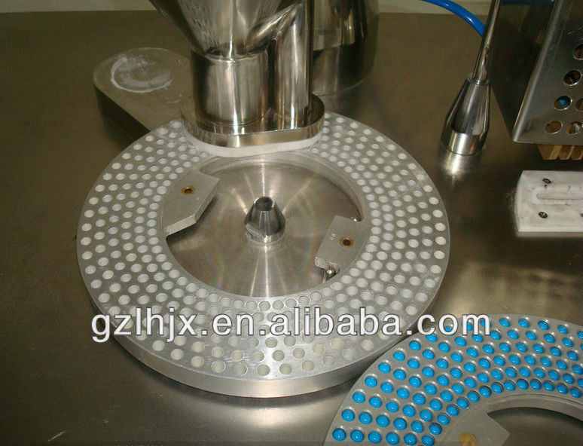
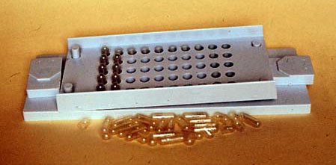

Slide 13
Note
The production of the hard gelatin capsule shell involve the following steps:
Dipping
Spinning
Drying
Joining
Trimming
Stripping

Slide 14
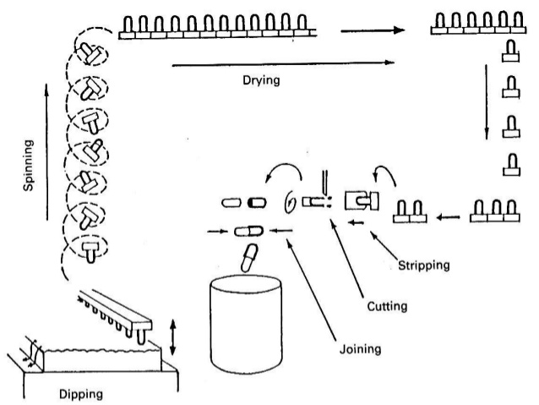
Steps of hard gelatin Capsule shell production

Slide 15
Steps for preparation
C- Polishing
(finishing)
1- Salt polishing as NaCl granules in a pan, but this method has the disadvantage of causing salty taste and removing the imprinting from the capsule.
3- Pan polishing by using a piece of cloth that must contain oil to be placed in a pan (coating pan).
4- Brushing the use of a rotating soft brush.
2- Cloth polishing by a piece of cloth which may or may not contain oil, the oil here is used to give the capsule an elegant and shiny shape.

Slide 16
Evaluation of capsules
1- Weight variation test:
It’s done by taking 20 capsule individually weighed and the average weight is determined. If 2 capsules fall outside the range of 10% of the average then should take another 40 capsules then determine the average of 60 capsules, the test requirement are met if 6 capsules fall outside the 10% of the average and none of the 6 capsules outside 25% range.

Slide 17
Evaluation of capsules
2- Content uniformity test:
It’s done by taking 10 capsules and assay each individually by specified procedure, if 9 out of 10 within the requirement of ±15% (85%-115%) limits and the tenth tablet is not outside ±25% (75%-125%) so the batch should be accepted.
While if 2 capsules out of 10 fall outside the range ±15% so take 20 capsules and assay them individually and take the average of 30 capsules, so the requirements are met if 27 capsules in the ±15% range and only 3 capsules in the ±25% range.

Slide 18
Evaluation of capsules
3- Disintegration test:
The disintegration time is measured when the capsule shell rupture and all the contents pass through the mesh, in order the batch to be accepted the time must be less than 30 minutes.

Slide 19
The factors affecting the disintegration time
1- The type of the gelatin shell.
2- The humidity of the capsule shell.
3- Dissolution media.
4- The type of the powder used.
5- The type and the amount of the binder used.

Slide 20
Special techniques used in the capsule manufacturing
1- Imprinting: which is done by imprinting the company name or symbol &/or the product identification code best to be applied on empty capsule.
2- Special purpose capsule: which is used to produce capsules with special treatment to retard the solubility of the gelatin or to provide enteric properties, this is done by the formalin treatment of the gelatin that will cause the cross linking of the gelatin molecules.
3- Separation of the incompatible ingredients: which consist of 2 phase capsule the first phase is either SGC or small coated tablet or pill or small HGC that are filled in the capsule then the second phase which is powder is added into the capsule in the usual manner.

Slide 21
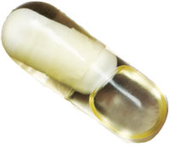
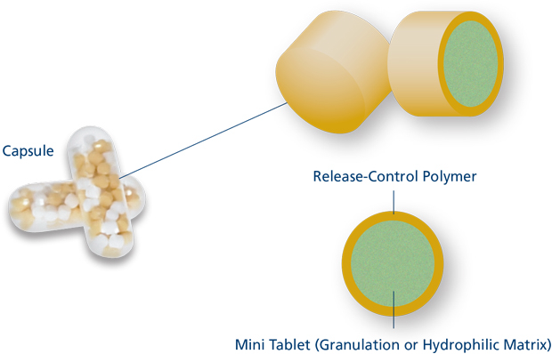
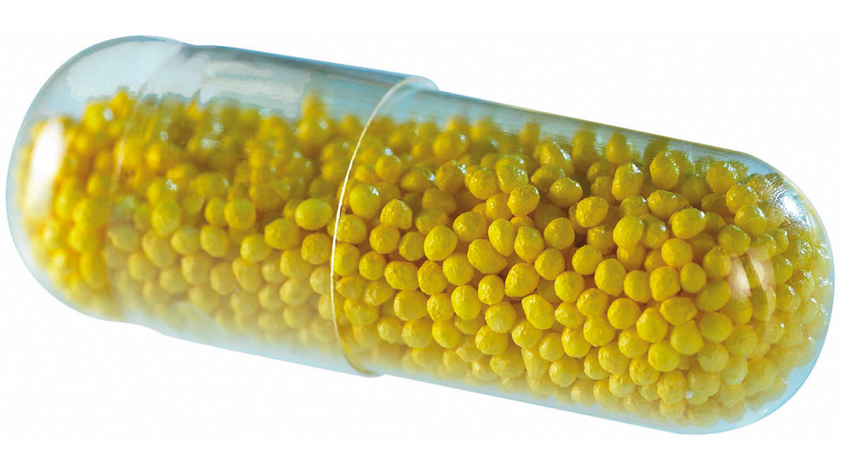

Slide 22


