Slide 1
Chronic obstructive pulmonary diseases
ا.م.د.بيداء حميد عبدالله

Slide 2
Chronic obstructive pulmonary diseases
1- Emphysema
2- Chronic bronchitis
3- Asthma
4- Bronchiactasis

Slide 3
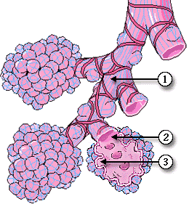
Normal respiratory acinus
Resp. bronchiole
Resp. bronchiole
Alveolar duct
Alveolar duct
Alveolar duct
Alveolar sac
Alveolar sac
Alveolar sac

Slide 5
Emphysema
It is an abnormal permanent
enlargement of the air space distal to
the terminal bronchiole with
destruction of their wall , There is NO
fibrosis.
Overinflation: dilatation of the airspace without destruction of their walls.

Slide 6
Types of emphysema
1- CENTRIACINAR EMPHYSEMA
It is the most common type
Occur in heavy smokers
The dilatation include the respiratory bronchiole only.
Affects the upper lobe mostly

Slide 7
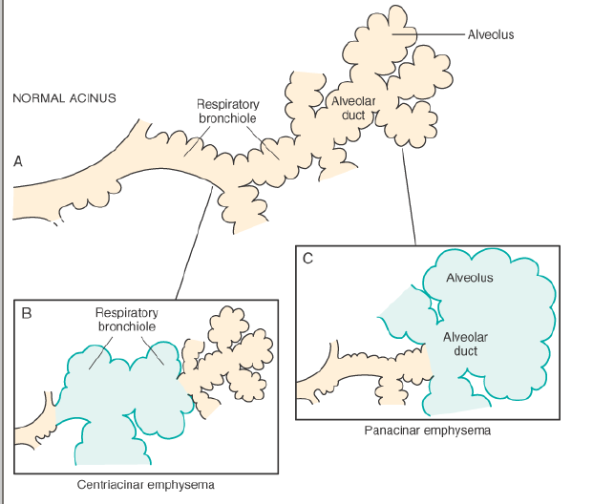

Slide 8
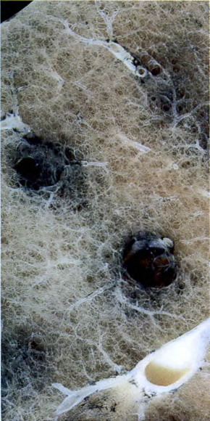
Grossly: centriacinar

Slide 9
2- PANACINAR EMPHYSEMA
The Whole Acinus is uniformly dilated.
Affects the lower zones mostly.
Associated with anti elastase deficiency
e.g α-1atni-trypsin deficiency.

Slide 10
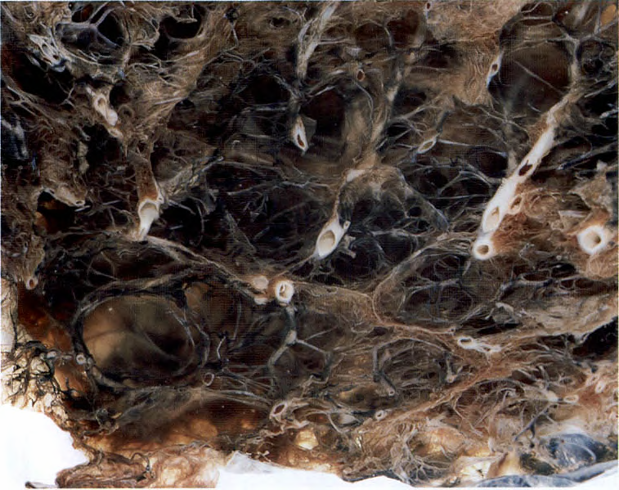
Grossly: Panacinar

Slide 11
3- PARASEPTAL EMPHYSEMA
Only the distal part of the acinus is involved i.e the alveolar SAC.
The common site is adjacent to the pleura, near a fibrotic, scaring, atelactic area.
It causes the formation of multiple cysts (0.5cm- 2 cm) that may rupture and → spontaneous pneumothorax in young adult.

Slide 12
4- IRREGULAR EMPHYSEMA
The Acini are irregularly involved.
Associated with scaring following a
healed inflammatory process.

Slide 13
4. Bullous emphysema: includes any form of emphysema that produce a large subpleural bullae > 1 cm in diameter.
5. Interstitial emphysema: (occur when there is cough +bronchial obstruction)→ air will escape into the connective tissue stroma of the lung, mediastinum & subcutaneous tissue.

Slide 14
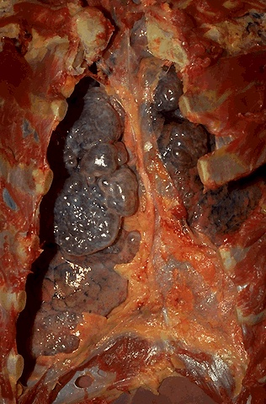
Bullous emphysema

Slide 15
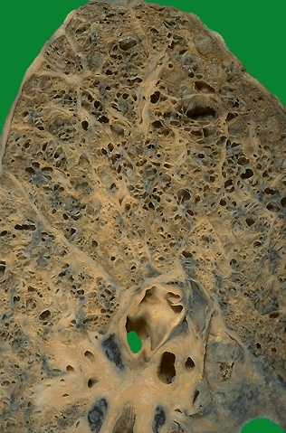
Gross: Emphysematous lung

Slide 16
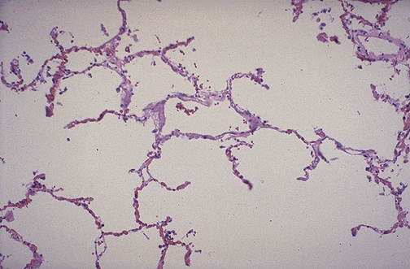
Microscopically

Slide 17
Pathogenesis
The key role in the whole process is:
PROTEASE --- ANTIPROTEASE imbalance.
Proteases: are enzymes which digest the tissue.
Anti-proteases: are the counteracting enzymes that stop the action of digestion.
Normal persons have a balance between the two enzymes.
The main cellular elastase (protease) is secreted from the NEUTROPHILS, it is capable to digest human lung if not inhibited by the anti-elastase enzyme e.g. (α-1 anti-trypsin).
The free radicals released from the neutrophils can inhibit the release of this α-1 atni-trypsin.
Other sites that release proteases:Macrophages.Bacteria.Mast cell.Pancreas.

Slide 18
So the Development of emphysema occurs:
When there is ⬆ elastase activity as in smoking.
When there is ↓ anti-elastase activity as in :
-Hereditary α-1 anti- trypsin deficiency.
-Acquired as in smokers due to the effect of nicotine, O2 free radicals that inhibit the release of anti-elastase.
The effect of smoking in the development of emphysema
1-It ⬆ the no. of neutrophils, macrophages, in the alveoli.
2-Nicotine is a chemotactic substance for neutrophils.
3-It stimulates the elastase activity.
4-The oxidants in the smoke and the free radicals from the accompanying neutrophils → inhibit the secretion of anti-elastase.

Slide 19
Chronic bronchitis
Clinically :
it is characterized by (cough +sputum) production for at least 3 months in at least 2 consecutive years.
.

Slide 20
Microscopically:
Enlarged mucous secreting glands in the trachea &bronchus, this is best estimated by the increase in the Reid Index.
Marked narrowing of the bronchioles due to goblet cell metaplasia, mucous plug, inflammation & fibrosis.
The bronchial epithelium may show squamous metaplasia and dysplasia.

Slide 21
Reid Index
It is the ratio of the thickness of the mucous gland layer / thickness of the wall between the epithelium and the cartilage.
Normally it is 0.4 , it increases in chronic bronchitis.

Slide 22
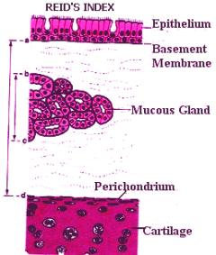

Slide 23
Bronchial Asthma
Is a chronic relapsing inflammatory disorder characterized by hyper-reactive airways→ episodic , reversible, bronchoconstriction due to ⬆ responsiveness of the trachiobronchial tree to various stimuli.

Slide 24
Morphologically
Grossly:
Lungs are over inflated.
There is foci of atelactasis.
The most striking is the occlusion of the airways by thick, mucous plugs .

Slide 25
Microscopically:
The plugs composed of sheded epithelium forming the so called Curschmann spirals.
Charcot leyden crystals which are collections of the eosinophils membrane protein.
Thickening of the basement membrane of the bronchial epithelium.
Edema &inflammatory cells in the Br. Wall.
Increase in the no. of submucosal glands.
Hypertrophy of the bronchial wall muscle as a reflection of prolonged bronchoconstriction.

Slide 26
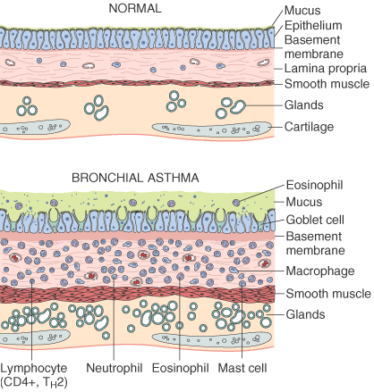

Slide 27
Bronchiectasis
Is a chronic necrotizing infection of the bronchi &bronchioles leading to or associated with abnormal permanent dilatation of these airways.

Slide 28
Clinically
Cough+ fever (when a powerful microorganism present) + copious foul smell purulent sputum .

Slide 29
Etiology &pathogenesis
Two important factors should be present:
Obstruction.
Infection.
So either the condition starts with :
A- Bronchial obstruction→ atelactasis→ bronchial wall inflammation + accumulated bronchial secretion→ dilatation which is reversible.

Slide 30
If :
The obstruction persist . or
There is a superadded infection.
The dilatation will be irreversible.
B – or it starts with bronchial infection→ bronchial wall inflammation & weakening → further dilatation.

Slide 31
Grossly:
Affects the lower lobes bilaterally.
The affected airways are dilated & may take the shape of tube (cylindroid bronchiectasis). Others may show fusiform or sharp saccular distention
The dilatation produce cystic pattern on cut surface.

Slide 32
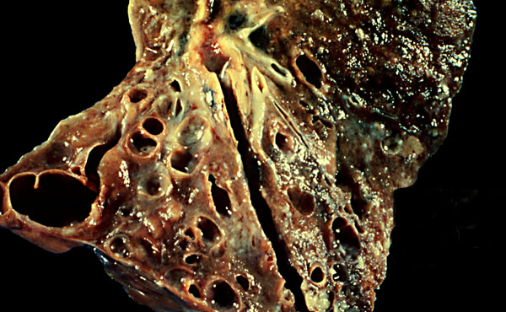
Bronchiectasis : gross

Slide 33
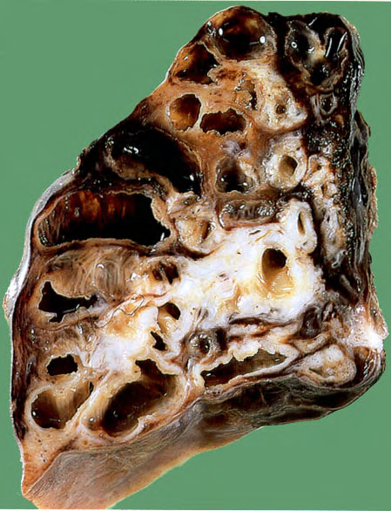
Gross

Slide 34
Microscopically
The full blown picture will show:
Ulceration of the lining epithelium with desquamation.
Pseudo-stratification of the columnar cells or squamous metaplasia.
Acute & chronic inflammatory exudates within the wall of the airway.
Necrosis of the cartilage .
Fibrosis of the bronchial wall.

