Slide 1
PULMONARY TUBERCULOSIS
د.بيداء حميد عبدالله

Slide 2
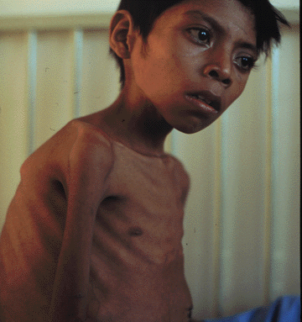
Pulmonary Tuberculosis
Tuberculosis (abbreviated as TB for tubercle bacillus or Tuberculosis) is a common and often deadly infectious disease caused by mycobacteria, mainly Mycobacterium tuberculosis. Tuberculosis usually attacks the lungs (as pulmonary TB.

Slide 3
Definition Chronic inflammatory response of prolonged duration (weeks,months,years) provoked by the persistence of the causative organism Mycobacterium tuberculosis accompanied by tissue destruction and repair of lung tissue.

Slide 4
TB Transmission
TB is spread through tiny drops sprayed into the air when an infected person coughs, sneezes, or speaks, or another person breathes the air into their lungs containing the TB bacteria.

Slide 5
Pathogenesis :The Players (mononuclear phagocyte system)
Macrophages
Scattered all over (microglia, Kupffer cells, sinus histiocytes, alveolar macrophages, etc.)
Circulate as monocytes and reach site of injury within 24 – 48 hrs and transform
Become activated by T cell-derived cytokines, endotoxins, and other products of inflammation

Slide 6
The Players….
T and B lymphocytes
Antigen-activated (via macrophages and dendritic cells)
Release macrophage-activating cytokines (in turn, macrophages release lymphocyte-activating cytokines until inflammatory stimulus is removed)
Plasma cells
Terminally differentiated B cells
Produce antibodies

Slide 7
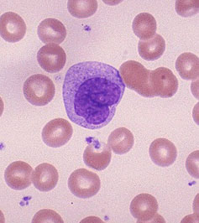
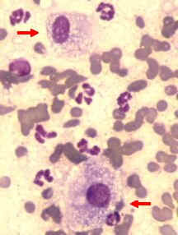
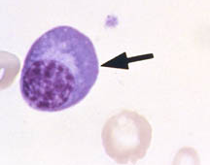
The dominant cellular player in pulmonary tuberculosis is the tissue macrophage
Blood monocyte
Tissue macrophage (RES)
migrate into tissue
within 48 hours
after injury
Kupffer cell (liver)
Microglia (CNS)
Histiocytes (spleen)
Alveolar macs (lung)
and differentiate
It is joined by lymphocytes and plasma cells,
however mast cells and eosinophils are as well involved in chronic allergic diseases
Plasma cell
Lymphocyte

Slide 8
Pathogenesis
A-Primary Pulmonary Tuberculosis (0-3 weeks):
inhalation of Mycobacteria---enter alveolar macrophages---replication in phagosome---bacteremia---seeding of multiple sites

Slide 9
Pathogenesis
B -Primary pulmonary tuberculosis (>3 weeks):
Alveolar macrophages---IL-2---T Cells--- T-helper cells---Activated macrophages
(i)--- TNF,Chemokines—Hypersensitivity (epith. granulomas) and
(ii)---Nitric oxide,reactive O2 sp.---Immunity (bactericidal activity)

Slide 10
Primary Tuberculosis
Develops in unexposed, unsensitized persons
Mostly(95%) asymptomatic; Infection contained
In 5 % symptomatic; Primary progressive tuberculosis
Source of organism; Exogenous
Difficult to diagnose

Slide 11
Primary Tuberculosis
Presentation :
Lung consolidation;
Lower and middle lobes
Hilar lymphadenopathy
Pleural effusion
In majority organism remain dormant
In severe immunosupression
- TB Meningitis
- Miliary Tuberculosis

Slide 12
Secondary Tuberculosis
Arises in previously sensitized host
Many years after primary infection
Reactivation of latent infection or overwhelming exogenous infection
Involves apex of upper lobes
Cavitation more prominant

Slide 13
Morphology
A-Primary Tuberculosis :
Ghon complex a bout(1 cm ) area of gray-white inflammatory consolidation develops (called Ghon focus). The center of this focus undergoes caseous necrosis.
- subpleural parenchymal lesion (lower part of upper lobe)
- hilar lymphadenopathy
Progressive fibrosis
Calcification

Slide 14
Histology :
Epithelioid cell granulomas
epithelioid cells
lymphocytes
plasma cells
multinucleated langhan’s type giant cells
with or without central caseation

Slide 15
Granulomatous Inflammation
Clusters of T cell-activated macrophages, which engulf and surround indigestible foreign bodies (mycobacteria, H. capsulatum, silica, suture material)
Resemble squamous cells, therefore called “epithelioid” granulomas

Slide 16
Morphology
B – Secondary Tuberculosis :
Focus of consolidation, < 2 cm
Within 1-2 cm of apical pleura
Histology :
Caseating granulomas

Slide 17
Morphology
c – Miliary Pulmonary Tuberculosis :
Organisms draining through lymphatics enter venous blood and circulate back into the lung and involving most of the parenchymal tissue.
Microscopic or small visible yellowish white foci resembling “millet” seeds
Coalesce to form larger cavity

Slide 18
Acute respiratory distress syndrome (ARDS)
Previously known as respiratory distress syndrome (RDS )or adult respiratory distress syndrome:is a severe, life-threatening medical condition characterized by widespread inflammation in the lungs. ARDS is a disease of the microscopic air sacs of the lungs called (alveoli) that leads to decreased exchange of oxygen and carbon dioxide. ARDS is associated with several pathologic changes: the release of inflammatory chemicals, breakdown of the cells lining the lung's blood vessels and surfactant loss leading to increased surface tension and fluid accumulation in the lung.

Slide 19
CAUSES
A. Respiratory
1. Diffuse infections (viral, bacterial)
2. Aspiration
3. Inhalation (toxic gases)
4. O2 therapy
B. Non-respiratory
1. Sepsis (septic shock) 2. Trauma (with hypotension)
3. Burns
4. Pancreatitis 5. Ingested toxins.

Slide 20
Surfactant
a mixture of phospholipids and lipoproteins , is secreted by lung cells. The air-fluid interface of the lining the alveoli of the lung (where the exchange of oxygen and CO2 occurs) exerts large forces that cause the alveoli to close if surfactant is deficient. Lung compliance is decreased, and the work of inflating the stiff lungs is increased.

Slide 21
Cystic fibrosis (CF)
is a multisystem disease affecting the lungs, digestive system, sweat glands, and the reproductive tract.
Patients with CF have abnormal transport of chloride and sodium across secretory epithelia, resulting in thickened, viscous secretions in the bronchi, biliary tract, pancreas, intestines, and reproductive

Slide 22
Although the disease is systemic, progressive lung disease continues to be the major cause of morbidity and mortality for most patients. Over a highly variable time course ranging from months to decades after birth, individuals eventually develop chronic infection of the respiratory tract with a characteristic array of bacterial flora, leading to progressive respiratory insufficiency and eventual respiratory failure

Slide 23
Etiology
Cystic fibrosis is an autosomal recessive disease caused by defects in the CFTRgene, which encodes for a protein that functions as a chloride channel, and also regulates the flow of other ions across the apical surface of epithelial cells.The CF locus was localized through linkage analysis to the long arm of human chromosome 7, band q31

Slide 24
Pathophysiology
Cystic fibrosis is caused by defects in the cystic fibrosis gene, which codes for a protein transmembrane conductance regulator (CFTR) that functions as a chloride channel and is regulated by cyclic adenosine monophosphate (cAMP). Mutations in the CFTR gene result in abnormalities of cAMP-regulated chloride transport across epithelial cells on mucosal surfaces

Slide 25
Defective CFTR results in decreased secretion of chloride and increased reabsorption of sodium and water across epithelial cells. The resultant reduced height of epithelial lining fluid and decreased hydration of mucus results in mucus that is stickier to bacteria, which promotes infection and inflammation. Secretions in the respiratory tract, pancreas, GI tract, sweat glands, and other exocrine tissues have increased viscosity, which makes them difficult to clear.
Most patients with cystic fibrosis have severe chronic lung disease and exocrine pancreatic insufficiency. Additional manifestations include the following:
Nasal polyposis
Pansinusitis
Rectal prolapse
Chronic diarrhea
Pancreatitis
Cholelithiasis
Cirrhosis or other forms of hepatic dysfunction

Slide 26
Cysic fibrosis Lung disease
Most deaths associated with cystic fibrosis result from progressive and end-stage lung disease. In individuals with cystic fibrosis, the lungs are normal in utero, at birth, and after birth, before the onset of infection and inflammation .Shortly after birth, many persons with cystic fibrosis acquire a lung infection, which incites an inflammatory response. Infection becomes established with a distinctive bacterial flora. A repeating cycle of infection and neutrophilic inflammation develops.

Slide 27
Pulmonary Embolism
is blockage of artery of lungs due to blood clots which might have travelled from mostly legs or other parts of body to lungs through bloodstream. As pulmonary Embolism derives blood clot in legs called deep vein thrombosis, it is referred as venous thromboembolism. Symptoms include shortness of breath, chest pain, cyanosis and rapid heart rate.

