Slide 1
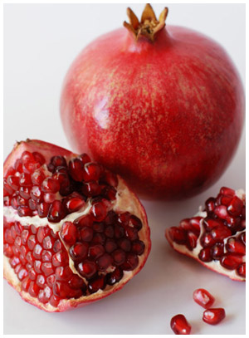
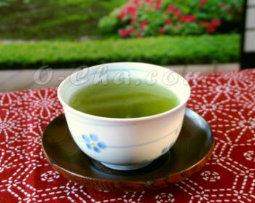
TANNINS
Pharmacognosy
3rd Class, 1st Semester
Lab.7

Slide 2
Introduction
Tannins are phenolic glycosides and comprise of a large group of complex substances that are widely distributed in the plant kingdom.
Chemically tannins are complex substances that are difficult to separate because they do not crystallized.
Properties
Pale yellow to light brown-red amorphous substances widely distributed in plants.
Water-soluble and also soluble in dilute alkali, alcohol, glycerol and acetone but slightly soluble in other organic solvents.
Tannins can precipitate alkaloids, gelatine, and other proteins.
Tannins give tea astringency, color, and flavor.
They are isolated from oak bark and sumac.
Their solutions are acid and have an astringent taste.

Slide 3
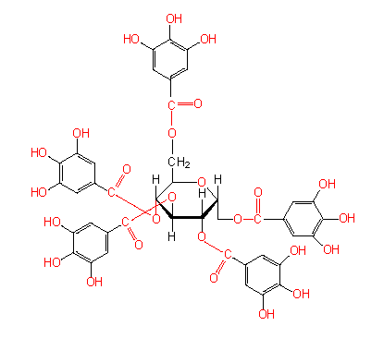
Tannin Structure

Slide 4
Tannins Uses
In the treatment of burns, the protein of the exposed tissue is precipitated and forms a mildly antiseptic, protective coat under which the regeneration of new tissue may take place.
Antidote treatment of the alkaloid poisoning.
Antiviral, antibacterial and antiparasitic effects.
Antioxidant for scavenging free radicals.
Used chiefly in tanning leather, dyeing fabric, and making ink.

Slide 5
Tanning : is the process of treating skins of animals to produce leather, which is more durable and less susceptible to decomposition and that is by formation of bonds between the collagen fibres of the hide (imparts resistance to water, heat and abrasion).
This capability of tannins to combine with macromolecules explains why :
They precipitate cellulose, pectin and proteins.
Explains their characteristic astringency and tartness by precipitating the glycoproteins which is contained in saliva and tannins make the saliva lose its lubricating power.

Slide 6
Cont…
The combination between tannins and macromolecules is established by :
Hydrophobic interactions
Hydrogen bonds between the phenolic groups of tannins and the proteins or other polymers.
The covalent bonds established after oxidation of the phenols to quinones.
The condition necessary for the formation of these linkages is the tannin’s molecular weight must fall within a well defined range.
If it is too high, the molecule cannot insert itself into the interfibrillar spaces of the macromolecule.
If it is too low, the molecule can insert itself but cannot form enough bonds to stabilize the combination.

Slide 7
Tannins are divided to two classes according to the identity of the phenolic nuclei involved:
HYDROLYSABLE TANNINS
(Esters of a sugar and phenolic acid molecules)
Gallotannins ex: Galls
Ellagitannins ex: Pomegranate rind
Hydrolysable tannins: are hydrolyzed by weak acids or weak bases or enzymes such as tannase to produce carbohydrate and phenolic acids and the phenolic acids are united by ester linkages to a central sugar (glucose) molecule and therefore the hydrolysable tannins are esters of a sugar and phenolic acid molecules.
The phenolic acid is:
In the case of Gallotannins – Gallic acid
In the case of Ellagitannins – Hexahydroxydiphenic acid (HHDP) and its oxidized derivatives (Dehydrohexahydroxydiphenic acid).

Slide 8
2) NONHYDROLYSABLE TANNINS OR CONDENSED TANNINS
Are polymers of 2 to 50 (or more) flavonoids units that are joined by carbon-carbon bonds, which are not susceptible to being cleaved by hydrolysis.
They are not readily hydrolysed to simpler molecules and they do not contain a sugar moiety (unlike hydrolysable tannins).
On treatment with acids or enzymes, condensed tannins are converted into red insoluble compounds known as phlobaphenes.
Phlobaphenes give the characteristic red colour to many drugs such as red cinchona bark.
These tannins are therefore sometimes called catechol tannins (as they yield catechol).

Slide 9
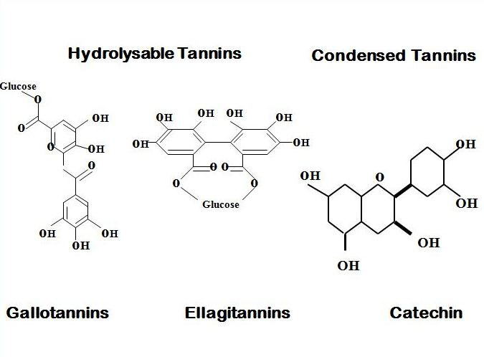

Slide 10
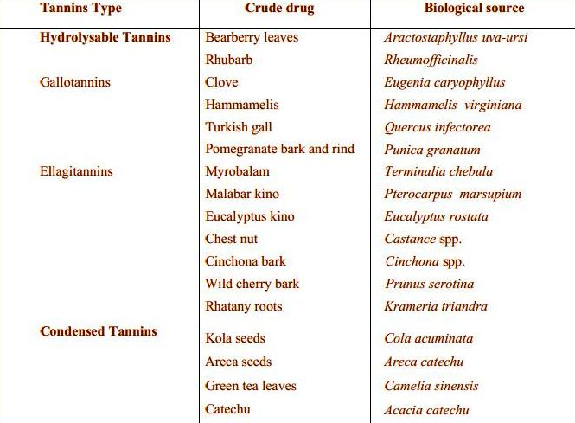

Slide 11
Test on Tannins
Catechol Tannins (Condensed Tannins)
Hamamelis leaf (witch-hazel leaf)
Botanical name Hamamelis virginiana
Family Hamamelidaceae
Medicinal uses
Witch Hazel contains tannins, flavonoids compounds, volatile oil and has astringent, antioxidant, antiseptic and antiviral properties.
It is prescribed for HSV, diarrhea, dysentery, mouth ulcers, varicose veins,, skin inflammation, sore throat, sprains and bruises .
It also acts as a skin tonic, a cure for eye inflammation and hemorrhoids.

Slide 12
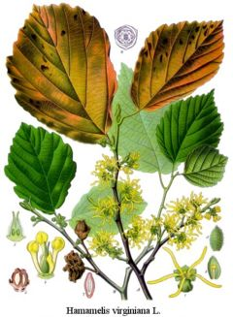
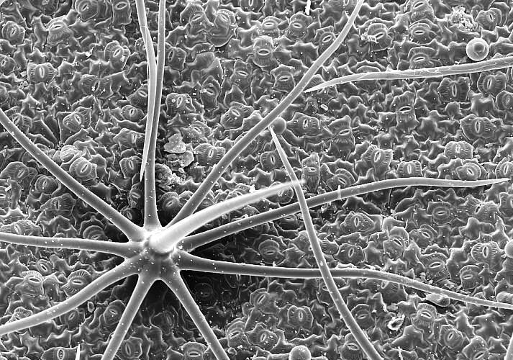
Examine
The powder drug microscopically for the trichomes and notice the type of stellate, the form branched stellate trichomes consisting of 4-12 unicellular branches united by their bases.

Slide 13
B. Chemical tests
Aim
To identify the catechol tannins.
Procedure
Boil 5gm of hamamelis leaf, coarsely powdered with 50 ml of water.
Cool and filter.
To 5ml portions add the following reagents and notice the results:-
Few drops solution of ferric chloride.
1ml solution of lead sub acetate.
1ml solution of potassium dichromate.
2ml solution of gelatin.
2ml solution of quinine dihydrochloride.
0.5ml of sodium acid phosphate, warm, cool and filter. To the filtrate add sodium of phenazone.
Bromine water.
5ml Mitchell's reagent (5ml of a 0.2%solution of iron and ammonium citrate) and add 1gm sodium acetate. Boil, cool and filter.
Results
Notice the colors and precipitates obtained.

Slide 14
Results
Ferric chloride | Greenish to black color
Lead sub acetate | Reddish brown bulky precipitate.
Potassium dichromate | Dark color
Gelatin | White precipitation of gelatin
Sodium acid phosphate Phenazone | Bulky, colored precipitate
Bromine water | No change in color
Mitchell's reagent | water soluble iron–tannin complex

Slide 15
Pyrogallol Tannins (Hydrolysable Tannins)
Galls, Nutgall
Botanical name Quercus infectoria
Family fagaceae
Medicinal uses
The bark is considered astringent, and used for treating nose bleeding, certain chronic skin diseases like eczema.
Seeds are used as a food flavoring agent, usually dry seeds are powdered and added into breads and cereals.
The galls are rich in tannins and also have anti-viral and anti-septic.
They are used in treating pharyngitis, diarrhea, dysentery, hemorrhoids.

Slide 16
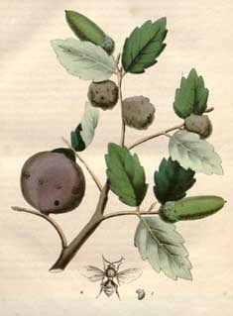
A. EXAMINE
The powdered drug microscopically and notice the following:
Fairly numerous sclernchymatous cell
Lignin bodies
The presence of only a few small vessels.
Few starch gains
Thick wall pitted parenchyma with both cluster and crystals of calcium oxalate.

Slide 17
B. CHEMICAL TEST
Aim
To identify the pyrogallol tannins
Procedure
Prepare 0.01% suspension of powdered nutgall in water and is treated with:-
A saturated solution of potassium dichromate plus a trace of acetic acid
A 1% solution of sodium carbonate
A 5%ferric sulphate solution
A 1% ferric acetate solution
Shake 0.1 gm powdered nutgall with 1ml of water, micro filter one drop into evaporating dish. Add one drop of a 5%ferric chloride solution
repeat the test e with bromine water
Results
Record the colors obtained

Slide 18
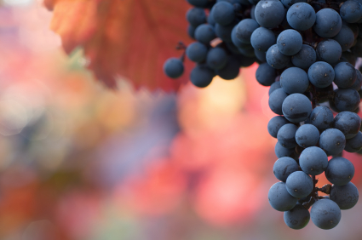
THANK YOU

