Slide 1

Titration
Volumetric analysis

Slide 2
Titration
Volumetric analysis relies on methods involving the accurate measurement of volumes of solutions, although mass measurements may also be required.
Essentially, we measure the volume of a standard solution (one of accurately known concentration) needed to react exactly with a known volume of another solution (one of unknown concentration) in a chemical reaction for which the stoichiometric or balanced chemical equation is known.
From the data, we are then in a position to calculate the accurate concentration of the second solution.

Slide 3
Titration
Simple and easy.
Fast and can be done on site.
Less expensive.
Estimation of content or Assay.
Precise and accurate.
In practical terms, volumetric analysis is achieved by a titration procedure
One of the solutions is added from a burette to a pipetted volume of the other solution in a conical flask.
The point at which the reaction between the two is just complete is usually detected by adding a suitable indicator to the solution in the flask, it is customary, although not essential, to have the solution of known concentration in the burette.

Slide 4
Standard solutions
A standard is a solution of precisely known concentration
It must be available in a highly pure state.
It must be stable in air (high stability).
It must dissolve easily in water (solvent).
It should have a fairly high relative molecular weight.
It should under go a complete and rapid reaction.
Chemicals are supplied in various grades of purity but for analytical work AnalaR grade primary standards must be used. AnalaR grade guarantees high purity.

Slide 5
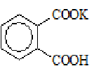
Primary standard
Examples
Acid
Hydrated oxalic acid, (COOH)₂.2H₂O
potassium hydrogenphthalate,
Base
Anhydrous sodium carbonate, Na₂CO₃
Oxidising agent
Potassium dichromate K₂Cr₂O₇; potassium iodate KIO₃
Reducing agent
Sodium oxalate (COONa)₂ = Na₂C₂O₄
Complexing agent
Hydrated disodium salt of EDTA
Precipitating agent
Sodium chloride, NaCl

Slide 6
Non standard solutions
Sodium hydroxide absorbs carbon dioxide from atmosphere.
HCl can produce chlorine gas in reactions and liberate hydrogen when exposed to air.
Nitric acid can act as an oxidising agent interfering with reactions.
Sulphuric acid absorbs water from the air.

Slide 7
Calculation of Results from titration
The calculation of the titration depend on chemical equation balanced, to determine the concentration of unknown solution by standard solution, (the equivalents No. of unknown equal to the equivalents No. of standard), for general reaction:-
a A + b B ➔ c C + d D
no. Eq. of A = no. Eq. of B
no. Eq. = N x V = Wt. / Eq. Wt.
N_{A} x V_{A} = N_{B} x V_{B}
(V_{A} M_{A}/a) = (V_{B} M_{B}/b)
Eq. Wt. of B = M.Wt. / a
Wt. of B = N_{A} x V_{A} x Eq. Wt. of B
Wt% of B = (Wt. of B / Wt. of sample ) x 100

Slide 8
Watch:
B
OH-
OH-
OH-
OH-
Burette
OH-
OH-
OH-
OH-
H+
H+
A
H+
pH is low
H+
H+
Conical flask

Slide 9
Watch:
B
OH-
OH-
OH-
OH-
OH-
OH-
OH-
H+
pH is getting higher
A
H-OH
H+
H+
H+

Slide 10
Watch:
B
OH-
OH-
OH-
OH-
OH-
OH-
H-OH
pH is even higher
A
H-OH
H+
H+
H+

Slide 11
Watch:
B
OH-
OH-
OH-
OH-
OH-
H-OH
pH is even higher
A
H-OH
H-OH
H+
H+

Slide 12
Watch:
B
OH-
OH-
OH-
OH-
H-OH
pH is near 7
A
H-OH
H-OH
H-OH
H+

Slide 13
Watch:
B
OH-
OH-
OH-
H-OH
pH is 7
A
H-OH
H-OH
H-OH
H-OH

Slide 14
Watch:
B
OH-
OH-
OH-
H-OH
pH is over 7
A
H-OH
H-OH
H-OH
H-OH

Slide 15
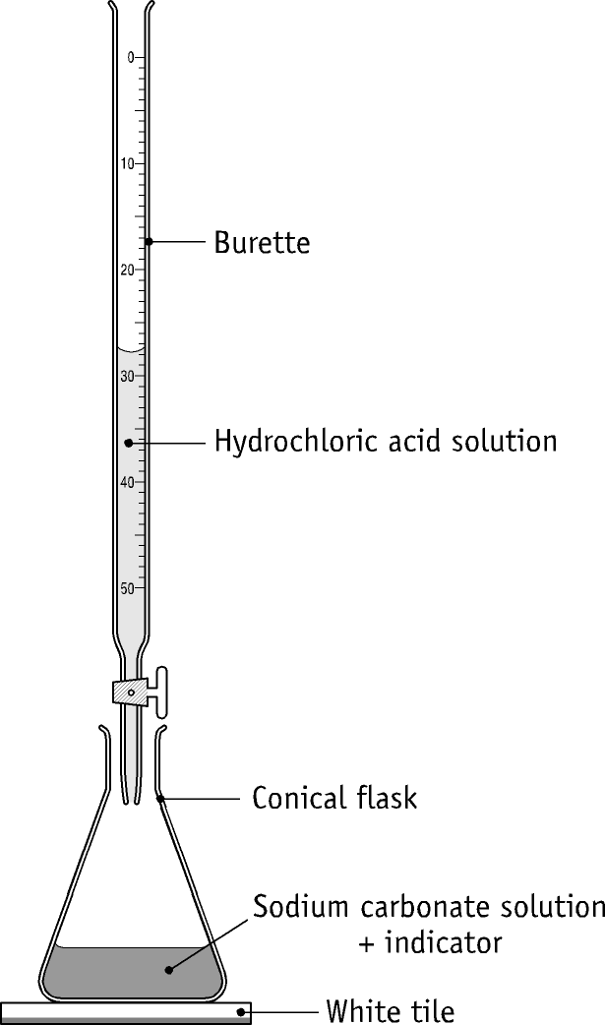
Na₂CO₃ + 2HCl → 2NaCl + H₂O + CO₂
1 mole 2 moles 2 moles 1 mole 1 mole
Titration of Sodium Carbonate with Hydrochloric acid

Slide 16
Apparatus used
Burette.
Conical flask.
Beaker.
Pipette.
Funnel.
White tile.

Slide 17
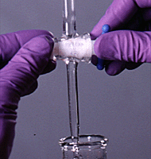
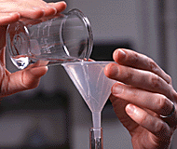
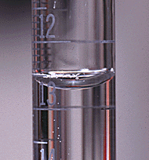
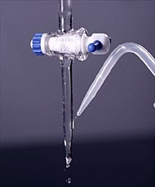
Burette titration procedures

Slide 18
Precautions when using equipment
Burette must be vertical, use and then remove funnel, check meniscus, rinse with distal water and then given solution.
In using a Pipette rinse with distal water first and then with given solution. Check meniscus. Do not blow out remainder of liquid into flask and keep tip of pipette in contact with flask

Slide 19
Precautions
Conical flask should not be rinsed with solution it is to contain and swirl
In using a Volumetric flask the last few mL must be added so that the meniscus rest on calibration mark
Invert stoppered flask to ensure solution is homogeneous/uniform

Slide 20
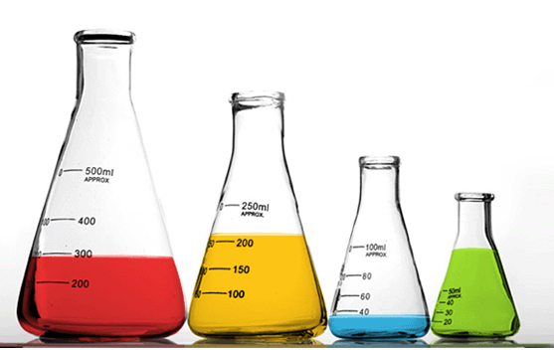
Why is a conical flask, rather than a beaker, used in the experiment?
To allow easy mixing of the contents, by swirling.

Slide 21
Why is the funnel removed from the burette after adding the acid solution?
So that drops of solution from the funnel will not fall into the burette.

Slide 22
In using a burette, it is important:-
(a) to rinse it with a little of the solution it is going to contain.
(b) to clamp it vertically.
(c) to have the part below the tap full?

Slide 23
(a) Rinsing
To remove any residual water, and so avoid dilution of the acid solution when it is poured into the burette.

Slide 24
(b) clamp vertically
To enable the liquid level to be read correctly

Slide 25
(c) Full tap
To ensure that the actual volume of liquid delivered into the conical flask is read accurately.

Slide 26
The following procedures were carried out during the titration:
The sides of the conical flask were washed down with distal water.
The conical flask was frequently swirled or shaken.
Give one reason for carrying out each of these procedures.

Slide 27
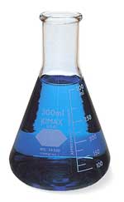
  To ensure that all of the acid added from the burette can react with the base.
To ensure complete mixing of the reactants

Slide 28
Why is a rough titration carried out?
To find the approximate end-point. This information enables the subsequent titrations to be carried out more quickly.
Why is more than one accurate titration carried out?
To minimise error by getting accurate readings within 0.1 mL of each other.

Slide 29
Calculation example
Volume of acid V_{A} (mL) is the titration figure from burette
The concentration of acid is M_{A} (mol.L⁻¹)
a is the mol of full balanced equation per litre
Volume of base is V_{B} (mL). Usually placed in the conical flask.
M_{B} is the concentration of the base
b is the mol of full balanced per litre

Slide 30
Calculations
M_{A} V_{A} /a = M_{B} V_{B} / b
Or N_{A} x V_{A} = N_{B} x V_{B}
Na₂CO₃ + 2HCl → 2NaCl + H₂O + CO₂
V_{A} = from burette
Ma is unknown
a = 2
V_{B} = 5 mL
M_{B} = 0.1 mol. L⁻¹
b = 1

Slide 31
THE END

