Slide 1
English Language
Lecture 5
1st stage
Dr Samah A. Jassam BSc MSc PhD MRSB

Slide 2
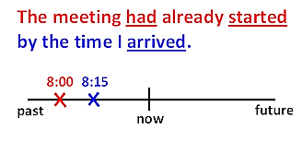
The Past perfect tense
When we talk about something that happened in the past we sometimes want to refer back to something that happened before that time. We can use the past perfect tense
(had + past participle) to do this.
Example

Slide 3
The Past perfect tense

Slide 4
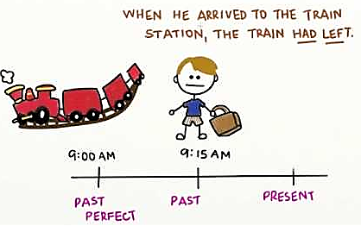
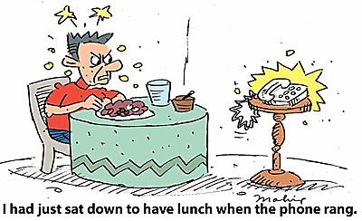
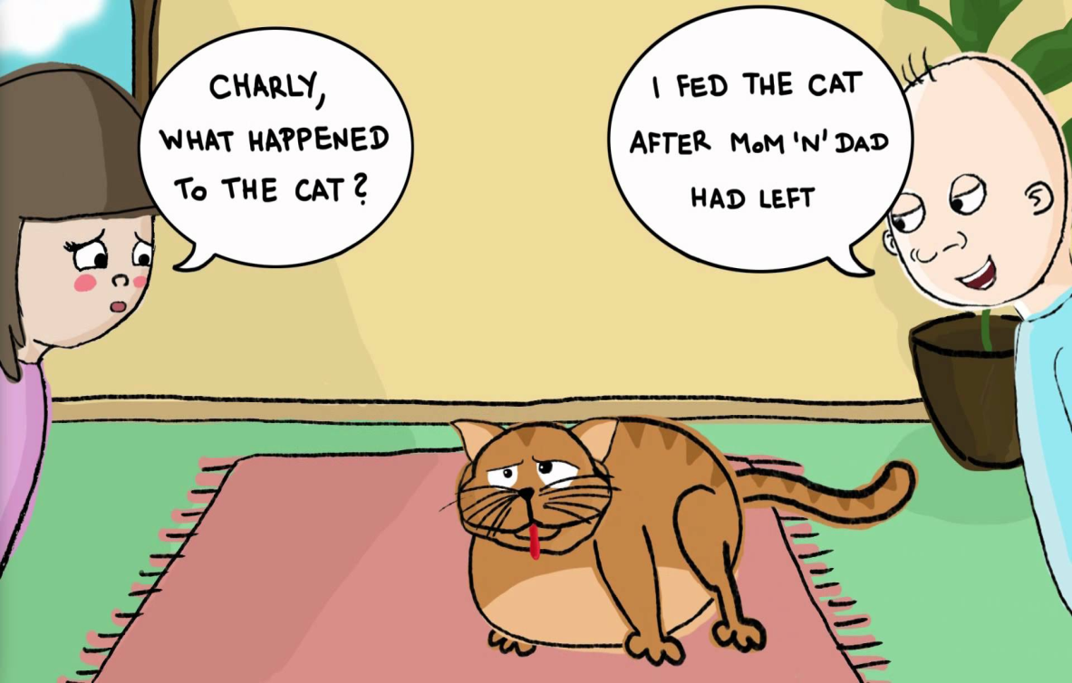
The Past perfect tense examples

Slide 5
How to use the present perfect and past perfect

