Slide 1

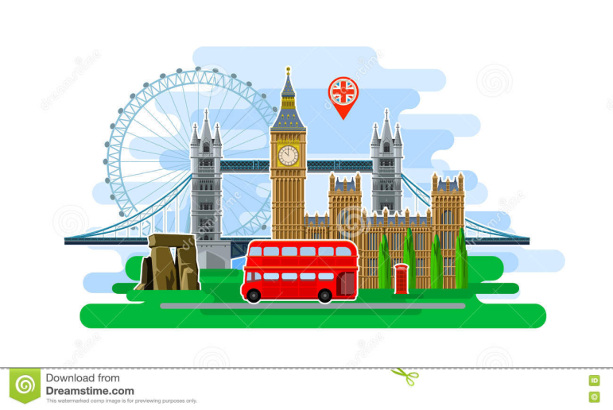
English Language
Lecture 1,2,3
1st stage
Dr Samah A. Jassam BSc MSc PhD MRSB

Slide 2
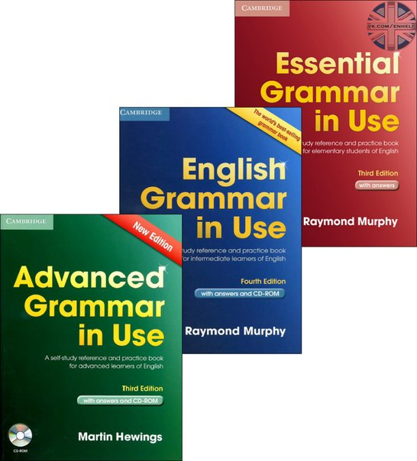
The used references

Slide 3
Lecture 1
How to Introduce Yourself in English
Break the Ice. “Break the ice” is a common English expression. ...
Ask Follow-up Questions. You need to keep the conversation going. ...
Listen and Ask More Questions. ...
Prepare Basic Answers about Yourself. ...
Have an Exit Plan. ...
Smile and Be Confident.

Slide 4
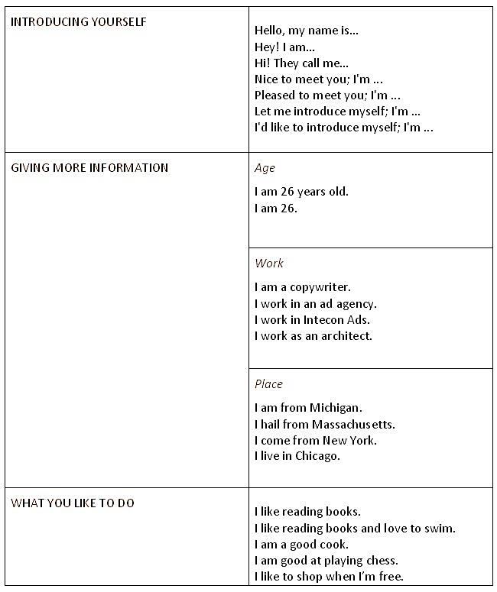
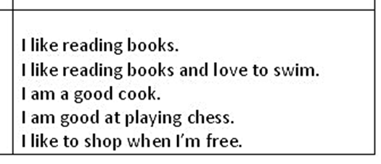
How to Introduce Yourself in English
2
1
3

Slide 5
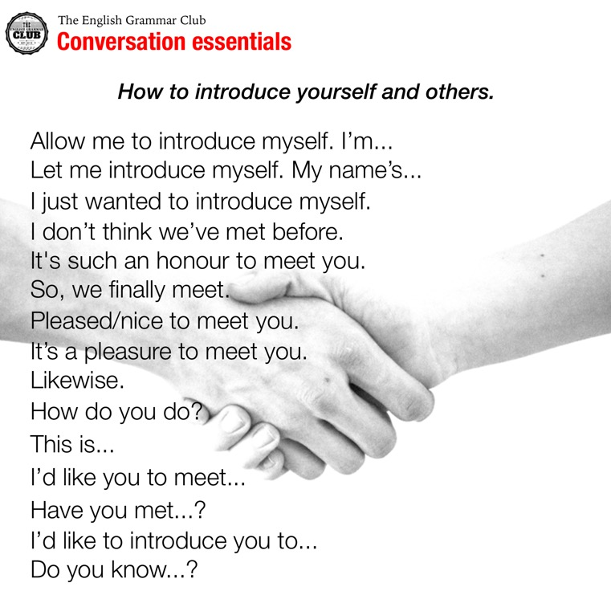

Slide 6
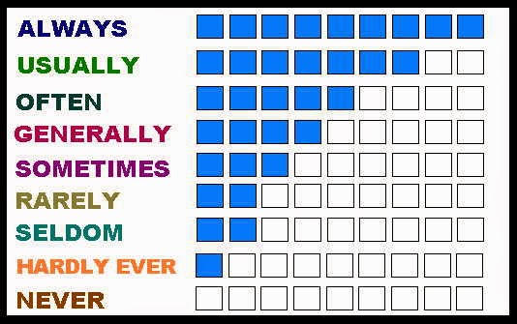
present simple
The present tense is the base form of the verb: I work in London.
But the third person (she/he/it) adds an -s: She works in London.
Use
1- We use the present tense to talk about: something that is true in the present
I’m nineteen years old.
He lives in London.
I’m a student.
I play football every weekend.
2-We use words like: sometimes, often. always, and never (adverbs of frequency) with the present tense:
I sometimes go to the cinema.
She never plays football.
https://learnenglish.britishcouncil.org/en/english-grammar/verbs/present-tense/present-simple

Slide 7
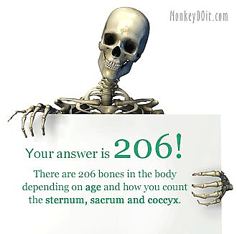

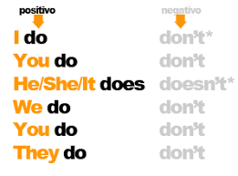
3- something that is always true:
The adult human body contains 206 bones.
Light travels at almost 300,000 kilometres per second.
4- something that is fixed in the future.
The school term starts next week.
The train leaves at 19:45 this evening.
We fly to Paris next week.
Questions and negatives
With the present tense, we use do and does to make questions.
We use does for the third person (she/he/it) and we use do for the others.
We use do and does with question words like where, what and why

Slide 8



present continuous
verb be and the present participle (-ing form) of a verb
Use
1. We use the present continuous tense to talk about the present: for something that is happening at the moment of speaking:
I’m just leaving work. I’ll be home in an hour.
Please be quiet. The children are sleeping.
2- for something which is happening before and after a given time:
At eight o’clock we are usually having breakfast.
When I get home the children are doing their homework.
3-for something which we think is temporary:
Michael is at university. He’s studying history.
I’m working in London for the next two weeks.

Slide 9



4- for something which is new and contrasts with a previous state:
These days most people are using email instead of writing letters.
What sort of clothes are teenagers wearing nowadays?
What sort of music are they listening to?
5- to show that something is changing, growing or developing:
The children are growing quickly
The climate is changing rapidly.
Your English is improving.
6-for something which happens again and again:
It’s always raining in London.
They are always arguing.
George is great. He’s always laughing.

Slide 10


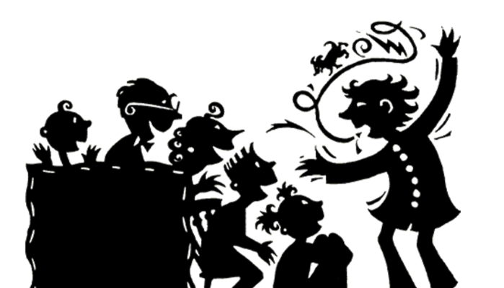
7- We use the present continuous tense to talk about the future:
for something which has been arranged or planned:
Mary is going to a new school next term.
What are you doing next week?
8. We can use the present continuous to talk about the past, When we are telling a story:
When we are summarising the story from a book, film or play.

Slide 11
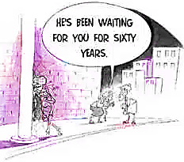
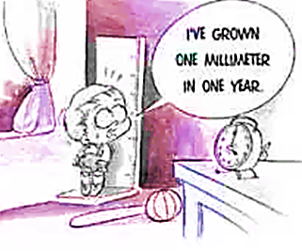
Present perfect continuous
The present perfect continuous is formed with have/has been and the -ing form of the verb
Use
1- We use the present perfect tense
for something that started in the past and continues in the present:
They’ve been married for nearly fifty years.
She has lived in Liverpool all her life.
Note: We normally use the present perfect continuous for this:
She has been living in Liverpool all her life.
It’s been raining for hours.

Slide 12
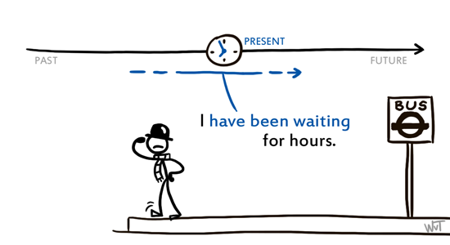
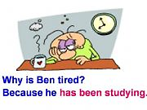
Present perfect continuous
2- for something we have done several times in the past and continue to do:
I’ve played the guitar ever since I was a teenager.
He has written three books and he is working on another one.
I’ve been watching that programme every week.
3- We often use a clause with since to show when something started in the past:
They’ve been staying with us since last week.
I have worked here since I left school.
I’ve been watching that programme every week since it started.

Slide 13
WARNING:
We do not use the present perfect with an adverbial which refers to past time which is finished:
I have seen that film yesterday.
We have just bought a new car last week.
When we were children we have been to California.
But we can use it to refer to a time which is not yet finished:
Have you seen Geoffrey today?
We have bought a new car this week.

Slide 14

Thank you and good luck!

