Slide 1
Pharmaceutical Technology
Lec 9
Dr Athmar Dhahir Habeeb
PhD in Industrial pharmacy and pharmaceutical formulations
athmar1978@yahoo.com

Slide 2
Physical Features of the Dispersed Phase of a suspension
The most important single consideration in a discussion of suspensions is the size of the particles. In most good pharmaceutical suspensions, the particle diameter is 1 to 50 μm.
Particle size reduction
10 to 50 μm
dry milling
rapid, convenient, and inexpensive methods of producing fine drug is micropulverization (Micropulverizers are high-speed attrition or impact mills )
oral and topical suspensions.
under 10 μm
fluid energy grinding (jet milling or micronizing )
for parenteral or ophthalmic suspensions
Particles of extremely small dimensions may also be produced by spray drying.
Note: The particles to be micronized are swept into violent turbulence by the sonic and supersonic velocities of the airstreams. The particles are accelerated to high velocities and collide with one another, resulting in fragmentation.

Slide 3
The reduction in the particle size of a suspensoid is beneficial to the stability of the suspension because the rate of sedimentation of the solid particles is reduced as the particles are decreased in size.
The reduction in particle size produces slow, more uniform rates of settling. Avoid reducing the particle size too much because fine particles have a tendency to form a compact cake upon settling to the bottom of the container.
the cake resists breakup with shaking and forms rigid aggregates of particles that are larger and less suspendable than the original suspensoid.
The particle shape of the suspensoid can also affect caking and product stability.
Ex: Symmetrical barrel-shaped particles of calcium carbonate produced more stable suspensions than did asymmetrical needle-shaped particles.

Slide 4
One common method of preventing rigid cohesion of small particles (forming a hard cake) of a suspension is intentional formation of a less rigid or loose aggregation of the particles held together by comparatively weak particle-to-particle bonds.
Such an aggregation of particles is termed a floc or a floccule, with flocculated particles forming a type of lattice that resists complete settling (although flocs settle more rapidly than fine, individual particles) and thus are less prone to compaction than unflocculated particles.
The flocs settle to form a higher sediment volume than unflocculated particles, the loose structure of which permits the aggregates to break up easily and distribute readily with a small amount of agitation.
Note: There are several methods of preparing flocculated suspensions, the choice depending on the type of drug and the type of product desired.

Slide 5
With highly flocculated suspensions, the particles of a suspension settle too rapidly to be consistent with what might be termed a pharmaceutically elegant preparation. The rapid settling hinders accurate measurement of dosage and produces too unsightly a supernatant layer.
In many commercial suspensions, suspending agents are added to the dispersion medium to lend it structure. Carboxymethylcellulose (CMC), methylcellulose, microcrystalline cellulose, polyvinyl pyrrolidone, xanthan gum, and bentonite are a few of the agents employed to thicken the dispersion medium and help suspend the suspensoid.
Note: When polymeric substances and hydrophilic colloids are used as suspending agents, appropriate tests must be performed to show that:
The agent does not interfere with availability of the drug because these materials can bind certain medicinal agents, rendering them unavailable or only slowly available for therapeutic function.
the amount of the suspending agent must not be such to render the suspension too viscous to agitate (to distribute the suspensoid) or to pour.
Note: Support of the suspensoid by the dispersion medium may depend on:
the density of the suspensoid, whether it is flocculated
the amount of material requiring support.

Slide 6
Flocculating agents
Surface charge on particles cause the particles to repel one another and cause deflocculation.
Electrolytes
They are used frequently to get products of large F.
The ions reduce the electrical barrier between the particles and also form a bridge between particles to link them together.
Particles are held in a lossely arranged structure in suspension
Although these large aggregates settle rapidly they yield open cell like structure and easily resuspended by agitation
Flocculating agents
Electrolytes
Polymers
Detergents SAA

Slide 7
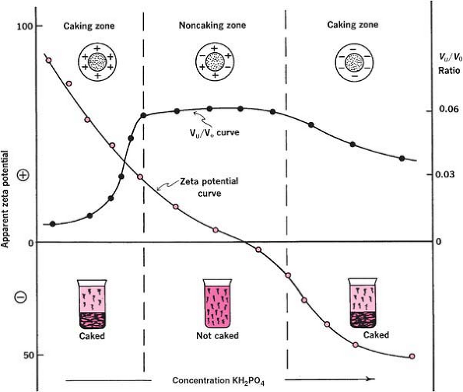
Ex: addition of monobasic potassium phosphate (a negative flocculating agent) to a suspension of bismuth subnitrate ( positively charged particles)

Slide 8
Ex: sufamerazine suspension (negatively charged) could be flocculated using aluminium chloride (positively charged)
Two mechanisms proposed for flocculation
Flocculation could be caused by formation of chemical bonds between the particles of the suspension and the ions of the flocculating agent (bridging )
Neutralization of the surface charge of the particles
Detergents SAA
Both ionic and nonionic SAA are used.
The use of ionic SAA will increase F
Ionic surface-active agents may also cause flocculation by neutralizing the charge on each particle, thus resulting in a deflocculated system.
Non-ionic surfactants will, of course, have a negligible effect on the charge density of a particle but may, because of their linear configurations, adsorb on to more than one particle, thereby forming a loose flocculated structure (Ex polyoxyethylated nonylphenols)

Slide 9
Polymers
Lyophilic polymers are commonly used
Polymers contain active groups spaced along their chains
Part of the long molecule may be adsorbed on the particles leaving extended segments projecting from the particle surface
The end of the polymers may be adsorbed and loops into the medium
These loops could bridge across to adjacent particles and produce flocculated system
Hydrocolloids also used as polyelectrolytes (Ex: gelatin)
Their action depends on pH and ionic strength of the medium.
Soluble sulfathiazole was precipitated from acid solution in the presence of gelatin
The suspending agent may act as
protective colloid to keep the settled particles from caking
flocculating agent to produce loss cell like structure in the liquid medium
It may also provide a certain consistency to assist in supporting the particles

