Slide 1
Pharmaceutical Technology
Lec 7 and 8
Dr Athmar Dhahir Habeeb
PhD in Industrial pharmacy and pharmaceutical formulations
athmar1978@yahoo.com

Slide 2
Principles of mixing
Adequate mixing is important
Mixing combined two factors
Factors involved in efficient mixing
Viscosity of the vehicle
Impeller shape, size, speed, location in the container and presence or absence of baffles.
Properties of the solid phase
Adequate flow of vehicle within the container to ensure uniform distribution of particles in the vehicle
Sufficient shear within the system to achieve dispersion of individual particles rather than agglomeration

Slide 3
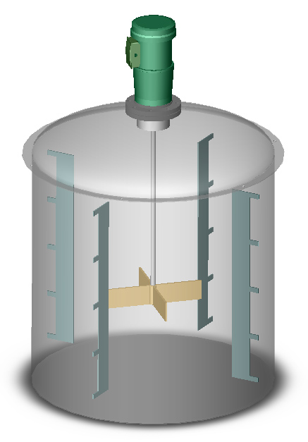
Preparation of suspension
Small scale production
Mortar and pestle
Levigation of insoluble drug with portion of suspending agent previously dispersed in water to form mucilage
Surface active agents (levigating agent such as PG or glycerin)
When a smooth past is formed the rest of the vehicle added in divided portions
Soluble drugs, flavouring agents, colouring materials added in the diluting portion of the vehicle
Transfer to graduate cylinder and complete the volume
Non-absorbing liquid (alcohol, PG or glycerin)
Methyl cellulose (suspending agent)
Large scale production
Large mixing tanks fitted with variable speed stirring device such as propeller or a turbine impeller. Invariably the product is then passed through a homogenizer or colloid mill which operates on a continuous flow basis.
Q/ Often 2-step homogenization process is required is suspension preparation?

Slide 4
Physical properties of dispersed particles
The main problem with suspensions is to have uniform dispersion of particles at the time patient use the product (physical stability).
Factors affecting physical stability
particle-vehicle interactions
Increase SA free surface energy increased Agglomeration into large masses
ΔF = γ_{xl} ΔA
γ_{xl} interfacial tension
ΔA Surface area
Note:
the system is thermodynamically stable when ΔF equal zero
(SAA wetting agents) is used to reduce the excess surface free energy through surface tension reduction. (disperse particles and reduce tendency to flocculate)
particle-particle interactions
play important role in flocculation /deflocculation mechanism
particle-vehicle interactions
significant in wetting and dispersing particles

Slide 5
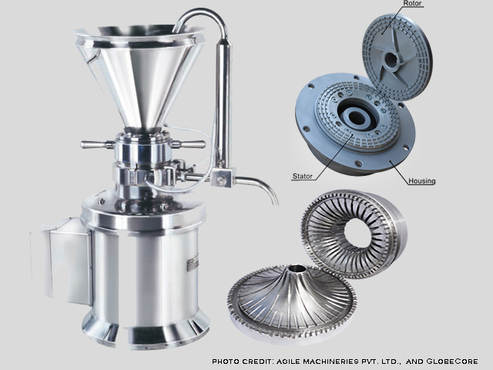
The initial dispersion of the particles in a suspension constitutes the first important step in suspension formulation
Types of powders based on their wettability
Note: Although good dispersion through the use of wetting agent is desirable it can lead to caking with the sediment formed subsequently
Lyophobic
Wetted with difficulty by the vehicle
Tends to clump and float on the surface of the vehicle (ex: sulfur or Mg stearate in water)
Increase wettability by passing through colloidal mill in the presence of wetting agent (alcohol, glycerin or any hygroscopic liquids)
Wetting agents are used to displace air, disperse the particles and allow penetration of the vehicle into the powder mass
Lyophilic (solvent attracting powders)
Easily wetted by the vehicle
(ex: talc or Mg carbonate in water)

Slide 6
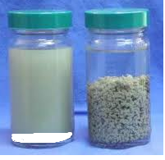
particle-particle interactions
Attraction and repulsion between particles result from forces that reside at the particle surfaces (surface free energy and surface electrical charges and distribution of ions around particles)
Surface electrical charges sources (ionizable group on their surface, adsorption of ions from the surrounding solution)
Electrostatic repulsion between adjacent particles prevent them from adhering to one another
Presence of solvated sheath around the particles results in the dispersion of primary particles rather than aggregates (deflocculation)
Flocculation results from the collision and combination of primary particles in a suspension.
Not all collisions results in binding.
The greater the protective layer, the slower will be the rate of combination of the particles.
Rate of collision
Small particles (1-5 μm)
Brownian movement
Large particles
Mild agitation to increase flocculation rate

Slide 7
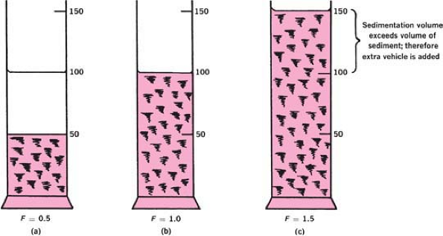
Sedimentation parameters
Sedimentation volume F
is defined as the ultimate volume of the sediment, Vu, divided by the original volume of the suspension, Vo, before settling
F= Vu / Vo
F could be = > < than 1
When F=1 flocculation equilibrium
When F>1 flocs formed in the suspension is so loose and fluffy that the volume they are able to encompass is greater than the original volume of suspension
Degree of flocculation β

Slide 8
Degree of flocculation β
Describe the relationship between the sedimentation volume of the flocculated suspension to the sedimentation volume of the same suspension when deflocculated
Large β indicates a flocculated suspension with floccules loosely held in an open scaffold.
small β indicates a highly condensed sediment
The lower value is 1 which indicates that no flocculation in the system
factors influencing β includes shape and size of the suspension particles and distribution of sizes
Temperature, density and viscosity have less effect

Slide 9
SEDIMENTATION RATE OF THE PARTICLES OF A SUSPENSION
The various factors involved in the rate of settling of the particles of a suspension are included in the equation of Stokes law
It is derived from an ideal situation in which uniform spherical particles in a very diluted suspension settle without producing turbulence , without colliding with other particles of the suspenoid and without chemical or physical attraction or affinity for dispersion medium

