Slide 1
Pharmaceutical Technology
Lec 4
10/10/2017
Dr Athmar Dhahir Habeeb
PhD in Industrial pharmacy and pharmaceutical formulations

Slide 2
Methods for expressing concentration of solutions
Most pharmaceutical solutions are unsaturated with solute. Thus, the amounts of solute to be dissolved are usually well below the capacity of the volume of solvent employed.
Solutions are expressed either in Physical units or chemical units
In Physical units the strengths of pharmaceutical preparations are usually expressed in terms of percent strength, although for very dilute preparations, expressions of ratio strength may be used.

Slide 3
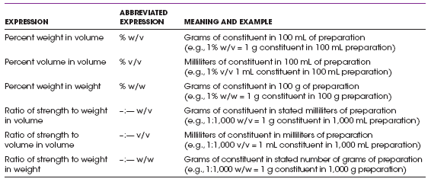

Slide 4
The symbol % used without qualification (as with w/v, v/v, or w/w) means percent weight in volume for solutions or suspensions of solids in liquids, percent weight in volume for solutions of gases in liquids.
Chemical Unit (milliequivalent mEq) is used to express concentration of electrolytes in solutions and it is related to the total number of ionic charges in solution.
It is the unit of measurement of chemical activity of solute.

Slide 5
Official Solutions
Are liquid preparations that contain one or more soluble chemical substances dissolved in liquid solvent that do not fall into another category.
The solvent used for preparing official solution is water; other liquids such as alcohol & glycerin are specified in some of monograph.
The term is used by USP and NF
Uses:
For specific therapeutic effect internally or externally.
Used as ingredient in compounding of Rx or in the formation of other official preparation.
Reagent in various processes.
Solvents for certain substances.
Coloring agents for pharmaceutical products.

Slide 6
Preparation of official solutions
The methods by which official solutions are prepared depends on their use
There is no general formula however, they could be classified based on type of process involved in their preparations into:
Solution prepared by simple solution.
Solution prepared by chemical reaction.
Solution prepared by simple solution with sterilization such as (ophthalmic solutions, anticoagulants).
Solution prepared by extraction.

Slide 7
General notes
Some chemical agents in a given solvent require an extended time to dissolve. To hasten dissolution, a pharmacist may employ one of several techniques, such as
applying heat
reducing the particle size of the solute
using a solubilizing agent
subjecting the ingredients to vigorous agitation

Slide 8
Most chemical agents are more soluble at elevated temperatures than at room temperature or below because an endothermic reaction between the solute and the solvent uses the energy of the heat to enhance dissolution.
Pharmacists are reluctant to use heat to facilitate solution, and when they do, they are careful not to exceed the minimally required temperature, for many medicinal agents are destroyed at elevated temperatures and the advantage of rapid solution may be completely offset by drug deterioration.

Slide 9
If volatile solutes are to be dissolved or if the solvent is volatile (as is alcohol), the heat would encourage the loss of these agents to the atmosphere and must therefore be avoided.
Pharmacists are aware that certain chemical agents, particularly calcium salts, undergo exothermic reactions as they dissolve and give off heat. For such materials, the use of heat would actually discourage the formation of a solution. The best pharmaceutical example of this type of chemical is calcium hydroxide, which is used in the preparation of Calcium Hydroxide Topical Solution, USP.
A pharmacist may choose to decrease the particle size of the solute. This may be accomplished by comminution (grinding a solid to a fine state of subdivision) with a mortar and pestle on a small scale or industrial micronizer on a larger scale.

Slide 10
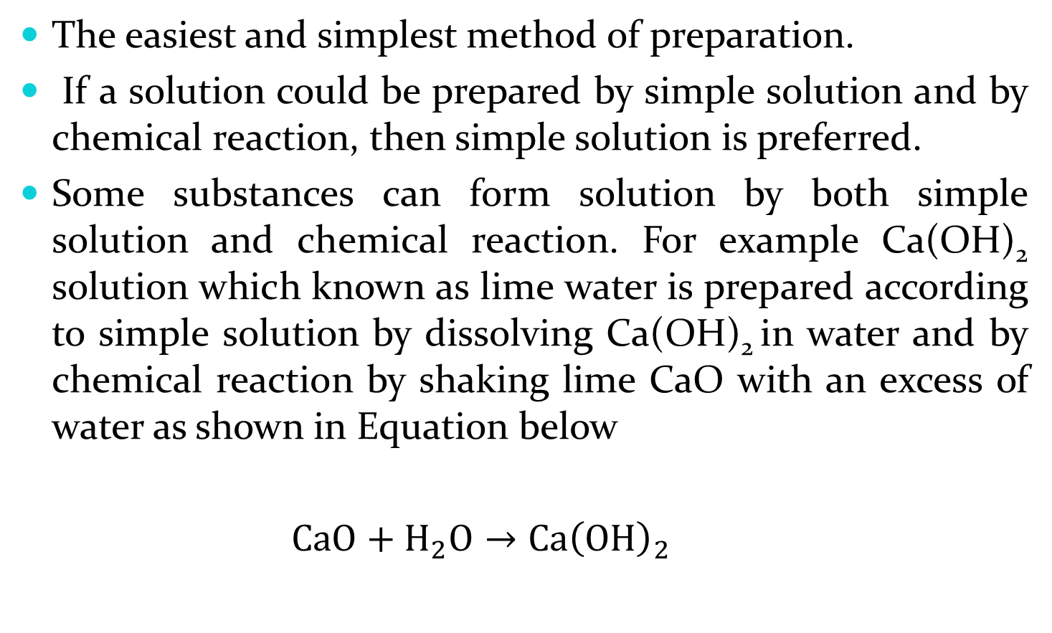
1-Solution prepared by simple solution
The easiest and simplest method of preparation.
If a solution could be prepared by simple solution and by chemical reaction, then simple solution is preferred.
Some substances can form solution by both simple solution and chemical reaction. For example Ca(OH)₂ solution which known as lime water is prepared according to simple solution by dissolving Ca(OH)₂ in water and by chemical reaction by shaking lime CaO with an excess of water as shown in Equation below
$CaO+H_{2}O→Ca{\left(OH\right)}_{2}$

Slide 11
2-Solution prepared by chemical reaction
chemical reaction involves using many reagents resulting in many compounds hard to be purified. It contains all the products of the reaction that have taken place during the method of preparation.
Although simple solution is preferred, sometimes chemical reaction has to be chosen for the following reasons:
1. The pure solute may not dissolve from a solid state in other way than chemical reaction. E.g. Aluminum subacetate

Slide 12
2. The active constituent is not obtained or not readily usable in a form other than that of solution e.g. formaldehyde solution (active constituent is gas) and hydrogen peroxide
3. Some by products are desired like Mg citrate, which is used as cathartic.

Slide 13
3-Solution prepared by extraction
for example epinephrine solution (adrenalin chloride USP) diluted to 1:1000 in purified water. It is prepared with the help of hydrochloric acid; it is used as vasoconstrictor to increase blood pressure, to prevent hemorrhage and to prolong action of local anesthetic for dentistry purposes.

Slide 14
4-Solution prepared by simple solution with sterilization
Anti-coagulants:
1. Heparin solution USP sterile solution of 75,000 units of sodium heparin in sodium chloride injection.
2. Citrate, phosphate, dextrose solution: it is sterile solution consist from 3% citric acid, 26.3% sodium citrate, 2.22% sodium biphosphate and 25.5% dextrose.
Irrigating solution: it is used to flush or bathe wounds or surgical tissues, should be sterilized because is used for sensitive areas of the body.
Aminoacetic acid sterile solution (NF): it consists from sterile solution of 1.5 and 15% aminoacetic acid in water for injection is used for irrigating solution in operation such that of prostate (prostatectomy).

Slide 15
Physiologic solutions: Ringer's solution (NF), it is Isotonic solution consists from 6.6% NaCl , 0.3% KCl, 0.33% CaCl₂ diluted in purified water. It cannot be used as parenteral solution, because its solvent is purified water (not water for injection). Ringer's could be considered as irrigating and physiologic solutions, and used as solvent for compound used topically for delicate membrane, use to keep living tissues to reverse all reflexes for a period of time.
Ringer's solution, sometimes called trichloride solution (Isotonic solution of trichloride).

Slide 16
Ophthalmic Solutions:
The sterility is one of the important consideration in their preparation. Autoclaving in the final container is the preferred method of sterilizing ophthalmic solutions.
Preservatives suggested for use in ophthalmic solutions include:
Phenyl ethyl alcohol 0.5%
Chlorobutanol 0.5%
Benzalkonium chloride 0.01%.
Phenyl mercuric nitrate 0.001%
Ophthalmic solutions that are intended for surgical use must be sterile and must not contain any preservative .Such solution should be packaged in single –use disposable container.

Slide 17
Ophthalmic solution should be isotonic with lacrimal fluid ,although the eye can tolerate tonicity values above and below that corresponding to 0.9% NaCl solution is less likely to produce discomfort or irritation to the eye. The agents which is used to adjust the tonicity of solutions must be compatible with the active medicament.
Viscosity: Increase the viscosity of ophthalmic solution offers prolonged contact with the tissue thus enhancing the penetration and therapeutic effect of drug. Thickening agents such as methyl cellulose may be added to increase the viscosity.

Slide 18
pH: The lacrimal fluid has pH 7.4 ideally ,an ophthalmic solutions should have the same pH as the lacrimal fluid ,this is not usually possible because at this pH many drugs are not soluble in water and most alkaloidal salts are precipitate at this level therefore a pH must be found which represents a compromise between optimum stability and maximum therapeutic effect, and this level must be held by buffers.
The buffer system that used should have the pH that is nearest to the physiologic pH of 7.4 and at which precipitation of drug does not occure.
The USP and NF give formulas for buffer vehicles which may be used for specific drugs.

Slide 19
Classification of official solutions
According to the pharmaceutical use solution may be classified into:
Oral solution.
Ophthalmic solution.
Otic and nasal solution.
Topical solution.
Parenteral solution.
According to their composition solution may be classified into:
Syrups (Aqueous solution containing sugar).
Elixer (sweetened hydroalcoholic solution).
Spirits (solution of aromatic material with alcohol solvent).
Aromatic water (solution of aromatic material in water as solvent).
Tinctures or fluid extract (prepared by extracting active constituent from crude drug).

Slide 20
Oral Solution
Most solutions intended for oral administration contain flavorants and colorants to make the medication more attractive and palatable. When needed, they may also contain stabilizers to maintain the chemical and physical stability of the medicinal agents and preservatives to prevent the growth of microorganisms in the solution.
The formulation pharmacist must be wary of chemical interactions between the various components of a solution that may alter the preparation’s stability and/or potency.
For instance, esters of p-hydroxybenzoic acid (methyl-, ethyl-,propyl-, and butylparabens), frequently used preservatives in oral preparations, have a tendency to partition into certain flavoring oils. This partitioning effect could reduce the effective concentration of the preservatives in the aqueous medium of a pharmaceutical product below the level needed for preservative action

Slide 21
Oral Solutions
The pharmacist may be called on to
dispense a commercially prepared oral solution
dilute the concentration of a solution, as in the preparation of a pediatric form of an adult product
prepare a solution by reconstituting a dry powder mixture
extemporaneously compound an oral solution from bulk ingredients.
Knowledge of the solubility and stability characteristics of the medicinal agents and the solvents employed in the commercial products is useful to the pharmacist for informing the patient of the advisability of mixing the solution with juice, milk, or other beverage upon administration.

Slide 22
Dry Mixtures for Solution:
A number of medicinal agents, particularly certain antibiotics, for example, penicillin V, have insufficient stability in aqueous solution to meet extended shelf-life periods.
Thus, commercial manufacturers of these products provide them to the pharmacist in dry powder or granule form for reconstitution with a prescribed amount of purified water immediately before dispensing to the patient. The dry powder mixture contains all of the formulative components, including drug, flavorant, colorant, buffers, and others, except for the solvent.
Once reconstituted by the pharmacist, the solution remains stable when stored in the refrigerator for the labeled period, usually 7 to 14 days, depending on the preparation. This is a sufficient period for the patient to complete the regimen usually prescribed. However, in case the medication remains after the patient completes the course of therapy, the patient should be instructed to discard the remaining portion, which would be unfit for use at a later time.

Slide 23
Oral Rehydration Solutions
Rapid fluid loss associated with diarrhea can lead to dehydration and ultimately death in some patients, particularly infants. During diarrhea, the small intestine secretes far more than the normal amount of fluid and electrolytes, and this simply exceeds the ability of the large intestine to reabsorb it. This fluid loss, can lead to a progressive loss of blood volume culminating in hypovolemic shock.
Oral rehydration solutions are usually effective in treatment of patients with mild volume depletion, 5% to 10% of body weight. These are available OTC and are relatively inexpensive, and their use has diminished the incidence of complications associated with parenterally administered electrolyte solutions.
A liter of typical oral rehydration solution contains 45 mEq Na+, 20 mEq K+, 35 mEq Cl−, 30 mEq citrate, and 25 g dextrose. These formulations are available in liquid or powder packet form for reconstitution. It is important that the user add the specific amount of water needed to prepare the powder forms. Furthermore, these products should not be mixed with or given with other electrolyte containing liquids, such as milk or fruit juices.

Slide 24
Oral Colonic lavage Solution
Magnesium citrate oral solution is a colorless to slightly yellow clear effervescent liquid having a sweet, acidulous taste and a lemon flavor. It is commonly referred to as citrate or as citrate of magnesia.
The solution is prepared by reacting official magnesium carbonate with an excess of citric acid , flavoring and sweetening the solution with lemon oil and syrup, filtering with talc, and then carbonating it by the addition of either potassium or sodium bicarbonate.
The solution provides an excellent medium for the growth of molds, and any mold spores present during the manufacture of the solution must be killed if the preparation is to remain stable. For this reason, during the preparation of the solution, the liquid is heated to boiling (prior to carbonation); boiled water is employed to bring the solution to its proper volume; and boiling water is used to rinse the final container. The final solution may be sterilized.
The solution is employed as a saline cathartic, with the citric acid, lemon oil, syrup, carbonation, and the low temperature of the refrigerated solution all contributing to the patient’s acceptance of the large volume of medication. For many patients, it is a pleasant way of taking an otherwise bitter saline cathartic.

