Slide 1
Helminths
I Trematodes

Slide 2
Introduction
The term “Helminths” mean “worm”, it is broadly interpreted; it refers to any worm-like animal, in a more restricted sense it refers to a parasitic worm, those comprises two large phyla:
1. Phylum: Platyhelminths (flat worms).
2. Phylum: Nemathelminths or Nematoda (true round worms).
And two smaller ones:
1. Phylum: Nematomorpha (hair snakes).
2. Phylum: Acanthocephala (thorny-headed worms).
And one class group [of phylum Annelida] the class Hirudinea (Leeches).

Slide 3
Trematodes also classified to groups to simplify the study according to the presence of the adult fluke in the host's body into:
1. Liver (or hepatic) flukes, ex: Fasciola hepatica
Clonorchis sienensis
2. Intestinal flukes, ex: Fasciolopsis buski
Heterophyes heterophyes
3. Blood flukes, ex: Schistosomes
4. Lung flukes, ex: Paragonimus westermani

Slide 4
1 Class: Trematoda
Ex: Blood flukes or Schistosomes:
It’s so-called because of the split body on the ventral side of the male in which the female is held during insemination and egg laying. The blood flukes referred to as family called Schistosomatidae, their parasites characterized by:
1. They need one intermediate host to complete their life cycle.
2. Metacercaria stage is absent in their life cycle.
3. They inhabit the circulatory system in their host’s body; their bodies are adapting to this environment.
4. They are dioecious (two sex).

Slide 5
5. The eggs are non-operculated, and fully embryonated when they discharges out of their host’s body.
6. The miracidium (larval stage) grows in the snail body (the intermediate host) to produce two generations of sporocysts, then cercaria with out passing through the stage of redia.
7. The cercaria characterized by its forked tail. They have the ability to penetrate the skin of the final host (the man).

Slide 6
The family Schistosomatidae include the genus Schistosoma which has three species parasitized on man, they are:
1. Schistosoma mansoni (Manson’s blood fluke)
It causes intestinal Schistosomiasis.
2. Schistosoma haematobium
It causes vesicle Schistosomiasis or called urinary Bilharziasis.
3. Schistosoma japonicum (orient blood fluke)
It causes orient Schistosomiasis.

Slide 7
The male & female worms in continuous copula, they lives in the inferior mesenteric venules[S. mansoni], or portal vein and its brunches [ex: the vesicle plexus venules (the vesicle venules of the caval system)] [S. haematobium], or in the superior mesenteric venules and their brunches, but it may be found in the gastric mesenteric venules [S. japonicum].

Slide 8
The male and female worms are delicate and cylindroidal, accommodated to the smaller vein by usually lying with the anterior end directed toward the capillaries. Each of the male & female worms have a small oral sucker in the anterior end of the worm, and ventral sucker may be projecting or has a short stalk.

Slide 9
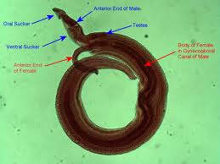
Schistosoma mansoni

Slide 10
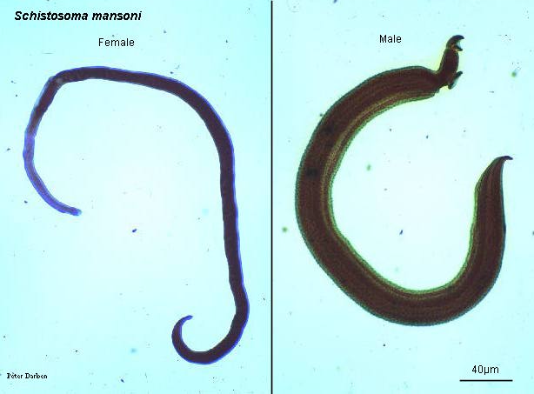

Slide 11
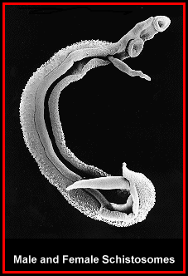
Schistosoma haematobium

Slide 12
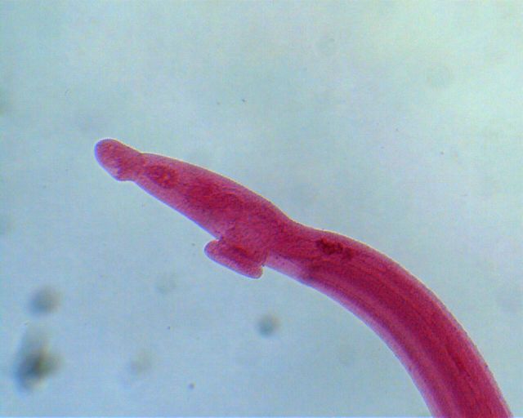
anterior end of the male Schistosoma haematobium, revealing the oral sucker and acetabulum.

Slide 13
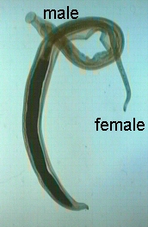
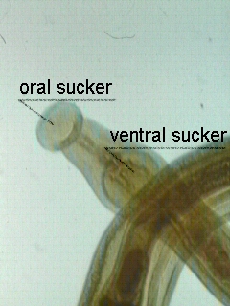
Schistosoma japonicum adults.
both male and female worm can be seen.
female is held by gynecophoral canal of male.
Schistosoma mansoni adult(male). Ventral sucker is prominent. gonophore is a male genital organ which passes sperm to female schistosome. Caudal to gonophore, gynecophoral canal is seen.

Slide 14
The mouth leads to oesophagus surrounded with oesophageal glands, the intestine branched in front of the ventral sucker into two caecal branches, then they band together again to consists one branch extends in the middle of the body, the joining area considered an important character to differentiate the three species.
The male body shorter and thicker than the female body, the outer surface of the male carrying tubercles different in size in the three species while the female body surface is smooth; there is a split like canal in the ventral side of the male, behind the ventral sucker, it is called gynecophoric canal or groove which is used to held the female
The somewhat larger, more muscular male is attached by its suckers to the wall of the vessel, holding the threadlike female in its sex canal and thus enabling the female to extend its anterior extremity into the smaller venules in which it deposits its eggs.

Slide 15
The eggs larger in size with relatively thin-shelled, non-operculated, covered with tubercles and have a spine different in position according to the species. The worms may live for (30) years in the human hosts, however the average life span in possibly less than (5) years.

Slide 16
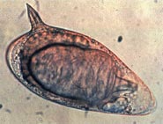
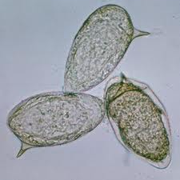
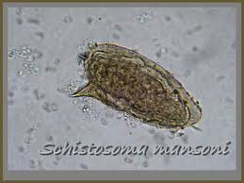
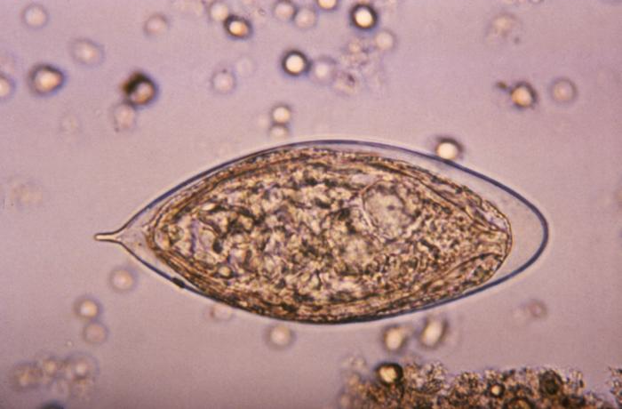
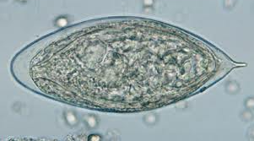
schistosoma mansoni eggs
schistosoma haematobium eggs

Slide 17
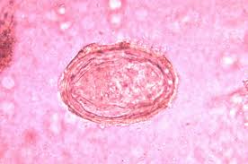
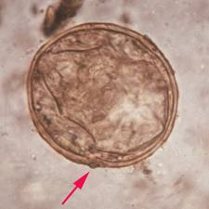
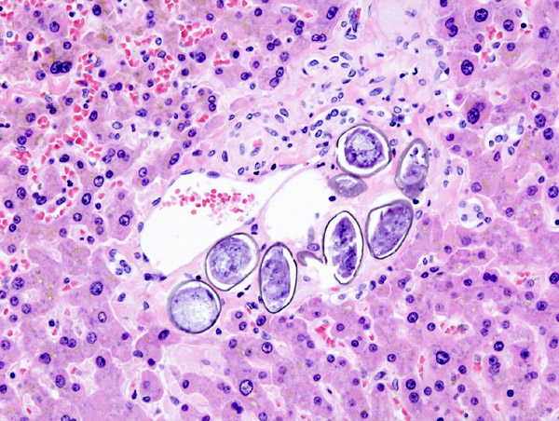
schistosoma japonicum eggs

Slide 18
Table (2): “Table for the comparison between the 3 species”
The character | S. haematobium | S. mansoni | S. japonicum
The male length & width | (10-15)mm length× (1)mm width | (6.4-9.9)mm× (1.1)mm | (12-20)mm× (0.5)mm
Body surface of the male | Rough=covered with tubercles(small tubercles) | Rough=covered with smaller tubercles | Smooth
No. of testes | (4-5) arranged nearby | (6-9) as cluster or bunch | (9) arranged vertically in one line
The female length & width | (20)×(0.25)mm | (7.2-14)×(0.16)mm | (15-30)×(0.2)mm
The position of the union between the 2 intestinal caeca | In the middle of the body | In the first half of the body | In front of the posterior half of the body
The spine of the egg (or ovum) | Large, terminal | Large, lateral | Small, lateral
The size & morphology of the egg, and number | Oval, large,(20-30) | Oval, large, one egg | Somewhat spherical to oval,(50) or more
The intermediate host | Snail from genus Bulinus or Physopsis | Snail from Biomphalaria | Snail from Oncomelania
The final hosts and the reservoir hosts | Man, monkeys, and other primates animal | Usually the man, sometimes the monkeys | Man, monkeys, rats, cattles, buffalo, cats and dogs
The position in the final host | Inferior mesenteric vein & pelvic vessels | The branches of the inferior mesenteric veins in the large intestine | The branches of the superior mesenteric veins, and may be in the gastric mesenteric veins

