Slide 1
Amine II. Reactions

Slide 2
1- Basicity of amines
amines are Brønsted and Lewis bases
Amines are basic because they possess a pair of unshared electron create an electron density around the nitrogen atom.
Amine are more basic than water and less basic than hydroxide ion:
The larger Kb, the stronger the base.
Groups that donate or supply electrons will increase the basicity of amines while groups that decrease the electron density around the nitrogen decrease the basicity of the molecule. For alkyl amines in the gas phase, the order of base strength is given below:
(CH₃)₃ N > (CH₃)₂NH > CH₃NH₂ >NH₃
Most least
Basic basic
Effect of substituent on bascicity of aromatic amines

Slide 3
2- Salt formation: Hofmann elimination of quaternary ammonium salt
Amine can react with an alkyl halide to yield Quaternary ammonium halide.
Quaternary ammonium halide react with silver oxide to yield quaternary ammonium hydroxide and silver halide precipitate.
When quaternary ammonium hydroxide heated to 120C or higher, it decompose to water, a tertiary amine and alkene.this reaction called Hofmann elimination.

Slide 4
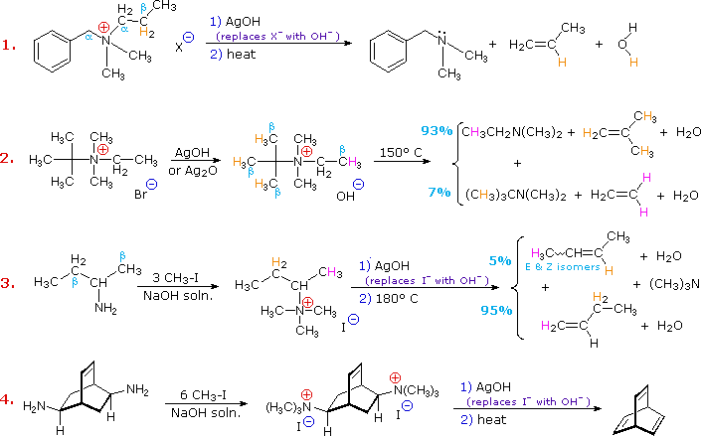

Slide 5
3- Conversion into amide and sulfanilamide (Sulfa drug)
Ammonia or amine react with
A. acid chloride of carboxylic acid to yield amide.
B. Acid chloride of sulfonic acid react similarly to yield sulfanilamide.
In similar way primary and secondary amines can react to yield substituted amides and sulfanilamide.
Tertiary amine fail to yield amide

Slide 6
Sulfonamide are prepared by reaction of sulfonyl chloride with ammonia or an amine.
4- Ring substitution in aromatic ring
The NH2, NHR, NR2 groups act as powerfull activators and ortho, para directors in electrophilic aromatic substitution.

Slide 7
5- Reaction with nitrous acid
Each class of amine yields a different kind of product in its reaction with nitrous acid HONO.
Primary aromatic amine react to yield diazonium salt
Primary aliphatic amine react to yield diazonium salt (unstable) and break down to yield mixture of compounds.
Secondary aromatic or aliphatic amines react with nitous acid to yield
N- nitrosoamides.
Tertiary aromatic amine undergo ring substitution (nitosation)

