Slide 1
Isolation of Podophyllotoxin from Podophyllum emodi
Lab.1

Slide 2
Podophyllum
*Botanical Name: Podophyllum emodi
*Family Name: Berberidaceae
*Common Name : Indian Podophyllum , Himalayan May apple
* Part used: Rhizomes, Roots, Fruits
* Habitat: Distributed in north Himalayan region

Slide 3
Podophyllo toxin PPT
*Podophyllotoxin (abbreviated as PPT) is a non-alkaloid to toxin lignan extracted from the roots and rhizomes of Podophyllum sp.
*It is used on the skin as a topical treatment of external genital warts caused by some types of the human papillomavirus (HPV), and other warts.
*PPT and its derivatives display a wide selection in medical applications such as purgative, antirhematic, antiviral, and anmtitumor agents.
*These derivatives include estoposidem teniposide, and etopophos.
*Their anticancer activity has been heavily under study and used in various chemotherapies, including lung cancer, lymphomas, and genital tumors.

Slide 4
Mechanism of action
*Like Colchicine and Vinblastine, Podophyllotoxin binds to tubulin, the protein subunit of spindle microtubules, blocking cell division in metaphase.
* Activity of cytochrome oxidase and soccinoxida-se in the mitochondria also is reduced, and DNA synthesis is blocked. This results in the slow disruption of cells and the destruction of tissue.
*Podophyllum is highly lipid soluble and is absorbed readily from the GI tract.

Slide 5
Aim:- Isolate the Podophyllotoxin from Podophyllum
Extract 4gm powder Podophyllum emodi root by stirring and heating with 100ml of ethanol for about 10 minutes.
Cool and filter the mixture
Re-extract the residue with further 100ml of ethanol
Combine the extracts and evaporate to about 20ml

Slide 6
Add the ethanolic solution into 100ml of water, and extract three times with 50ml ethyl acetate.
Combine the extract and evaporate to dryness
Isolate the Podophyllotoxin by preparative TLC
Crystallization at 0C for several days

Slide 7
Identlification of Podophyllotoxin by Chromatography (TLC)
Making the tank.
The mobile phase = chloroform: methanol (90:10),
Dichloromethanol : methanol (95:5).
Making the silica gel plates
Spotting sample and standard of podophyllotoxin

Slide 8
Detection
254 U.V 254nm
Or 50% ethanolic H2SO4
Or concentrated H2SO4
Or vanillin-sulphuric acid

Slide 9
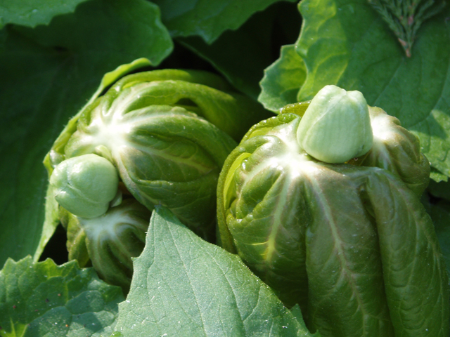
Podophyllum peltatum

Slide 10
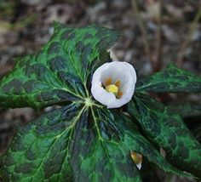
Podophyllum hexandrum

