Slide 1
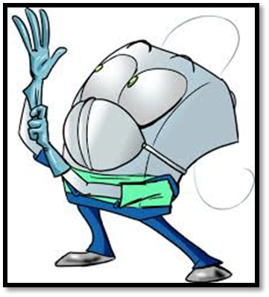
Hazards that you can face in a Dental Clinic
By:
Dr. Farah Salah aldeen

Slide 2
Contents
Hazards with cutting instruments
Pulp precautions
Soft tissue precautions
Eye precautions
Ear precautions
Inhalation precautions

Slide 3
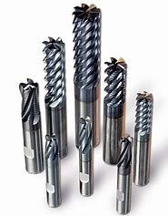
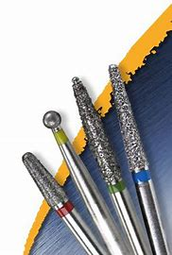
Hazards with cutting instruments

Slide 4
Pulp precautions
Use of cutting instruments can harm the pulp; By exposure to mechanical vibration, heat generation, transection of odonto blastic process
Steel burs more heat generation than carbide.
Longer time of cutting ,,more heat,, greater thermal trauma…
Air coolant: enhance vision, minimize trauma.
Finishing procedures for cavity prep..
Air/ water coolant : cool, moist, clear operating site during normal cutting procedures.

Slide 5
Soft tissue precautions
Lip, cheek, tongue of the patient are most frequent areas of soft tissue injury.
Rubber dam helpful in isolating operating field.
Retract soft tissue with mouth mirror, cotton roll, evacuator tip.
Turbine, Hand piece rotating instru..not stop immediately when foot control released…

Slide 6
Dentist be aware of patient”s response during cutting procedure.
If accident occur remain calm, control bleeding (pressure pack), patient told what happened, medical assistance if needed…

Slide 7
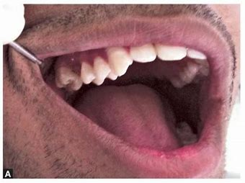
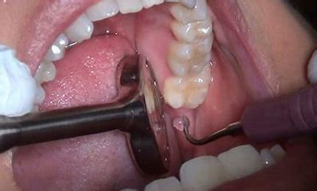
Dental mirror

Slide 8
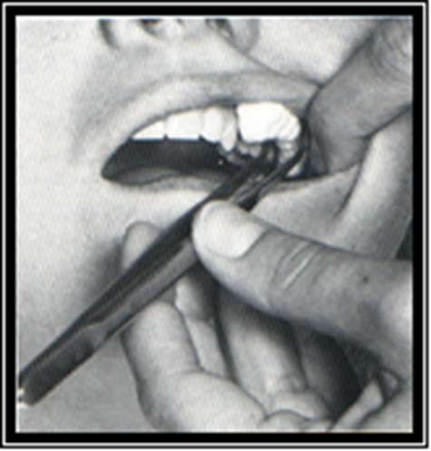
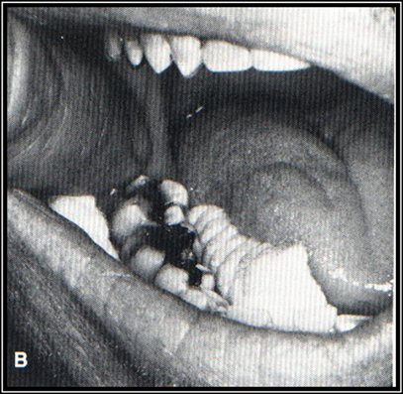
Cotton roll

Slide 9
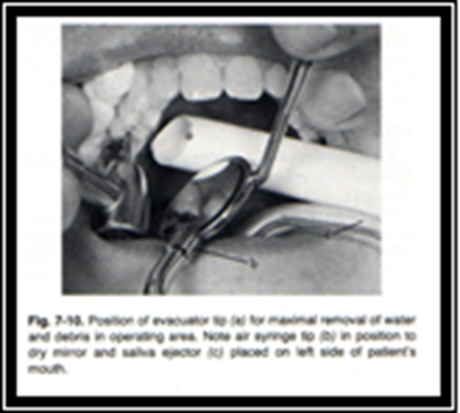
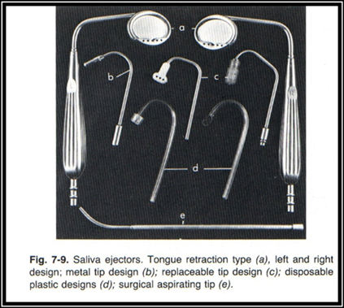
Oral evacuation system

Slide 10
Eye precautions
Eye glasses & face shield prevent air borne particles (old restoration, tooth structure, bacteria) during operative procedures .
Dentist more direct path of such particles.
Unusual light sources visible L.C. unit & Laser equipment; using colored plastic shield attached to fiber optic tip.

Slide 11
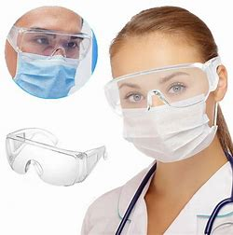
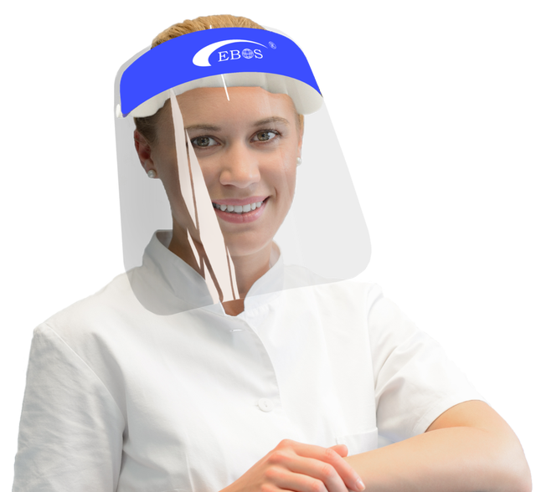
Protective eye glasses
Face shield

Slide 12
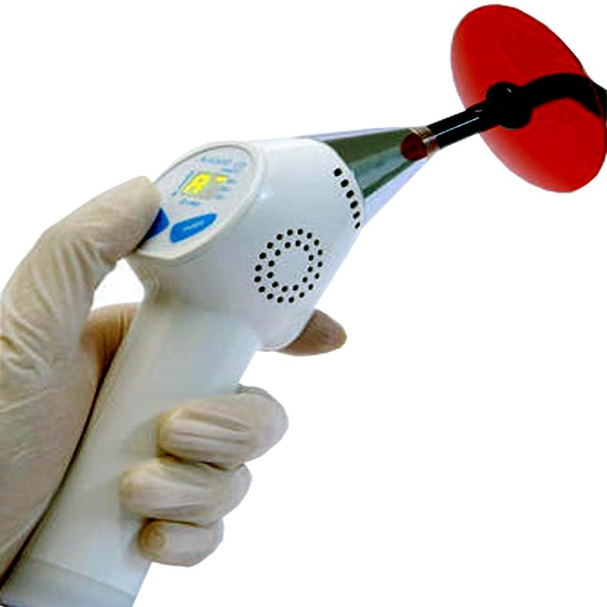
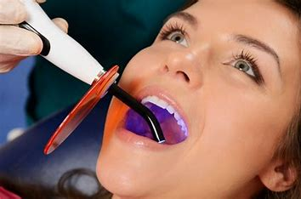
Hazards of visible light curing system

Slide 13
Ear precautions
Loud noise mental & physical distress
ability to concentrate & efficiency.
Loud noise / short duration temporary threshold shift recovery complete.
Extended exposure/ permenant threshold shift persistant hearing loss.
Absorbing material used in walls & floor.

Slide 14
Inhalation precautions
Aerosols are fine dispersions in air consist of water, tooth debris, M.Os.,restorative material
Aerosols & vapor are created by cutting tooth structure& restor. Material.
Aerosols are health hazard to all present.
Cutting amalgam or composite produce submicron particles & vapor; may be inhaled produce alveolar irritation & tissue reaction.

Slide 15
Rubber dam protect patient from oral inhalation of aerosols or vapor but nasal inhalation still may occur.
Mask filter out bacteria ;do not filter out mercury or monomer vapor.

Slide 16
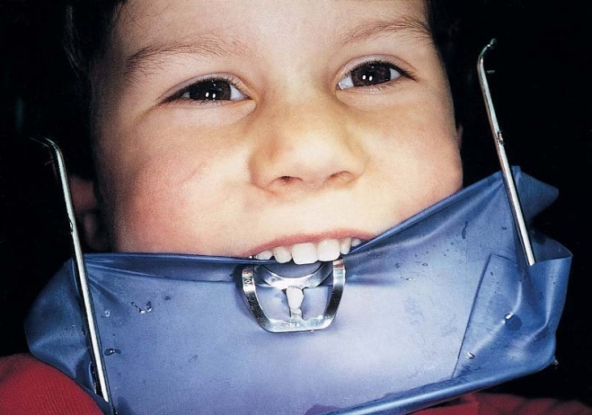
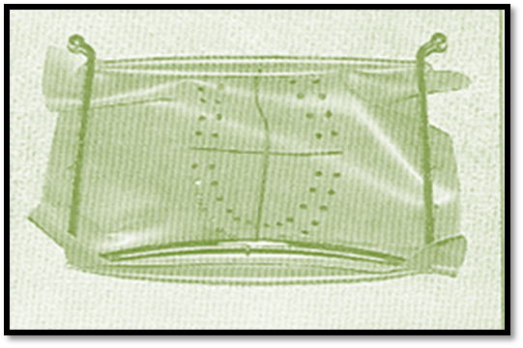
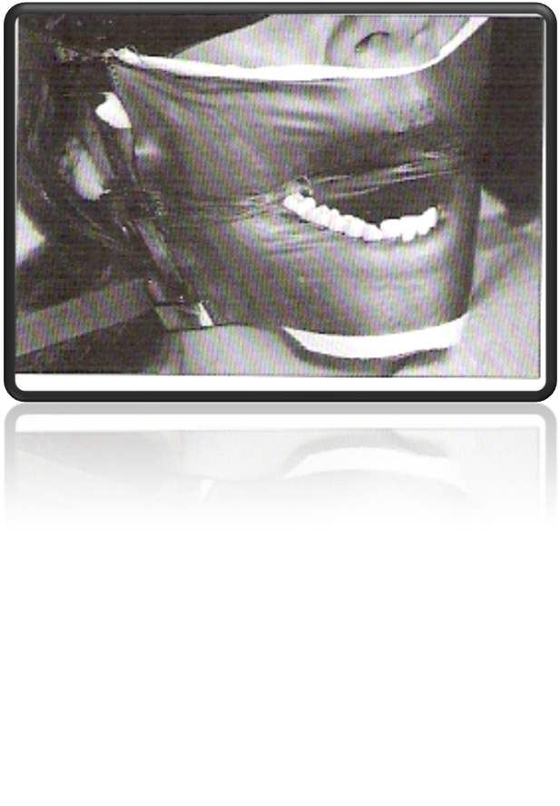
Rubber dam

Slide 17
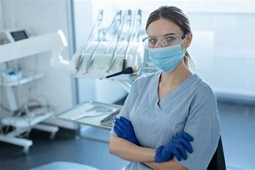
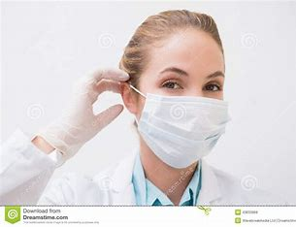
Face Mask& Gloves

Slide 18
According to the centers for disease control dental insruments classified into 3 categories depend upon their risk for transmitting infection:
1-critical: penetrate oral soft tissue
Bone ,blood sream.
Forceps, scalpels, bone chisels, surgical burs.
Sterilized after each use
Steam under pressure, dry Heat or chemical sterilization
2- semi critical: not penetrate oral tissue
In contact oral mucous membrane
Non intact skin
Dental mirror, amalgam condensor, impression tray.
Sterilized after each use.
Or high level disinfictant
3- non critical: contact intact skin, m. membrane.
X-ray head, pulse oximeter.
Cleaned by low level disinfectant.

Slide 19
Pre sterilization
Instrument cleaning
Before sterilization or high-level disinfection, instruments should be cleaned thoroughly to remove debris.
• Persons involved in cleaning and reprocessing instruments should wear heavy- duty (reusable utility) gloves to lessen the risk of hand injuries.
•Placing instruments into a container of water or disinfectant/detergent as soon as possible after use will prevent drying of patient material and make cleaning easier and more efficient.

Slide 20
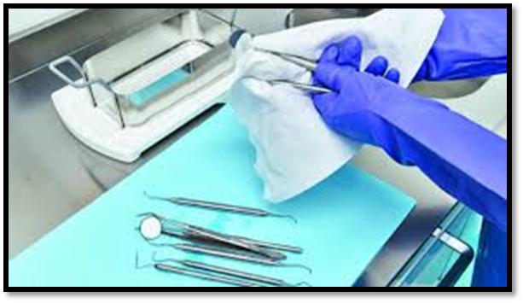
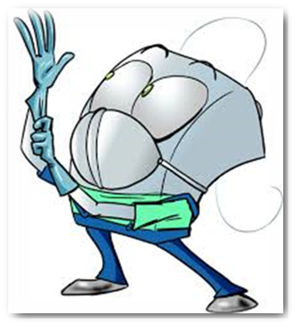
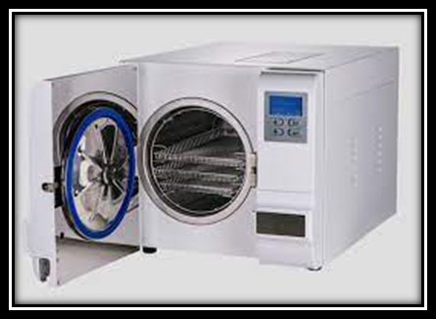
Pre sterilization
Instrument cleaning

Slide 21
Disposal of Waste Materials
• Blood, suctioned fluids, or other liquid waste may be poured carefully into a drain connected to a sanitary sewer system.
• Disposable needles, scalpels, or other sharp items should be placed intact into puncture-resistant containers before disposal.
• Solid waste contaminated with blood or other body fluids should be placed in sealed, sturdy impervious bags to prevent leakage of the contained.

Slide 22
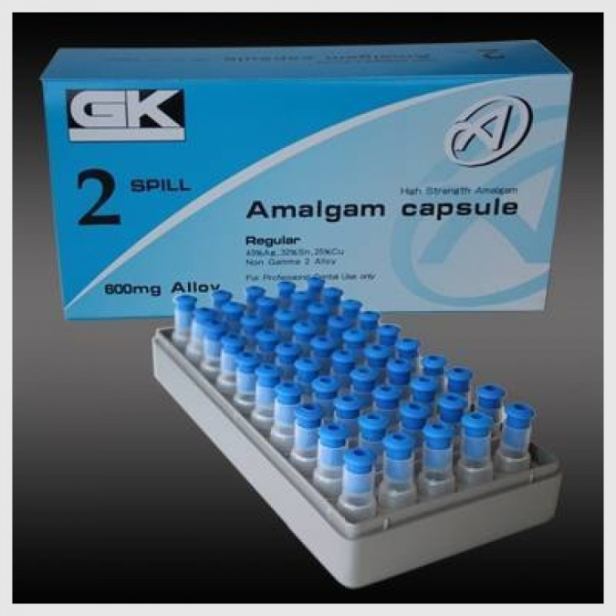
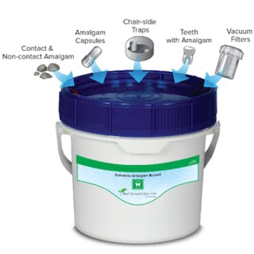
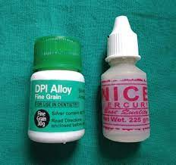
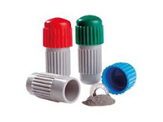
Pre capsulated amalgam
Amalgam waste regulation
Alloy & Mercury in bulk
Reusable capsule

Slide 23
Thank you

