Slide 1
Operative
dentistry

Slide 2
Diagnosis, prevention and treatment of dental caries

Slide 3
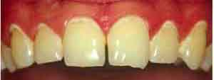
Clinical characteristic of enamel caries
White spot are chalky white, opaque areas that are
revealed only when the tooth is dried, and are
termed incipient caries.

Slide 4
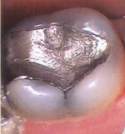



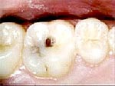
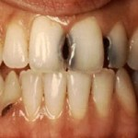

Slide 5
Clinical characteristic of dentinal caries
Progressing of caries in dentin is different from progression in overlying enamel because of the structural differences of dentin.
Caries advance more rapidly in dentin than in enamel.
Dentin contains much less mineral and possesses microscopic tubules that provide a pathway for the ingress of bacteria and egress of minerals.

Slide 6
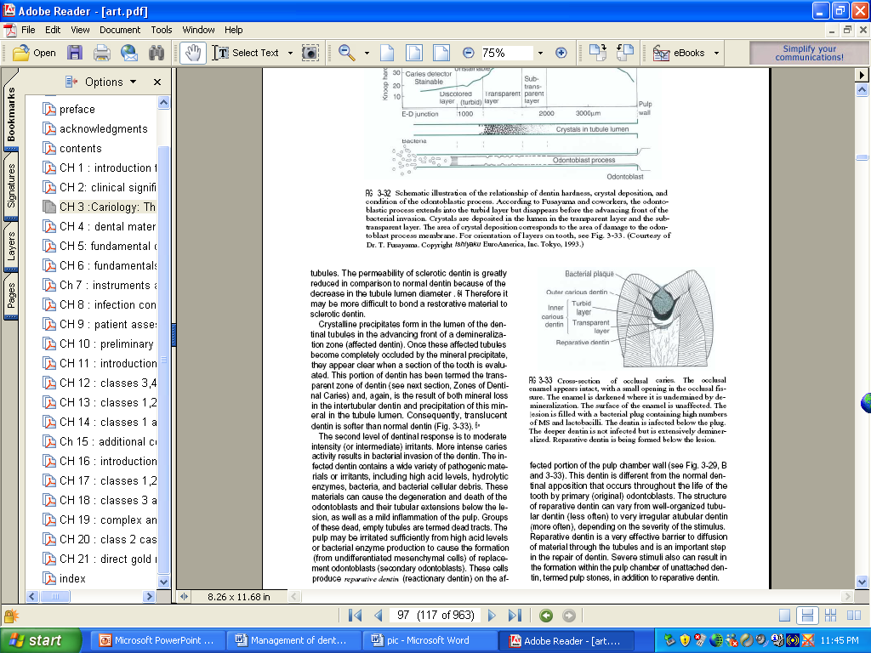
The DEJ is less resistant to caries attack and allow rapid lateral spreading when caries has penetrated the enamel
V-shaped in cross section.
Caries produces a variety of responses; pain, sensitivity, demineralization&
remineralization.

Slide 7
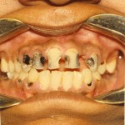
Often, pain is not reported even when caries invades dentin, except when deep lesions bring the bacterial infection close to the pulp.
Episodes of short duration of pain may be felt occasionally during earlier stages of dentin caries.
The pain is caused by stimulation of pulp tissue by the movement of fluid through the dentinal tubules that have been opened to the oral environment by cavitation.

Slide 8
Caries advancement in dentin proceeds through three changes
(1) Weak organic acids demineralize the dentin (pH:6.2)
(2) The organic material of dentin, particularly collagen degenerates and dissolve
(3) The loss of structural integrity is followed by invasion of bacteria.

Slide 9
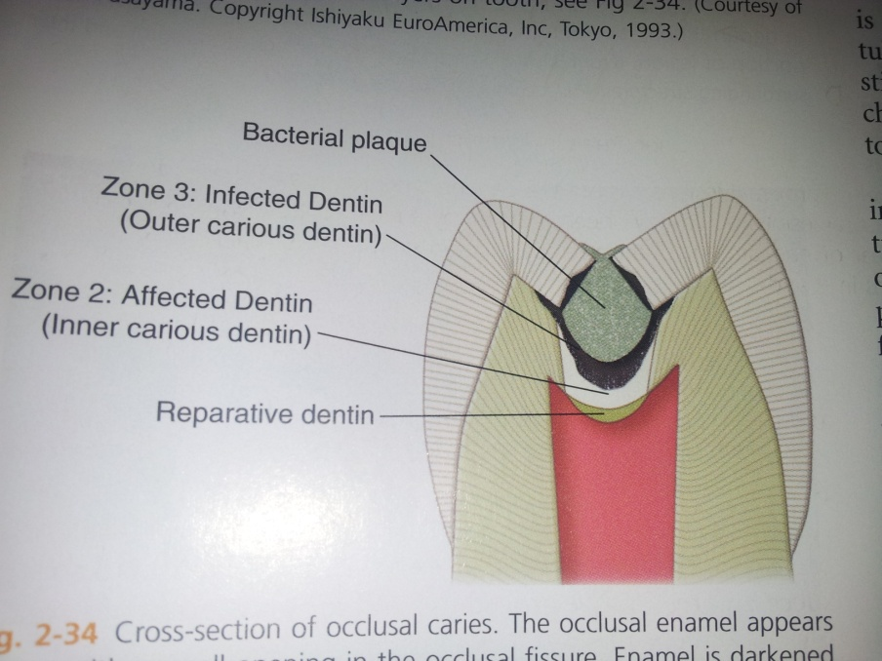
Zones on dentin caries
1. Normal dentin; Deep area, tubules with odonblaste processes, no crestales in lumens, normal crossbanded collagen, no bacteria.
2. Affected dentin (inner carious D) softer than normal dentin and show loss of minerals from intertubular dentin and many large crystals in the lumen of the dentinal tubules. Collagen is intact can serve as template for remineralization of intertubular dentin.

Slide 10
3. Infected dentin (demineralized and infected with bacteria). Widening and distortion of the dentinal tubules, which are filled with bacteria. Little mineral is present, and the collagen in this zone is irreversibly denatured. It should be removed.

Slide 11
Caries diagnosis & treatment
Caries diagnosis has traditionally been limited to the detection and restoration of cavitated lesions.
This “drill and fill” approach is simply symptomatic treatment and fails to deal with the underlying etiological factors.
Determining the lesion is active or arrested before a logical management plan can be proposed.

Slide 12
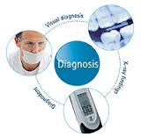
Diagnostic tests
Diagnostic methods are:
Inspection, radiographic, fiber-optic transillumination, and dye uptake.
A single test for caries diagnosis usually cannot be used alone
Therefore, multiple diagnostic criteria should be adjusted according to the patient’s overall risks (age, gender, fluoride exposure history, general health, and ability to maintain good oral hygiene).

Slide 13
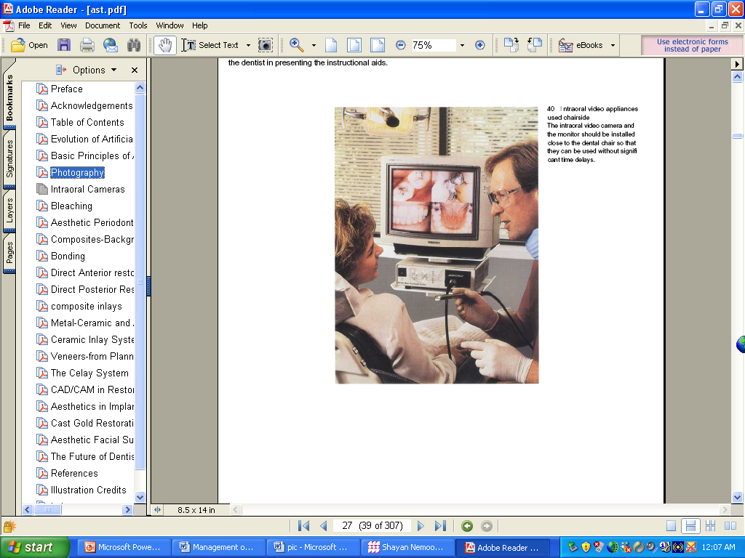
Caries diagnosis
Pain onset, location and duration
Stimuli /spontaneity
Intensity
Factors relieve

Slide 14
Clinical characteristic of dentinal caries
- A short (10 sec. or less), painful response to cold suggests reversible pulpits or pulpal hyperemia.
- More severely, continuous pain (more than 10 sec) suggest irreversible pulpitis( partial or total pulp necrosis).
which need pulp extirpation and root canal filling.

Slide 15
Diagnosis
Early detection of incipient caries and limitation of caries prior to significant tooth destruction are primary goals of an effective diagnosis and treatment program.
Detection of caries clinically by cleaning the teeth otherwise, reliable detection may be obstructed by the presence of plaque and saliva.

Slide 16
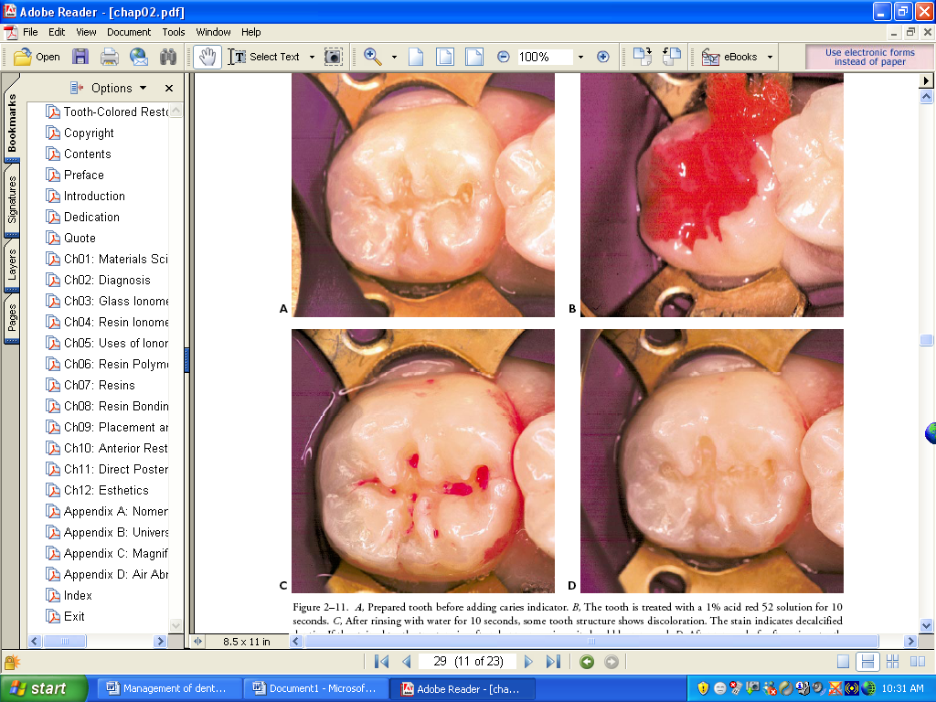
Chemical dye also used (such as acidic red dye) that selectively stain the outer layer infective dentin (demineralized and infected with bacteria) that should be removed, while the inner affected dentine (demineralized but not infected) will not stain

Slide 17
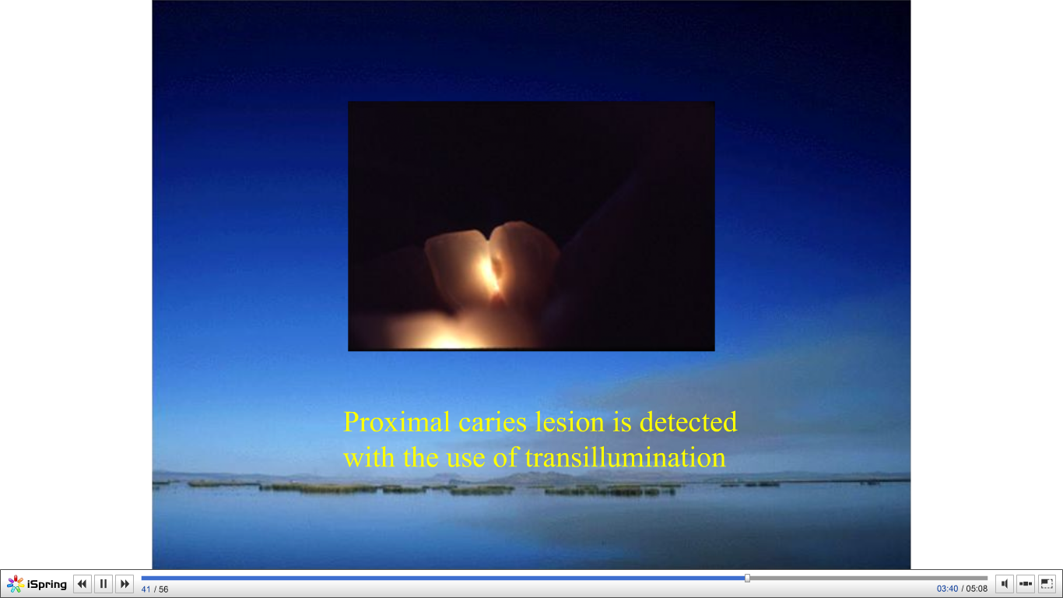

Slide 18
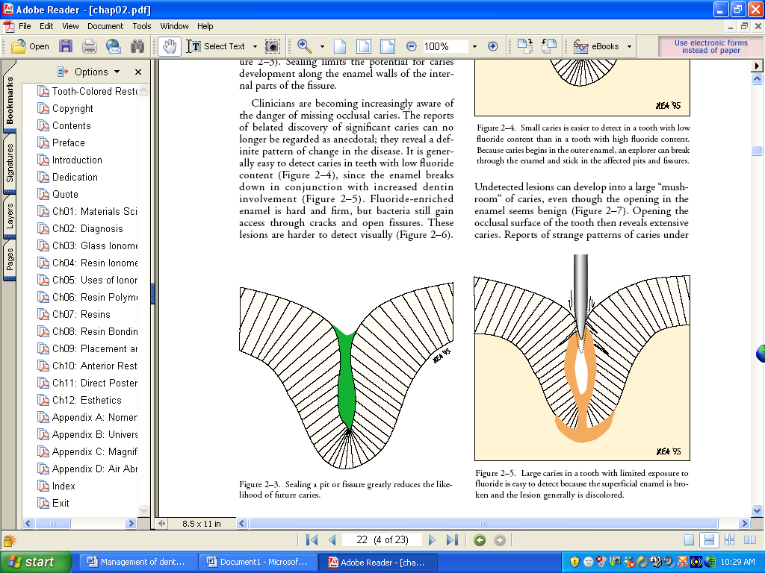
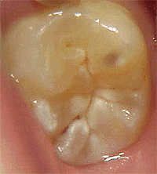
Pits and fissures
Detection of fissure caries lesions should rely on sharp eyes not sharp explorers.
Thus, other factors:
Softening at the base of the pit or fissure
Opacity surrounding the pit or fissure
Softened enamel that may be flaked away by the explorer
Arrested lesions indicated by white or brown spot lesions with a shiny surface.

Slide 19
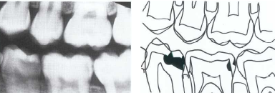
Smooth surfaces
Bitewing radiographs are the most effective method
Difficult to assessed visually or tactilely.
Incipient lesions have intact surfaces and care should be given to avoid damaging the surface with an explorer.

Slide 20

Active smooth surface lesions that need treatment are:
1-White spot lesions close to the gingival margins with matte or visibly frosted surface and covered with plaque.
2- Cavitated covered with plaque lesions with or without exposed dentin, or exposed and soft dentin (indicating infected dentin)
While arrested smooth surface lesions are:
A- Shiny white or brown lesions not plaque-covered.
B- Cavitated lesions, often dark brown, with hard dentin at their bases, not covered with plaque and remote from the gingival margin.

Slide 21
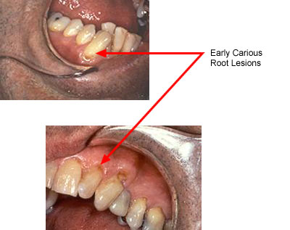
Root surfaces
Exposed root surfaces (gingival recession)
examined visually and tactilely
Discoloration is common and usually is associated with remineralization
Generally the darker the discoloration, the greater the remineralization
Active, progressing caries shows little discoloration and is primarily detected by the presence of softness and cavitations and covered with plaque.

Slide 22
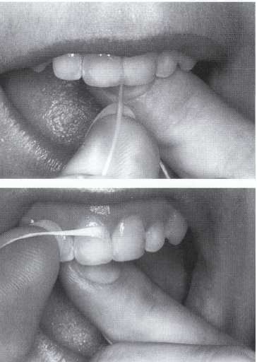
Caries prevention and treatment
1. Maintaining of good oral hygiene “brushing & flossing”.
2. Diet containing sucrose & carbohydrate control. In general, dietary advice for caries prevention is based on three principles:
a) The drop of pH lasts for approximately 30 minutes
b) The frequency of intake is more important than the quantity
c) The stickiness of food is an important factor in their cariogenicity.

Slide 23
Noninvasive or prevention treatment
3- Fluoride treatment (rinses, tooth pastes/ twice a day).
4- Chlorhexideine; an antimicrobial agent is highly effective against SM infections.
5- Xylitol-containing chewing gum. Xylitol is a five-carbon sugar that is not fermentable by SM. The gum causes increasing salivary flow.
6- Casein: casein phosphopeptide-amorphous calcium phosphate (CPP-ACP) is a milk-derived product that strengthens and remineralizes teeth and helps prevent dental caries. Available in solutions, gums, and creams.
7- Pit and fissure sealant is the most effective method in preventing pit and fissure caries.

Slide 24
Caries prevention
Pit and fissure sealant
Enameloplasty

Slide 25
Invasive or restorative treatment
Active treatment is by restoring all active carious lesions that penetrated dentin.
Once caries has produced cavitations of the tooth surface, and preventive measures are inadequate to prevent further progression of caries.
However, once the pulp is dead partially or completely; root canal filling become necessary to avoid tooth extraction.

Slide 26
Indications for restorative treatment:
1- The cavitated tooth is sensitive to hot, cold, sweetness, etc.
2- Occlusal and proximal lesions extend deep into dentin and cannot be reached by the toothbrush.
3- The pulp is endangered.
4- Previous attempts to arrest the lesion have failed and there is evidence that the lesion is progressing.
5- The patient's ability to provide effective home care is impaired.
6- Drifting is likely to occur through loss of proximal contact.
7- The tooth has an unaesthetic appearance.

Slide 27

Thank you

